Slide 1
Project Work
Group 3

Slide 2
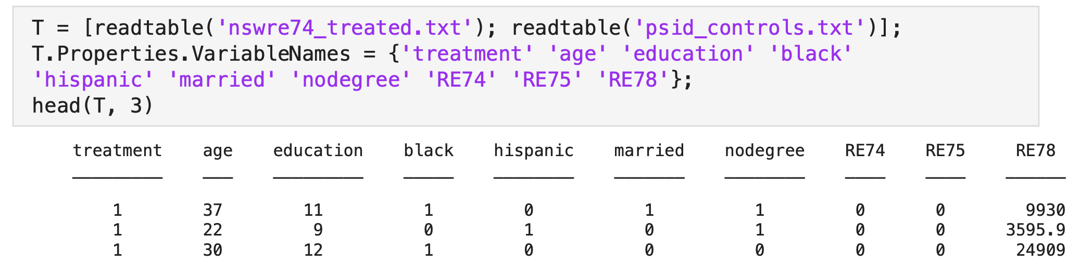
4. Analysis of the Employment Program (Part 1)
4.1 Data Preparation
Read Data

Slide 3
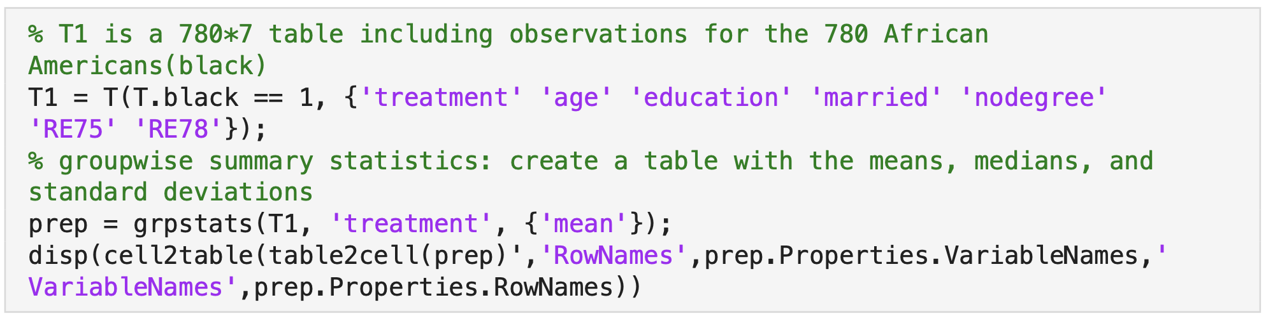
4. Analysis of the Employment Program (Part 1)
4.1 Data Preparation
create a table with the means, medians, and standard deviations of the variables age, education, married, nodegree, RE75, and RE78, separated by program participants and non-participants.

Slide 4
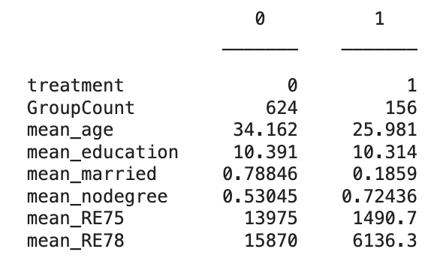
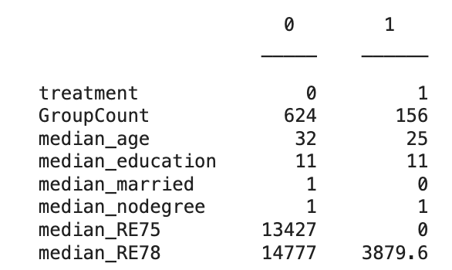
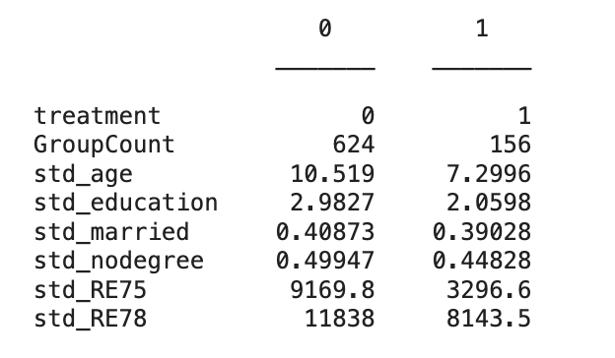
4. Analysis of the Employment Program (Part 1)
4.1 Data Preparation
create a table with the means, medians, and standard deviations of the variables age, education, married, nodegree, RE75, and RE78, separated by program participants and non-participants.

Slide 5
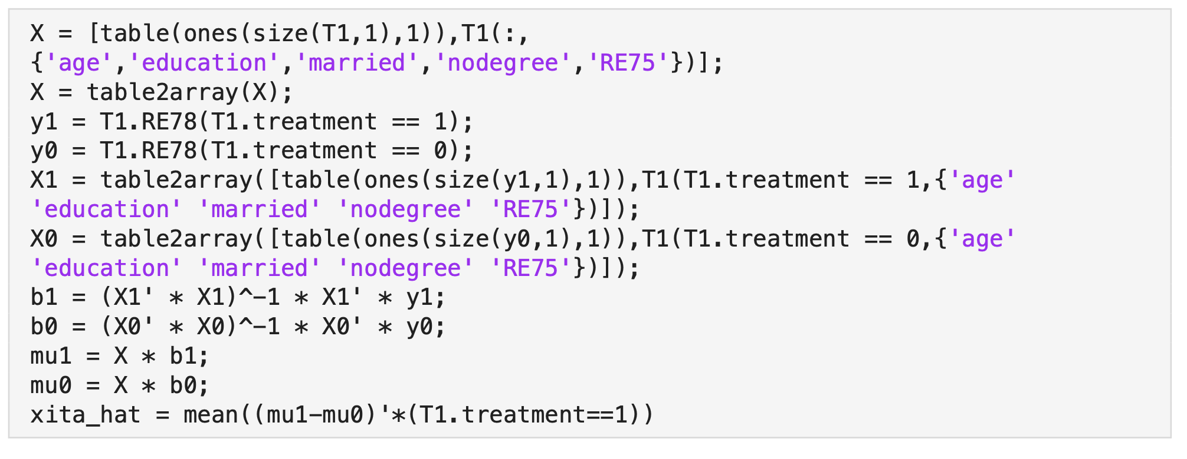

4. Analysis of the Employment Program (Part 1)
4.2.1 Algorithm for the estimation method

Slide 6
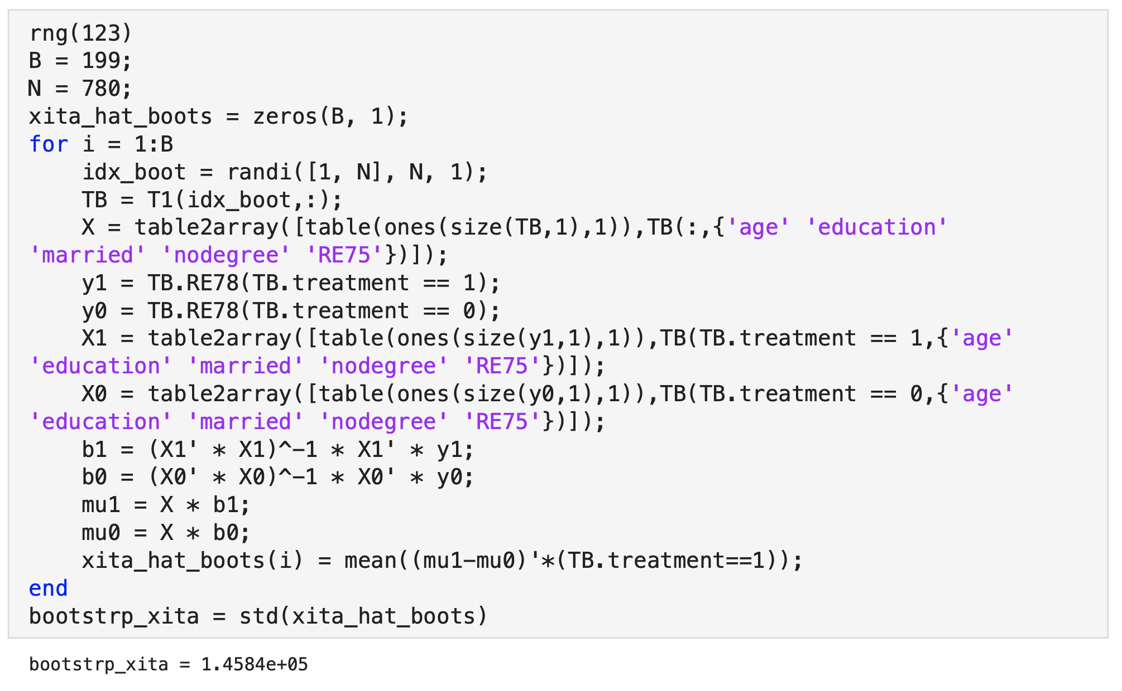
4. Analysis of the Employment Program (Part 1)
4.2.2 Bootstrap
standard error

Slide 7
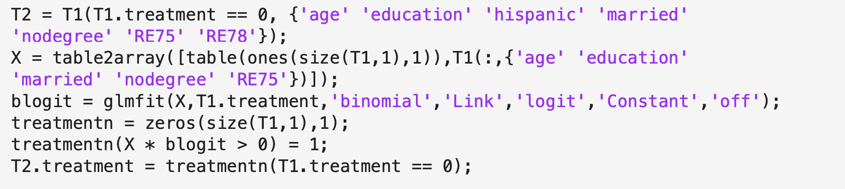
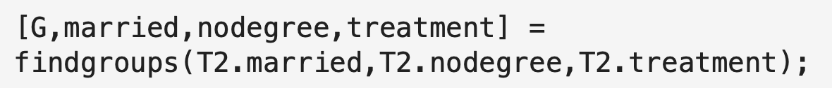
5 Evaluation of an Estimation Method through Data Simulations
5.1 Simulation of data
Redefine ‘treatment’
Use function ‘findgroups’ to classify the data

Slide 8
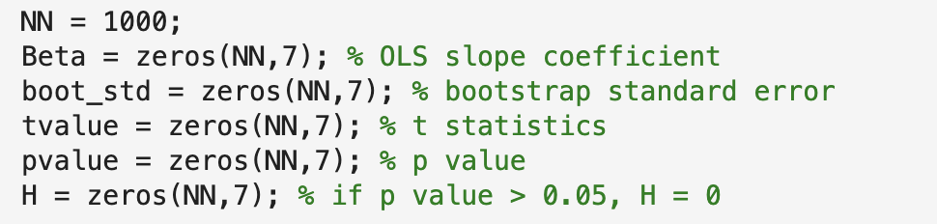
5 Evaluation of an Estimation Method through Data Simulations
5.1 Simulation of data
Generate 1,000 times stimulation

Slide 9
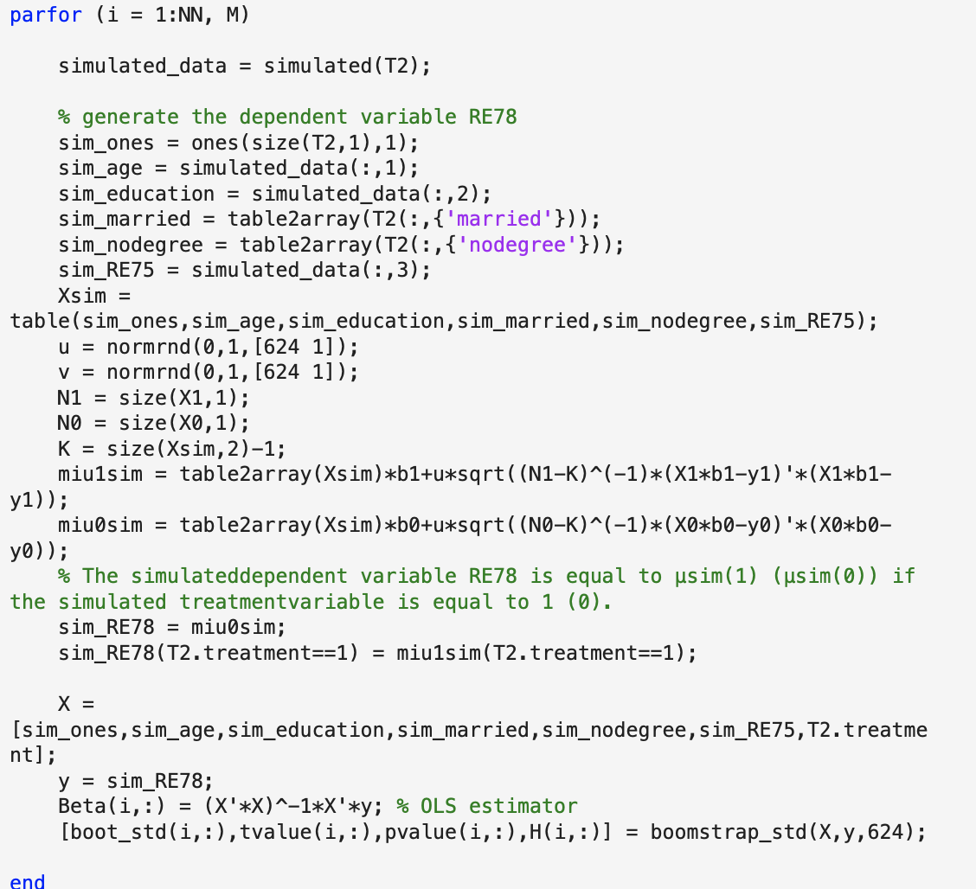
5 Evaluation of an Estimation Method through Data Simulations
5.1 Simulation of data
Start simulations
Use ‘parfor’ to improve the speed of the code

Slide 10
5 Evaluation of an Estimation Method through Data Simulations
Use self-defined function ‘simulated’
to simulate ‘age’ ‘education’ ‘RE75’
Simulate ‘RE78’
based on the simulated data
Use self-defined function ‘boomstrap_std’ to calculate the slope coefficients, standard errors, t-values, and p-values of the OLS model

Slide 11
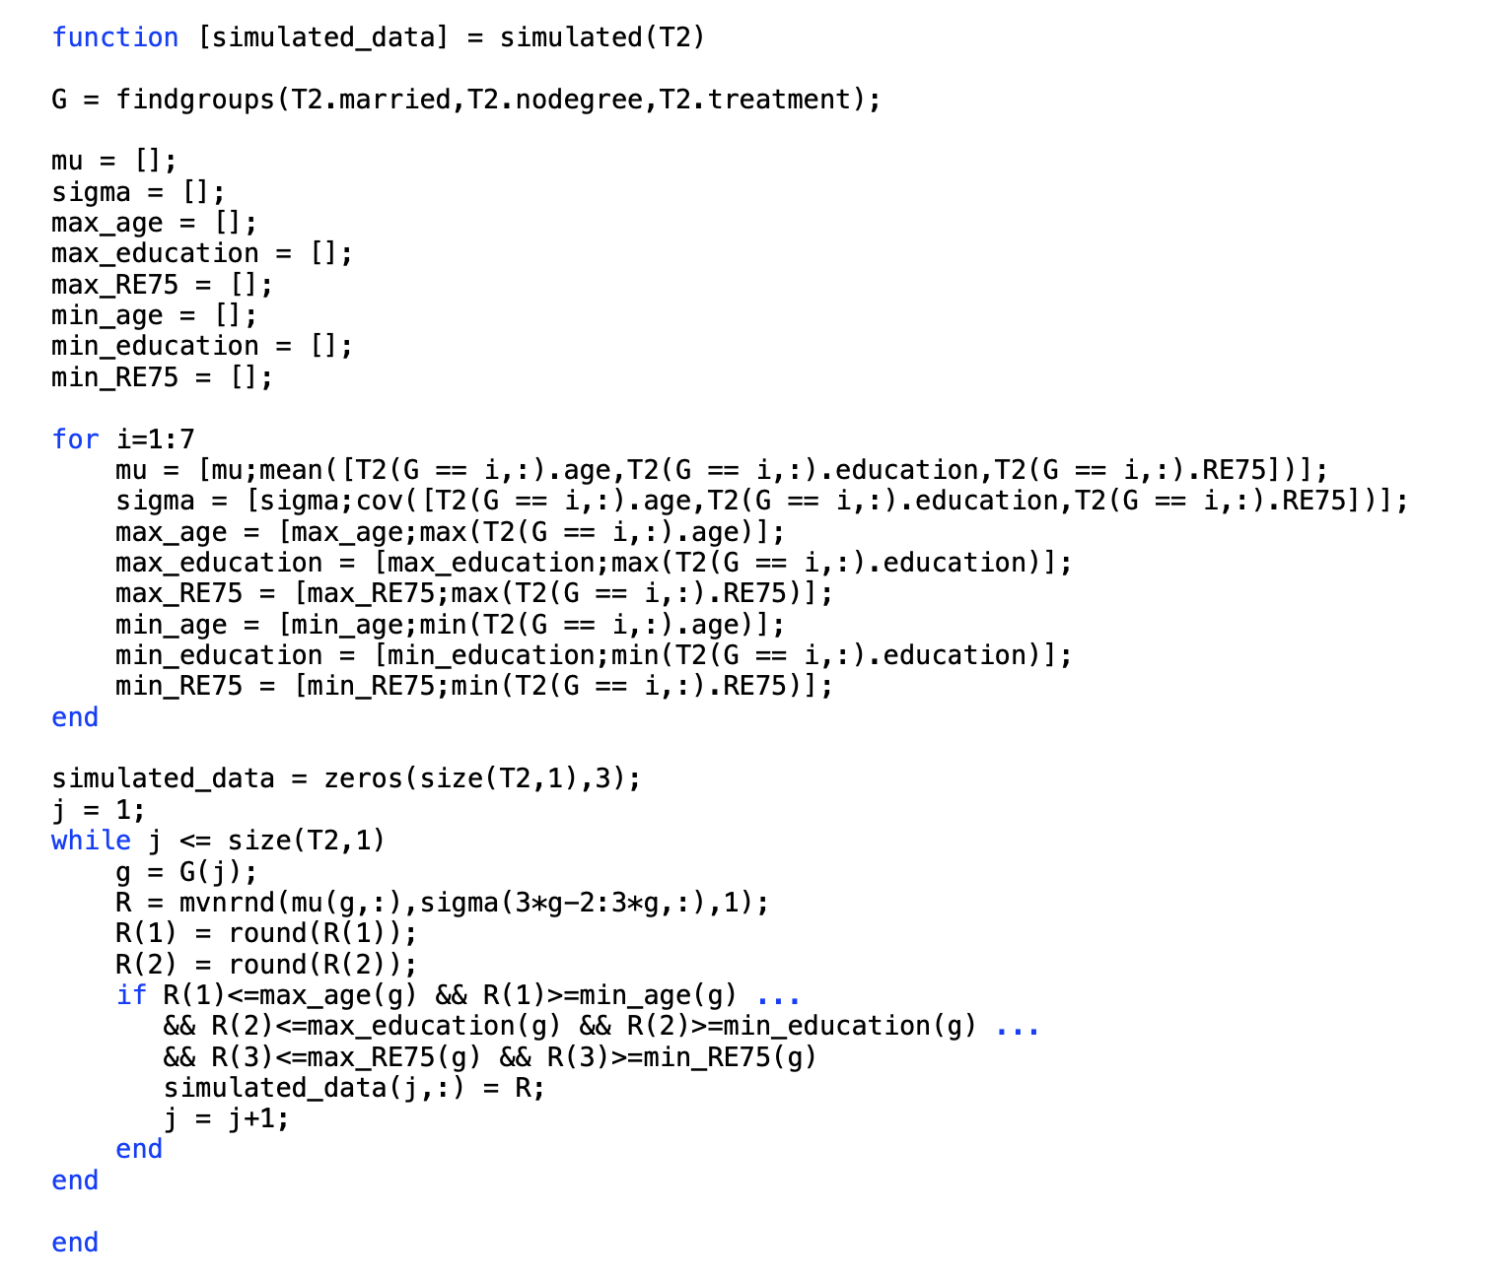
5 Evaluation of an Estimation Method through Data Simulations
Define a function ‘simulated’

Slide 12
5 Evaluation of an Estimation Method through Data Simulations
Simulate ‘RE78’
based on the simulated data

Slide 13
5 Evaluation of an Estimation Method through Data Simulations
Use self-defined function ‘boomstrap_std’ to calculate the slope coefficients, standard errors, t-values, and p-values of the OLS model

Slide 14
5 Evaluation of an Estimation Method through Data Simulations
Use self-defined function ‘boomstrap_std’ to calculate the slope coefficients, standard errors, t-values, and p-values of the OLS model

Slide 15
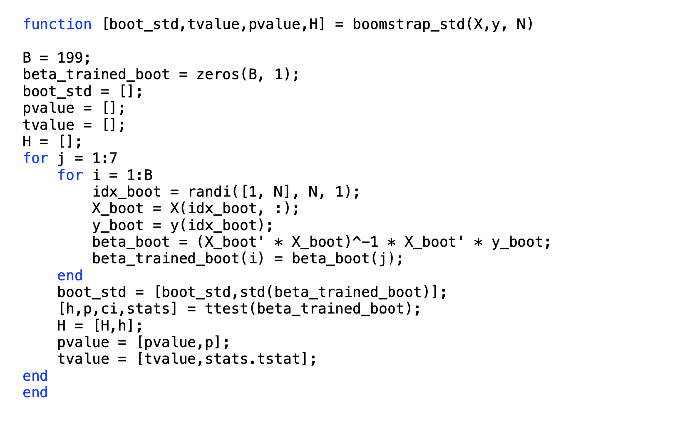
5 Evaluation of an Estimation Method through Data Simulations
Define a function ‘boomstrap_std’

Slide 16

5 Evaluation of an Estimation Method through Data Simulations
5.1 Simulation of data
Start simulations
Use ‘parfor’ to improve the speed of the code
Use ‘tic’ ‘toc’ to record the time:
50 s

Slide 17
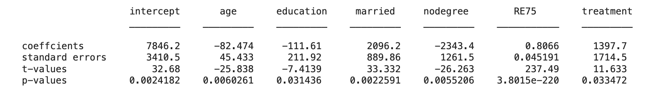
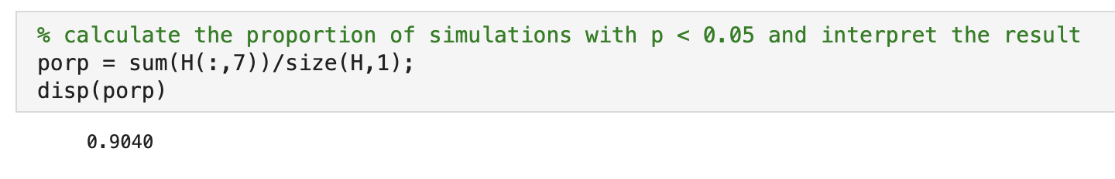
5 Evaluation of an Estimation Method through Data Simulations
5.2 OLS Estimator
Calculate the mean of 4 statistics
calculate the proportion of simulations with p < 0.05 : 90%

Slide 18
5 Evaluation of an Estimation Method through Data Simulations
5.2 OLS Estimator
Plot the distribution of p-values of ‘treatment’ for participants and non-participants
To get of p-values of ‘treatment’ for participants, we set ’treatment == 1’ and repeat what we do in 5.1

Slide 19
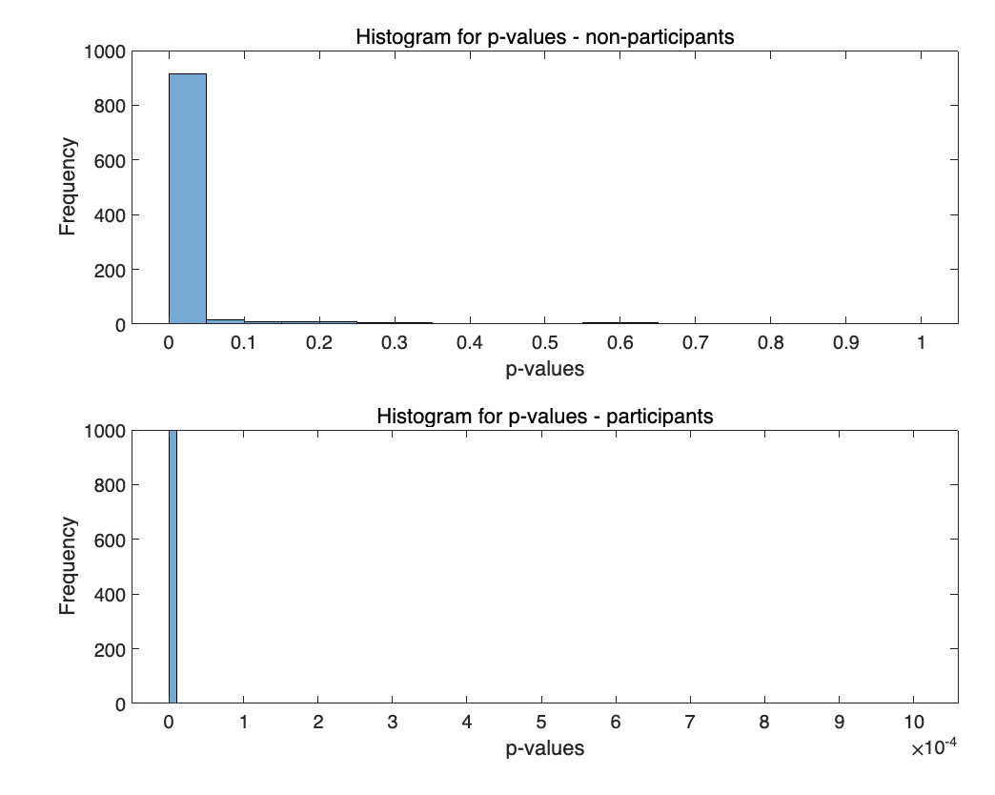
5 Evaluation of an Estimation Method through Data Simulations
5.2 OLS Estimator
Plot the distribution of p-values of ‘treatment’ for participants and non-participants

Slide 20
The task distribution
Xinyue Meng: 4(Analysis of the Employment Program (Part 1)), part of 5.1(Simulation of data)
Jue Yan: 5(Evaluation of an Estimation Method through Data Simulations)
Siyuan Xue: participation in group discussion, improvement of the efficiency of the code

