Slide 1
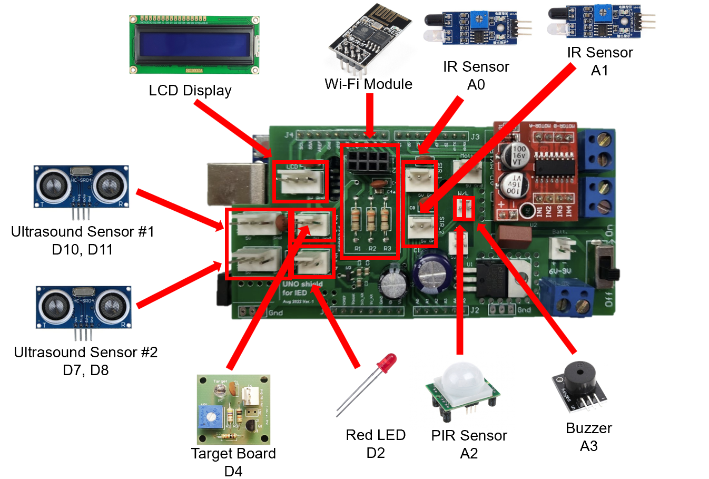
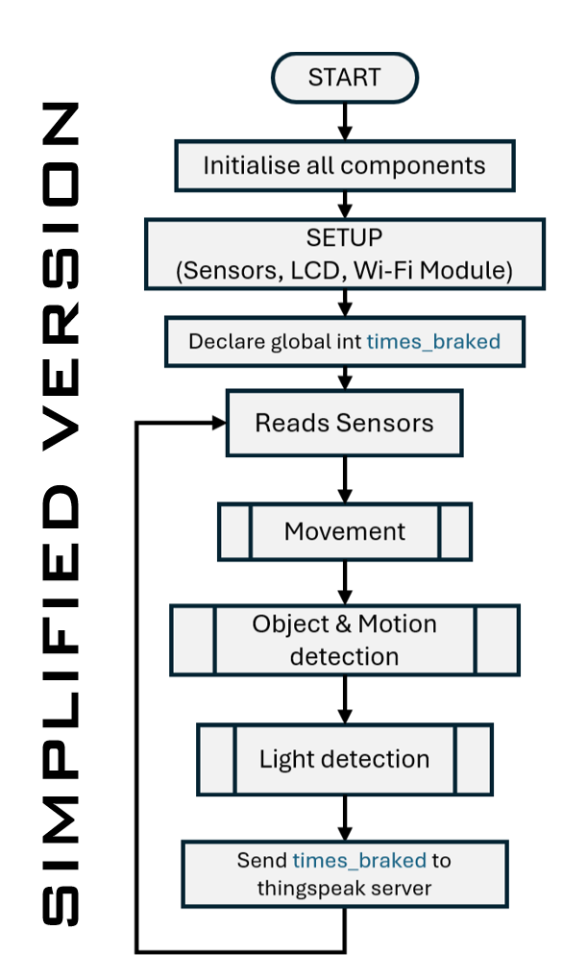
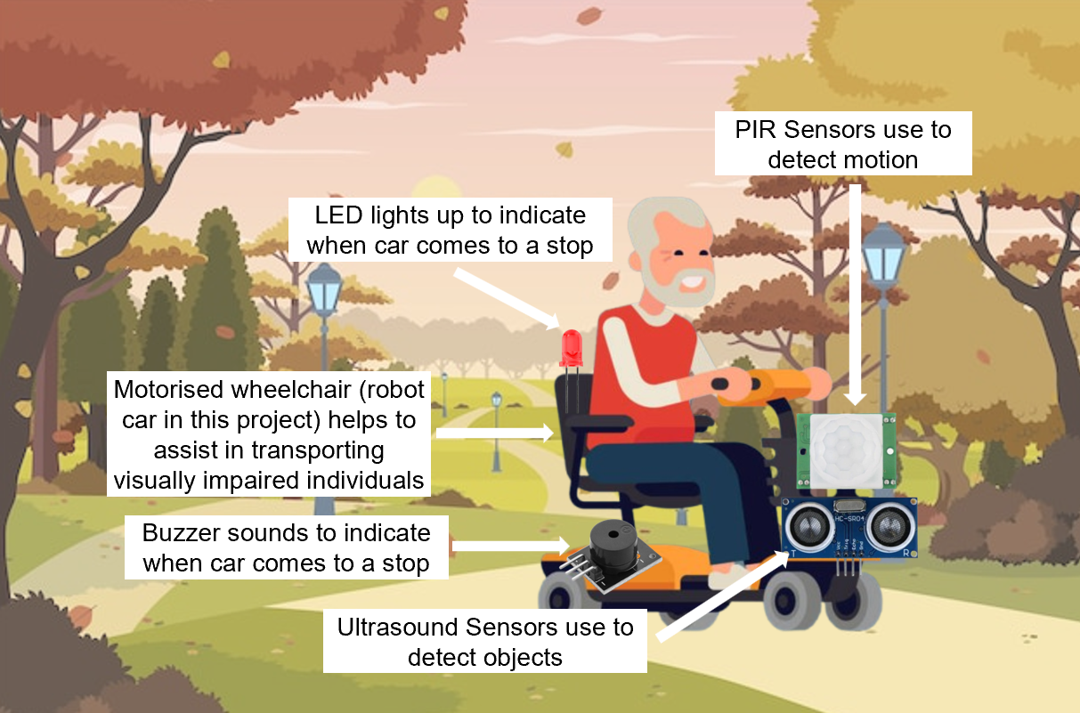
Smart Assistive Navigation System for the Visually Impaired
ET1015/ET1024 Introduction to Engineering & Design
Problem
Hardware design
Implementation / Outcome / Improvements
Procedure
Visually impaired individuals face significant challenges in safely navigating their environment due to obstacles. Traditional mobility aids like canes provide limited feedback and require physical contact, making independent movement difficult. A more advanced, real-time assistive system can enhance mobility, safety, and independence. This aligns with UN SDGs, including Goal 10 (Reduced Inequalities) by ensuring equal access to safe mobility solutions, Goal 11 (Sustainable Cities and Communities) by supporting inclusive infrastructure, and Goal 13 (Climate Action) by incorporating environmental monitoring features for safety in adverse weather conditions
Implementation
The system will use an Arduino Uno with an Arduino Shield to manage all components and connections efficiently.
Ultrasonic sensors will detect obstacles and measure real-time distances.
Infrared (IR) sensors will guide a 2WD robot car along a black path.
A PIR sensor will detect motion and contribute to obstacle detection.
An LCD screen will display real-time information about detected obstacles.
Audio indicators (buzzer and LED) will provide real-time feedback when the car stops.
A target board will enable light-based start and stop functionality.
Wi-Fi integration (ESP-01 module) will allow obstacle data transmission to caregivers.
Outcome
Enhanced navigation safety for visually impaired users through real-time obstacle detection.
Real-time feedback via buzzer and LED when the car stops, improving user awareness.
Structured navigation with IR-based path-following to ensure smooth movement.
Remote monitoring through Wi-Fi, allowing caregivers to receive real-time obstacle alerts.
Automated control with light-based start and stop functionality for better usability.
Improvements
Integration with AI and machine learning for better obstacle classification.
Compact wearable version (e.g., smart glasses or belt).
Enhanced environmental sensing (temperature, humidity, rain detection).
GPS integration for outdoor navigation assistance.
Adaptive path correction if the robot deviates from the track.
Real-time audio feedback to alert users of nearby obstacles.
Idea / Objectives
Develop an affordable real-time obstacle detection system.
Improve mobility, independence, and safety for visually impaired users.
Integrate multi-sensory feedback (audio, optional vibration).
Ensure the system is lightweight, easy to use, and scalable for future improvements.
Software Design
Project Overview
Our Team
June Wai (Team Leader) – Designing & fabricating (3D printing for car body & laser cutting for car top) & codes for line tracer (IR sensors and Motors)
Eddie – Codes for WiFi-module, improves line tracer and combines overall code
Sarah – Codes for LCD, Buzzer, Ultrasound Sensors, PIR Sensor, LED & does poster & video
Javen – Codes for Target Board, motor, combines code & improves line tracer
Class: DCEP/FT/1B/12
Lecturer: Thian Boon Meng
Student members:
P2401182 Neo June Wai
P2435893 Aung Kaung Khant (Eddie)
P2421892 Sarah Lim Shi-Qin
P2422439 Javen Tang

Slide 2
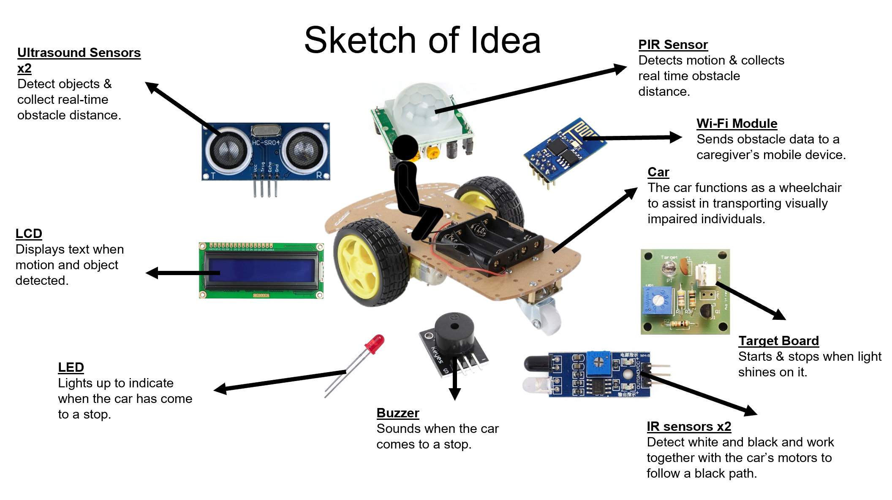
Smart Assistive Navigation System for the Visually Impaired
ET1015/ET1024 Introduction to Engineering & Design
Project Overview
Class: DCEP/FT/1B/12
Lecturer: Thian Boon Meng
Student members:
P2401182 Neo June Wai
P2435893 Aung Kaung Khant (Eddie)
P2421892 Sarah Lim Shi-Qin
P2422439 Javen Tang

Slide 3

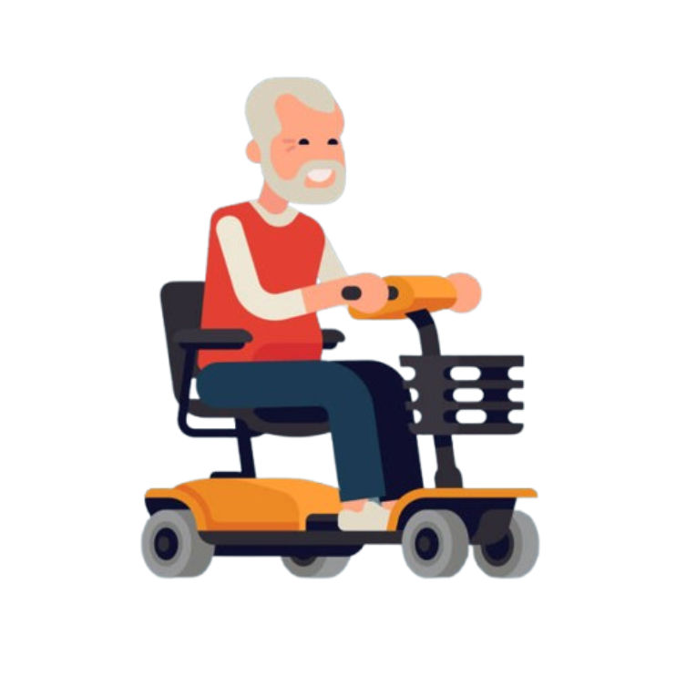
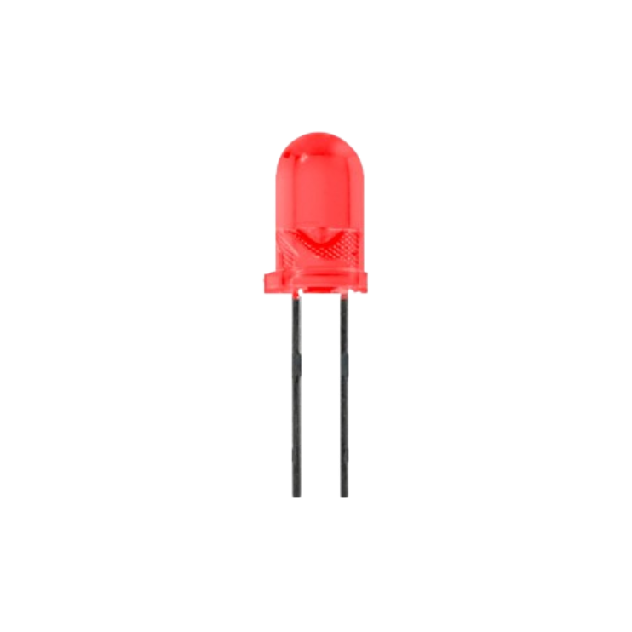
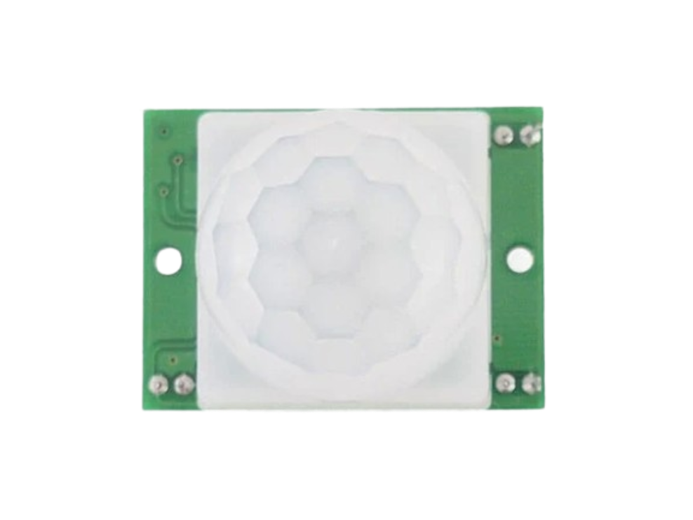
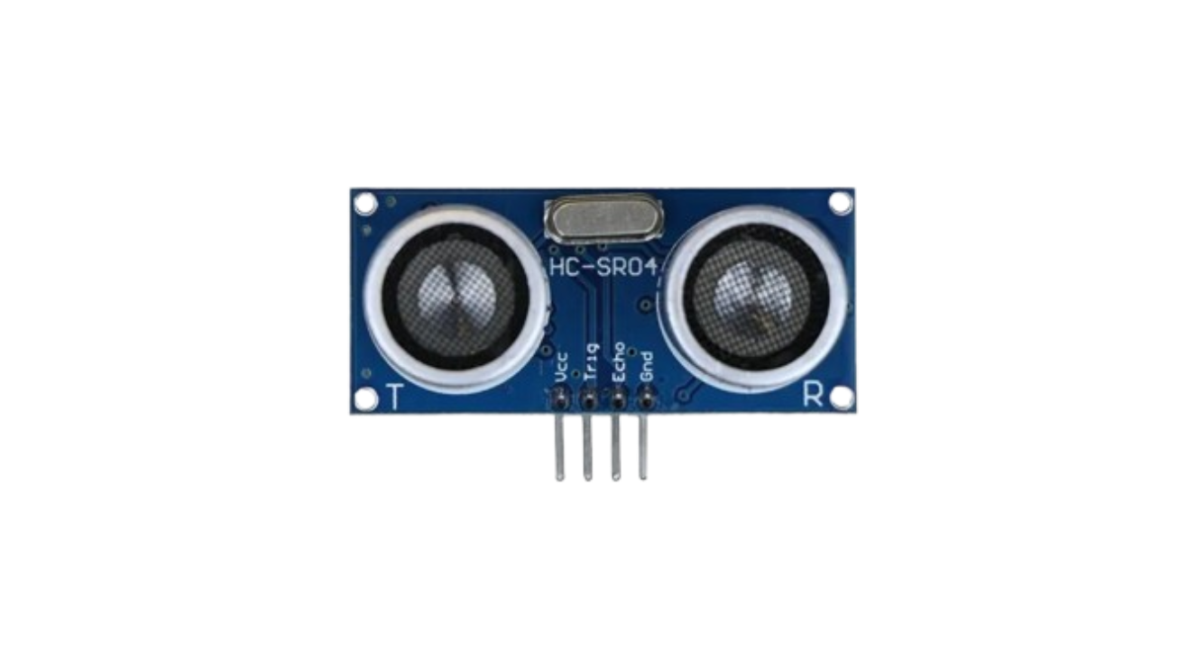
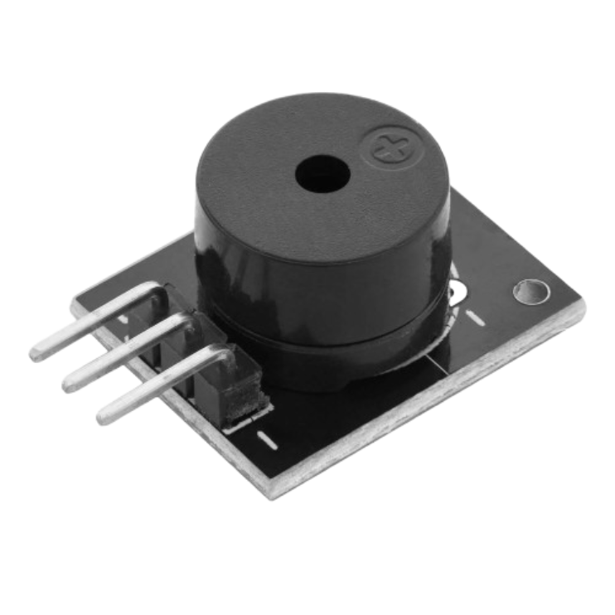
Smart Assistive Navigation System for the Visually Impaired
ET1015/ET1024 Introduction to Engineering & Design
Project Overview (sketch)
PIR Sensors use to detect motion
LED lights up to indicate when car comes to a stop
Motorised wheelchair (robot car in this project) helps to assist in transporting visually impaired individuals
Buzzer sounds to indicate when car comes to a stop
Ultrasound Sensors use to detect objects
Class: DCEP/FT/1B/12
Lecturer: Thian Boon Meng
Student members:
P2401182 Neo June Wai
P2435893 Aung Kaung Khant (Eddie)
P2421892 Sarah Lim Shi-Qin
P2422439 Javen Tang

Slide 4
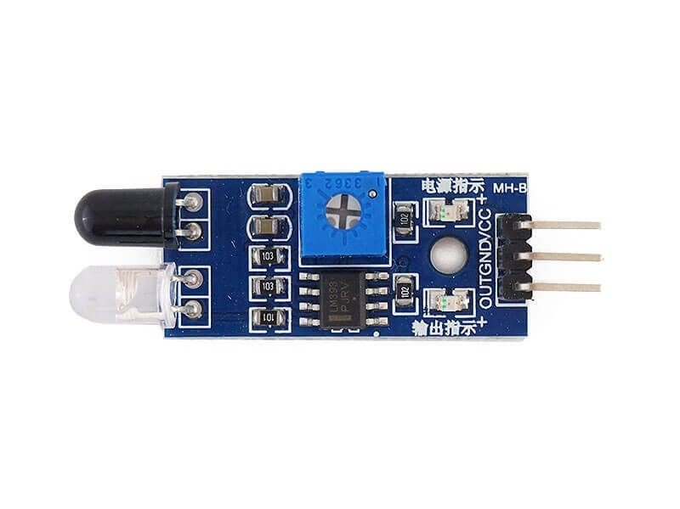
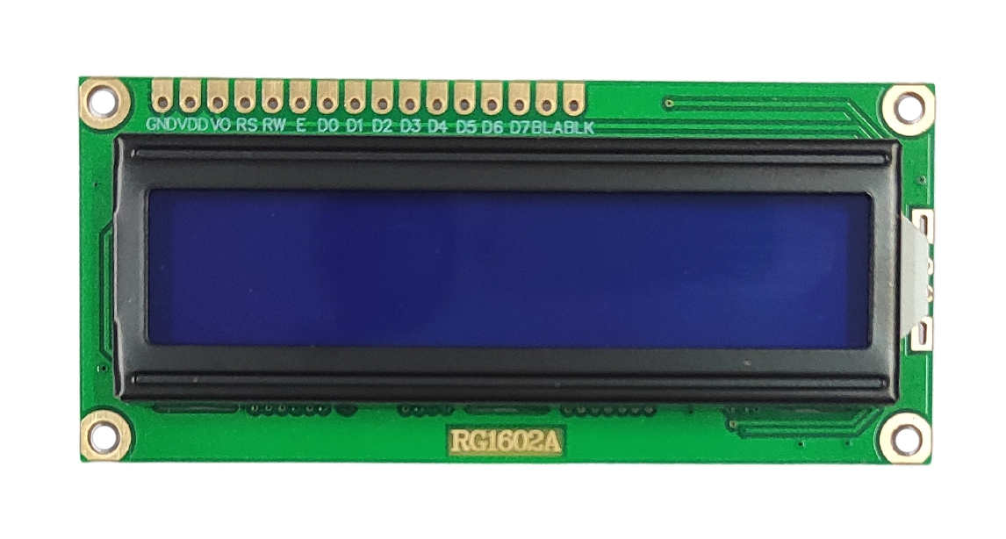
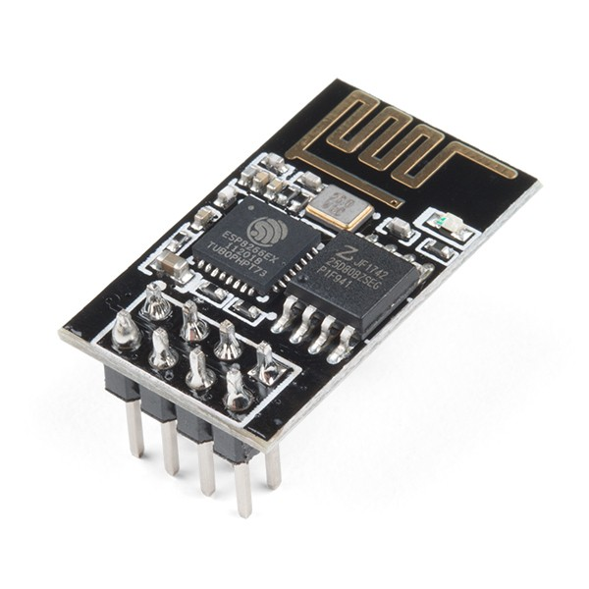
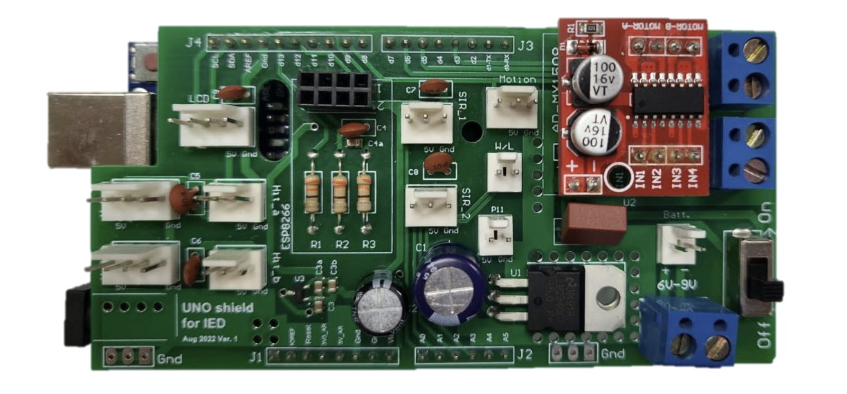
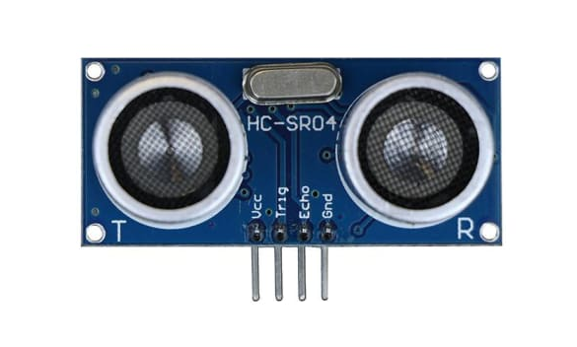
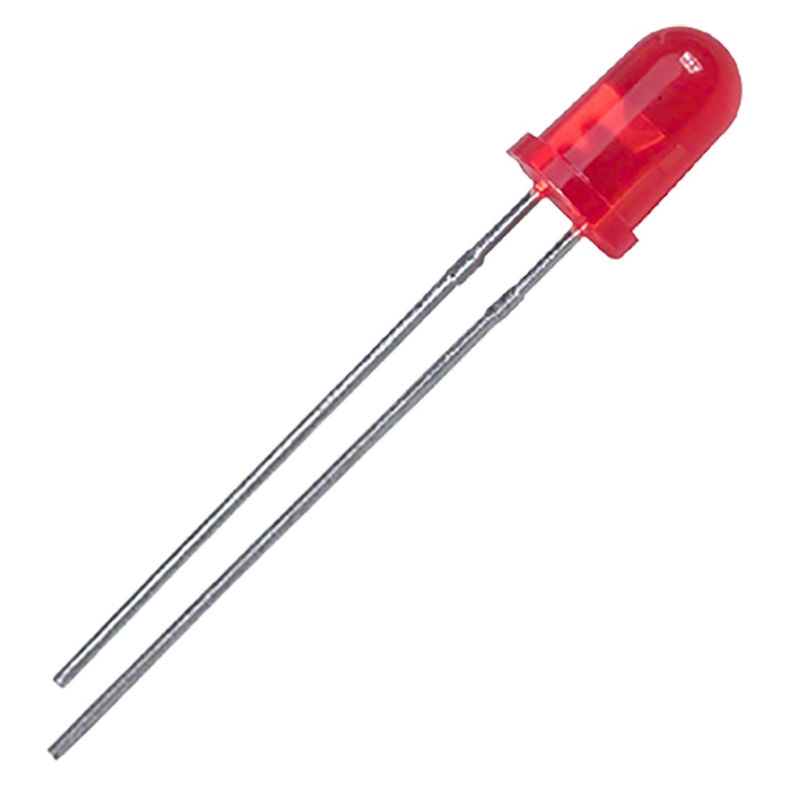
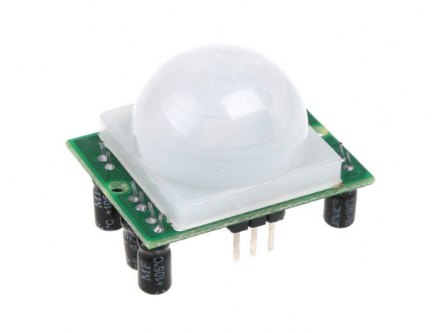
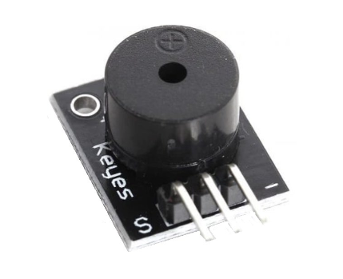
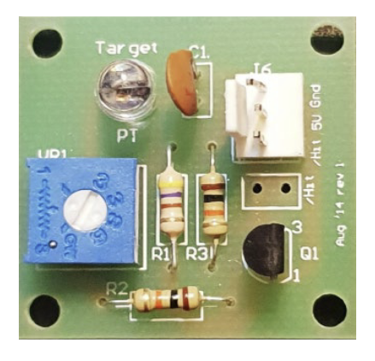
Smart Assistive Navigation System for the Visually Impaired
ET1015/ET1024 Introduction to Engineering & Design
Hardware Design
IR Sensor
A1
IR Sensor
A0
LCD Display
Wi-Fi Module
Ultrasound Sensor #1
D10, D11
Ultrasound Sensor #2
D7, D8
Red LED
D2
PIR Sensor
A2
Buzzer
A3
Target Board
D4
Class: DCEP/FT/1B/12
Lecturer: Thian Boon Meng
Student members:
P2401182 Neo June Wai
P2435893 Aung Kaung Khant (Eddie)
P2421892 Sarah Lim Shi-Qin
P2422439 Javen Tang

Slide 5
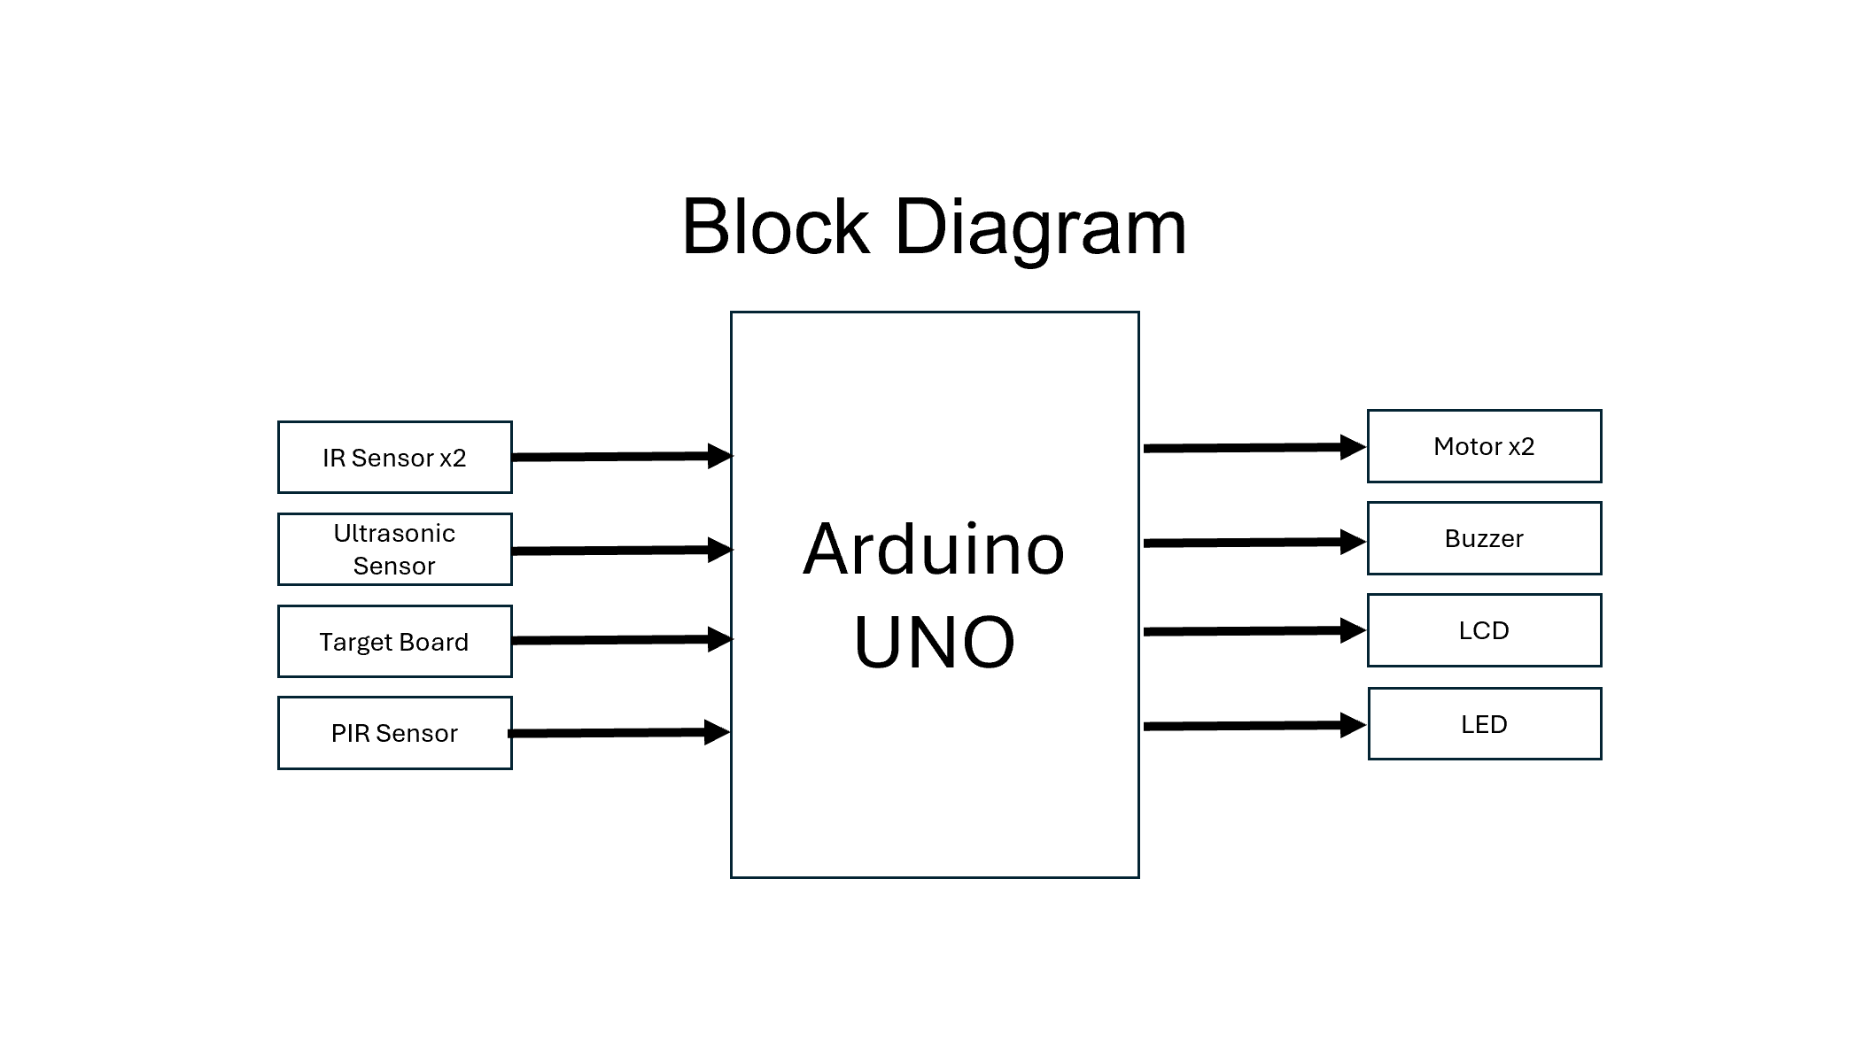
Smart Assistive Navigation System for the Visually Impaired
ET1015/ET1024 Introduction to Engineering & Design
Hardware Design
Class: DCEP/FT/1B/12
Lecturer: Thian Boon Meng
Student members:
P2401182 Neo June Wai
P2435893 Aung Kaung Khant (Eddie)
P2421892 Sarah Lim Shi-Qin
P2422439 Javen Tang

Slide 6
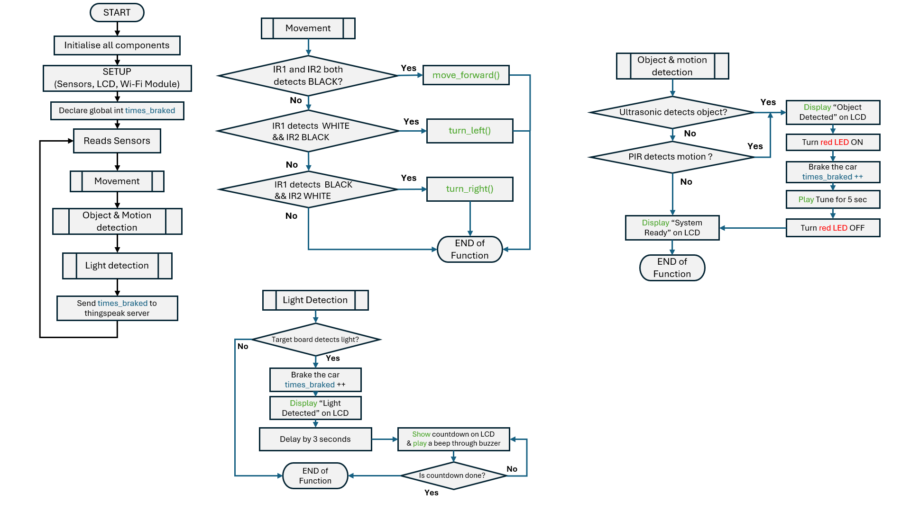
Smart Assistive Navigation System for the Visually Impaired
ET1015/ET1024 Introduction to Engineering & Design
Software Design
Class: DCEP/FT/1B/12
Lecturer: Thian Boon Meng
Student members:
P2401182 Neo June Wai
P2435893 Aung Kaung Khant (Eddie)
P2421892 Sarah Lim Shi-Qin
P2422439 Javen Tang

Slide 7
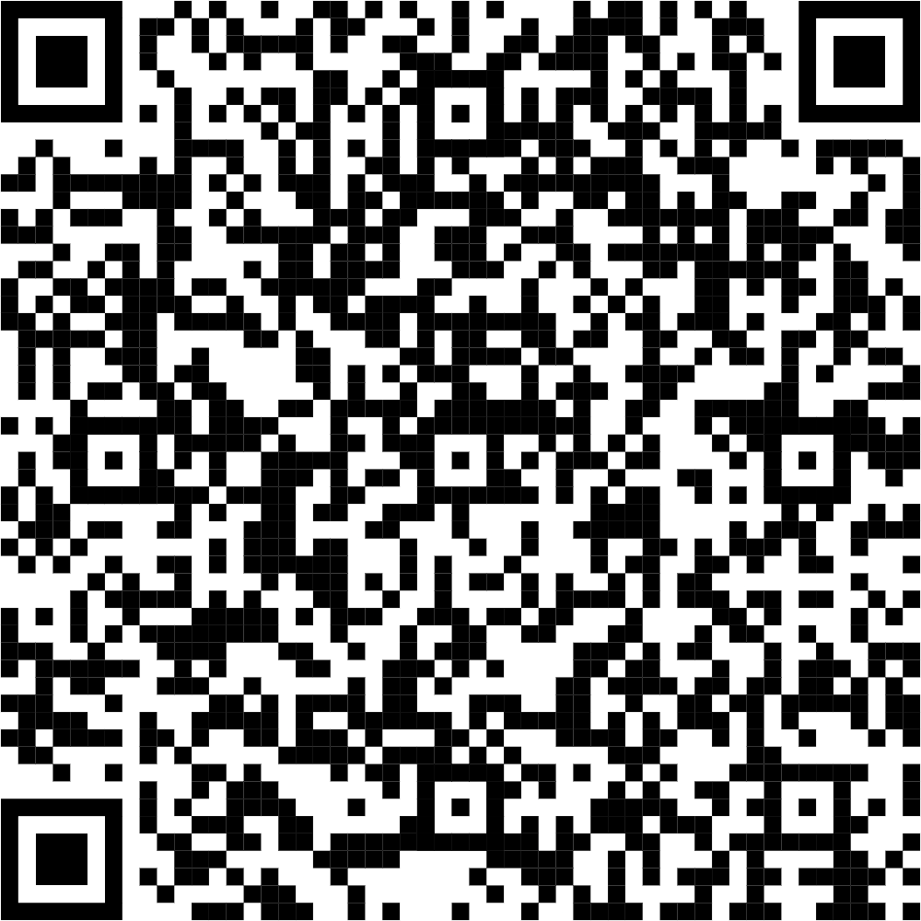
Smart Assistive Navigation System for the Visually Impaired
ET1015/ET1024 Introduction to Engineering & Design
ENDING
SCAN THIS TO ACCESS OUR PROJECT REPOSITORY (CODE and others included); if you are interested, of course.
SCAN THIS
Class: DCEP/FT/1B/12
Lecturer: Thian Boon Meng
Student members:
P2401182 Neo June Wai
P2435893 Aung Kaung Khant (Eddie)
P2421892 Sarah Lim Shi-Qin
P2422439 Javen Tang

