Slide 1


Abstracts
Lie?
Measuring Thematic Alignment Between Journal Scope and Article Abstracts
Case study: Journal of Machine Learning Research (JMLR)
Orazov Temirlan

Slide 2
How reliably do article abstracts represent the thematic focus declared in a journal’s Aims & Scope?
Research
AIMS & SCOPE
Journal-level thematic description
Question
ABSTRACTS
Paper-level summaries
GOAL
Measure alignment between them

Slide 3



DATASET
JMLR
“The Journal of Machine Learning Research (JMLR), established in 2000, provides an international forum for the electronic and paper publication of high-quality scholarly articles in all areas of machine learning.”
80
PAPER ABSTRACTS
TITLE
|
ABSTRACT
|
YEAR
|
URL

Slide 4
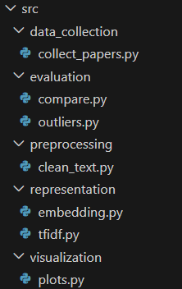
JMLR website
PROJECT
Collect abstracts
PIPELINE
collect_papers.py
Clean Text
clean_text.py
TF-IDF vectors
tfidf.py
Embedding vectors
embedding.py
Cosine Similarity
Comparison. Outliers. Plots.
compare.py | outliers.py | plots.py

Slide 5

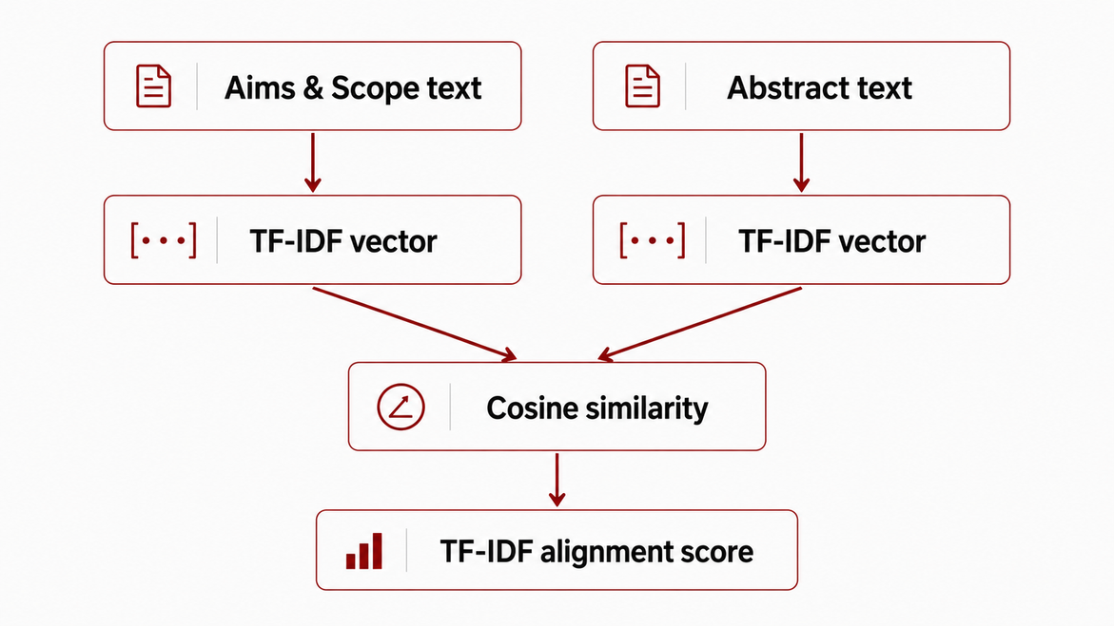
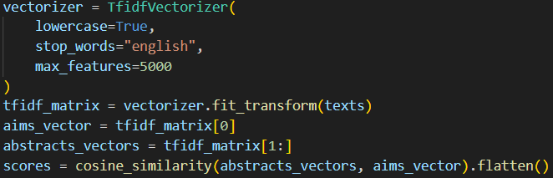
TF - IDF
Method
Lexical baseline
- Converts text into sparse word-based vectors
- Measures vocabulary overlap
- Uses cosine similarity

Slide 6

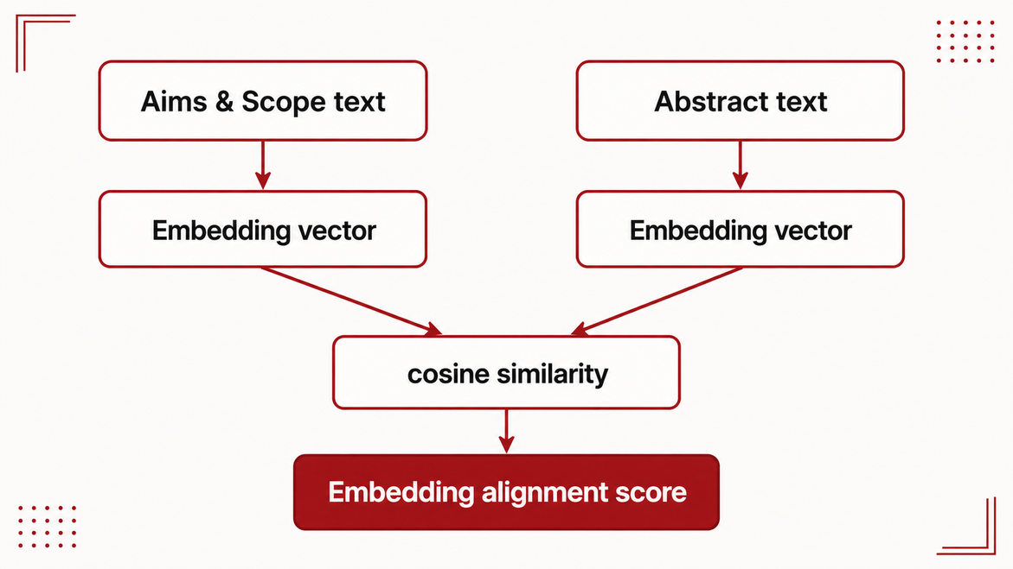
Embedding
Method
Semantic comparison
Embeddings represent text as dense numerical vectors that capture semantic meaning.
Why used?
They can detect similarity even when two texts use different words

Slide 7
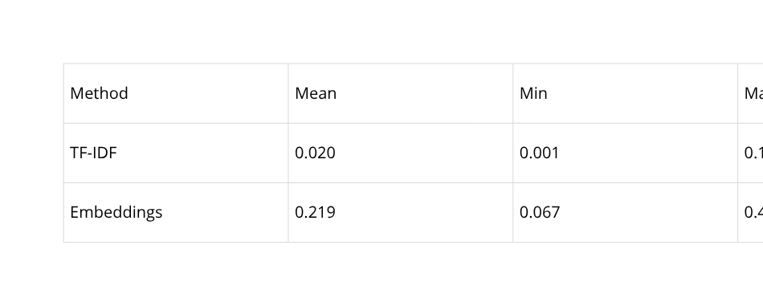
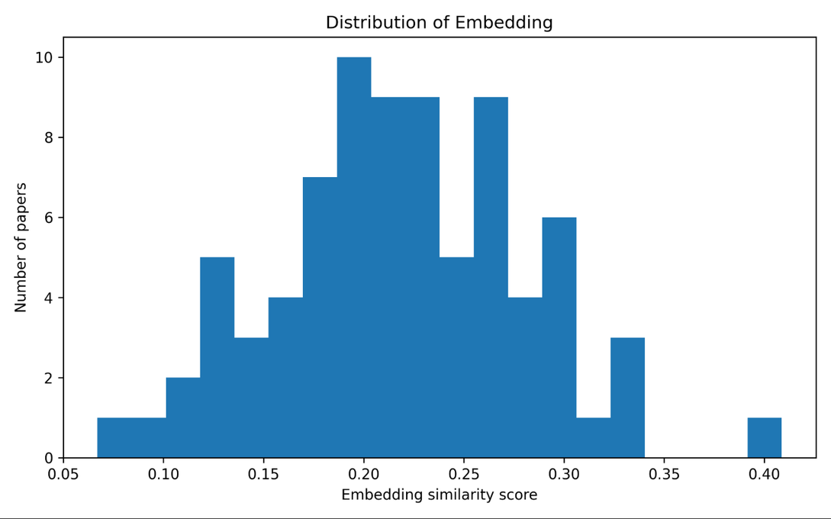
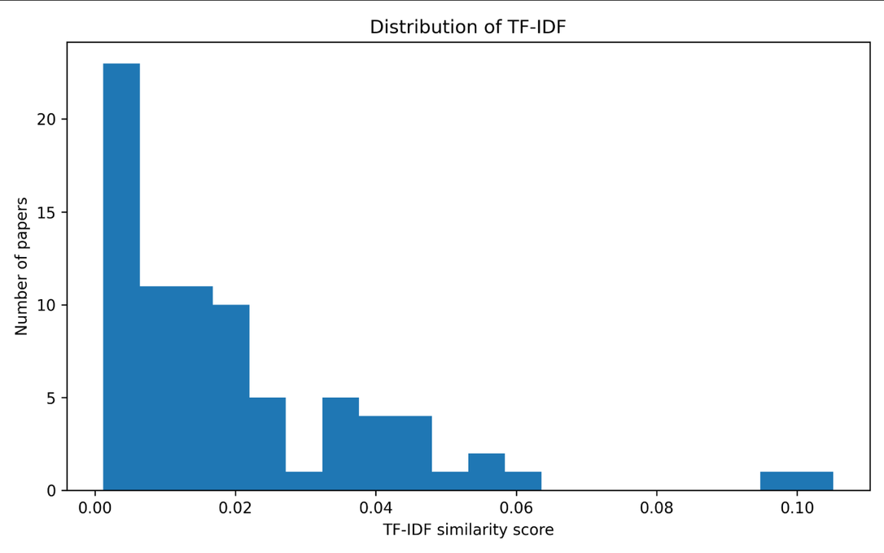
Main
Results
“Embedding similarity is much higher than TF-IDF similarity”
Embedding scores are higher because embeddings capture semantic similarity.
TF-IDF scores are low because abstracts use technical vocabulary.

Slide 8
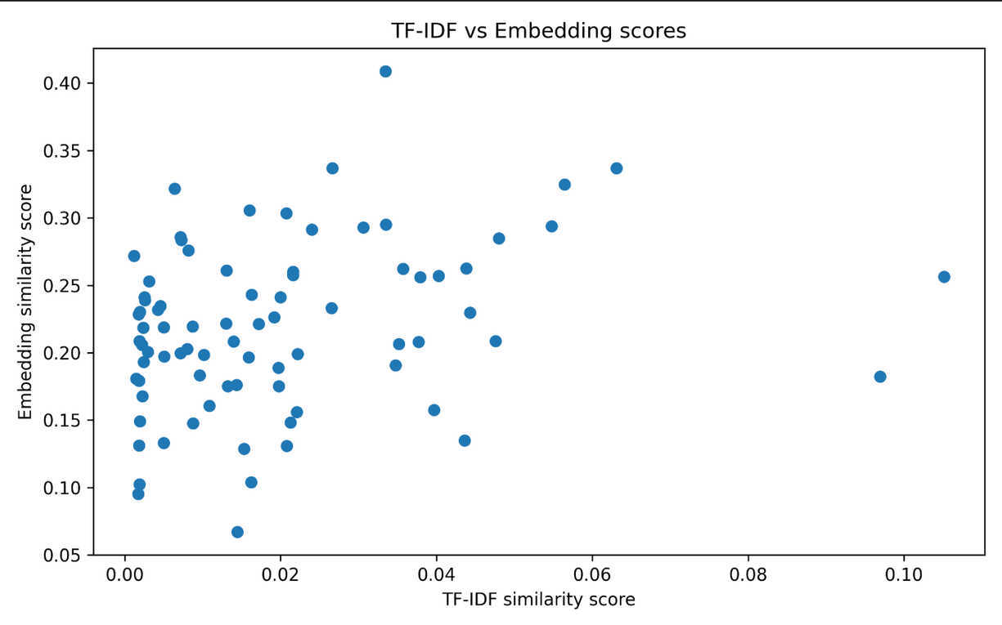
Method
Comparison
TF-IDF and embeddings measure different types of alignment.
Correlation = 0.279
Weak positive relationship
TF - IDF
Lexical overlap
Embeddings
Semantic similarity
The methods partly agree, but they do not rank abstracts in the same way.

Slide 9
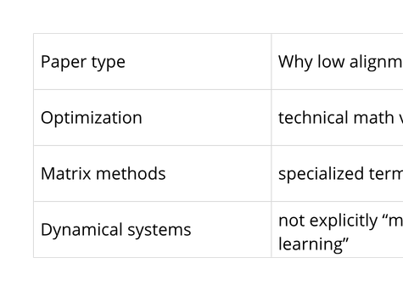
Outlier
Analysis
Low allignment does not automatically mean irrelevant
LOW SCORE ≠ IRRELEVANT
Lowest embedding alignment papers were mostly about:
- Semismooth Newton methods
- Unlabeled PCA and matrix methods
- Sketching operators
- Linear dynamical systems
- Nonconvex ADMM

Slide 10
Limitations
Conclusion
- Aims & Scope is short and general
- Dataset contains 80 abstracts
- Abstracts are not full papers
- Embedding model is pretrained, not domain-specific
- Abstracts are useful, but imperfect thematic proxies
- TF-IDF underestimates alignment
- Embeddings capture broader semantic similarity
- Results are exploratory

