Slide 1
ASSIGNMENT 3 | SOFTWARE DEVELOPMENT AND INTEGRATION
Building a verifiable KPI evaluation system
115 + 53
automated tests
91 % / 89 %
NLP + computer vision, Git/GitHub, CI/CD and reproducible research software
backend / frontend coverage
3
OrazovTairlan
Applied Software Development Project, Astana IT University, 2026
GitHub Actions workflows
github.com/OrazovTairlan/asdp_dissertation
Notes:
Assignment 3 covers the development process, technology selection, Git and GitHub, CI/CD and scientific software. The practical part is the dissertation prototype: an intelligent system that verifies employee KPI reports with an LLM and computer vision. Everything shown is in one public repository.

Slide 2
Stages and organisation of the process
Requirements
Planning
Design
Construction
Testing
Deployment
Maintenance
Waterfall
V-model
Spiral
Iterative / incremental
Agile: Scrum, Kanban
Fixed requirements, formal documents
Every phase has a mirror test phase
Risk analysis and prototypes per turn
Requirements refined, functions added
Short sprints, visual flow, WIP limits
Our choice: iterative-incremental development with a Kanban-style flow. Requirements emerged from experiments on the real KPI regulation; user stories are prioritised with MoSCoW labels; every increment is a branch merged only after the quality gates pass.
Notes:
Seven framework activities exist in every methodology; models differ in how they order and repeat them. Waterfall and V-model suit fixed requirements and regulated domains, Spiral adds risk analysis, iterative and incremental models fit research where requirements emerge from experiments, Agile frameworks add short feedback loops. For a single-researcher project with changing requirements we combined iterative-incremental development with a Kanban-style flow and MoSCoW priorities.

Slide 3
Criteria for selecting technologies
FROM LECTURE 5
Performance
Scalability
Community
Compatibility
LLM inference is GPU-bound; Python is enough
Stateless API, JSON storage, Docker image
Python, React, MUI and Ollama ecosystems
REST + Ollama API, Windows and Linux
ADDED FOR RESEARCH SOFTWARE
Data privacy
Reproducibility
Licence
Testability
On-premises LLM: documents never leave
Open weights, pinned versions, fixed seed
MIT code, Apache-2.0 model weights
Replaceable LLM client: CI without a GPU
Notes:
The lecture names four criteria: performance, scalability, community support and compatibility. Research software adds privacy, reproducibility, licence and testability. For each criterion the second line shows what it meant for this project.

Slide 4
Technology stack and why
Layer | Choice | Why (alternatives)
Backend | Python 3.11 + FastAPI | NLP / CV ecosystem, typed API, OpenAPI (vs Django, Java)
LLM runtime | Ollama + gpt-oss:20b | On-premises, open weights, JSON-schema output (vs cloud APIs)
Documents / CV | pdfplumber, OpenCV | Cell-level tables, explainable image checks
Frontend | React 19 + Vite + MUI | Components, accessible kit, 5 themes x light/dark
Quality | pytest, Vitest, ruff, ESLint | 115 + 53 tests, coverage gates, one tool per language
Packaging | Docker multi-stage | Node build, Python runtime, one artefact
Notes:
Each decision lists alternatives. Python for the ecosystem, FastAPI for typed requests and OpenAPI, Ollama with open-weight gpt-oss for on-premises reproducible inference with schema-constrained JSON, classical OpenCV checks because they are explainable, React with Material UI for a themeable accessible interface, ruff and ESLint for quality, Docker for a single artefact.

Slide 5
Version control: Git and GitHub
Version control systems
Hosting platforms
Branching strategies
Git
distributed, fast branches, huge ecosystem
chosen
GitHub
PRs, Actions, Dependabot, CodeQL, GHCR
chosen
GitHub Flow
short branches, PR review, deployable main
chosen
Subversion
centralised, simple, weak merging
GitLab
built-in CI/CD, self-hosting
Git Flow
feature / release / hotfix branches
Mercurial
distributed, easy CLI, small ecosystem
Bitbucket
tight Jira integration
Trunk-based
tiny commits to one trunk, toggles
Practices applied: small commits, Conventional Commits, topic branches, merge after green checks, tags for releases, protected main.
Notes:
Distributed systems keep the whole history on every machine, so commits and branching work offline. Git wins on speed, cheap branches and ecosystem. GitHub adds pull requests, issues, Actions, Dependabot and CodeQL around Git. We used GitHub Flow: short-lived topic branches merged into a deployable main after automated checks.

Slide 6
Git and GitHub in the project
v1.0.0
main
GitHub features used
1
README + docs
architecture, prompts, changelog
ci/github-actions
feat/grounded-llm
2
MIT licence
LICENSE, CONTRIBUTING
feat/react-mui-frontend
3
Issues
user stories, MoSCoW labels, milestone
docs/report-and-readme
4
Templates
bug / feature forms, PR checklist
fix/prompt-undefined-circumstances
5
Releases
semantic tags, GHCR image, assets
chore/strip-comments
docs/presentation
6
Automation
Dependabot, CodeQL, protected main
Notes:
The history is a sequence of topic branches merged into main with merge commits, so the work of each increment stays visible in the network graph. Issues carry user stories with MoSCoW labels, pull requests use a checklist template, and the v1.0.0 tag triggers the release workflow. The repository is published by the prepared bootstrap script.

Slide 7
Continuous integration and delivery
1
Continuous integration
2
Continuous delivery
3
Continuous deployment
Merge often; build, lint and test every change automatically
Early defects, small integration problems
Every change is packaged and deployable at any time
Release stays a manual decision
Validated changes reach production automatically
Fast feedback, small safe releases
TOOLS COMPARED
GitHub Actions
YAML next to the code, marketplace, free for public repos
GitLab CI/CD
built-in pipelines, strong containers
Jenkins
own server, plugins, full control
Travis CI
hosted, limited free tier today
Notes:
Continuous integration merges often and verifies each merge with an automated build and tests. Continuous delivery keeps every change deployable; production release is a manual decision. Continuous deployment releases validated changes automatically. We chose GitHub Actions because it lives next to the code and is free for public repositories.

Slide 8
CI/CD pipeline of the project
backend x 3
Python 3.11 / 3.12 / 3.13: ruff, pytest, coverage >= 80 %
push / PR
main
frontend (Node 22)
ESLint, Vitest + coverage, Vite build
Docker build
smoke test /api/health
CONTINUOUS DELIVERY
CodeQL + Dependabot
static security analysis, weekly updates
Image to GHCR
tag vX.Y.Z
re-runs CI first
GitHub Release
Configuration: ci.yml | release.yml | codeql.yml
Notes:
Every push to main and every pull request runs backend lint and tests on three Python versions, frontend lint, tests and build, and a Docker build with a health smoke test. A version tag re-runs the whole CI and then publishes the image to GHCR and creates a GitHub Release with the frontend build and the report. The LLM cannot run on a free runner, so its client is replaced by a test double and the pipeline verifies all code around the model.

Slide 9
Features of scientific software
Requirements
Environments
Libraries
Best practices
Reproducibility
Transparency
Efficiency
venv / conda
Lock files
Docker
Maintained
Open licences
Pinned and cited
Version everything
Tests of validity
Fixed seeds, FAIR docs
REPRODUCIBILITY MEASURES IN THE PROJECT
Non-determinism: temperature 0, top_k 1, seed, response cache
Model / prompt drift: versioned prompts, model digest in every result
Dependency drift: lock files, CI matrix, Dependabot, Docker
Documentation gaps: README, architecture, prompts, CLI, samples
Notes:
Research software has incomplete and changing requirements and its results are scientific evidence, so reproducibility, transparency and efficiency come first. Environments are controlled with virtual environments, lock files and containers. Libraries should be maintained and openly licensed. Our reproducibility measures target the typical threats from the lecture: non-determinism, model and prompt drift, dependency drift and documentation gaps.

Slide 10
The module: an untrusted LLM in a verified shell
KPI regulation
PDF / DOCX / XLSX
Table parser
deterministic, no LLM
KPI catalog
position > block > item
Weights, targets
sum = 100 % check
Why it cannot make things up
Closed-world prompt
Schema enums
Quotes checked by code
Math in code
Image gate
Employee report
PDF / DOCX / TXT
LLM: achievements
verbatim quotes
LLM: conditions
quote per condition
Code decides
quotes verified, counts
Evidence images
certificates, photos
CV checks
blur, EXIF, ELA, noise
Vision LLM
description + OCR
KPI + Excel
damaged: human review
teal code amber LLM red classical CV
Notes:
The LLM is treated as an untrusted component. Tables are parsed without it. Achievements must carry verbatim quotes; indicator identifiers are schema enums; each condition of an indicator needs its own quote that the code re-checks, and the code decides whether all conditions hold. Quantities and percentages are computed by code, and damaged or edited images are never counted automatically.

Slide 11
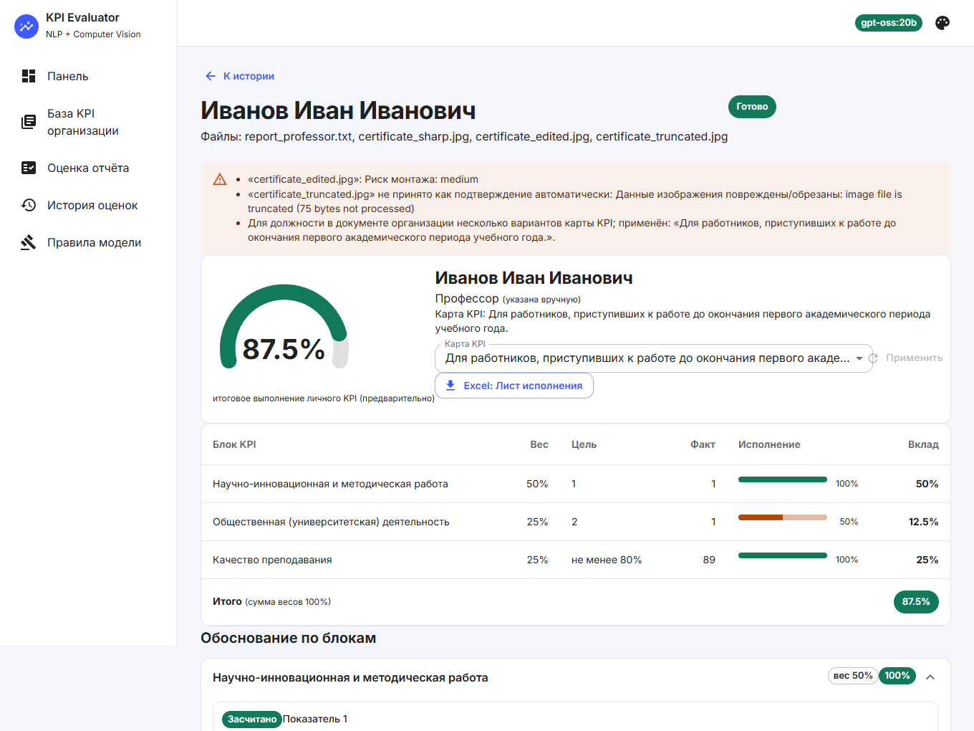
Tested without a GPU
115
53
0
backend tests
frontend tests
lint errors
Result page: 87.5 % for the sample report, evidence per condition
Notes:
The LLM client is a thin replaceable module, so tests inject a fake and verify all logic around the model. Backend: 115 pytest tests with 91 percent coverage. Frontend: 53 Vitest and Testing Library tests with 89 percent coverage. The live run on the real university regulation gave 87.5 percent for the sample professor report; the Q4 article and the chess club were correctly not counted.

Slide 12
Conclusion and challenges
Done
Challenges
Links
Process, tools, Git and CI/CD studied and applied
Strict, versioned prompts + code verification
React + MUI interface with themes
168 automated tests, Docker, release workflow
LLM hallucinations: defence in depth
Testing without a GPU: replaceable client
Tables across pages: cell-level parsing
Slow local inference: response cache
Repository
ci.yml
release.yml
codeql.yml
Prompt design
Architecture
Next: calibrate image forensics on a real labelled sample.
Notes:
The work covered the whole path from organising the process to a tested, containerised and documented module. The hardest problem was keeping an LLM strict: a live run showed that a boolean returned by the model is unreliable, which motivated per-condition grounding and a code-enforced quantity floor. Limitations: heuristic forgery detection, no large real evaluation set yet. The repository and workflow links are on the right.

