Slide 1
AI and Ethics
Shannon Kealey, Willamette University
Jason Cabaniss, Seattle University
April 24, 2026

Slide 2
In this section:
Privacy
Environmental Impact
Bias
Copyright
Disclosure/Transparency

Slide 3
AI and Privacy
Things to consider:
What data are companies using to train their AI models?
AI and privacy in the news
AI integration into operating systems:
Impact on encrypted apps and any app with personal data/login information.
For libraries:
Monitor license agreements and documentation.
Is the AI model training on user prompts? What happens to user data?
Gather staff feedback and make collective decisions on new tools.
Opt out options

Slide 4
AI’s Environmental Impact
Chip manufacturing
Frequency of chip replacement
Data Centers
Use of potable water
Use of electricity
Energy usage per prompt (text, image, and video)
Considerations for libraries?

Slide 5
AI and Bias
Generative AI tools have significant biases - including racism and sexism - hard-coded into their algorithms and source data
Opaque, “black box” nature of most AI makes it impossible to directly examine their code and data for bias
Bias must be evaluated indirectly by analyzing outputs generated
Scholars such as Dr. Safiya Noble, Dr. Joy Buolamwini, and Dr. Tiera Tanksley have published and presented extensive research on bias in AI

Slide 6
AI and Copyright
Lawsuits over legislation - Generative AI Copyright Disclosure Act of 2024 has not advanced past the initial committee stage in Congress
Cases to watch
New York Times v Microsoft & OpenAI
Authors Guild v. OpenAI
Andersen, et al. v. Stability AI, Midjourney, and DeviantArt
Nielsen’s Gracenote v. OpenAI (filed March 2026)

Slide 7
Transparency
Journal publishers, scholarly societies, and many academic institutions call for transparency around gen AI use
Promoting the only known published discipline / publisher-agnostic framework for AI Disclosure: AID Framework by Kari Weaver
European Council of Research Integrity adoption as international standard - see https://council.science/our-work/ai-disclosure-in-research/
AID statement builder: https://aidframework.org/
Exercise

Slide 8
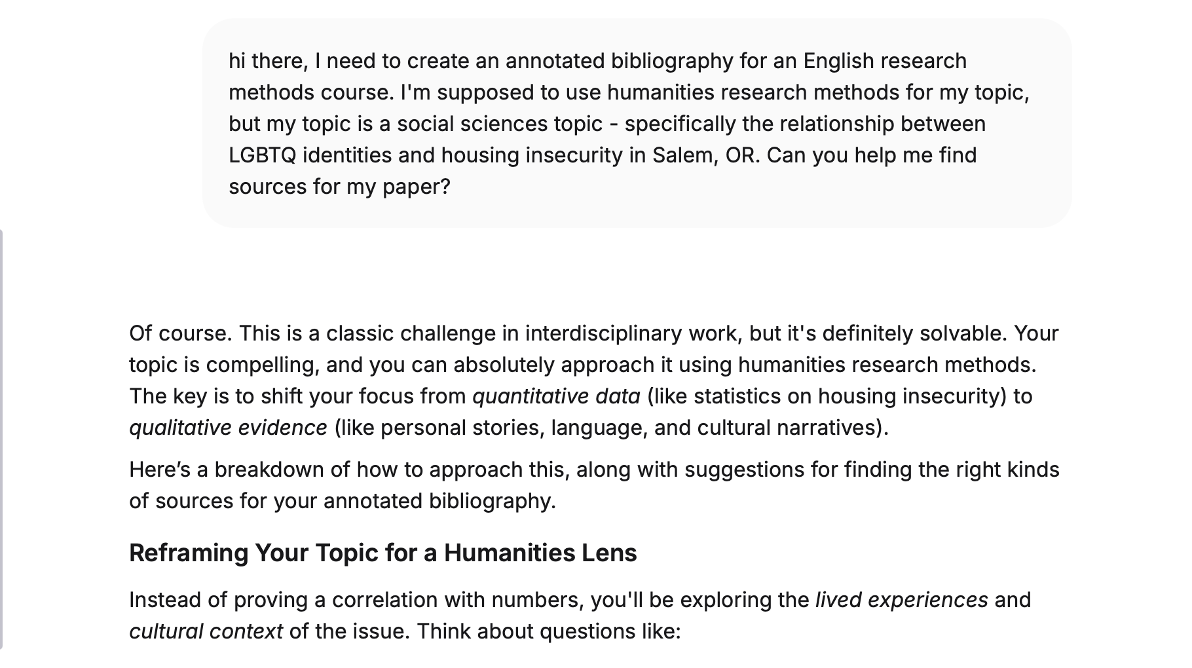
Slide Title
Slide contents

Slide 9
Thank you!

