Slide 1


Slide 2


Slide 3
Purpose
Specifies the software's operational characteristics
Indicates the software's interfaces with other system elements
Establishes constraints that the software must meet

Slide 4
Purpose
Provides the software designer with a representation of information, function, and behavior
  This is later translated into architectural, interface, class/data and component-level designs
Provides the developer and customer with the means to assess quality once the software is built

Slide 5
Overall Objectives
Three primary objectives
  To describe what the customer requires
  To establish a basis for the creation of a software design
  To define a set of requirements that can be validated once the software is built
All elements of an analysis model are directly traceable to parts of the design model, and some parts overlap

Slide 6
Analysis Rules of Thumb
The analysis model should focus on requirements that are visible within the problem or business domain
  The level of abstraction should be relatively high
Each element of the analysis model should add to an overall understanding of software requirements and provide insight into the following
  Information domain, function, and behavior of the system

Slide 7
Analysis Rules of Thumb
The model should delay the consideration of infrastructure and other non-functional models until the design phase
  First complete the analysis of the problem domain
The model should minimize coupling throughout the system
  Reduce the level of interconnectedness among functions and classes

Slide 8
Analysis Rules of Thumb
The model should provide value to all stakeholders
The model should be kept as simple as can be

Slide 9


Slide 10
Domain Analysis
Definition
  The identification, analysis, and specification of common, reusable capabilities within a specific application domain
  Do this in terms of common objects, classes, subassemblies, and frameworks

Slide 11
Domain Analysis
Sources of domain knowledge
  Technical literature
  Existing applications
  Customer surveys and expert advice
  Current/future requirements

Slide 12
Domain Analysis
Outcome of domain analysis
  Class taxonomies
  Reuse standards
  Functional and behavioral models
  Domain languages

Slide 13
Goals of Analysis Modeling
Provides the first technical representation of a system
Is easy to understand and maintain
Deals with the problem of size by partitioning the system
Uses graphics whenever possible

Slide 14
Goals of Analysis Modeling
Differentiates between essential information versus implementation information
Helps in the tracking and evaluation of interfaces
Provides tools other than narrative text to describe software logic and policy

Slide 15
Analysis Modeling Approaches
Structured analysis
  Considers data and the processes that transform the data as separate entities
  Data is modeled in terms of only attributes and relationships (but no operations)
  Processes are modeled to show the
    input data,
    the transformation that occurs on that data, and
    the resulting output data

Slide 16
Analysis Modeling Approaches
Object-oriented analysis
  Focuses on the definition of classes and the manner in which they collaborate with one another to fulfill customer requirements

Slide 17
Introduction
The analysis model addresses the three aspects of objects:
  Static structure of objects
    Class model
  Interactions among objects
    Interaction model
  Life-cycle histories of objects
    State model

Slide 18

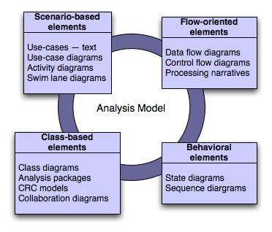
Elements of the analysis model

Slide 19
A Set of Models
Flow-oriented modeling –
  provides an indication of how data objects are transformed by a set of processing functions
Scenario-based modeling –
  represents the system from the user's point of view

Slide 20
A Set of Models
Class-based modeling –
  defines objects, attributes, and relationships
Behavioral modeling –
  depicts the states of the classes and the impact of events on these states

Slide 21


Slide 22

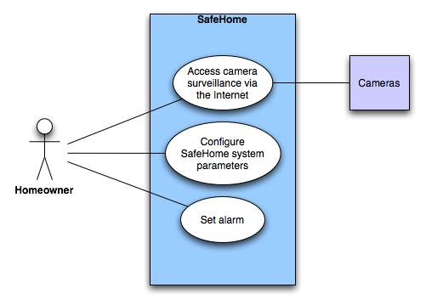
Use-case diagram for surveillance function

Slide 23
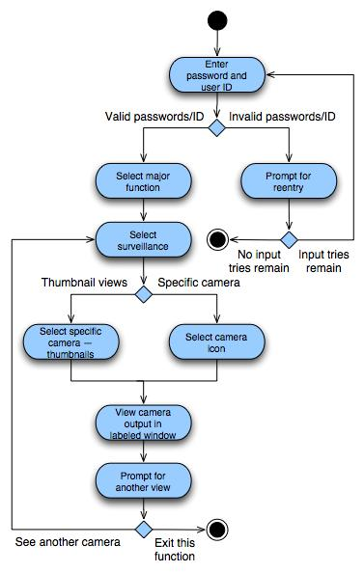
Activity diagram for Access camera surveillance—display camera views function

Slide 24
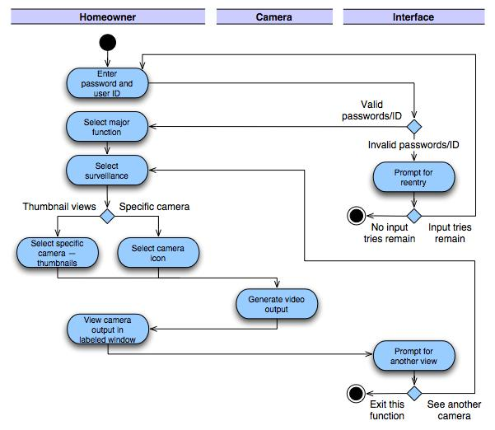
Swimlane diagram

Slide 25


Slide 26

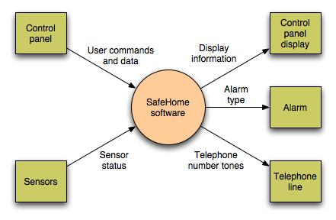
Context-level DFD for SafeHome security function

Slide 27
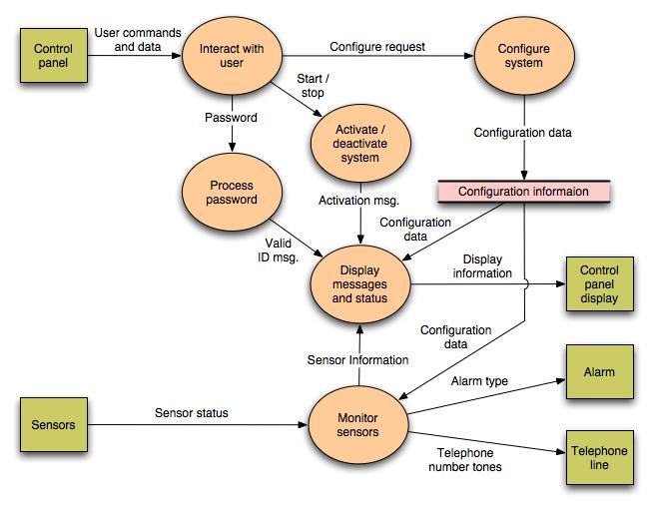

Slide 28
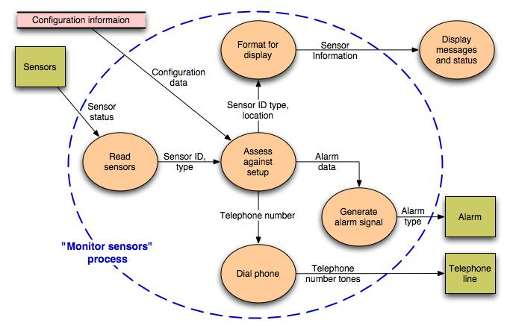
Level 2 DFD that refines the monitor sensors process

Slide 29

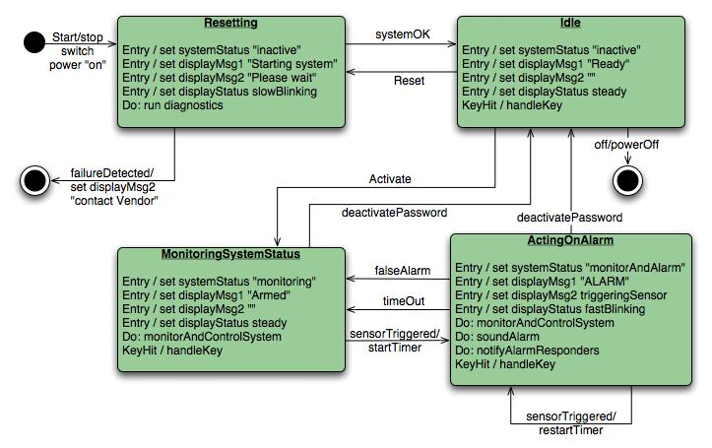
State diagram for SafeHome security function

Slide 30


Slide 31

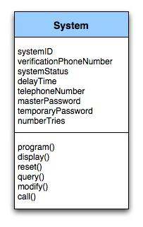
Class diagram for the system class

Slide 32
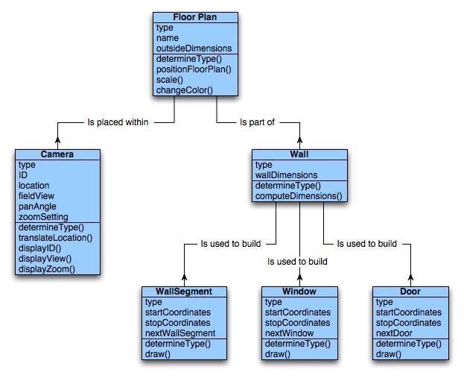
Class diagram for FloorPlan

Slide 33

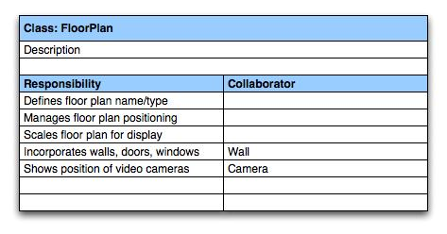
A CRC model index card for FloorPlan class

Slide 34


Slide 35

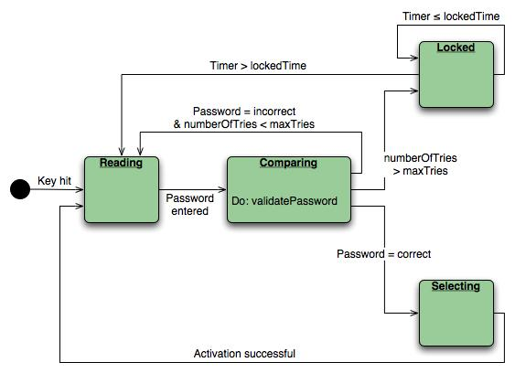
State diagram for the ControlPanel class

Slide 36

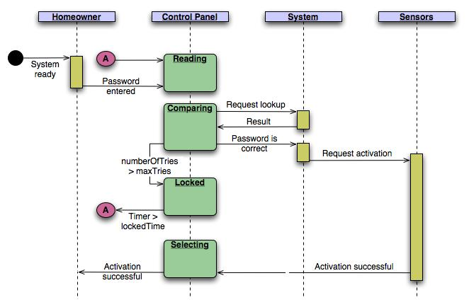
Sequence diagram (partial) for the SafeHome security function

Slide 37
Data Modeling Concepts
Data Objects
Data Attributes
Relationships
Cardinality & modality

