Slide 1
VIDEO GAME SALES ANALYSIS REPORT
prepared by:
Gyro A. Madrona
Electronics Engineer
Six Sigma Certified

Slide 2
REPORT OUTLINE
Dataset
Data Cleaning
Data Visualization
A/B Testing
Conclusion

Slide 3
DATASET

Slide 4
definition
VIDEO GAME SALES
The dataset contains a list of video games with sales greater than 100,000 copies

Slide 5
DATA DICTIONARY
Sales in Millions
NA_Sales - Sales in North America
EU_Sales - Sales in Europe
JP_Sales - Sales in Japan
Other_Sales - Sales in Rest of the World
Global_Sales - Total Worldwide Sales
'Misc' Genre
diverse category that encompasses games that don't fit neatly into specific genres
‘Action’ Genre
Games that emphasize physical challenges, hand-eye coordination, and reaction time.
e.g. platform, shooter, beat’em ups, and more

Slide 6
DATA CLEANING

Slide 7
DATA CLEANING STEPS
raw data
Drop column: ‘Rank’, ‘Name’, ‘Publisher’
Delete ‘Misc’ Genre
Interpolate missing ‘Year’
Removing outliers
clean data

Slide 8
DATA VISUALIZATION

Slide 9
KEY QUESTIONS
What is the top performing platform by global sales?
in Europe, Japan, and North America?
What is the top performing genre by global sales?
in Europe, Japan, and North America?
What investment opportunities can be found in the video game market?

Slide 10
PLATFORM SALES

Slide 11
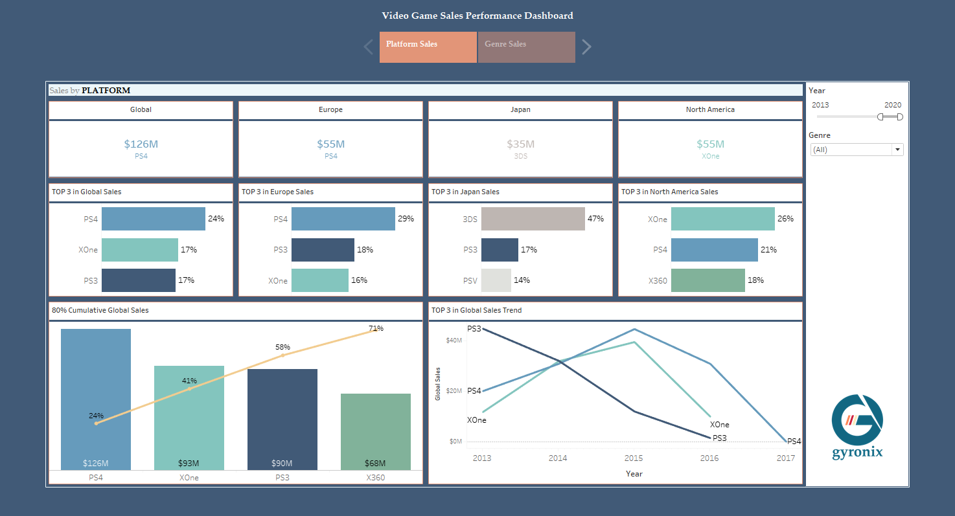
PS4 takes 24% of the Global Sales
PS4 and Xbox One was released in 2013

Slide 12
Japanese prefer portable gaming platform: Nintendo’s 3DS

Slide 13
Americans prefer Xbox One

Slide 14
2 years after released (2015), PS4 outperformed Xbox One by $6M
$45M
$39M
The peak sales in 2015 followed by a decline in 2017 suggest that a portion of the gaming market had likely acquired the platform (i.e. PS4).

Slide 15
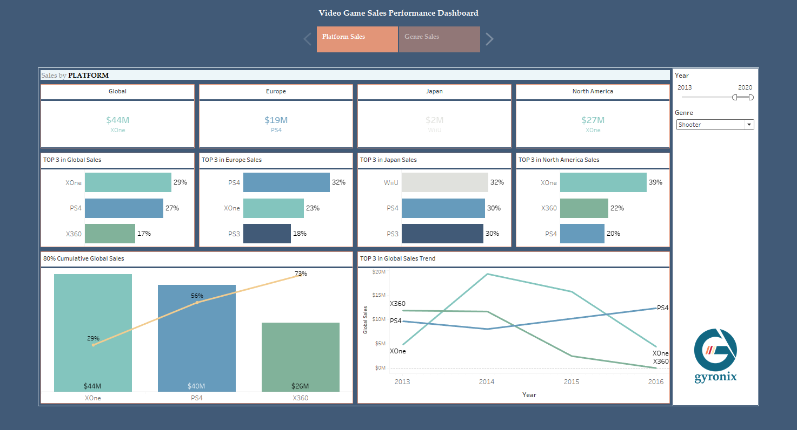
Xbox One is the preferred platform for Shooter genre

Slide 16
Genre Sales

Slide 17
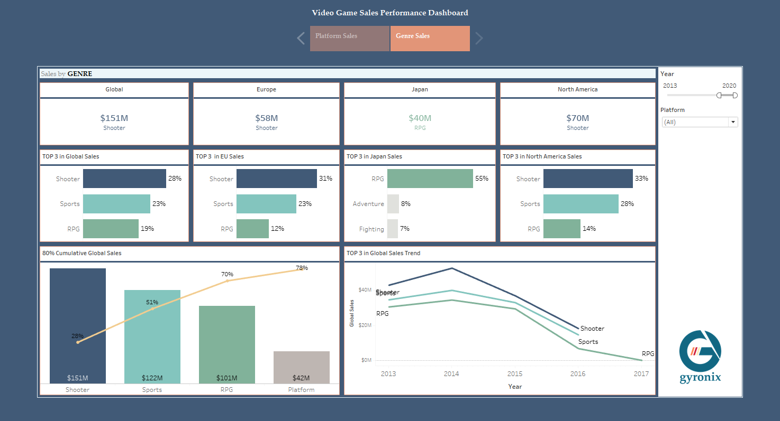
Shooter takes 28% of the Global Sales

Slide 18
Japanese prefer RPG

Slide 19
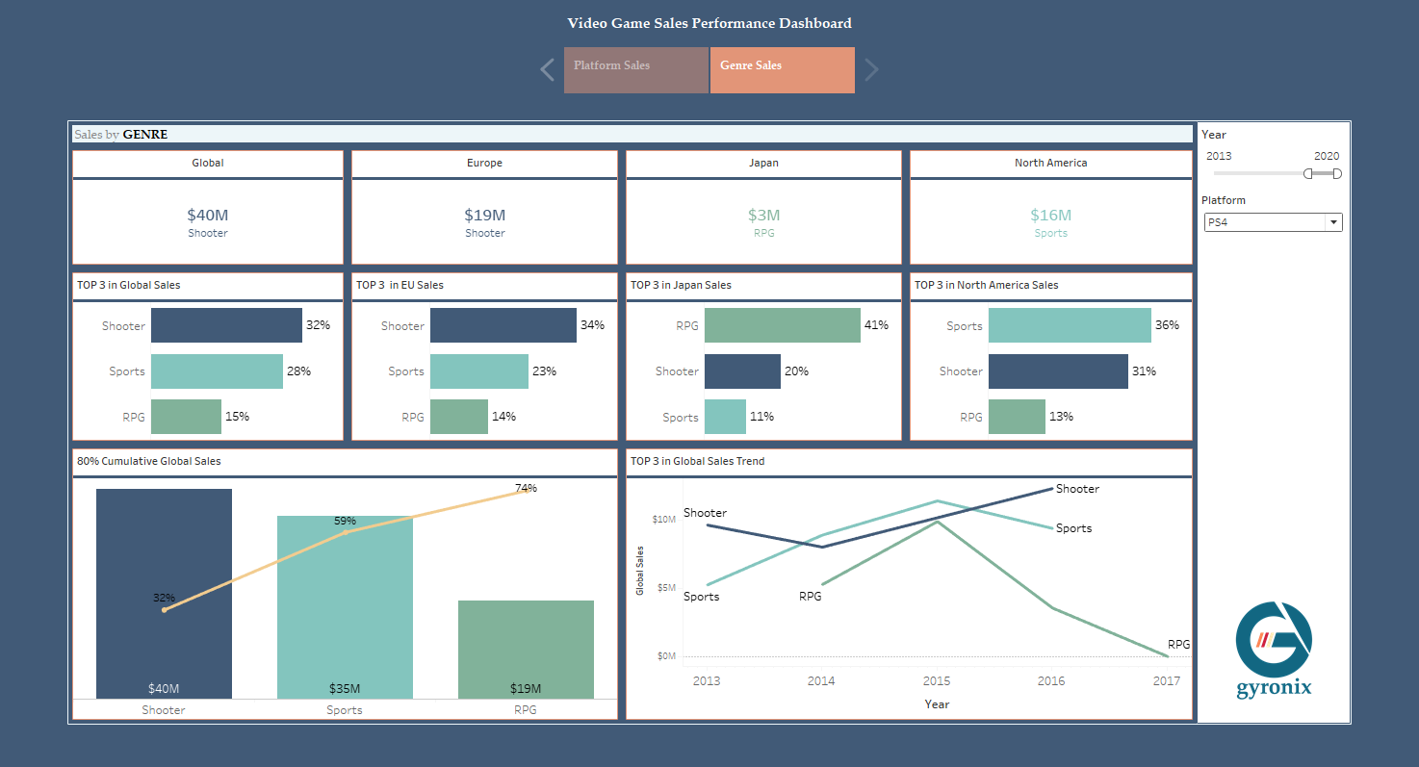
Shooter genre takes 32% of Global PS4 Sales

Slide 20
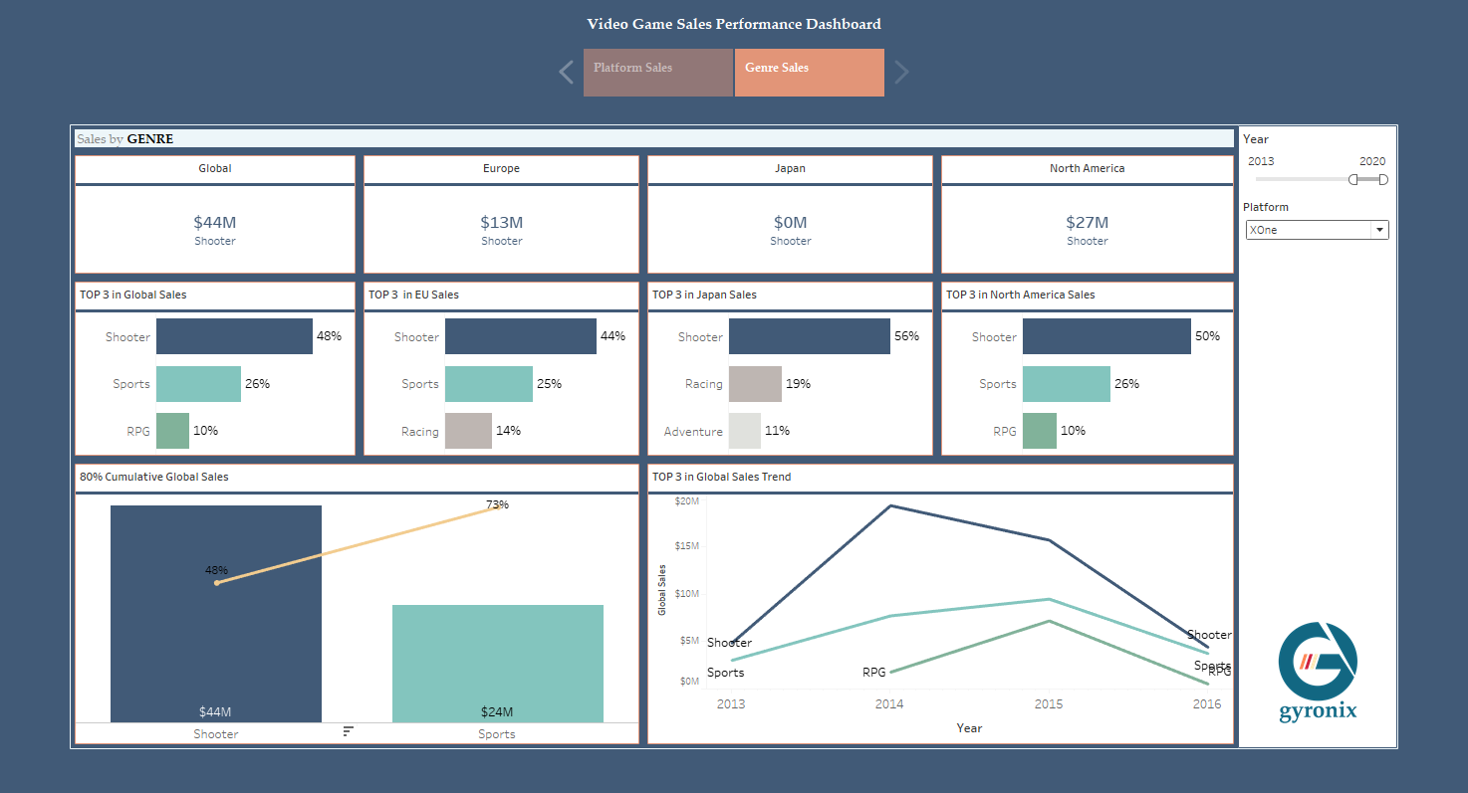
Shooter genre takes 48% of Global Xbox One Sales

Slide 21
A/B Testing

Slide 22
PS4 vs
XBOX ONE

Slide 23


HYPOTHESIS
PS4 Global Sales is higher than Xbox One
Null Hypothesis,
$H_{o}:$ PS4 Sales $=$ Xbox One Sales
Alternative Hypothesis,
$H_{a}:$ PS4 Sales > Xbox One Sales

Slide 24
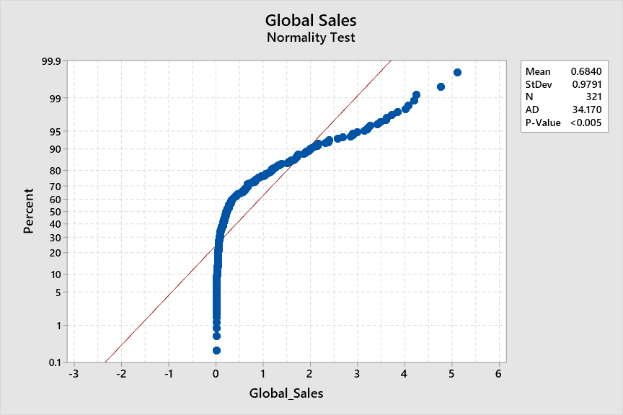
DATA IS NOT NORMAL

Slide 25
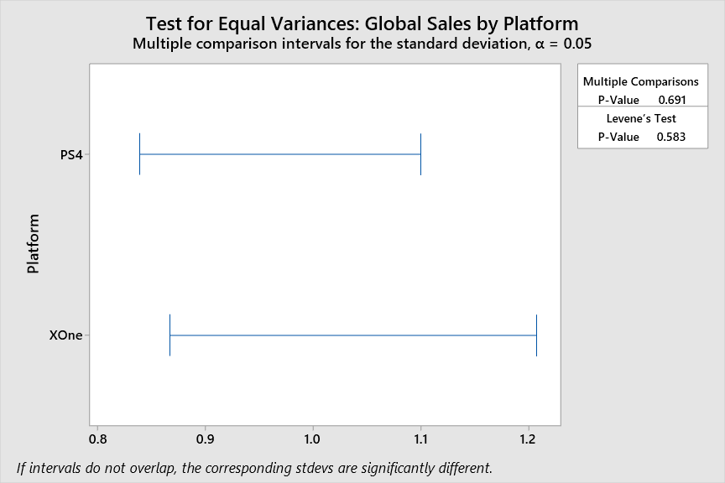
EQUAL VARIANCES

Slide 26
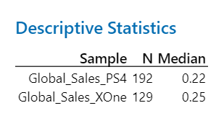
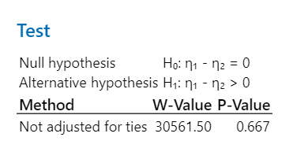
Mann-whitney test
P-Value = 0.667 suggests that there is NO SIGNIFICANT DIFFERENCE in global sales between the PS4 and Xbox One platform

Slide 27
SHOOTER vs
SPORTS

Slide 28


HYPOTHESIS
Shooter global sales is higher than Sports
Null Hypothesis,
$H_{o}:$ Shooter Sales $=$ Sports Sales
Null Hypothesis,
$H_{a}:$ Shooter Sales $>$ Sports Sales

Slide 29
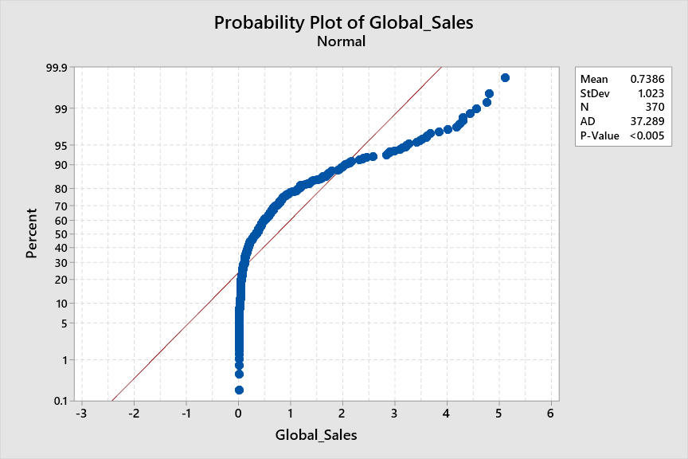
DATA IS NOT NORMAL

Slide 30
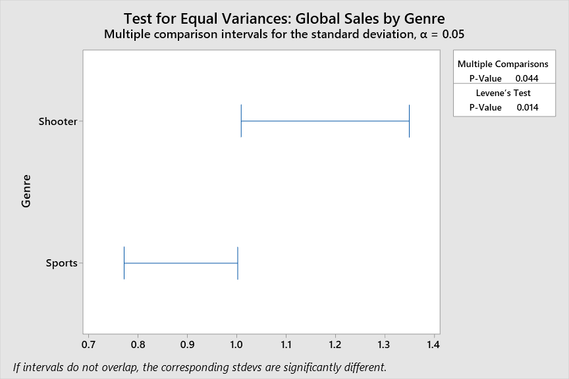
NOT EQUAL VARIANCES

Slide 31
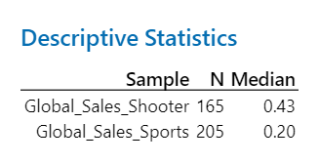
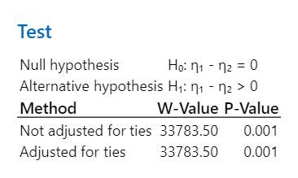
Mann-whitney test
P-Value = 0.001 suggests that there is SIGNIFICANT DIFFERENCE in global sales between the Shooter and Sports genre

Slide 32
CONCLUSION

Slide 33
Investment opportunity for shooter genre
The hypothesis test results implies that, from a platform perspective, investing in either PS4 or Xbox One may yield similar returns (p-value = 0.667). On the other hand, there appears to be a potential investment opportunity in the shooter genre, as it demonstrates significantly higher (p-value: 0.001) global sales compared to the sports genre.

