Slide 1
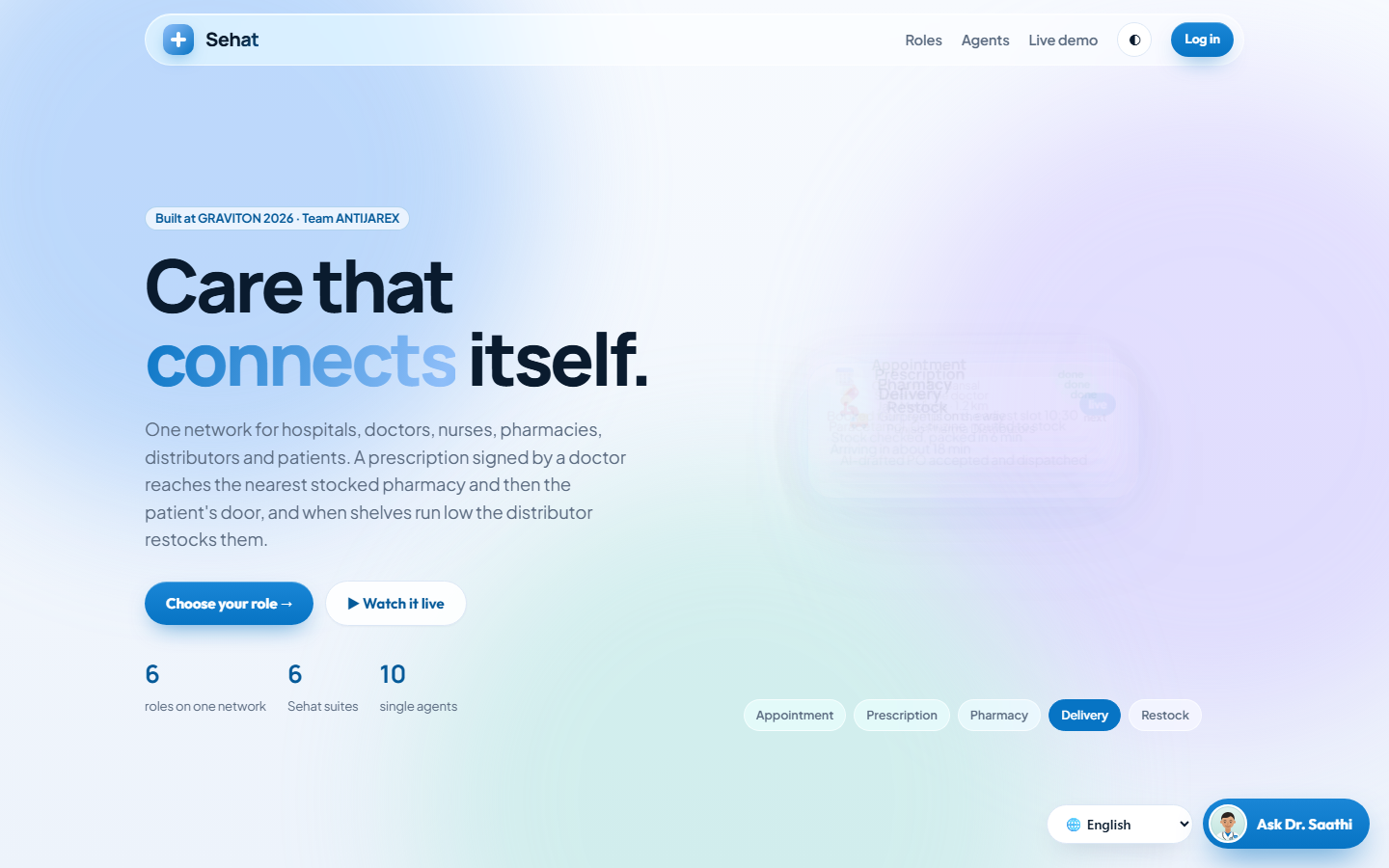
+
Sehat
Your health, connected:
from doctor to doorstep.
One app for patients and families, live-connected to hospitals, doctors, pharmacies and suppliers. In your language.
GRAVITON 2026 · Team ANTIJAREX · CGC University
🔗 Try it live: sehat-ashen.vercel.app

Slide 2
THE PROBLEM
Getting care in India is a maze for patients
1 : 1,194
2 in 3
₹1.61 L cr
One allopathic doctor for every ~1,200 people. Long queues, rushed visits.
Chronic patients in one study were not taking medicines as prescribed.
Spent by Indians on medicines in a year, mostly from their own pocket.
Allopathic-only estimate (govt 1:834 includes AYUSH)
Chennai urban health centre study (WHO IMSEAR)
National Health Accounts 2022-23
Patients run between clinic, pharmacy and lab, lose prescriptions, cannot read their reports,
and elders forget doses. Nothing is connected.
Sehat · Team ANTIJAREX · GRAVITON 2026 · sehat-ashen.vercel.app
2

Slide 3
A DAY WITHOUT VS WITH SEHAT
Meet Rahul and his mother Sunita
Without Sehat
With Sehat
✗ Waits hours to see a doctor
✗ Carries a paper prescription to 3 chemists
✗ Cannot understand his lab report
✗ Mother forgets her BP tablet
✗ No one knows if she needs help
✓ Books the right doctor in a minute
✓ Prescription goes straight to his pharmacy
✓ Report explained in Hindi or Punjabi
✓ Mother gets spoken reminders
✓ One tap SOS alerts family and hospital
Sehat · Team ANTIJAREX · GRAVITON 2026 · sehat-ashen.vercel.app
3

Slide 4
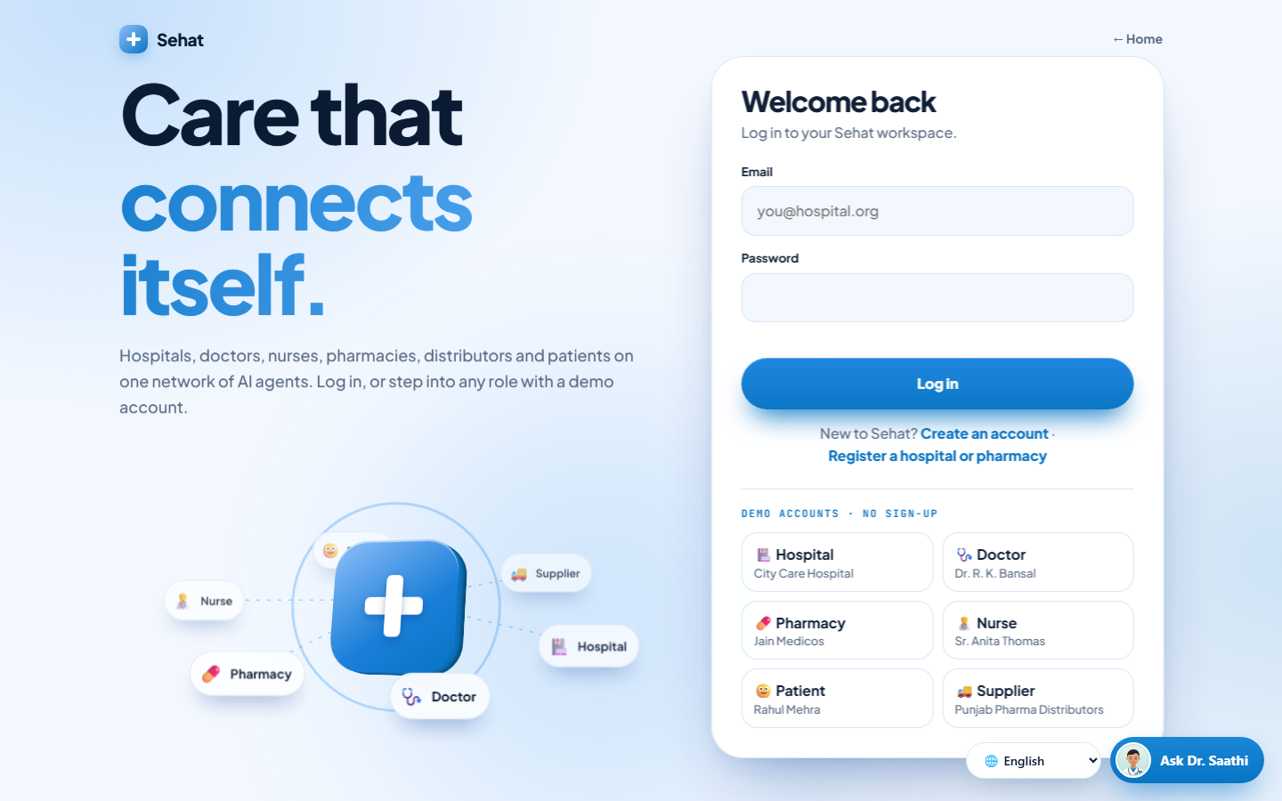
THE SOLUTION
One app for patients, connected to everyone
🙂
Patient & family
Book, track medicines, understand reports
🏥
Hospital
Sees every booking live, beds, doctors
🩺
Doctor
Queue by urgency, prescription in one tap
💊
Pharmacy
Gets prescriptions live, sends the bill
🚚
Supplier
Restocks pharmacies before they run out
Sehat · Team ANTIJAREX · GRAVITON 2026 · sehat-ashen.vercel.app
4

Slide 5
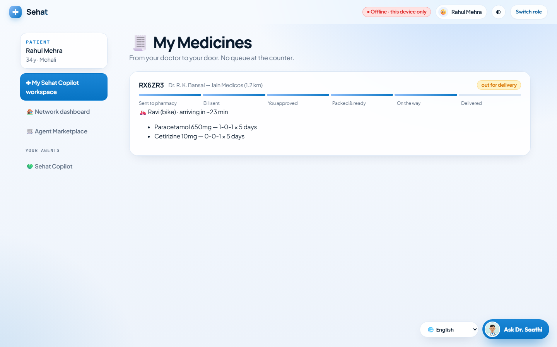
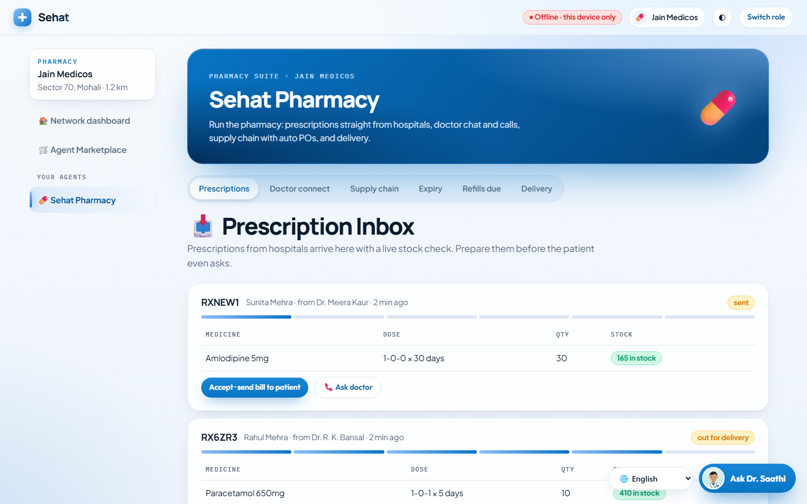
RAHUL'S JOURNEY
From symptom to doorstep, live
1
Book
2
Visit
3
Approve
4
Delivered
Types "fever": right doctor and earliest slot
Hospital checks him in, doctor signs the prescription
His pharmacy sends the bill, Rahul approves
Rider brings it home, tracked live
Sehat · Team ANTIJAREX · GRAVITON 2026 · sehat-ashen.vercel.app
5

Slide 6
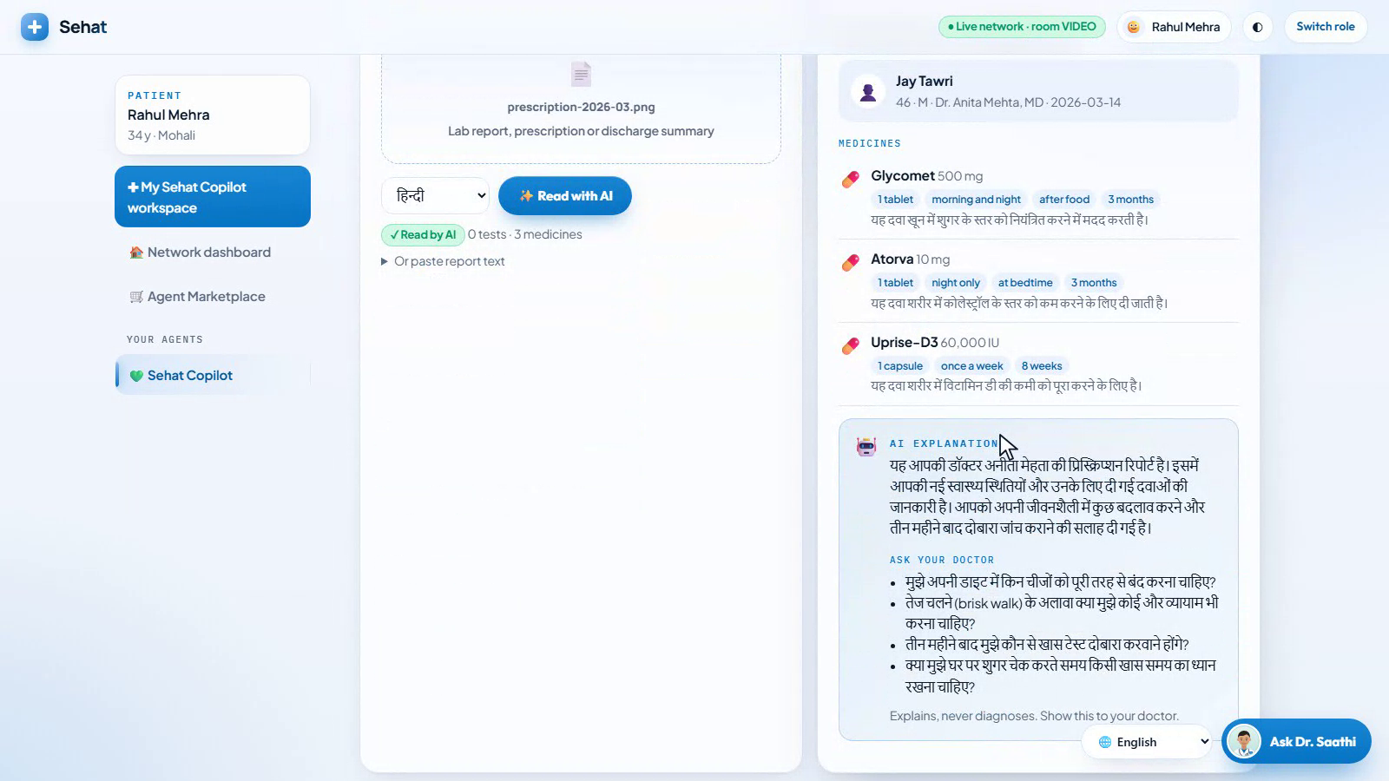
AI THAT HELPS PATIENTS
Your report, explained in your language
📄
Photo or PDF of any report
Lab reports, prescriptions, discharge summaries
🗣️
10 Indian languages
Hindi, Punjabi, Tamil, Bengali, Telugu and more
🎙️
Dr. Saathi voice assistant
Ask by speaking, answers in the same language
🛡️
Safe by design
Explains, never diagnoses; our code flags values
Sehat · Team ANTIJAREX · GRAVITON 2026 · sehat-ashen.vercel.app
6

Slide 7
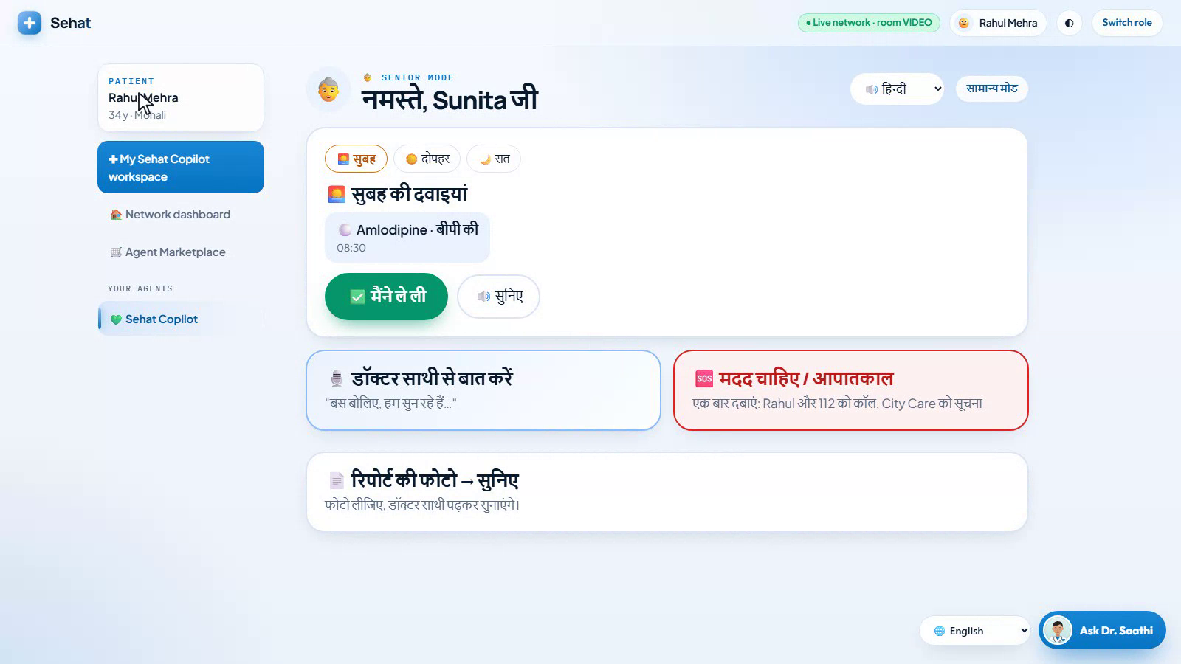
FOR ELDERS
Senior Mode: built for Dadi and Nani
🔘
Three big buttons, nothing else
Medicines now · talk to Dr. Saathi · SOS
🔊
Spoken reminders
In her language, with a lock against double doses
🔔
Family is alerted
If a dose is 45 minutes late, her son is told
🆘
One-tap SOS
Alerts the hospital with her history, calls 112
Sehat · Team ANTIJAREX · GRAVITON 2026 · sehat-ashen.vercel.app
7

Slide 8
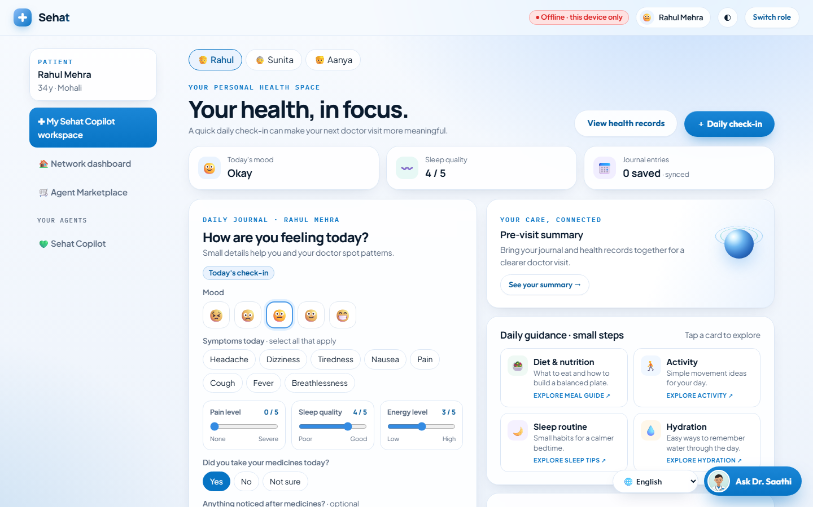
TRUST
Private by default. Shared only with consent.
📔
Daily journal
Mood, symptoms, sleep in a minute; a pre-visit summary
🔒
Patient owns it
Pharmacy and others never see the journal
✅
Doctor sees it only when shared
Stop sharing any time
👁️
Each role sees only its work
Hospital: its bookings · pharmacy: its orders
Sehat · Team ANTIJAREX · GRAVITON 2026 · sehat-ashen.vercel.app
8

Slide 9
PRICING
Free for patients. Simple monthly plans for providers.
🩺 Doctor
₹999 / month
PATIENTS & FAMILIES
₹0
🧑‍⚕️ Nurse
₹499 / month
💊 Pharmacy
₹1,499 / month
Free forever
Booking, tracking, reports explained, journal, Senior Mode
🚚 Supplier
₹2,499 / month
🏥 Hospital
₹4,999 / month
Providers pay because Sehat brings them patients and saves staff time. Proposed launch pricing.
Sehat · Team ANTIJAREX · GRAVITON 2026 · sehat-ashen.vercel.app
9

Slide 10
PROOF
Working today, not a mock-up
6 roles
140/140
10
0
Live across separate devices, synced in about a second
Fields read correctly on our printed report benchmark
Indian languages for reports and voice; 8 in Senior Mode
Server libraries to install: pure Python, deployed on Vercel
Try it now: sehat-ashen.vercel.app → Live demo → ▶ Auto-play
Benchmark is on clean printed samples; real handwritten prescriptions go through a review screen.
Sehat · Team ANTIJAREX · GRAVITON 2026 · sehat-ashen.vercel.app
10

Slide 11
OUR EDGE
Why Sehat wins
🔗
Connected, not another single app
Patient, hospital, doctor, pharmacy and supplier on one live network
🗣️
Indian languages, end to end
Reports, chat, voice and Senior Mode
🔒
Consent built in
Patients decide who sees what
🧓
Designed for elders too
The Dadi / Nani test: big buttons, voice, SOS
🧱
Honest foundation
Sehat Copilot was our earlier patient app; at GRAVITON we built the network around it
Sehat · Team ANTIJAREX · GRAVITON 2026 · sehat-ashen.vercel.app
11

