Slide 1

OrchestrAI
System Overview
Workflow · Architecture · Routing

Slide 2
END-TO-END
The Workflow, in One Slide
One request, start to finish. Any write — chosen by a human or by a planner — stops at the same gate.
You ask
browser or terminal
It plans
reads the project first
It shows you
exactly what it intends
APPROVAL GATE
you decide
It runs
only after you say yes
Read-only work never reaches the gate at all — it just finishes on its own.
The next slide shows this same run at full protocol detail.

Slide 3
FULL DETAIL
Sequence — plan-task with the LLM Harness
context/demo/current-workflow-sequence.html · one real run: "setup my project from scratch", harness enabled
Browser
Orchestrator
Planning Agent
LLM Provider
MCP Server
:3006
DevOps Agent
POST /tasks — "setup my project from scratch"
POST / — selectedSkill: plan-task + capabilities
decide (tools bound: git_status, analyze_project only)
tool_call: git_status
MCP tool call: git_status
MCP result
result fed back → decide again (repeats: analyze_project)
final plan (schema-validated)
plan text — 4 steps
dispatch step — selectedSkill authoritative
MCP tool call — write, pending approval
approval gate — rows 12–15
input-required + actionId-bound preview
SSE — CUSTOM orchestrai.approval-required
POST /tasks/:id/approve {actionId}
POST /approve {actionId} — forwarded only, never client-supplied
MCP tool call — execute write
completed
SSE — RUN_FINISHED (→ browser & TUI, same stream)

Slide 4
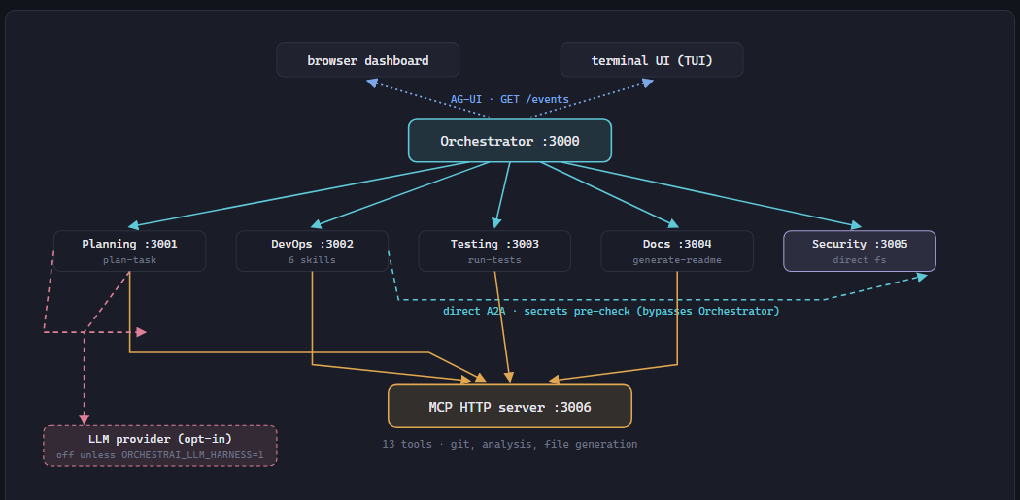
SYSTEM
Architecture Overview
context/demo/status-cheat-sheet.html · System map — what changed
Four agents are now real MCP clients, not three: Planning joined them, but only through its harness and only for two read-only tools. Security remains deliberately direct-filesystem.

Slide 5
ROUTING
The Detection Workflow
“Is it just calling an LLM for everything?” — no. Each tier only runs if the one above found nothing:
1
Keyword match
Deterministic, checked first, always. Instant, reproducible, no network call.
e.g. “dockerize” → dockerize · “run tests” → run-tests
if no match
2
Local classifier
Only runs if no keyword matched. Static embeddings (Model2Vec) — on-device, no network, no LLM.
minishlab/potion-base-8M · needs score ≥ .30 and margin ≥ .05, or falls through
below threshold
3
plan-task
Still unresolved → defaults here: the deterministic keyword planner, or — only if
ORCHESTRAI_LLM_HARNESS=1 — the opt-in LLM harness instead.
harness: 2 read-only MCP tools only, enforced at graph-build time
Whichever tier picks a write-capable skill — same approval gate, identical for all three
“Most of this system is deliberately not AI. The non-deterministic part is allowed to suggest; it is never what makes something safe.”

Slide 6
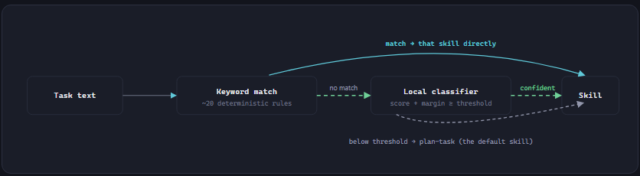
ROUTING
The Simple Version
Before any protocol wire gets chosen, the Orchestrator first decides which skill a task is even for — entirely inside its own process (detectSkill()), before any agent is ever contacted.
minishlab/potion-base-8M (Model2Vec static embeddings): tokenize → look up one vector per token → mean-pool → cosine similarity. No inference engine, no network call, not an LLM — and it never overrides a keyword match, only fills the gap when nothing matched at all.

Slide 7
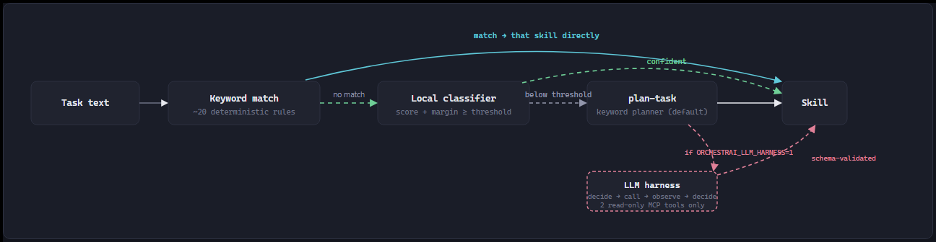
ROUTING
The Simple Version, With the LLM Harness
Same flow as the previous slide — plan-task is just drawn out fully now, including its one opt-in branch.
plan-task's default is still the deterministic keyword planner — the LLM harness only runs when ORCHESTRAI_LLM_HARNESS=1 is explicitly set.

Slide 8
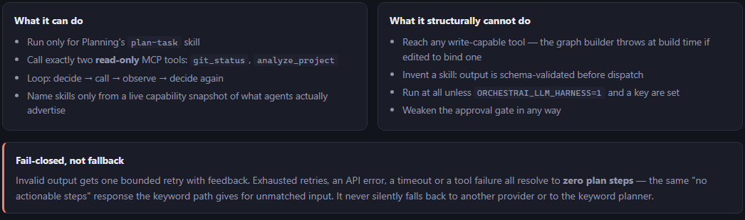
LLM HARNESS
Scoped Deliberately Narrow
The one place an LLM API call can happen in this system — off by default, and narrow even when it's on.
Same approval gate applies regardless: the harness can name a write-capable skill, but naming one and executing one are different things.

Slide 9
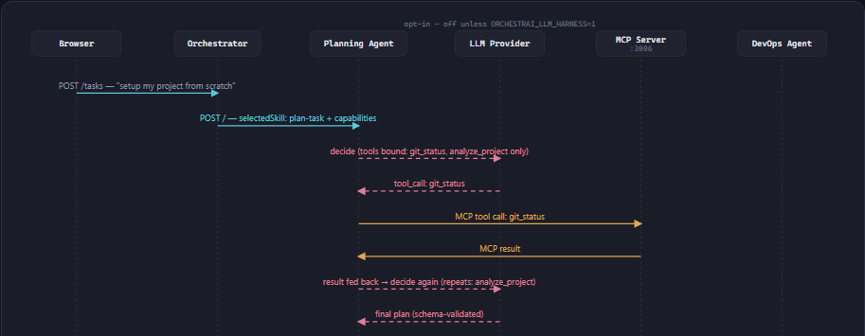
LLM HARNESS
The Loop, From a Real Run
context/demo/current-workflow-sequence.html · the same tool-calling loop, isolated from the full sequence
Only two read-only MCP tools are ever bound — git_status, analyze_project — enforced when the graph is built, not by a prompt. The loop can retry once on invalid output; anything else fails closed to zero plan steps.

