Slide 1
A comparative study regarding the effect Of weight constraint in feature extraction From malware call graph
A thesis submitted in partial fulfillment of the requirements for the degree of Bachelor of Science in Computer Science and Engineering

Slide 2
Presented By supervisor
Faddilin Mahady Riniyad
ID: 2015–2–60–055
Mohammad Sohag Rana
ID: 2015–2–60–074
Raghib Shahriyer
ID: 2015–2–60–076
Jesan Ahammed Ovi
Lecturer
Department of Computer Science and Engineering
East West University

Slide 3
Antivirus Work Flow
.EXE
REVERSE ENGINEERING
ASSEMBLY CODE
CALL GRAPH
CLASSIFIER
MALWARE
UNKNOWN
BENIGN
SANDBOX
DECISION

Slide 4
Antivirus Work Flow
Raw Dataset
Identify discriminative feature
gSpan
MaxPWS
Preprocess and prepare training / testing set
Test
Train
CLASSIFIER

Slide 5
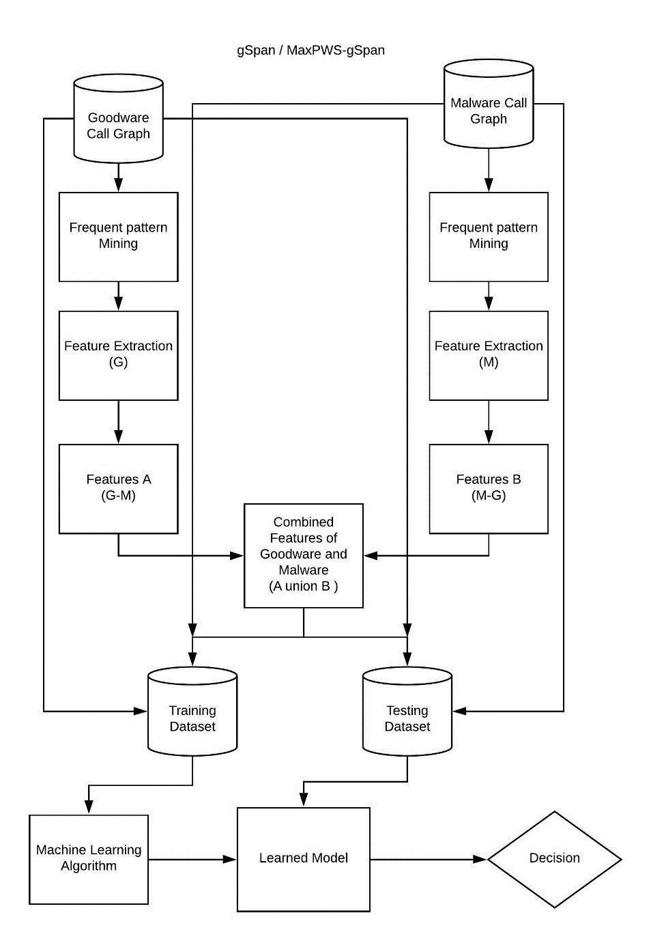
Our Proposed Framework

Slide 6
gSpan Algorithm
DFS Lexicographic Order
VS Minimum DFS Code
DFS Code
DFS Code Tree

Slide 7
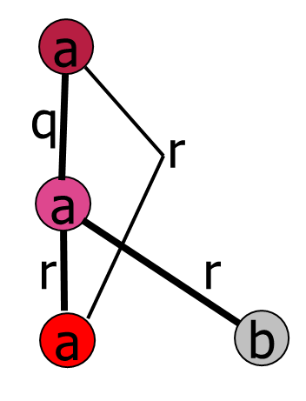
DFS Code
v₁
E₁ = (v₁ , v₂ , a , a , q)
E₂ = (v₂ , v₃ , a , a , r)
E₃ = (v₃ , v₁ , a , a , r)
E₄ = (v₂ , v₄ , a , b , r)
v₂
v₃
v₄

Slide 8
gSpan Algorithm
DFS Lexicographic Order
VS Minimum DFS Code
DFS Code
DFS Code Tree

Slide 9

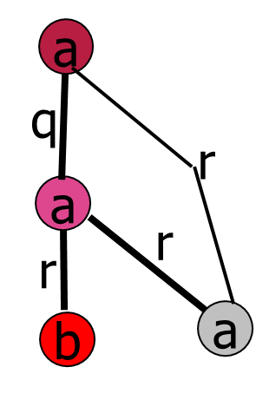
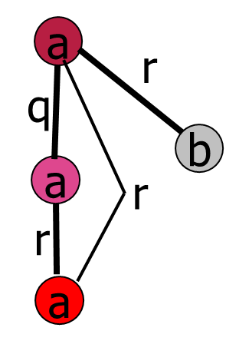
DFS Code and Isomorphic Graph
(G1)
Canonical DFS Code
(G2)
(G3)
E₁ = (v₁ , v₂ , a , a , q)
E₂ = (v₂ , v₃ , a , a , r)
E₃ = (v₃ , v₁ , a , a , r)
E₄ = (v₂ , v₄ , a , b , r)
E₁ = (v₁ , v₂ , a , a , q)
E₂ = (v₂ , v₃ , a , b , r)
E₃ = (v₂ , v₄ , a , a , r)
E₄ = (v₄ , v₁ , a , a , r)
E₁ = (v₁ , v₂ , a , a , q)
E₂ = (v₂ , v₃ , a , a , r)
E₃ = (v₃ , v₁ , a , a , r)
E₄ = (v₁ , v₄ , a , b , r)
DFS Code(G1)
DFS Code(G2)
DFS Code(G3)

Slide 10
gSpan Algorithm
DFS Lexicographic Order
VS Minimum DFS Code
DFS Code
DFS Code Tree

Slide 11
DFS Code Tree
1-edge
...
2-edge
...
...
...
...
3-edge
...
...
...

Slide 12
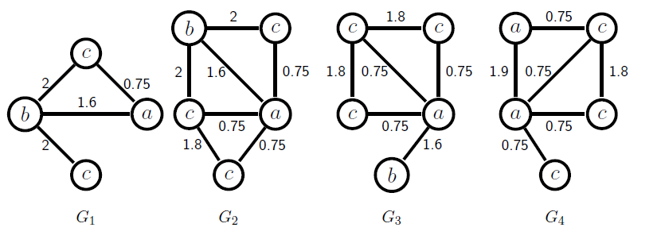
Weighted gSpan
Partial simulation of MaxPWS on sample graph database, GDB. (MaxW = 2.0, τ = 3.0)
Figure: Sample graph database, GDB

Slide 13
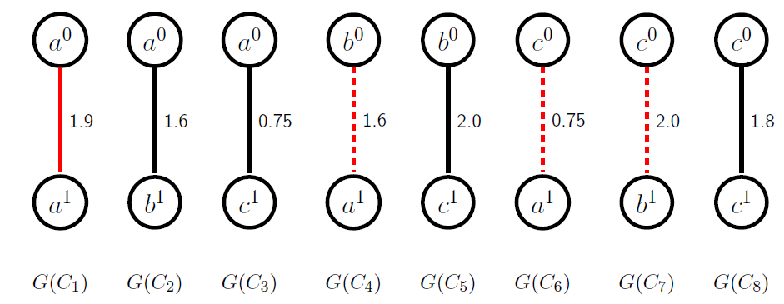
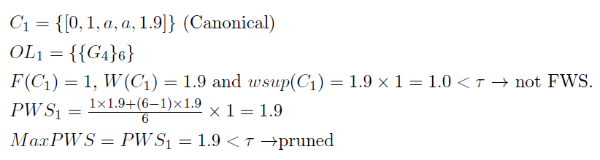
Weighted gSpan Cont.
C₀=Φ Extensions
PWS(g_{→m}) = $\frac{\left|g\right|×Wavg\left(g\right)+(m−|g|)×MaxW}{m} ×MPF(g→m)$

Slide 14
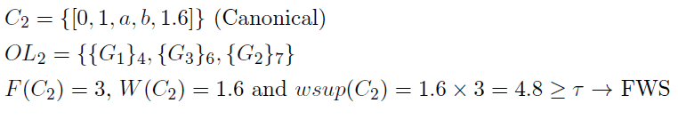
Weighted gSpan Cont.
C₀ Extensions

Slide 15
Weighted gSpan Cont.
C₀ Extensions
C₄ Not Canonical
Canonical code of it is C₂

Slide 16
Weighted gSpan Cont.
C₀ Extensions
ExtensionStack = {C₂, C₃, C₅, C₈}

Slide 17
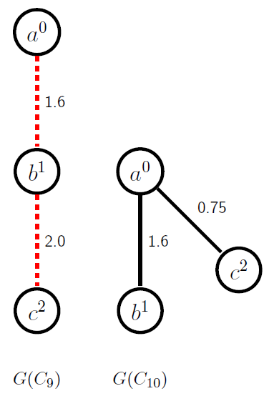
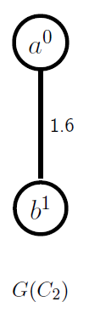
Weighted gSpan Cont.
C₂ Extensions
ExtensionStack = {C₁₀, C₃, C₅, C₈}

Slide 18
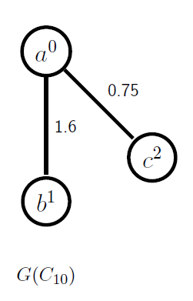
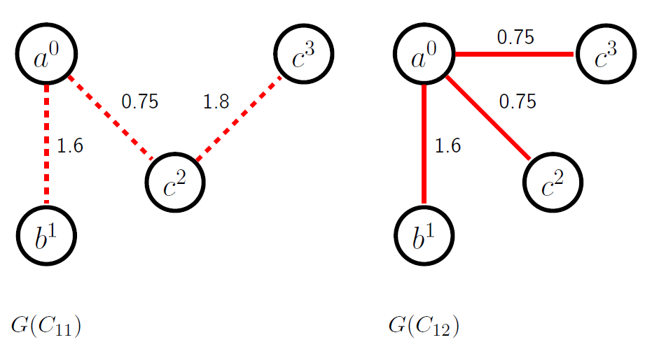
Weighted gSpan Cont.
C₁₀ Extensions
Not Canonical
ExtensionStack = {C₃, C₅, C₈}

Slide 19
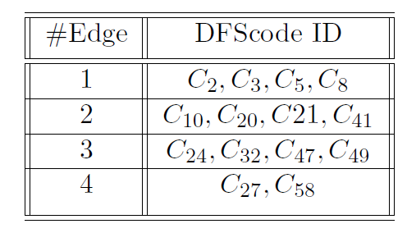
Weighted gSpan Cont.
After completing the simulation we will get 14 weighted frequent subgraphs.

Slide 20
Data Description
Source: Quarkslab , a company which provides vulnerability research and reverse engineering.
Link
Goodware:
Malware:
Number of graphs : 546
Mean number of nodes : 648.1
Mean degree : 3.3
Maximum degree : 10
Number of isolated nodes : 130812
Mean of isolated nodes : 239.6
Number of self-loops : 0
Number of graphs : 815
Mean number of nodes : 871.5
Mean degree : 3.6
Maximum degree : 34
Number of isolated nodes : 231990
Mean of isolated nodes : 284.7
Number of self-loops : 0

Slide 21
Data Description Cont.
L_leacallmovsub
Example Data :
el
el
16
25
t # 0
v 0 L_leacallmovsub
v 1 L_xorcallmovcmp
v 2 L_addcallmov
V 3 L_pushleaxormovcall
.
.
e 0 1 el 16
e 1 2 el 29
e 2 3 el 18
.
.
.
L_xorcallmovcmp
L_callmovcmp
45
29
el
el
el
37
L_addcallmov
L_xorcallmovcmp
18
el
el
56
L_pushleaxormovcall
L_addcmpxorjmpmov

Slide 22
Recap of Our Framework
STEP FIVE
STEP FIVE
A learned model has been formed to take a decision.
STEP FOUR
Using Classifier to classify from a feature table to two different classes. Goodware and Malware.
STEP FOUR
STEP THREE
STEP THREE
Constructing training dataset and testing dataset
K-fold Cross validation
STEP TWO
Find the discriminative features by removing the common features. {G-M}U{M-G}
STEP TWO
STEP ONE
STEP ONE
Finding features by frequent pattern mining

Slide 23
Implementation Details
CPU-Core : Intel Core i5-4210U
Ram: 8GB Bus 1600MHz
Language: Python3
IDE: Visual Studio Code v.1.3.0

Slide 24
Experimental Results (Step:1)
L_
el
Individual Features (gSpan Goodware) :
(0, 1, 'L_', 'L_pushxorcallmov', 'el')
(1, 2, 'L_pushxorcallmov', 'L_callmov', 'el')
(2, 3, 'L_callmov', 'L_xorsubjmpmovaddcallpushcmp', 'el')
(3, 4, 'L_xorsubjmpmovaddcallpushcmp', 'L_xorsubjmpmovaddcallpushcmp', 'el')
(2, 5, 'L_callmov', 'L_xorsubjmpmovaddcallpushcmp', 'el')
.
.
4500 patterns
L_pushxorcallmov
L_xorsubjmpmovaddcallpushcmp
el
L_callmov
el
'L_xorsubjmpmovaddcallpushcmp
L_xorsubjmpmovaddcallpushcmp

Slide 25
Experimental Results (Step:1) Cont..
L_leaaddcallmov
16.0
el
L_pushleaxormovcall
Individual Features (MaxPWS Goodware) :
(0, 1, 'L_leaaddcallmov', 'L_pushleaxormovcall', 'el', 16.0)
(1, 2, 'L_pushleaxormovcall', 'L_leacallmovsub', 'el', 15.0)
(2, 3, 'L_leacallmovsub', 'L_leaxorsubjmpmovaddcallpushcmp', 'el', 17.0)
(1, 4, 'L_pushleaxormovcall', 'L_xorsubjmpmovaddcallpushcmp', 'el', 23.0)
(1, 5, 'L_pushleaxormovcall', 'L_xorsubjmpmovaddcallpushcmp', 'el', 26.6)
(1, 6, 'L_pushleaxormovcall', 'L_xorsubjmpmovaddcallpushcmp', 'el', 29.0)
…
109500 patterns
23.0
el
el
L_xorsubjmpmovaddcallpushcmp
15.0
el
L_leacallmovsub
17.0
el
el
26.6
el
L_leaxorsubjmpmovaddcallpushcmp
29.0
L_leaxorsubjmpmovaddcallpushcmp
L_xorsubjmpmovaddcallpushcmp

Slide 26
Experimental Results (Step:2)
Combine features:
Discriminative Features (Goodware)
(G-M)
A
Discriminative Features (Malware)
(M – G)
B
Combined Features of Goodware and Malware.
(A union B)

Slide 27
Experimental Results (Step:3)
Splitting Train and Test Set :
From dataset we use 70% threshold for unweighted and get
913 x 4003 dimension of features.
From weighted dataset we use 857 threshold for 200 graph and get
913 x 4610 dimension of features.
We used K-fold cross validation to separate training and testing data
Where k= 5.

Slide 28
Result Analysis (Step:4)
Unweighted Result :
Random Forest:
Precision: 80.17%
Recall: 58.89%
Gaussian naive Bayes:
Precision: 92.23%
Recall: 37.44%
SVM:
Precision: 80.17%
Recall: 58.89%

Slide 29
Result Analysis (Step:4)
Weighted Result :
Random Forest:
Precision: 83.84%
Recall: 90.77%
Gaussian naive Bayes:
Precision: 92.23%
Recall: 37.44%
SVM:
Precision: 80.17%
Recall: 58.89%

Slide 30
Threshold vs Time

Slide 31
Our Research Outcome and Future Work
In our comparative study we found weight constraint has less effect and it’s time complexity is high.
• A Multithreaded system could be introduced in the algorithms for faster
extraction of feature using more of the idle CPU.
• The study could be done in a distributed system like HADOOP or any other
distributed model for better and faster result.
• We could utilize the weighted support calculated from MaxPWS rather than just considering it’s presence
or absence.

Slide 32
THANK YOU

Slide 33
Any Question ?

Slide 34
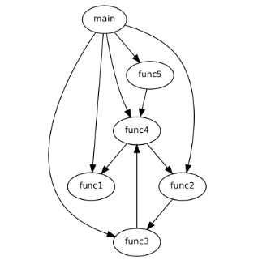
Call Graph
A call graph is an abstract object produced by program analysis tools to represent the relationships between subroutines in a computer program. Where,
Node => Functions
Edge => A call from a function to another

Slide 35
Binjuice
Metamorphic malware
BinJuice is a tool for extracting the semantic juice of a binary. It symbolically interprets individual blocks of a binary to extract their semantics

Slide 36
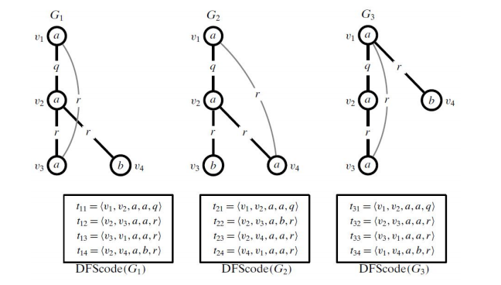
gSpan Algorithm
Produces a Depth-first Search (DFS) code for each edge in graphs.
Edges are sorted according to lexicographic order of codes.
Yan and Han (Authors of gSpan) proved that graph isomorphism can be tested for two graphs annotated with DFS codes.
Starting with small graph patterns containing 1-edge, patterns are expanded systemically by the DFS search.
Employ anti-monotonic property of graph frequency

Slide 37
Canonical DFS Code Condition
Condition (1) If eij and exy are both forward edges, then (a) j < y, or (b) j = y and i > x. That is, (a) a forward extension to a node earlier in the DFS node order is smaller, or (b) if both the forward edges point to a node with the same DFS node order, then the forward extension from a node deeper in the tree is smaller.
Condition (2) If eij and exy are both backward edges, then (a) i < x, or (b) i = x and j < y. That is, (a) a backward edge from a node earlier in the DFS node order is smaller, or (b) if both the backward edges originate from a
node with the same DFS node order, then the backward edge to a node earlier in DFS node order (i.e., closer to the root along the rightmost path) is smaller.
Condition (3) If eij is a forward and exy is a backward edge, then j ≤ x. That is, a forward edge to a node earlier in the DFS node order is smaller than a backward edge from that node or any node that comes after it in DFS
node order.
Condition (4) If eij is a backward and exy is a forward edge, then i < y. That is, a backward edge from a node earlier in DFS node order is smaller than a forward edge to any later node.

Slide 38
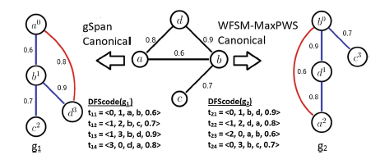
WFSM-MaxPWS Algorithm
Produces a Depth-first Search (DFS) code for each edge in graphs.
To give a rank of a DFScode of subgraph, the WFSM-MaxPWS canonical order gives the highest priority to (dis u, dis v) as in gSpan.
The second highest priority is given to edge weight W(u, v) and then comes the lexicographic comparison.
Starting with small graph patterns containing 1-edge, patterns are expanded systemically by the DFS search.
MaxPWS-measure is anti-monotonic.

