Slide 1

Challenging the Effectiveness of SecSVM and Drebin: An Analysis of Attack Strategies
Shlomi Lantser Or Kazu-Cohen

Slide 2

Introduction
Explanation about Our classifier: About our Features set – API permissions, API Calls, URLs Our Data set – Weak spots on our classifier How we intended to attack those Weak spots

Slide 3

Now we are going to present several attacks which we try to exploit:
Feature Removal
Evasion attack

Slide 4
Features Removal
The Feature Removal method is a strategy that involves removing certain features from the input data in an attempt to evade the classifier's
detection. The idea behind this method is that by removing important features, the classifier may not be able to accurately classify the input data.
The steps we used in this attack:
Identify the important features of the classifier (According to the article)
Remove the important features from the input data.
Evaluate the performance of the classifier on the modified data.
Repeat steps 2 and 3 until the classifier's performance significantly decreases.

Slide 5
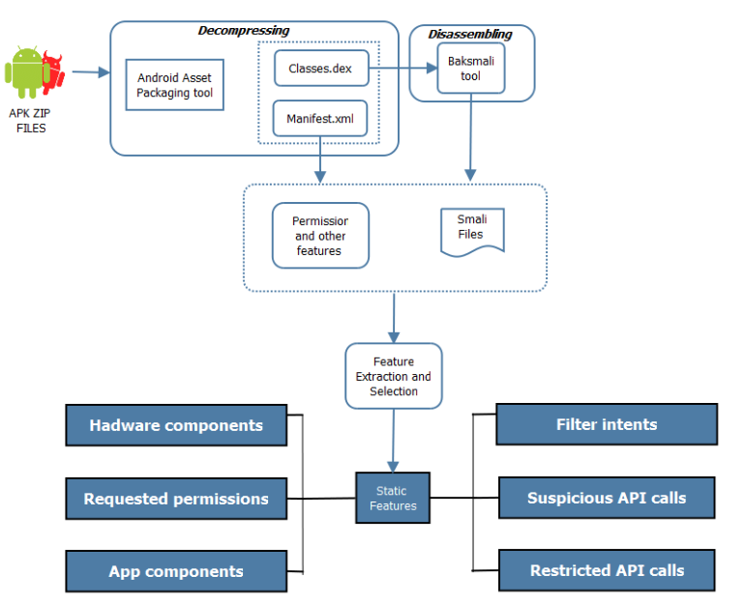
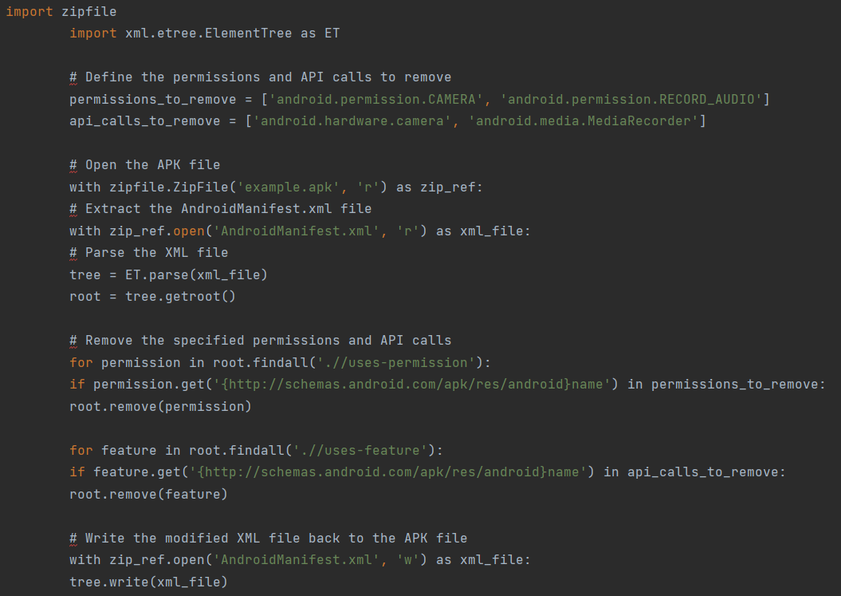






Features Removal scheme
Decompressing the APK ZIP Files using the features extractor
With script we wrote , we removing specific features from the Manifest.xml file.
Compile the application again using APKTool
Insert the app to the classifier as malicious.

Slide 6

What is it? Evasion attack using feature manipulation: This type of attack aims to manipulate the feature set of the input data in a way that would cause the classifier to misclassify it as malware. By adding specific features, the attacker hopes to make the classifier unable to recognize the malware, thus evading detection. The steps we used in this attack: 1. Identify the important features of the classifier (According to the article) 2. Remove the important features from the input data. 3. Evaluate the performance of the classifier on the modified data. 4. Repeat steps 2 and 3 until the classifier's performance significantly decreases.
Evasion attack

Slide 7

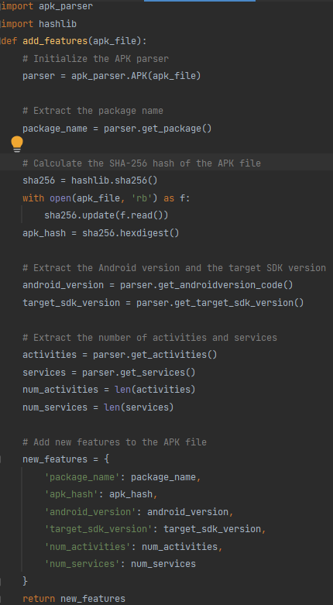
How we exploit this attack
- The steps we used in this attack:
Obtain a set of APK files, both benign and malicious.
Use the feature-etractor to extract the features from the APK files.
Use a script to add new features to the APK files, specifically crafted to evade the SECSVM classifier.
Use the modified APK files to test the SECSVM classifier and observe the results.
Analyze the results to understand how the added features affected the classifier's performance.
Repeat steps 3-5 with different sets of added features until the classifier is successfully evaded.
Use the successful set of added features in a real-world scenario to evade the SECSVM classifier in practice.

Slide 8

Results
After the two methos we tried, our classifier still classified correctly the apps (benign as benign and malicious as malicious) Interesting point we notice during those processes, in the second attack (Evasion Attack) and in specific train set and test set, a minor number of application was classified incorrectly, but the results was Inconclusive.

