Slide 1
Pipelining
Week 6
CSIS 2810

Slide 2
Object Lessons
Breakfast Buffet/Cereal Sundae
  Moral
Hula Hoops
  Moral
Beads
  Moral

Slide 3
Parallelism
What is paralellism?
  Compared to serialism(NOT cerealism!)?
Why is it desirable?
What problems can it cause?

Slide 4
Principles of Pipelining
Parallelism in your processor
Add registers between stages of instruction execution
Execute multiple instructions at the same time
Slightly longer time per instruction
Higher throughput

Slide 5
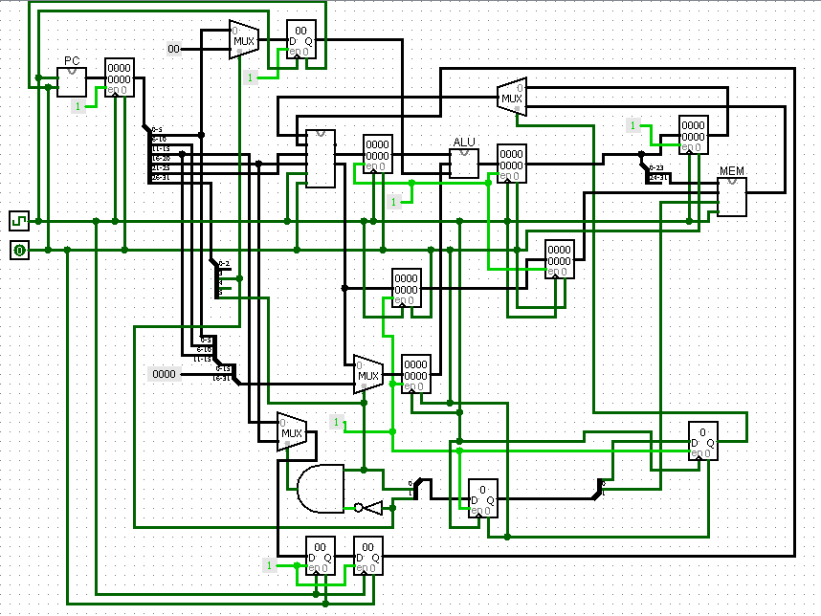
Pipeline Picture (book 349?)

Slide 6
What is a dependency?
Two instructions that are close together that use the same register
Is this a problem? MAYBE!!!
  No…. If
    RAR(read after read)
    WAR(write after read)
    WAW(write after write)
  YES…. If
    RAW (read after write)

Slide 7
Which instructions read/write?
Instruction | Read/Write of Registers
arithmetic $rd, $rs, $rt | $w, $r, $r
lw $rt, num($rs) | $w, num ($r)
sw $rt, num($rs) | $r, num ($r)
jr $r | $r

Slide 8
What is a data hazard?
Must wait for an earlier instruction to generate needed value
  Occurs with a RAW (read after write) dependency
  Example:
  add $s0, $s0, $t1
  sub $t2, $s0, $t3
can sometimes avoid with forwarding
  Steal answer immediately after “execute” stage
can sometimes avoid by re-ordering instructions
  Typically done by compiler
can also wait/stall/nop
  May be inevitable

Slide 9
Data Hazard:
Rule and Example
Read after Write(RAW) —potential hazards
  With forwarding only a hazard if next instruction uses
  Without forwarding, a hazard if next 3 instructions use
lw $5, -16($5)
sw $5, -16($5)
add $5, $5, $5
Where are dependencies? Where to add nops?
What about forwarding? Does it help?

Slide 10
Hazards Generalized
Adverse event created by pipelining
Three Kinds
  Data hazards
  Control Hazards
    Can simply stall
    Can try to predict which branch will be taken
  Structural hazards(2 stages need hardware)
    MIPS does not have by design
    e.g. if MIPS had one memory instead of 2

