Slide 1

14-513
18-613

Slide 2

Exceptional Control Flow: Exceptions and Processes 15-213/18-213/14-513/15-513/18-613: Introduction to Computer Systems 19th Lecture, November 3, 2020

Slide 3
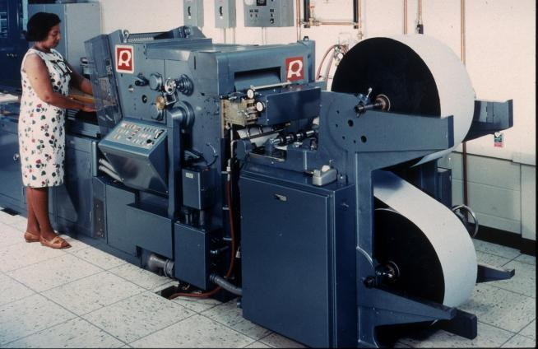
Printers Used to Catch on Fire

Slide 4
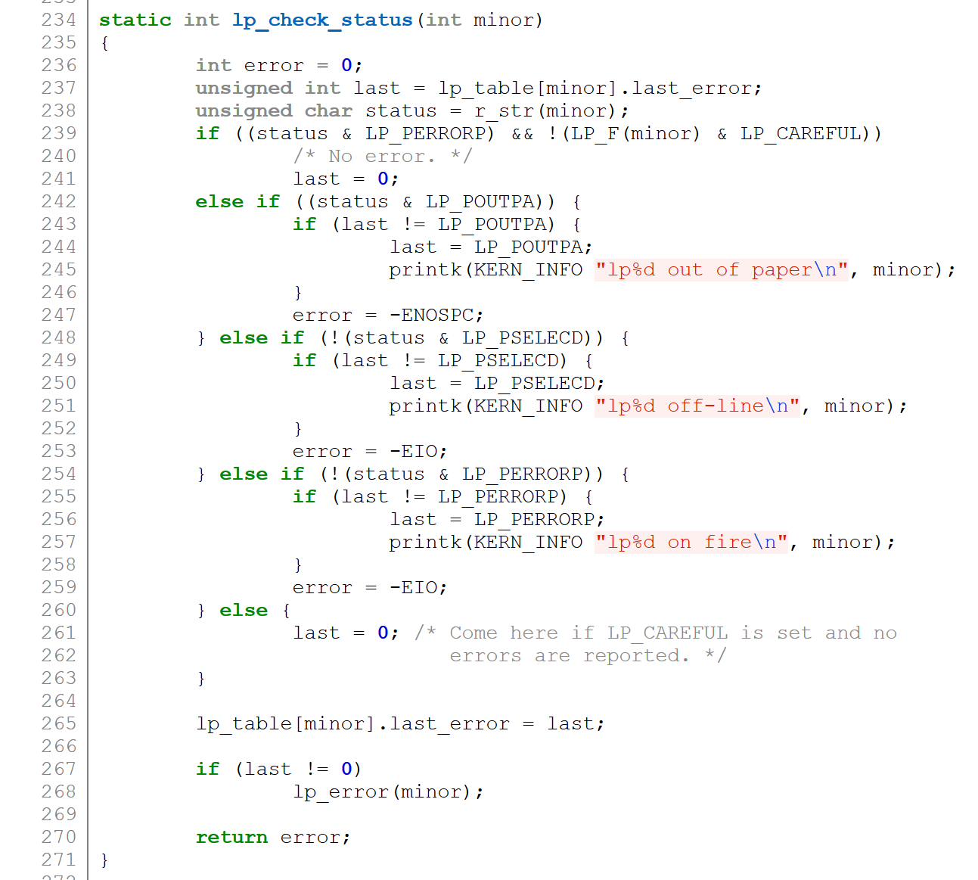
Highly Exceptional Control Flow
https://git.kernel.org/pub/scm/linux/kernel/git/torvalds/linux.git/tree/drivers/char/lp.c?h=v5.0-rc3

Slide 5
Today
Exceptional Control Flow CSAPP 8
Exceptions CSAPP 8.1
Processes CSAPP 8.2
Process Control CSAPP 8.3-8.4

Slide 6
Control Flow
Processors do only one thing:
From startup to shutdown, each CPU core simply reads and executes (interprets) a sequence of instructions, one at a time *
This sequence is the CPU’s control flow (or flow of control)
Physical control flow
<startup>
inst₁
inst₂
inst₃
…
inst_{n}
<shutdown>
Time
* Externally, from an architectural
viewpoint (internally, the CPU may use parallel out-of-order execution)

Slide 7
Altering the Control Flow
Up to now: two mechanisms for changing control flow:
Jumps and branches
Call and return
React to changes in program state
Insufficient for a useful system: Difficult to react to changes in system state
Data arrives from a disk or a network adapter
Instruction divides by zero
User hits Ctrl-C at the keyboard
System timer expires
System needs mechanisms for “exceptional control flow”

Slide 8
Exceptional Control Flow
Exists at all levels of a computer system
Low level mechanisms
1. Exceptions
Change in control flow in response to a system event (i.e., change in system state)
Implemented using combination of hardware and OS software
Higher level mechanisms
2. Process context switch
Implemented by OS software and hardware timer
3. Signals
Implemented by OS software
4. Nonlocal jumps: setjmp() and longjmp()
Implemented by C runtime library

Slide 9
Today
Exceptional Control Flow
Exceptions
Processes
Process Control

Slide 10
Exceptions
An exception is a transfer of control to the OS kernel in response to some event (i.e., change in processor state)
Kernel is the memory-resident part of the OS
Examples of events: Divide by 0, arithmetic overflow, page fault, I/O request completes, typing Ctrl-C
User code
Kernel code
Event
I_current
Exception
I_next
Exception processing
by exception handler
Return to I_current
Return to I_next
Abort
Notes:
Three options after exception handler completes

Slide 11
Exception Tables
Exception
numbers
Code for
exception handler 0
Each type of event has a unique exception number k
k = index into exception table (a.k.a. interrupt vector)
Handler k is called each time exception k occurs
Exception
Table
Code for
exception handler 1
0
1
Code for
exception handler 2
2
...
n-1
...
Code for
exception handler n-1

Slide 12
(partial) Taxonomy
ECF
Asynchronous
Synchronous
Interrupts
Traps
Faults
Aborts

Slide 13
Asynchronous Exceptions (Interrupts)
Caused by events external to the processor
Indicated by setting the processor’s interrupt pin
Handler returns to “next” instruction
Examples:
Timer interrupt
Every few ms, an external timer chip triggers an interrupt
Used by the kernel to take back control from user programs
I/O interrupt from external device
Hitting Ctrl-C at the keyboard
Arrival of a packet from a network
Arrival of data from a disk

Slide 14
Synchronous Exceptions
Caused by events that occur as a result of executing an instruction:
Traps
Intentional, set program up to “trip the trap” and do something
Examples: system calls, gdb breakpoints
Returns control to “next” instruction
Faults
Unintentional but possibly recoverable
Examples: page faults (recoverable), protection faults (unrecoverable), floating point exceptions
Either re-executes faulting (“current”) instruction or aborts
Aborts
Unintentional and unrecoverable
Examples: illegal instruction, parity error, machine check
Aborts current program

Slide 15
System Calls
Each x86-64 system call has a unique ID number
Examples:
Number | Name | Description
0 | read | Read file
1 | write | Write file
2 | open | Open file
3 | close | Close file
4 | stat | Get info about file
57 | fork | Create process
59 | execve | Execute a program
60 | _exit | Terminate process
62 | kill | Send signal to process

Slide 16
System Call Example: Opening File
User calls: open(filename, options)
Calls __open function, which invokes system call instruction syscall
00000000000e5d70 <__open>:
...
e5d79: b8 02 00 00 00 mov $0x2,%eax # open is syscall #2
e5d7e: 0f 05 syscall # Return value in %rax
e5d80: 48 3d 01 f0 ff ff cmp $0xfffffffffffff001,%rax
...
e5dfa: c3 retq
User code
Kernel code
%rax contains syscall number
Other arguments in %rdi, %rsi, %rdx, %r10, %r8, %r9
Return value in %rax
Negative value is an error corresponding to negative errno
syscall
Exception
cmp
Open file
Returns

Slide 17
System Call Example: Opening File
Almost like a function call
Transfer of control
On return, executes next instruction
Passes arguments using calling convention
Gets result in %rax
One Important exception!
Executed by Kernel
Different set of privileges
And other differences:
E.g., “address” of “function” is in %rax
Uses errno
Etc.
User calls: open(filename, options)
Calls __open function, which invokes system call instruction syscall
00000000000e5d70 <__open>:
...
e5d79: b8 02 00 00 00 mov $0x2,%eax # open is syscall #2
e5d7e: 0f 05 syscall # Return value in %rax
e5d80: 48 3d 01 f0 ff ff cmp $0xfffffffffffff001,%rax
...
e5dfa: c3 retq
User code
Kernel code
%rax contains syscall number
Other arguments in %rdi, %rsi, %rdx, %r10, %r8, %r9
Return value in %rax
Negative value is an error corresponding to negative errno
syscall
Exception
cmp
Open file
Returns

Slide 18
Fault Example: Page Fault
int a[1000];
main ()
{
a[500] = 13;
}
User writes to memory location
That portion (page) of user’s memory is currently on disk
80483b7: c7 05 10 9d 04 08 0d movl $0xd,0x8049d10
User code
Kernel code
Exception: page fault
movl
Copy page from disk to memory
Return and reexecute movl

Slide 19
Fault Example: Invalid Memory Reference
int a[1000];
main ()
{
a[5000] = 13;
}
80483b7: c7 05 60 e3 04 08 0d movl $0xd,0x804e360
User code
Kernel code
Exception: page fault
movl
Detect invalid address
Signal process
Sends SIGSEGV signal to user process
User process exits with “segmentation fault”

Slide 20
Today
Exceptional Control Flow
Exceptions
Processes
Process Control

Slide 21
Processes
Definition: A process is an instance of a running program.
One of the most profound ideas in computer science
Not the same as “program” or “processor”
Process provides each program with two key abstractions:
Logical control flow
Each program seems to have exclusive use of the CPU
Provided by kernel mechanism called context switching
Private address space
Each program seems to have exclusive use of main memory.
Provided by kernel mechanism called virtual memory
Memory
Stack
Heap
Data
Code
CPU
Registers

Slide 22
Multiprocessing: The Illusion
Memory
Memory
Memory
Stack
Stack
Stack
Heap
Heap
…
Heap
Data
Data
Data
Code
Code
Code
CPU
CPU
CPU
Registers
Registers
Registers
Computer runs many processes simultaneously
Applications for one or more users
Web browsers, email clients, editors, …
Background tasks
Monitoring network & I/O devices

Slide 23
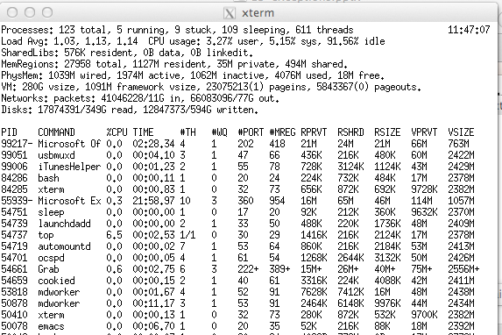
Multiprocessing Example
Running program “top” on Mac
System has 123 processes, 5 of which are active
Identified by Process ID (PID)

Slide 24
Multiprocessing: The (Traditional) Reality
Memory
Stack
Stack
Stack
Heap
Heap
…
Heap
Data
Data
Data
Code
Code
Code
Saved registers
Saved registers
CPU
Registers
Single processor executes multiple processes concurrently
Process executions interleaved (multitasking)
Address spaces managed by virtual memory system (like last week)
Register values for nonexecuting processes saved in memory

Slide 25
Multiprocessing: The (Traditional) Reality
Memory
Stack
Stack
Stack
Heap
Heap
…
Heap
Data
Data
Data
Code
Code
Code
Saved registers
Saved registers
Saved registers
CPU
Registers
Save current registers in memory

Slide 26
Multiprocessing: The (Traditional) Reality
Memory
Stack
Stack
Stack
Heap
Heap
…
Heap
Data
Data
Data
Code
Code
Code
Saved registers
Saved registers
CPU
Registers
Schedule next process for execution

Slide 27
Multiprocessing: The (Traditional) Reality
Memory
Stack
Stack
Stack
Heap
Heap
…
Heap
Data
Data
Data
Code
Code
Code
Saved registers
Saved registers
Saved registers
CPU
Registers
Load saved registers and switch address space (context switch)
Notes:
Ask: how change address space? (kernel uses new page tables for this process, PTBR value stored with context)

Slide 28
Multiprocessing: The (Modern) Reality
Memory
Stack
Stack
Stack
Heap
Heap
…
Heap
Data
Data
Data
Code
Code
Code
Saved registers
CPU
CPU
Multicore processors
Multiple CPUs on single chip
Share main memory (and some caches)
Each can execute a separate process
Scheduling of processors onto cores done by kernel
Registers
Registers

Slide 29
Concurrent Processes
Each process is a logical control flow.
Two processes run concurrently (are concurrent) if their flows overlap in time
Otherwise, they are sequential
Examples (running on single core):
Concurrent: A & B, A & C
Sequential: B & C
Process A
Process B
Process C
Time

Slide 30
User View of Concurrent Processes
Control flows for concurrent processes are physically disjoint in time
However, we can think of concurrent processes as running in parallel with each other
Process A
Process B
Process C
Time

Slide 31
Context Switching
Processes are managed by a shared chunk of memory-resident OS code called the kernel
Important: the kernel is not a separate process, but rather runs as part of some existing process.
Control flow passes from one process to another via a context switch
Process A
Process B
user code
kernel code
context switch
Time
user code
kernel code
context switch
user code

Slide 32
Today
Exceptional Control Flow
Exceptions
Processes
Process Control

Slide 33
System Call Error Handling
On error, Linux system-level functions typically return -1 and set global variable errno to indicate cause.
Hard and fast rule:
You must check the return status of every system-level function
Only exception is the handful of functions that return void
Example:
if ((pid = fork()) < 0) {
fprintf(stderr, "fork error: %s\n", strerror(errno));
exit(-1);
}

Slide 34
Error-reporting functions
Can simplify somewhat using an error-reporting function:
But, must think about application. Not alway appropriate to exit when something goes wrong.
void unix_error(char *msg) /* Unix-style error */
{
fprintf(stderr, "%s: %s\n", msg, strerror(errno));
exit(-1);
}
if ((pid = fork()) < 0)
unix_error("fork error");
Note: csapp.c exits with 0.

Slide 35
Error-handling Wrappers
We simplify the code we present to you even further by using Stevens¹-style error-handling wrappers:
NOT what you generally want to do in a real application
¹e.g., in “UNIX Network Programming: The sockets networking API“ W. Richard Stevens
pid_t Fork(void)
{
pid_t pid;
if ((pid = fork()) < 0)
unix_error("Fork error");
return pid;
}
pid = Fork();
Notes:
Ie, because you’ll do real error handling in reality, propagate error state

Slide 36
Obtaining Process IDs
pid_t getpid(void)
Returns PID of current process
pid_t getppid(void)
Returns PID of parent process

Slide 37
Creating and Terminating Processes
From a programmer’s perspective, we can think of a process as being in one of three states
Running
Process is either executing, or waiting to be executed and will eventually be scheduled (i.e., chosen to execute) by the kernel
Stopped
Process execution is suspended and will not be scheduled until further notice (next lecture when we study signals)
Terminated
Process is stopped permanently

Slide 38
Terminating Processes
Process becomes terminated for one of three reasons:
Receiving a signal whose default action is to terminate (next lecture)
Returning from the main routine
Calling the exit function
void exit(int status)
Terminates with an exit status of status
Convention: normal return status is 0, nonzero on error
Another way to explicitly set the exit status is to return an integer value from the main routine
exit is called once but never returns.

Slide 39
Creating Processes
Parent process creates a new running child process by calling fork
int fork(void)
Returns 0 to the child process, child’s PID to parent process
Child is almost identical to parent:
Child get an identical (but separate) copy of the parent’s virtual address space.
Child gets identical copies of the parent’s open file descriptors
Child has a different PID than the parent
fork is interesting (and often confusing) because it is called once but returns twice

Slide 40
Conceptual View of fork
Memory
Memory
parent
child
Stack
➔
Stack
Stack
Heap
Heap
Heap
Data
Data
Data
Code
Code
Code
Saved registers
Saved registers
Saved registers
CPU
CPU
Registers
Registers
Make complete copy of execution state
Designate one as parent and one as child
Resume execution of parent or child

Slide 41
The fork Function Revisited
VM and memory mapping explain how fork provides private address space for each process.
To create virtual address for new process:
Create exact copies of current mm_struct, vm_area_struct, and page tables.
Flag each page in both processes as read-only
Flag each vm_area_struct in both processes as private COW
On return, each process has exact copy of virtual memory.
Subsequent writes create new pages using COW mechanism.

Slide 42
fork Example
Call once, return twice
Concurrent execution
Can’t predict execution order of parent and child
int main(int argc, char** argv)
{
pid_t pid;
int x = 1;
pid = Fork();
if (pid == 0) { /* Child */
printf("child : x=%d\n", ++x);
return 0;
}
/* Parent */
printf("parent: x=%d\n", --x);
return 0;
}
fork.c
linux> ./fork
parent: x=0
child : x=2
linux> ./fork
child : x=2
parent: x=0
linux> ./fork
parent: x=0
child : x=2
linux> ./fork
parent: x=0
child : x=2

Slide 43
fork Example
Call once, return twice
Concurrent execution
Can’t predict execution order of parent and child
Duplicate but separate address space
x has a value of 1 when fork returns in parent and child
Subsequent changes to x are independent
Shared open files
stdout is the same in both parent and child
int main(int argc, char** argv)
{
pid_t pid;
int x = 1;
pid = Fork();
if (pid == 0) { /* Child */
printf("child : x=%d\n", ++x);
return 0;
}
/* Parent */
printf("parent: x=%d\n", --x);
return 0;
}
linux> ./fork
parent: x=0
child : x=2

Slide 44
Modeling fork with Process Graphs
A process graph is a useful tool for capturing the partial ordering of statements in a concurrent program:
Each vertex is the execution of a statement
a -> b means a happens before b
Edges can be labeled with current value of variables
printf vertices can be labeled with output
Each graph begins with a vertex with no inedges
Any topological sort of the graph corresponds to a feasible total ordering.
Total ordering of vertices where all edges point from left to right

Slide 45
Process Graph Example
int main(int argc, char** argv)
{
pid_t pid;
int x = 1;
pid = Fork();
if (pid == 0) { /* Child */
printf("child : x=%d\n", ++x);
return 0;
}
/* Parent */
printf("parent: x=%d\n", --x);
return 0;
}
child: x=2
Child
printf
exit
x==1
parent: x=0
Parent
main
fork
printf
exit
fork.c

Slide 46
Interpreting Process Graphs
Original graph:
Relabled graph:
child: x=2
printf
exit
x==1
parent: x=0
main
fork
printf
exit
Feasible total ordering:
e
f
a
b
e
c
f
d
a
b
c
d
Feasible or Infeasible?
a
b
f
c
e
d
Infeasible: not a topological sort

Slide 47
fork Example: Two consecutive forks
Bye
void fork2()
{
printf("L0\n");
fork();
printf("L1\n");
fork();
printf("Bye\n");
}
printf
L1
Bye
printf
fork
printf
Bye
printf
L0
L1
Bye
forks.c
printf
fork
printf
fork
printf
Feasible output:
L0
L1
Bye
Bye
L1
Bye
Bye
Infeasible output:
L0
Bye
L1
Bye
L1
Bye
Bye
Notes:
Run ./forks 2
(Similarly for other examples)

Slide 48
fork Example: Nested forks in parent
void fork4()
{
printf("L0\n");
if (fork() != 0) {
printf("L1\n");
if (fork() != 0) {
printf("L2\n");
}
}
printf("Bye\n");
}
Bye
Bye
printf
printf
L0
L1
L2
Bye
printf
fork
printf
fork
printf
printf
forks.c
Feasible or Infeasible?
L0
Bye
L1
Bye
Bye
L2
Feasible or Infeasible?
L0
L1
Bye
Bye
L2
Bye
Infeasible
Feasible

Slide 49
fork Example: Nested forks in children
void fork5()
{
printf("L0\n");
if (fork() == 0) {
printf("L1\n");
if (fork() == 0) {
printf("L2\n");
}
}
printf("Bye\n");
}
L2
Bye
printf
printf
L1
Bye
printf
fork
printf
L0
Bye
printf
fork
printf
forks.c
Feasible or Infeasible?
L0
Bye
L1
Bye
Bye
L2
Feasible or Infeasible?
L0
Bye
L1
L2
Bye
Bye
Infeasible
Feasible

Slide 50
No Quiz Today …But let’s take a short break now

Slide 51
Reaping Child Processes
Idea
When process terminates, it still consumes system resources
Examples: Exit status, various OS tables
Called a “zombie”
Living corpse, half alive and half dead
Reaping
Performed by parent on terminated child (using wait or waitpid)
Parent is given exit status information
Kernel then deletes zombie child process
What if parent doesn’t reap?
If any parent terminates without reaping a child, then the orphaned child should be reaped by init process (pid == 1)
Unless ppid == 1! Then need to reboot…
So, only need explicit reaping in long-running processes
e.g., shells and servers

Slide 52
Zombie Example
void fork7() {
if (fork() == 0) {
/* Child */
printf("Terminating Child, PID = %d\n", getpid());
exit(0);
} else {
printf("Running Parent, PID = %d\n", getpid());
while (1)
; /* Infinite loop */
}
}
linux> ./forks 7 &
[1] 6639
Running Parent, PID = 6639
Terminating Child, PID = 6640
linux> ps
PID TTY TIME CMD
6585 ttyp9 00:00:00 tcsh
6639 ttyp9 00:00:03 forks
6640 ttyp9 00:00:00 forks <defunct>
6641 ttyp9 00:00:00 ps
linux> ./forks 7 &
[1] 6639
Running Parent, PID = 6639
Terminating Child, PID = 6640
linux> ./forks 7 &
[1] 6639
Running Parent, PID = 6639
Terminating Child, PID = 6640
linux> ps
PID TTY TIME CMD
6585 ttyp9 00:00:00 tcsh
6639 ttyp9 00:00:03 forks
6640 ttyp9 00:00:00 forks <defunct>
6641 ttyp9 00:00:00 ps
linux> kill 6639
[1] Terminated
linux> ps
PID TTY TIME CMD
6585 ttyp9 00:00:00 tcsh
6642 ttyp9 00:00:00 ps
forks.c
ps shows child process as “defunct” (i.e., a zombie)
Killing parent allows child to be reaped by init

Slide 53
Non- terminating Child Example
void fork8()
{
if (fork() == 0) {
/* Child */
printf("Running Child, PID = %d\n",
getpid());
while (1)
; /* Infinite loop */
} else {
printf("Terminating Parent, PID = %d\n",
getpid());
exit(0);
}
}
linux> ./forks 8
Terminating Parent, PID = 6675
Running Child, PID = 6676
forks.c
linux> ./forks 8
Terminating Parent, PID = 6675
Running Child, PID = 6676
linux> ps
PID TTY TIME CMD
6585 ttyp9 00:00:00 tcsh
6676 ttyp9 00:00:06 forks
6677 ttyp9 00:00:00 ps
linux> ./forks 8
Terminating Parent, PID = 6675
Running Child, PID = 6676
linux> ps
PID TTY TIME CMD
6585 ttyp9 00:00:00 tcsh
6676 ttyp9 00:00:06 forks
6677 ttyp9 00:00:00 ps
linux> kill 6676
linux> ps
PID TTY TIME CMD
6585 ttyp9 00:00:00 tcsh
6678 ttyp9 00:00:00 ps
Child process still active even though parent has terminated
Must kill child explicitly, or else will keep running indefinitely

Slide 54
wait: Synchronizing with Children
Parent reaps a child by calling the wait function
int wait(int *child_status)
Suspends current process until one of its children terminates
Implemented as syscall
Parent Process
Kernel code
syscall
Exception
And, potentially other user processes, including a child of parent
…
Returns

Slide 55
wait: Synchronizing with Children
Parent reaps a child by calling the wait function
int wait(int *child_status)
Suspends current process until one of its children terminates
Return value is the pid of the child process that terminated
If child_status != NULL, then the integer it points to will be set to a value that indicates reason the child terminated and the exit status:
Checked using macros defined in wait.h
WIFEXITED, WEXITSTATUS, WIFSIGNALED, WTERMSIG, WIFSTOPPED, WSTOPSIG, WIFCONTINUED
See textbook for details

Slide 56
wait: Synchronizing with Children
void fork9() {
int child_status;
if (fork() == 0) {
printf("HC: hello from child\n");
exit(0);
} else {
printf("HP: hello from parent\n");
wait(&child_status);
printf("CT: child has terminated\n");
}
printf("Bye\n");
}
HC
exit
printf
CT
Bye
HP
fork
printf
wait
printf
forks.c
Feasible output:
HC
HP
CT
Bye
Feasible output(s):
HC HP
HP HC
CT CT
Bye Bye
Infeasible output:
HP
CT
Bye
HC

Slide 57
Another wait Example
If multiple children completed, will take in arbitrary order
Can use macros WIFEXITED and WEXITSTATUS to get information about exit status
void fork10() {
pid_t pid[N];
int i, child_status;
for (i = 0; i < N; i++)
if ((pid[i] = fork()) == 0) {
exit(100+i); /* Child */
}
for (i = 0; i < N; i++) { /* Parent */
pid_t wpid = wait(&child_status);
if (WIFEXITED(child_status))
printf("Child %d terminated with exit status %d\n",
wpid, WEXITSTATUS(child_status));
else
printf("Child %d terminate abnormally\n", wpid);
}
}
forks.c
Notes:
Will consistently terminate in order, even with random delays.
But, can turn off delays on parent with
setenv PARENT 0
Then see variations in termination order

Slide 58
waitpid: Waiting for a Specific Process
pid_t waitpid(pid_t pid, int *status, int options)
Suspends current process until specific process terminates
Various options (see textbook)
void fork11() {
pid_t pid[N];
int i;
int child_status;
for (i = 0; i < N; i++)
if ((pid[i] = fork()) == 0)
exit(100+i); /* Child */
for (i = N-1; i >= 0; i--) {
pid_t wpid = waitpid(pid[i], &child_status, 0);
if (WIFEXITED(child_status))
printf("Child %d terminated with exit status %d\n",
wpid, WEXITSTATUS(child_status));
else
printf("Child %d terminate abnormally\n", wpid);
}
}
forks.c
Notes:
Will always terminate in reverse order

Slide 59
execve: Loading and Running Programs
int execve(char *filename, char *argv[], char *envp[])
Loads and runs in the current process:
Executable file filename
Can be object file or script file beginning with #!interpreter (e.g., #!/bin/bash)
…with argument list argv
By convention argv[0]==filename
…and environment variable list envp
“name=value” strings (e.g., USER=droh)
getenv, putenv, printenv
Overwrites code, data, and stack
Retains PID, open files and signal context
Called once and never returns
…except if there is an error

Slide 60
execve Example
Execute "/bin/ls –lt /usr/include" in child process using current environment:
envp[n] = NULL
envp[n-1]
"PWD=/usr/droh"
…
envp[0]
"USER=droh"
environ
myargv[argc] = NULL
(argc == 3)
myargv[2]
"/usr/include"
myargv[1]
"-lt"
myargv
myargv[0]
"/bin/ls"
if ((pid = Fork()) == 0) { /* Child runs program */
if (execve(myargv[0], myargv, environ) < 0) {
printf("%s: Command not found.\n", myargv[0]);
exit(1);
}
}

Slide 61
Structure of the stack when a new program starts
Null-terminated
environment variable strings
Bottom of stack
Null-terminated
command-line arg strings
envp[n] == NULL
envp[n-1]
environ
(global var)
...
envp[0]
argv[argc] = NULL
envp
(in %rdx)
argv[argc-1]
...
argv
(in %rsi)
argv[0]
argc
(in %rdi)
Stack frame for
libc_start_main
Top of stack
Future stack frame for
main

Slide 62
The execve Function Revisited
User stack
Private, demand-zero
To load and run a new program a.out in the current process using execve:
Free vm_area_struct’s and page tables for old areas
Create vm_area_struct’s and page tables for new areas
Programs and initialized data backed by object files.
.bss and stack backed by anonymous files.
Set PC to entry point in .text
Linux will fault in code and data pages as needed.
libc.so
.data
Memory mapped region
for shared libraries
Shared, file-backed
.text
Runtime heap (via malloc)
Private, demand-zero
Uninitialized data (.bss)
Private, demand-zero
a.out
Initialized data (.data)
.data
Private, file-backed
.text
Program text (.text)
0

Slide 63
A few final curiosities about processes + VM
Finding shareable pages
Moving data without going to user-space

Slide 64
Finding More Shareable Pages
Easy places to identify shareable pages
Child create via fork
Processes loading the same binary file
E.g., bash or python interpreters, web browsers, ...
Processes loading the same library file
What about others?
Kernel Same-Page Merging
OS scans through all of physical memory, looking for duplicate pages
When found, merge into single copy, marked as copy-on-write
Implemented in Linux kernel in 2009
Limited to pages marked as likely candidates
Especially useful when processor running many virtual machines

Slide 65
Example: Using mmap to Copy Files
Copying a file to stdout without transferring data to user space
Warning: this code does not meet our coding standards.
#include "csapp.h"
void mmapcopy(int fd, int size)
{
/* Ptr to memory mapped area */
char *bufp;
bufp = mmap(NULL, size,
PROT_READ,
MAP_PRIVATE,
fd, 0);
write(STDOUT_FILENO,
bufp, size);
return;
}
/* mmapcopy driver */
int main(int argc, char **argv)
{
struct stat stat;
int fd;
/* Check for required cmd line arg */
if (argc != 2) {
printf("usage: %s <filename>\n",
argv[0]);
exit(0);
}
/* Copy input file to stdout */
fd = Open(argv[1], O_RDONLY, 0);
fstat(fd, &stat);
mmapcopy(fd, stat.st_size);
exit(0);
}
mmapcopy.c
mmapcopy.c

Slide 66
Summary
Exceptions
Events that require nonstandard control flow
Generated externally (interrupts) or internally (traps and faults)
Processes
At any given time, system has multiple active processes
Only one can execute at a time on any single core
Each process appears to have total control of processor + private memory space

Slide 67
Summary (cont.)
Spawning processes
Call fork
One call, two returns
Process completion
Call exit
One call, no return
Reaping and waiting for processes
Call wait or waitpid
Loading and running programs
Call execve (or variant)
One call, (normally) no return

Slide 68
Making fork More Nondeterministic
Problem
Linux scheduler does not create much run-to-run variance
Hides potential race conditions in nondeterministic programs
E.g., does fork return to child first, or to parent?
Solution
Create custom version of library routine that inserts random delays along different branches
E.g., for parent and child in fork
Use runtime interpositioning to have program use special version of library code

Slide 69
Variable delay fork
/* fork wrapper function */
pid_t fork(void) {
initialize();
int parent_delay = choose_delay();
int child_delay = choose_delay();
pid_t parent_pid = getpid();
pid_t child_pid_or_zero = real_fork();
if (child_pid_or_zero > 0) {
/* Parent */
if (verbose) {
printf(
"Fork. Child pid=%d, delay = %dms. Parent pid=%d, delay = %dms\n",
child_pid_or_zero, child_delay,
parent_pid, parent_delay);
fflush(stdout);
}
ms_sleep(parent_delay);
} else {
/* Child */
ms_sleep(child_delay);
}
return child_pid_or_zero;
}
myfork.c
Notes:
Enable with:
setenv LD_PRELOAD ./myfork.so
Can turn on/off verbose printing with:
setenv VERBOSE 1
unsetenv VERBOSE

