Slide 1

Upgrading extensions - help is at hand
Ian Wright, MalariaGEN, Uni. of Oxford

Slide 2

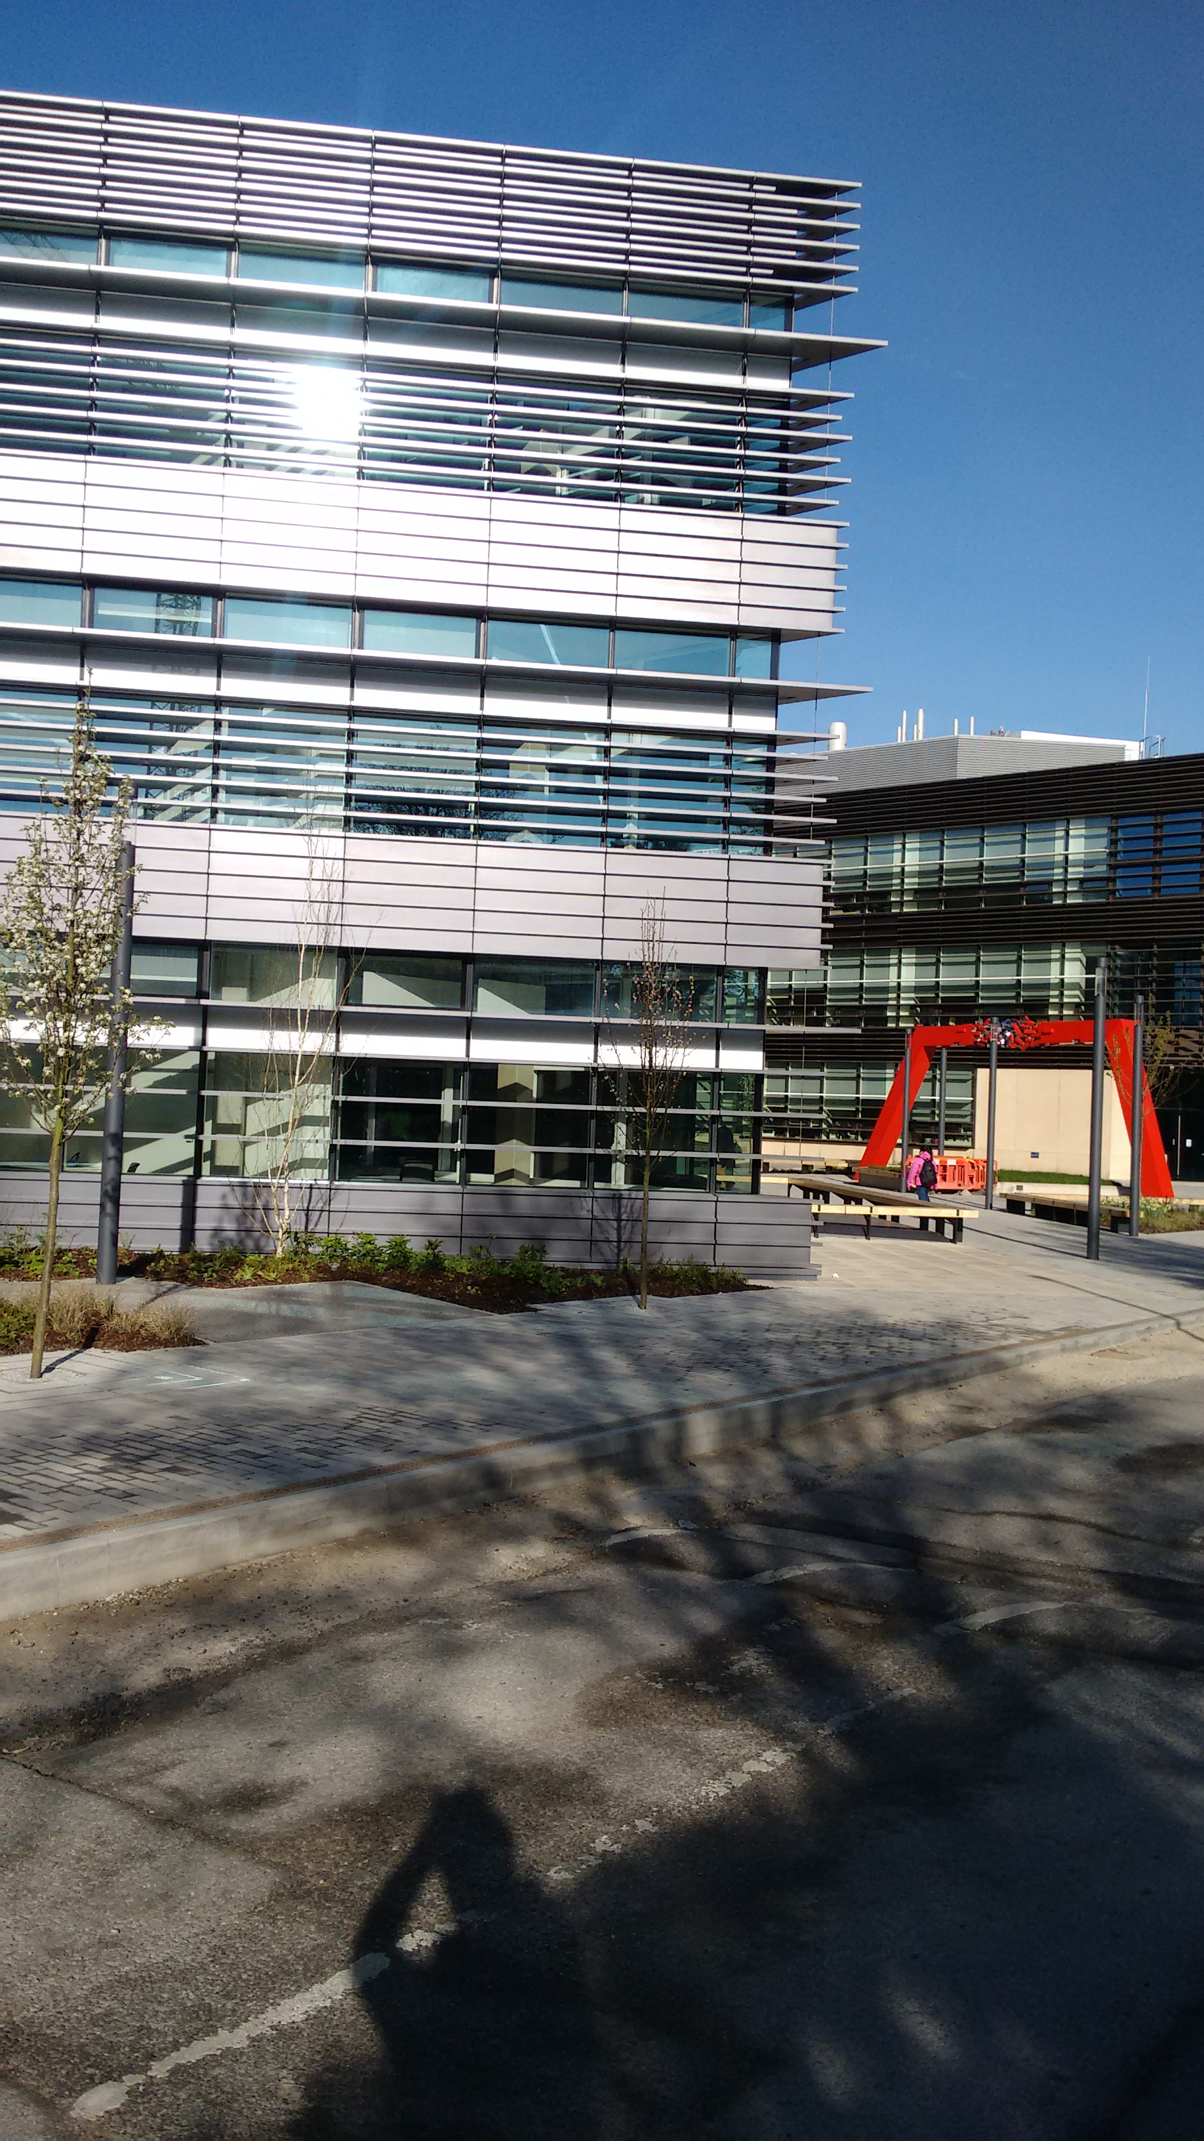
Introduction
Senior Scientific Software Engineer with MalariaGEN.
MalariaGEN is a research group based across the Big Data Institute and the Wellcome Trust Centre for Human Genetics at the University of Oxford, and the Sanger Institute at the University of Cambridge as well as many collaborators worldwide.
We study the genetics of people, mosquitos and the malaria parasite (plasmodium)
Using Alfresco since version 3.5 to manage our collaborations and facilitate communication between all the different groups.

Slide 3

How it all began
Discussions at BeeCon 2016...

Slide 4
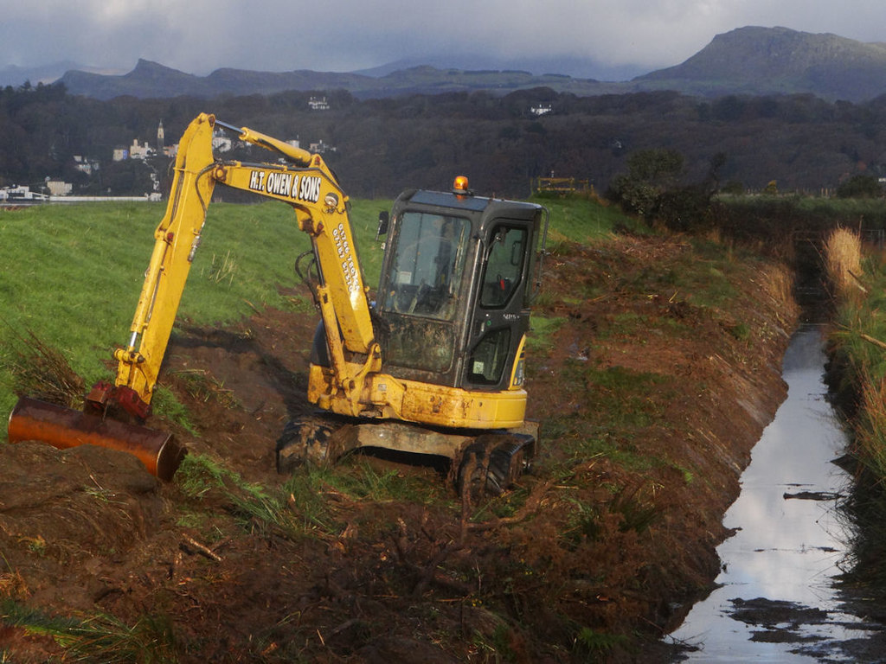

Upgrading
Necessary evil?
Exciting opportunity?
Necessary evil?
http://www.geograph.org.uk/photo/3226688 © Copyright Arthur C Harris and licensed for reuse under this Creative Commons Licence
https://www.flickr.com/photos/alexnormand/5992512756
For a longer discussion see https://tech.wrighting.org/2016/06/upgrade-time/

Slide 5

QA
Looking for a way to check if add ons will work with the new version

Slide 6
How it works
A quick overview

Slide 7
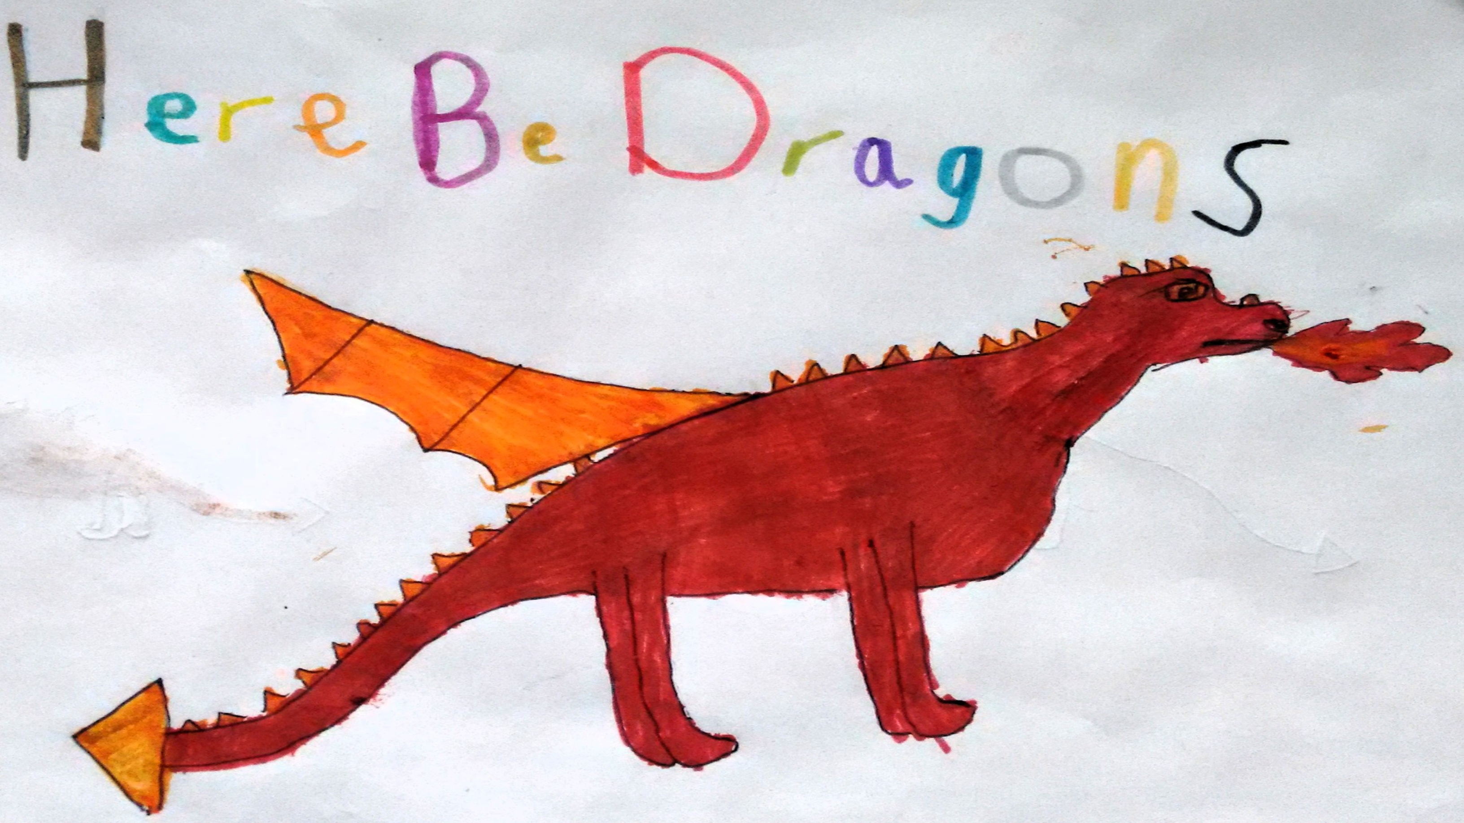
Caveat Emptor
An assistant not a substitute for understanding the application, and the changes between versions.
Does significantly reduce the amount of work required.
Don’t skip (major) versions.
Plenty of room for improvement.

Slide 8
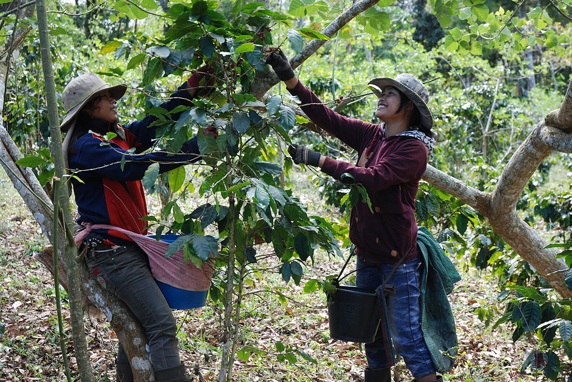
Harvest
Parse the extension to collect information about:
Bean definitions
Java classes
Files under extension (SDK 2.2 and 3)
https://upload.wikimedia.org/wikipedia/commons/0/0e/Coffee_Harvest_Laos.jpg
By Thomas Schoch [GFDL (http://www.gnu.org/copyleft/fdl.html) or CC BY-SA 3.0 (http://creativecommons.org/licenses/by-sa/3.0)], via Wikimedia Commons

Slide 9

Compare
Check out the old version and the new version from svn
Look for anything defined in all three places
If it’s changed between old and new report it.
http://www.pixnio.com/free-images/people/female-women/women-coffee-farmers-in-ethiopia-sort-coffee-beans-to-produce-higher-quality-specialty-725x483.jpg

Slide 10
Manual Intervention
For cases where the mapping can’t be automatically determined you can use a mapping file - upgrade-assist.mapping.json
{
"beans": {
"custom-mail": {
"reference-bean-id": "mail"
},
"avatarService": {
"files": [
"/templates/webscripts/org/alfresco/slingshot/profile/avatar.get.js",
"/templates/webscripts/org/alfresco/slingshot/profile/uploadavatar.post.js"
]
}
},
"aspects": {
"BuildPerson.aj": {
"classes": [
"org.alfresco.repo.web.scripts.discussion.AbstractDiscussionWebScript"
]
}
}
}

Slide 11
Examples

Slide 12
Bean definition
BeanDef in all versions:SiteService_security
*** alfresco/alfresco-open-mirror/5.0.d/repo/alfresco/public-services-security-context.xml
--- alfresco/alfresco-open-mirror/5.1.g/repo/root/projects/repository/config/alfresco/public-services-security-context.xml
***************
*** 27,32 ****
--- 27,33 ----
org.alfresco.service.cmr.site.SiteService.listMembers=ACL_ALLOW
org.alfresco.service.cmr.site.SiteService.listMembersInfo=ACL_ALLOW
org.alfresco.service.cmr.site.SiteService.listMembersPaged=ACL_ALLOW
+ org.alfresco.service.cmr.site.SiteService.listSiteMemberships=ACL_ALLOW
org.alfresco.service.cmr.site.SiteService.listSites=ACL_ALLOW,AFTER_ACL_NODE.sys:base.ReadProperties
org.alfresco.service.cmr.site.SiteService.listSitesPaged=ACL_ALLOW,AFTER_ACL_NODE.sys:base.ReadProperties
org.alfresco.service.cmr.site.SiteService.removeMembership=ACL_ALLOW
You need to check: example/example-platformjar/src/main/resources/alfresco/module/example-platform-jar/context/public-services-security-context.xml
Different bean definition:
Old file:alfresco/alfresco-open-mirror/5.0.d/repo/alfresco/public-services-security-context.xml
New file:alfresco/alfresco-open-mirror/5.1.g/repo/root/projects/repository/config/alfresco/public-services-security-context.xml
diff output from custom code to old version
This lead to PR https://github.com/jpotts/share-site-creators/pull/24

Slide 13
What happens next?
You need to manually examine the output of the tool and work through the files listed

Slide 14
What could happen next?
Create a patch file
Patch your code
Create a pull request
(Optionally when using Alfresco git) create a PR against the Alfresco code base
This would be best done with an interactive mode

Slide 15
Bean replacement 1
<bean id="usernamePropertiesDecorator" parent="baseDecorator"
class="org.wrighting.alfresco.upgrade.repo.jscript.app.CustomUsernamePropertyDecorator">
<property name="nodeService" ref="nodeService" />
<property name="personService" ref="PersonService" />
<property name="propertyNames">
<set>
<value>cm:creator</value>
<value>cm:modifier</value>
<value>cm:workingCopyOwner</value>
<value>cm:lockOwner</value>
<value>cm:owner</value>
<value>qshare:sharedBy</value>
</set>
</property>
</bean>
BeanDef in all versions:usernamePropertiesDecorator
Bean definitions match
Custom class is being used:org.wrighting.alfresco.upgrade.repo.jscript.app.CustomUsernamePropertyDecorator
Checking java for:org.alfresco.repo.jscript.app.UsernamePropertyDecorator org.alfresco.repo.jscript.app.UsernamePropertyDecorator
You need to check: /home/iwright/git/upgrade-assist/example/example-platform-jar/src/main/java/org/wrighting/alfresco/upgrade/repo/jscript/app/CustomUsernamePropertyDecorator.java
Different java between versions
Diff output

Slide 16
Bean replacement 2
<!-- https://gist.github.com/AFaust/b83b405998cb4303e77a -->
<bean class="de.axelfaust.examples.beans.ImplementationClassReplacingBeanFactoryPostProcessor">
<property name="targetBeanName" value="dbNodeService" />
<property name="originalClassName" value="org.alfresco.repo.node.db.DbNodeServiceImpl" />
<property name="replacementClassName" value="de.axelfaust.examples.service.BetterDbNodeServiceImpl" />
<property name="active" value="${my.patches.service.betterDbNodeService.enabled}" />
</bean>
BeanDef in all versions:dbNodeService
Bean definitions match
Custom class is being used:de.axelfaust.examples.service.BetterDbNodeServiceImpl
Checking java for:org.alfresco.repo.node.db.DbNodeServiceImpl org.alfresco.repo.node.db.DbNodeServiceImpl
Cannot find java for class:de.axelfaust.examples.service.BetterDbNodeServiceImpl
You need to check:
Different java between versions
Old file:/home/iwright/git/upgrade-assist/alfresco/alfresco-open-mirror/5.0.d/repo/root/projects/repository/source/java/org/alfresco/repo/node/db/DbNodeServiceImpl.java
New file:/home/iwright/git/upgrade-assist/alfresco/alfresco-open-mirror/5.1.g/repo/root/projects/repository/source/java/org/alfresco/repo/node/db/DbNodeServiceImpl.java
Diff output

Slide 17
Derived classes
You want to know if something has changed – even if you’re not directly interacting with it
{
"beans": {
"custom-mail": {
"reference-bean-id": "mail"
},
}
}

Slide 18
Javascript 1
file in all versions:/templates/webscripts/org/alfresco/slingshot/documentlibrary/doclist.get.js
You need to check: example/example-platform-jar/src/main/resources/alfresco/extension/templates/webscripts/org/alfresco/slingshot/documentlibrary/doclist.get.js
Different file:
Old file:alfresco/alfresco-open-mirror/5.0.d/repo/root/projects/remote-api/config/alfresco/templates/webscripts/org/alfresco/slingshot/documentlibrary/doclist.get.js
New file:alfresco/alfresco-open-mirror/5.1.g/share/share-services/src/main/resources/alfresco/templates/webscripts/org/alfresco/slingshot/documentlibrary/doclist.get.js
Diff output

Slide 19
Javascript 2
You need to check:
Conflicting customization
Old file:example/example-platform-jar/src/main/resources/alfresco/extension/templates/webscripts/org/alfresco/repository/site/site.put.json.js
New file:example/custom-site-props-repo/src/main/amp/config/alfresco/extension/templates/webscripts/org/alfresco/repository/site/site.put.json.js
Good example of why the tool can’t always help.
https://community.alfresco.com/community/ecm/blog/2016/11/23/create-and-edit-site-customization
(Note the SDK 2.2 vs SDK 3 paths)

Slide 20
XML
Reports on differences in web.xml and share-config-custom.xml
Quite a lot of noise but useful to know what’s changed.

Slide 21
Aspects
AbstractDiscussionWebScript
BuildPerson.aj
ForumPostDelete
ForumPostGet
ForumPostPut
ForumRepliesGet
7 more classes
"aspects": {
"BuildPerson.aj": {
"classes": [
"org.alfresco.repo.web.scripts.discussion.AbstractDiscussionWebScript"
]
}
}
Custom class is being used:BuildPerson.aj
Checking java for:org.alfresco.repo.web.scripts.discussion.AbstractDiscussionWebScript org.alfresco.repo.web.scripts.discussion.AbstractDiscussionWebScript
Cannot find java for class:BuildPerson.aj
Usual different java output

Slide 22
How to use it?
Python 3 script so you’ll need that installed.
https://github.com/wrighting/upgrade-assist
All the examples and more via the example.sh script
(which is more or less the same as alfresco-upgrade.sh)
I use links to set up ../my-alfresco-extensions which contains everything I want to check

Slide 23
Speaker contacts
ian.wright@well.ox.ac.uk
@techwrighting
https://tech.wrighting.org/

