Slide 1

Boost your career with Alfresco
Vasil Iliev

Slide 2

Quick survey…

Slide 3
Content
In the next 5 minutes you are going to hear about:
Leverage Alfresco for a career boost from a point of view as a:
End-user
Business operation
Developer / enthusiast
Why?!

Slide 4
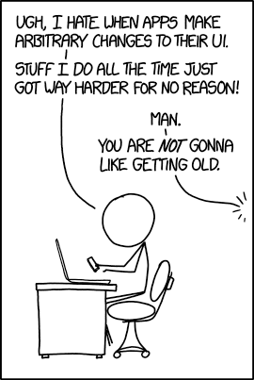
End-user
Endless use-cases
Improve your daily workflows
Awesome tutorials
Alfresco = Tool

Slide 5
Business operation
The career of my business.
From Out-of-the-box to fully customized solution with your own brand
Already made addons
Faster retrieving and processing can result in more revenue

Slide 6
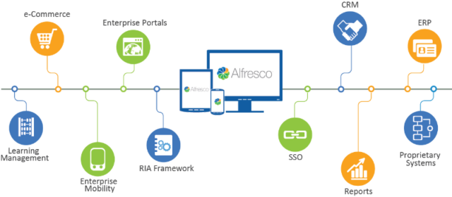
Business operation

Slide 7
Networking through conferences, open days, finding new business, meet new potential employees

Slide 8
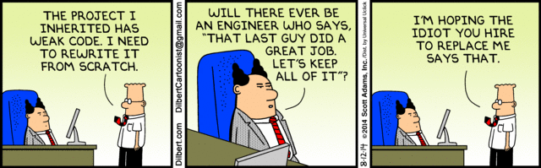
Business operation

Slide 9
Developer / enthusiast
It never hurts to learn something new
Official place to preset your work and get recognized for it
Freedom of choice for the technology stack
Best community to support you
Makes you think outside of the box
Continuous improvement of the developer tools

Slide 10
How did Alfresco help me?!

Slide 11
Summary
Embrace a new challenge
Share your knowledge
Create a solution for your own requirements
Promote yourself

Slide 12
Boost your career with Alfresco
Vasil Iliev
Software Developer at Monsenso

