Slide 1

Alfresco
Worst Practices
Boriss Mejías
Holistic System Software Engineer
Order of the Bee

Slide 2

Alfresco
Worst Practices
Boriss Mejías
Holistic System Software Engineer
Order of the Bee

Slide 3

Learn from mistakes
Spot and avoid
Worst Practices!

Slide 4

Run Alfresco as root

Slide 5

Run Alfresco as root
...and just open ports under 1024

Slide 6
Run Alfresco as root as in alfresco.sh
# Allow only root execution
if [ `id|sed -e s/uid=//g -e s/\(.*//g` -ne 0 ]; then
echo "This script requires root privileges"
exit 1
fi

Slide 7
There is a trick
# Avoid root execution
if [ `id|sed -e s/uid=//g -e s/\(.*//g` -eq 0 ] && [ $2 != "stop" ]; then
echo "Execution by root not allowed"
exit 1
fi

Slide 8
Do not change JMX’s password
monitorRole change_asap
controlRole change_asap

Slide 9
Do not change JMX’s password
As Soon As Possible
monitorRole change_asap
controlRole change_asap

Slide 10
Logs

Slide 11
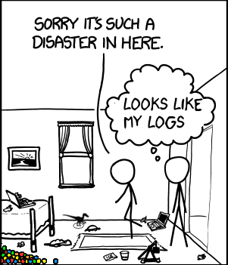
Do not change default logs location

Slide 12
Do not change default logs location
And find a mess in
$ALFRESCO_HOME
solr.log
solr.log.2017-04-13
solr.log.2017-04-14
...
alfresco.log
alfresco.log.2017-04-13
alfresco.log.2017-04-14
...
share.log
share.log.2017-04-13
share.log.2017-04-14
...

Slide 13
Just log every HTTP access on localhost
Hint:
$ALFRESCO_HOME/tomcat/conf/server.xml

Slide 14
Just log every HTTP access on localhost
Hint:
$ALFRESCO_HOME/tomcat/conf/server.xml
Forget about reverse proxies!

Slide 15
Let catalina.out grow forever
+5 GB

Slide 16
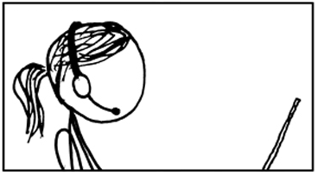
Let catalina.out grow forever
+5 GB

Slide 17
Deploy custom code as jars
What does AMP mean anyway!?

Slide 18
Deploy custom code as jars
Job for life
What does your jar do?
Random order excitement!

Slide 19
Don’t bother creating titles and descriptions for AMP
Module 'foo-share-amp' installed in 'tomcat/webapps/share.war'
- Title: Alfresco Share AMP Module
- Version: 5.1.1
- Install Date: Wed Apr 12 16:18:10 CEST 2017
- Description: This is a sample Alfresco Share AMP project, depended upon by the share WAR module

Slide 20
Don’t bother creating titles and descriptions for AMP
...and keep sample files inside
Module 'foo-share-amp' installed in 'tomcat/webapps/share.war'
- Title: Alfresco Share AMP Module
- Version: 5.1.1
- Install Date: Wed Apr 12 16:18:10 CEST 2017
- Description: This is a sample Alfresco Share AMP project, depended upon by the share WAR module

Slide 21
Don’t take yourself too seriously
So you can learn from your mistakes and avoid the worst practices!

Slide 22
I may not have gone where I intended to go, but I think I have ended up where I needed to be.
Dirk Gently

