Slide 1

Sending customizable emails in Alfresco
Tom Vandepoele, Amplexor
Notes:
Hi there!
I’m Tom Vandepoele, senior developer at Amplexor, and I’m going to talk about sending customizable emails in Alfresco.

Slide 2

Sending customizable emails in Alfresco
Out-of-the-box email sending
What it looks like
Summary of shortcomings
Solutions?
Custom email sending
Flexibility through eml creation
Recipients prefilling
User actions
Storing sent email in Alfresco
Notes:
For completeness, I’ll start with a brief overview of the OOTB functionality, aka the basics how to send emails in Alfresco.
Once that’s established, I’ll talk about the shortcomings from a user’s perspective, and how we solved those.
Finally, you’ll be taken through sample code and a visual tour of the custom email sending.

Slide 3
Sending customizable emails in Alfresco
Out-of-the-box email sending
What it looks like
Summary of shortcomings
Solutions?
Custom email sending
Flexibility through eml creation
Recipients prefilling
User actions
Storing sent email in Alfresco
Notes:
For completeness, I’ll start with a brief overview of the OOTB functionality, aka the basics how to send emails in Alfresco.
Once that’s established, I’ll talk about the shortcomings from a user’s perspective, and how we solved those.
Finally, you’ll be taken through sample code and a visual tour of the custom email sending.

Slide 4
Out-of-the-box email sending
What it looks like
Action mail = actionService.createAction(MailActionExecuter.NAME);
mail.setParameterValue(MailActionExecuter.PARAM_FROM, from)
mail.setParameterValue(MailActionExecuter.PARAM_TO, to);
mail.setParameterValue(MailActionExecuter.PARAM_SUBJECT, subject);
mail.setParameterValue(MailActionExecuter.PARAM_HTML, mailBody);
actionService.executeAction(mail, nodeRef);
Notes:
With the official documentation found a bit lacking regarding email sending, I’ll quickly go over the basics. This is for those who are not familiar with email sending in Alfresco.
Basically, we create an email action, tell it what to send to whom through the right parameters and execute it.

Slide 5
Out-of-the-box email sending
Standard mail model using the org.alfresco.repo.action.executer.MailActionExecuter: see createEmailTemplateModel method
(*) conditional, this key might not be available depending on other action parameters
In addition to these you can provide custom key/value pairs by passing a map to the action with parameter PARAM_TEMPLATE_MODEL
FreeMarkerProcessor will convert all NodeRef values in the model to TemplateNode instances, and AssociationRef values to TemplateAssociation instances. This includes NodeRef and AssociationRef values that are in a List, Map or Array, at any level of the model
person*
document*
space*
date
hasAspect()
message()
dateCompare()
url
shareUrl
imageresolver*
TemplateNode
TemplateNode
TemplateNode
Date
HasAspectMethod
I18NMessageMethod
DateCompareMethod
URLHelper
String
TemplateImageResolver
Notes:
To customize the mail body, we have the following model available in the Freemarker template. (person, document, …)
Some of these aren’t available depending on the parameters and node you launched the action upon.
You can also add your own custom model through the PARAM_TEMPLATE_MODEL parameter.
NodeRef and AssociationRef values are automatically converted into template objects for your convenience.

Slide 6
Out-of-the-box email sending
Standard mail model using the org.alfresco.repo.action.executer.MailActionExecuter: see createEmailTemplateModel method
(*) conditional, this key might not be available depending on other action parameters
In addition to these you can provide custom key/value pairs by passing a map to the action with parameter PARAM_TEMPLATE_MODEL
FreeMarkerProcessor will convert all NodeRef values in the model to TemplateNode instances, and AssociationRef values to TemplateAssociation instances. This includes NodeRef and AssociationRef values that are in a List, Map or Array, at any level of the model
person*
document*
space*
date
hasAspect()
message()
dateCompare()
url
shareUrl
imageresolver*
TemplateNode
TemplateNode
TemplateNode
Date
HasAspectMethod
I18NMessageMethod
DateCompareMethod
URLHelper
String
TemplateImageResolver
Notes:
To customize the mail body, we have the following model available in the Freemarker template. (person, document, …)
Some of these aren’t available depending on the parameters and node you launched the action upon.
You can also add your own custom model through the PARAM_TEMPLATE_MODEL parameter.
NodeRef and AssociationRef values are automatically converted into template objects for your convenience.

Slide 7
Out-of-the-box email sending
Summary of shortcomings
Users cannot customize email body
Users cannot edit recipients or use his/her (Exchange) address book
Users cannot keep track of sent emails
Notes:
The body of the email is not customizable by the user (since the template and model is created by the developer)
The recipients cannot be edited by the user at time of sending + the user has no access to his (Exchange) address book
Sent email is not stored in Alfresco, so keeping track of your conversation is hard

Slide 8
Out-of-the-box email sending
Summary of shortcomings
Users cannot customize email body
Users cannot edit recipients or use his/her (Exchange) address book
Users cannot keep track of sent emails
Notes:
The body of the email is not customizable by the user (since the template and model is created by the developer)
The recipients cannot be edited by the user at time of sending + the user has no access to his (Exchange) address book
Sent email is not stored in Alfresco, so keeping track of your conversation is hard

Slide 9
Out-of-the-box email sending
Solutions?
Have users edit the email in their preferred client
Have metadata field ‘default recipients’ somewhere, add it to the mail
Create a container node to store conversation, add it as CC recipient
Notes:
Offer email as downloadable .eml file which opens up in user’s preferred email client
Add a ‘default recipients’ aspect/property to your document/folder/site, whose recipients are added to the .eml before offering it to the user
Create a node (optional with emailserver:aliasable aspect if you don’t want to use the node dbid) and add it as cc address before offering the .eml (how exactly is explained later)

Slide 10
Out-of-the-box email sending
Solutions?
Have users edit the email in their preferred client
Have metadata field ‘default recipients’ somewhere, add it to the mail
Create a container node to store conversation, add it as CC recipient
Notes:
Offer email as downloadable .eml file which opens up in user’s preferred email client
Add a ‘default recipients’ aspect/property to your document/folder/site, whose recipients are added to the .eml before offering it to the user
Create a node (optional with emailserver:aliasable aspect if you don’t want to use the node dbid) and add it as cc address before offering the .eml (how exactly is explained later)

Slide 11
Custom email sending
Flexibility through eml creation
public void execute(WebScriptRequest req, WebScriptResponse res) throws IOException {
…
res.setContentType("message/rfc822");
res.addHeader("Content-Disposition", "attachment; filename=email-draft.eml");
MimeMessage msg = mailService.createMimeMessage();
try {
msg.addRecipients(RecipientType.TO, getDefaultRecipients(nodeRef, mailTemplate));
//msg.addRecipients(RecipientType.CC, getTopicRecipient(nodeRef)); // store as forum post
//msg.setReplyTo(getTopicRecipient(nodeRef)); // store reply as forum post
msg.setSubject(subject);
msg.setFlag(Flag.DRAFT, true);
msg.addHeader("X-Unsent", "1");
msg.setText(getProcessedTemplate(mailTemplate, mailModel), "UTF-8", "html");
msg.writeTo(res.getOutputStream(), new String[]{});
}
catch (MessagingException e)
…
Notes:
Here’s an abstract webscript were we set the response content to EML (rfc822), set the attachment download filename, then create the mimemessage, adding recipients based on the passed node through some custom logic. We set the DRAFT flag and mark it as unsent.
Then we insert an html body (a processed Freemarker template) and write it to the outputstream. We don’t use a simple ‘mailto’ link due to it’s limitations (for one, allowed body length varies per browser) and we want a uniform user experience.

Slide 12
Custom email sending
Flexibility through eml creation
public void execute(WebScriptRequest req, WebScriptResponse res) throws IOException {
…
res.setContentType("message/rfc822");
res.addHeader("Content-Disposition", "attachment; filename=email-draft.eml");
MimeMessage msg = mailService.createMimeMessage();
try {
msg.addRecipients(RecipientType.TO, getDefaultRecipients(nodeRef, mailTemplate));
//msg.addRecipients(RecipientType.CC, getTopicRecipient(nodeRef)); // store as forum post
//msg.setReplyTo(getTopicRecipient(nodeRef)); // store reply as forum post
msg.setSubject(subject);
msg.setFlag(Flag.DRAFT, true);
msg.addHeader("X-Unsent", "1");
msg.setText(getProcessedTemplate(mailTemplate, mailModel), "UTF-8", "html");
msg.writeTo(res.getOutputStream(), new String[]{});
}
catch (MessagingException e)
…
Notes:
Here’s an abstract webscript were we set the response content to EML (rfc822), set the attachment download filename, then create the mimemessage, adding recipients based on the passed node through some custom logic. We set the DRAFT flag and mark it as unsent.
Then we insert an html body (a processed Freemarker template) and write it to the outputstream. We don’t use a simple ‘mailto’ link due to it’s limitations (for one, allowed body length varies per browser) and we want a uniform user experience.

Slide 13
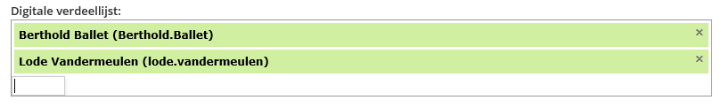
Custom email sending
Recipients prefilling
Edit metadata of distribution list (recipients) on some level (site/folder/document)
Recipients
Notes:
For user convenience, prefilling recipients is done, usually by a supervisor, at some level (site/folder/document), where they pass the usernames and/or email addresses to a metadata field.
This occurs only in those instances where certain mails are to be send to a predetermined group of people.
The form control you see, in case you’re wondering, is a type-ahead tokeninput control.

Slide 14
Custom email sending
Recipients prefilling
Edit metadata of distribution list (recipients) on some level (site/folder/document)
Recipients
Notes:
For user convenience, prefilling recipients is done, usually by a supervisor, at some level (site/folder/document), where they pass the usernames and/or email addresses to a metadata field.
This occurs only in those instances where certain mails are to be send to a predetermined group of people.
The form control you see, in case you’re wondering, is a type-ahead tokeninput control.

Slide 15
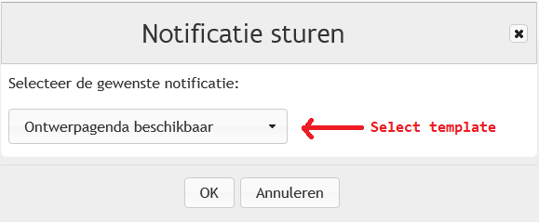
Custom email sending
User actions
Launch the custom ‘send email’ action and select an email template to use
Notes:
When users launch a ‘send email’ action, we can optionally provide them with a select, predetermined list of email templates. (The templates themselves can be dynamically added to some folder, the list contains each of their cm:title properties)
It is meaningful not to clutter up the interface with ‘send email’ actions for each and every template, as the user quickly loses overview of the important actions.
This, of course, is up to the customer and functional analist to decide.

Slide 16
Custom email sending
User actions
Launch the custom ‘send email’ action and select an email template to use
Notes:
When users launch a ‘send email’ action, we can optionally provide them with a select, predetermined list of email templates. (The templates themselves can be dynamically added to some folder, the list contains each of their cm:title properties)
It is meaningful not to clutter up the interface with ‘send email’ actions for each and every template, as the user quickly loses overview of the important actions.
This, of course, is up to the customer and functional analist to decide.

Slide 17
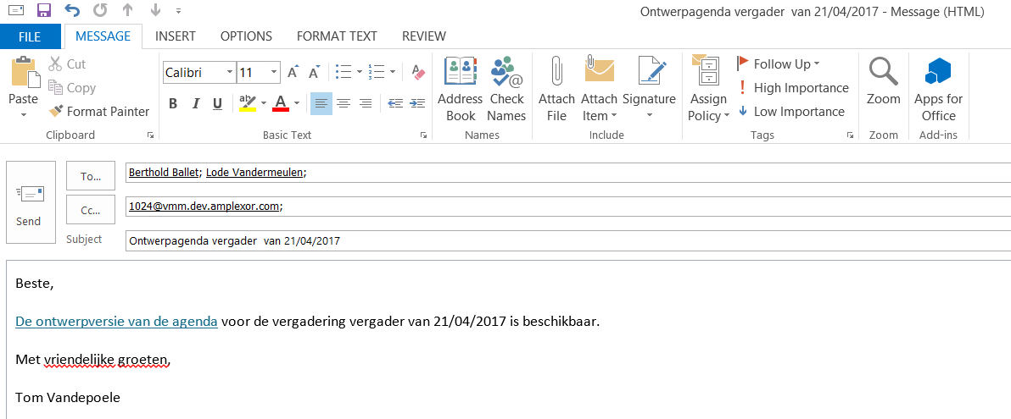
Custom email sending
User actions
Open the .eml file the browser offers as download in your favourite email client, edit as desired and send!
Notes:
The user, after receiving a download link, opens it in his/her favourite email client.
You see the TO and CC recipients have been prefilled, as are the subject and body.
The user if free to modify any of these as desired.
In order to store the mail in Alfresco, the CC address here contains the node dbid of the created container node.

Slide 18
Custom email sending
User actions
Open the .eml file the browser offers as download in your favourite email client, edit as desired and send!
Notes:
The user, after receiving a download link, opens it in his/her favourite email client.
You see the TO and CC recipients have been prefilled, as are the subject and body.
The user if free to modify any of these as desired.
In order to store the mail in Alfresco, the CC address here contains the node dbid of the created container node.

Slide 19
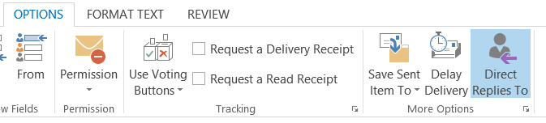
Custom email sending
Storing mails in Alfresco
sys:node-dbid @ domain if you want to store replies in a generic container node
alias @ domain if you added the emailserver:alias property to your container node
Notes:
To store mails in Alfresco, you need to configure the inbound SMTP server, after which you can send mails to specific container nodes by referencing:
Their node dbid
Their email alias, if defined by the emailserver:alias property on the container node
Optionally you’ll want to set the REPLY-TO address as the container node if you want to show a different FROM address.

Slide 20
Custom email sending
Storing mails in Alfresco
sys:node-dbid @ domain if you want to store replies in a generic container node
alias @ domain if you added the emailserver:alias property to your container node
Notes:
To store mails in Alfresco, you need to configure the inbound SMTP server, after which you can send mails to specific container nodes by referencing:
Their node dbid
Their email alias, if defined by the emailserver:alias property on the container node
Optionally you’ll want to set the REPLY-TO address as the container node if you want to show a different FROM address.

Slide 21

How to customize emails
Thank you for listening!
Notes:
Note that a typical use case for inbound mail is the forum, where users can reply to topics directly in a received email notification of that topic.
Thank you for listening!

Slide 22
Speaker contacts
presentations@orderofthebee.org

