Slide 1
Honeycomb & Beyond
Martin Cosgrave
Daren Firminger

Slide 2

Why Honeycomb?
Objective to have an Order of the Bee distribution
Demonstrating a production quality implementation of Alfresco Open Source

Slide 3
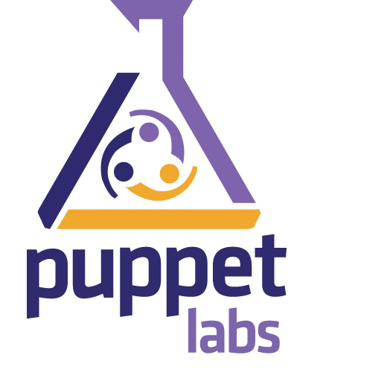
Why Puppet?
Bring your machine to a known state, and keep it there using automation
Repeatable builds all the way to production.

Slide 4
case($alfresco_version){
'4.2.f': {
$alfresco_ce_url = $urls::alfresco_ce
$indexer = 'solr'
$cmis_url = '/alfresco/s/cmis'
}
'5.0.x', 'NIGHTLY': {
$indexer = 'solr4'
$cmis_url = '/alfresco/cmisatom'
} default: { fail("Unsupported version ${alfresco_version}")
}
}
Some puppet examples

Slide 5
class alfresco::addons::reset-password inherits alfresco::addons { safe-download { 'addons::reset-password': url => "${reset_password_jar_url}", filename => "${reset_password_jar_file}", download_path => "${tomcat_home}/shared/lib",
}
}
Minimal addon

Slide 6




Good Times & Bad Times

Slide 7
Lessons Learnt
Collaboration is difficult
Puppet is strange and difficult
Stable releases are comforting
Test harnesses are required
Upstream is not necessarily your friend
Puppet installers are sturdy! But development lifecycle can be slow.

Slide 8
Do we upgrade to handle 5.1+ changes or are we chasing a forever moving target?
We need other contributors to help us to support 4.2.f, 5.0d, 5.1 and future versions
Future Puppet-Alfresco

Slide 9
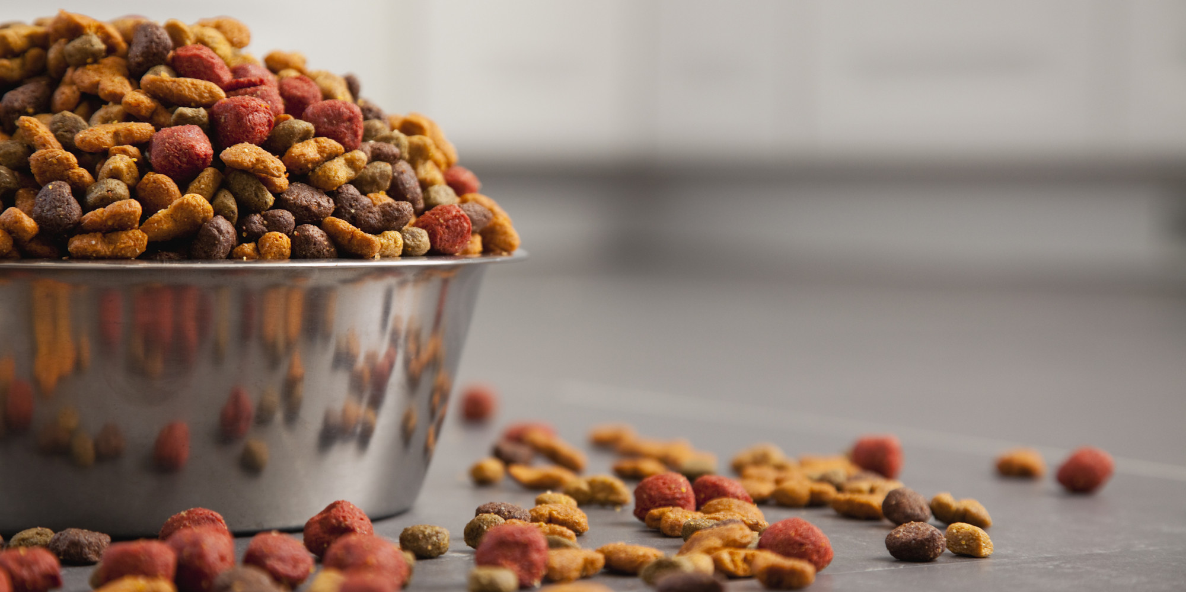
DOG FOODING
HoneyComb build used to support
Beecon 2016

Slide 10

Docker … Grua ...
Docker as a production environment ?
Why grua and not docker-compose? grua : Why another docker tool?
How to solve ordering problem! grua grua fill grua refill grua stack grua restack https://github.com/marsbard/grua https://github.com/marsbard/docker-alfresco
Beyond Puppet

Slide 11
alfresco: build: alfresco dns: <% INSPECT consul {{ .NetworkSettings.IPAddress }} %> options:
- "--expose=2021"
- "--expose=7070"
- "--expose=8080" upwhen: logmsg: "INFO: Server startup in " timeout: 120 before:
- solr
- share volumes:
- data:/data
- logs:/logs
- upgrade:/upgrade
grua.yaml

Slide 12
Growing beyond a single host
Scaling
Horizontal scaling running component containers on separate hosts
Homogenous networking across hosts is required, using weave, docker-networking or openvpn
A stepping stone to clustering for community Alfresco

Slide 13
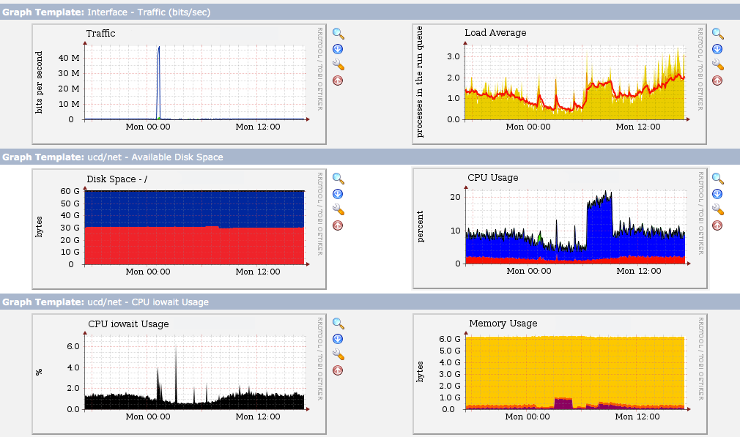
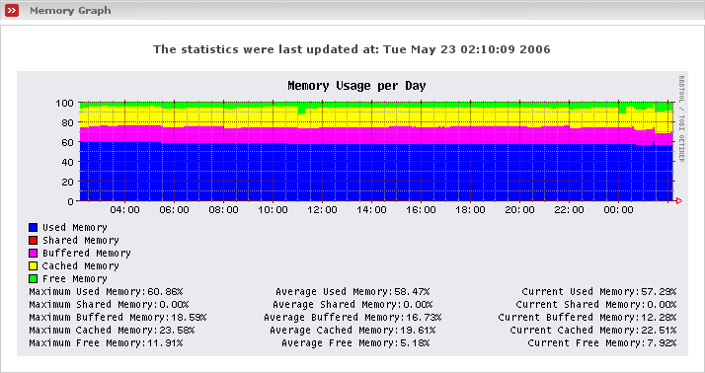
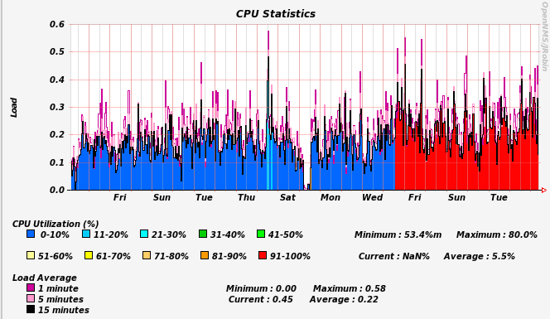
Future steps - monitoring
Cacti, Zabbix, OpenNMS

Slide 14

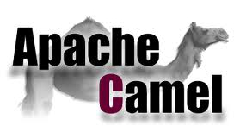
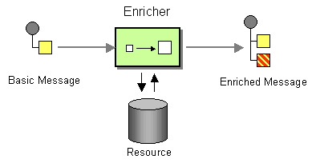
Future steps - integrations
Active MQ
Apache Camel
Offload workloads to queues
Anyone fancy sponsoring an Open Source Transformation Server?
http://www.enterpriseintegrationpatterns.com/

Slide 15
Getting Involved
Know puppet? Jump right in!
Want to learn puppet? We can help get you started.
You're a domain expert. Help review our work

Slide 16
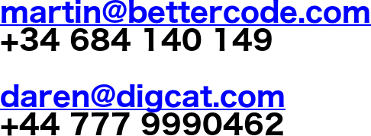
Will work for cash!
Alfresco Devops guns for hire!
Also backend stuff, systems integration and Drupal frontends.

