Slide 1

Solr lab for sharding experiments
Roxana Angheluta (Xenit Solutions)
Axel Faust (Acosix GmbH)

Slide 2

Motivation and solution
Large archives with >50mil documents
No sites
Particular use case: most of the queries are targeted to a specific client id
Search speed <3s
Implement a new sharding method: by property (now existing in Alfresco 5.2) with targeted queries
Create a “solr lab”: define relevant parameters, design relevant experiments, execute them and draw conclusions
Notes:
The present work was started in 2016 due to a need to deal with very large repositories. Back then Alfresco had just started with splitting of the index into shard and the only sharding method available was by acl, which was mostly suited for Alfrescos with many sites (and even then the distribution of documents into shards might be skewed when using an even number of shards.
To address this problem, we implemented a custom sharding method – by property, which is now also present in Alfresco 5.2
Another requirement was to aim to response times lower than 3 seconds in the particular case of a client where most of the queries will be client-specific. We changed the search in Alfresco to target the specific shard only and we built a solr lab, allowing to quickly experiment with configurations and parameters.

Slide 3
Motivation and solution
Large archives with >50mil documents
No sites
Particular use case: most of the queries are targeted to a specific client id
Search speed <3s
Implement a new sharding method: by property (now existing in Alfresco 5.2) with targeted queries
Create a “solr lab”: define relevant parameters, design relevant experiments, execute them and draw conclusions
Notes:
The present work was started in 2016 due to a need to deal with very large repositories. Back then Alfresco had just started with splitting of the index into shard and the only sharding method available was by acl (field aclid from the database), which was only suited for Alfrescos with many sites (and even then the distribution of documents into shards might be skewed when using an even number of shards.
To address this problem, we implemented a custom sharding method – by property.
Another requirement was to aim to response times lower than 3 seconds in the particular case of a client where most of the queries will be client-specific.

Slide 4
Motivation and solution
Large archives with >50mil documents
No sites
Particular use case: most of the queries are targeted to a specific client id
Search speed <3s
Implement a new sharding method: by property (now existing in Alfresco 5.2) with targeted queries
Create a “solr lab”: define relevant parameters, design relevant experiments, execute them and draw conclusions
Notes:
The present work was started in 2016 due to a need to deal with very large repositories. Back then Alfresco had just started with splitting of the index into shard and the only sharding method available was by acl (field aclid from the database), which was only suited for Alfrescos with many sites (and even then the distribution of documents into shards might be skewed when using an even number of shards.
To address this problem, we implemented a custom sharding method – by property.
Another requirement was to aim to response times lower than 3 seconds in the particular case of a client where most of the queries will be client-specific.

Slide 5


Sharding by property - Solr side
nodesWithShardedProperty
nodesWithShardedProperty
hash(shardedPropertyValue, num shards, shard instance)
hash(shardedPropertyValue,num shards, shard instance)
Shard1
Shard2
Shard3
Shard1
Shard2
Shard3
Notes:
In the following slides we explain the implementation we made for sharding by property, which on solr’s side is almost identical with Alfresco’s sharding by property from Alfresco 5.2.
On solr’s side, when the Solr tracker asks Alfresco for changed nodes, it also receives values for a particular property (configurable) and dispatches documents into shards based on a hash function depending on the value, the current shard instance and the total number of shards.
All acls are added to all shards.

Slide 6
Sharding by property - Alfresco side
Query:
=model:shardingKey:$value
SolrQueryHTTPClient
shards=shard1,shard2,shard3
Shard1
Shard2
Shard3
Shard1
Shard2
Shard3
Notes:
In our specific implementation, since we know upfront that most of the queries are client-specific, we by-pass the distributed solr mechanism: we parse the query, extract the value for the shardingKey property, apply the same hashing function as the one used on solr’s side to detect the relevant shard and forward the query directly to the relevant shard without the “shards” parameter.

Slide 7



Solr lab
Requirements
  Easy to start
  Easy to replicate
  Easy to change parameters
  Easy to resume
  Easy to monitor
core1:
image:
volumes:
hostname:
ports:
environment:
solr1:
…
solr2:
…
solr3:
…
postgres:
….
libreoffice
Notes:
For the solr lab, we need to be able to easily start / stop Alfresco’s and Solr’s, to easily move them to new servers, to change parameters , to pause and resume executions and to monitor the instances.
The requirements can be fulfilled by using docker as a virtualization layer and docker-compose with environment variables to orchestrate starting/stopping of a set of containers. At Xenit we have invested a lot of work in building good docker images for alfresco and even more – a full infra stack with load balancers in front of a clustered alfresco, if needed.
For those familiar with docker and docker-compose, starting up a (clustered) alfresco with (sharded) solr can be done very easily by writing a docker-compose.yml file and issuing “docker-compose up -d”.
In our experiments we use a single Alfresco node, with variable number of shards on the same machine. The configuration can be adapted to factor out the database or to use multiple alfresco nodes.

Slide 8
Solr lab
Requirements
  Easy to start
  Easy to replicate
  Easy to change parameters
  Easy to resume
  Easy to monitor
core1:
image:
volumes:
hostname:
ports:
environment:
solr1:
…
solr2:
…
solr3:
…
postgres:
….
libreoffice
Notes:
For the solr lab, we need to be able to easily start / stop Alfresco’s and Solr’s, to easily move them to new servers, to change parameters , to pause and resume executions and to monitor the instances.
The requirements can be fulfilled by using docker as a virtualization layer and docker-compose with environment variables to orchestrate starting/stopping of a set of containers. At Xenit we have invested a lot of work in building good docker images for alfresco and even more – a full infra stack with load balancers in front of a clustered alfresco, if needed.
For those familiar with docker and docker-compose, starting up a (clustered) alfresco with (sharded) solr can be done very easily by writing a docker-compose.yml file and issuing “docker-compose up -d”.
In our experiments we use a single Alfresco node, with variable number of shards on the same machine. The configuration can be adapted to factor out the database or to use multiple alfresco nodes.

Slide 9
Solr lab
core1:
image: image: hub.xenit.eu/alfresco-ethias-sharded-by-property:build-3
volumes:
- alfresco10milnoacls:/opt/alfresco/alf_data
environment:
- SOLR_HOST=solr1
- SOLR_PORT=8081
- ALFRESCO_HOST=core1
- ALFRESCO_PORT=8080
- JAVA_XMS=6144M
- JAVA_XMX=6144M
- ENABLE_CLUSTERING=true
- DYNAMIC_SHARD_REGISTRATION=true
- DEBUG=false
- JMX_ENABLED=true
- JMX_RMI_HOST=xxx.xxx.xxx.xxx
- GLOBAL_shardedProperty.qname={http://www.ethias.be/model/content}shardingKey
- GLOBAL_cache.node.nodesSharedCache.maxItems=1250000
……………..
-
solr1:
image: hub.xenit.eu/solr-sharded-by-property:5.1
volumes:
- solr10milnoacls1index:/opt/alfresco/alf_data
environment:
- ALFRESCO_HOST=core1
- ALFRESCO_PORT=8080
- SOLR_HOST=solr1
- SOLR_PORT=8081
- JAVA_XMS=7168M
- JAVA_XMX=7168M
- SHARDING=true
- NUM_SHARDS=3
- NUM_NODES=3
- NODE_INSTANCE=1
- TEMPLATE=rerank
- SHARD_IDS=0
- ALFRESCO_SSL=none
- ARCHIVE_ENABLE_ALFRESCO_TRACKING=false
- ARCHIVE_INDEX_CONTENT=false
- ALFRESCO_INDEX_CONTENT=false
- MAX_HTTP_HEADER_SIZE=65536
- JMX_ENABLED=true
- JMX_RMI_HOST=xxx.xxx.xxx.xxx
……………….
Notes:
A zoom into the docker-compose for the Alfresco core shows us parameters which can be changed via environment variables. Many of them are parameters from alfresco-global.properties, but the flexibility is not reduced to those. One can also change JAVA_OPTS parameters (debugging options, jmx options, Xmx), and variables from server.xml (tomcat ports).
The tomcat header size was also made configurable.
On the solr side, one can change parameters from solrcore.properties and also tomcat-specific variables as well (from server.xml) and JAVA_OPTS variables. In our experiments we disable ssl. We have also parameters which manipulate schema.xml: really disabling suggester (which can be done also with a separate template) or fixing tokenization for categories to be able to facet on categories (which is currently a jira issue).

Slide 10
Solr lab
core1:
image: image: hub.xenit.eu/alfresco-ethias-sharded-by-property:build-3
volumes:
- alfresco10milnoacls:/opt/alfresco/alf_data
environment:
- SOLR_HOST=solr1
- SOLR_PORT=8081
- ALFRESCO_HOST=core1
- ALFRESCO_PORT=8080
- JAVA_XMS=6144M
- JAVA_XMX=6144M
- ENABLE_CLUSTERING=true
- DYNAMIC_SHARD_REGISTRATION=true
- DEBUG=false
- JMX_ENABLED=true
- JMX_RMI_HOST=xxx.xxx.xxx.xxx
- GLOBAL_shardedProperty.qname={http://www.ethias.be/model/content}shardingKey
- GLOBAL_cache.node.nodesSharedCache.maxItems=1250000
……………..
-
solr1:
image: hub.xenit.eu/solr-sharded-by-property:5.1
volumes:
- solr10milnoacls1index:/opt/alfresco/alf_data
environment:
- ALFRESCO_HOST=core1
- ALFRESCO_PORT=8080
- SOLR_HOST=solr1
- SOLR_PORT=8081
- JAVA_XMS=7168M
- JAVA_XMX=7168M
- SHARDING=true
- NUM_SHARDS=3
- NUM_NODES=3
- NODE_INSTANCE=1
- TEMPLATE=rerank
- SHARD_IDS=0
- ALFRESCO_SSL=none
- ARCHIVE_ENABLE_ALFRESCO_TRACKING=false
- ARCHIVE_INDEX_CONTENT=false
- ALFRESCO_INDEX_CONTENT=false
- MAX_HTTP_HEADER_SIZE=65536
- JMX_ENABLED=true
- JMX_RMI_HOST=xxx.xxx.xxx.xxx
……………….
Notes:
A zoom into the docker-compose for the Alfresco core shows us parameters which can be changed via environment variables. Many of them are parameters from alfresco-global.properties, but the flexibility is not reduced to those. One can also change JAVA_OPTS parameters (debugging options, jmx options, Xmx), and variables from server.xml (tomcat ports).
The tomcat header size was also made configurable.
On the solr side, one can change parameters from solrcore.properties and also tomcat-specific variables as well (from server.xml) and JAVA_OPTS variables. In our experiments we disable ssl. We have also parameters which manipulate schema.xml: really disabling suggester (which can be done also with a separate template) or fixing tokenization for categories to be able to facet on categories (which is currently a jira issue).

Slide 11
Experiments – dimensions and metrics
Dimension | Values
Size of repo | 1mil | 10mil | more
Sharding method | property | acl
Number of shards | 1 | 3 | 11
Acls | With artificial acls | Without artificial acls
Types of queries | simple | complex
Query concurrency | yes | no
Load in the same time | yes | no
Response times
Memory usage
Load
Caches utilization
Database performance
Notes:
Having implemented the shard by property and the solr lab, we defined a number of dimensions to dictate the types of experiments we want to perform. We are looking at repositories of different sizes, at different sharding methods. Since the default acl sharding is not applicable in the case we simply pomp documents under the admin user, we have an option to artificially create acls on folders, to have more acl ids. The number of shards is also a parameter.
In terms of queries, we want to compare simple shardingKey=value queries with more complex queries, involving boolean operators and facets. The queries can be executed concurrently and while writing in the same time in the repository.
We want to measure the response times and to monitor the load, memory usage, cache utilization and database performance during the experiments.

Slide 12
Experiments – dimensions and metrics
Dimension | Values
Size of repo | 1mil | 10mil | more
Sharding method | property | acl
Number of shards | 1 | 3 | 11
Acls | With artificial acls | Without artificial acls
Types of queries | simple | complex
Query concurrency | yes | no
Load in the same time | yes | no
Response times
Memory usage
Load
Caches utilization
Database performance
Notes:
Having implemented the shard by property and the solr lab, we defined a number of dimensions to dictate the types of experiments we want to perform. We are looking at repositories of different sizes, at different sharding methods. Since the default acl sharding is not applicable in the case we simply pomp documents under the admin user, we have an option to artificially create acls on folders, to have more acl ids. The number of shards is also a parameter.
In terms of queries, we want to compare simple shardingKey=value queries with more complex queries, involving boolean operators and facets. The queries can be executed concurrently and while writing in the same time in the repository.
We want to measure the response times and to monitor the load, memory usage, cache utilization and database performance during the experiments.

Slide 13
Experiments - hardware
Started experiments at Amazon, with AuroraDB as database
Moved to Hetzner dedicated servers, tried multiple configurations, stabilized to:
https://www.hetzner.de/nl/hosting/produkte_rootserver/px121ssd
- Intel(R) Xeon(R) CPU E5-1650 v3 @ 3.50GHz, 12 cores
- 264GB RAM
- 2TB SSD disks
 |  | Database | Index 1 shard
1 mil | 1 shard | 8.7G | 5.1G
 | 3 shard |  | 1.8G
10 mil | 1 shard | 78G | 51G
 | 3 shard |  | 17G
 | 11 shard |  | 4.8G
100 mil | 1 shard | 1.3T | 500G
 | 3 shard |  | 164G
Notes:
We started the experiments at Amazon, with AuroraDB as database. In the beginning there were many unknowns and we quickly realized that we’ll need the Vms for a long(er) time, we’ll need fast disks (therefore we need to additionally buy IOPS) and the costs will go high quickly. Therefore we looked at having own dedicated servers. We used Hetzner – a German provider – with powerful machines with SSD sisks, 264GB RAM and 12 cores CPU.
To have an idea of disk space usage, in the table are sizes of the database and of the indexes needed for various configurations.

Slide 14
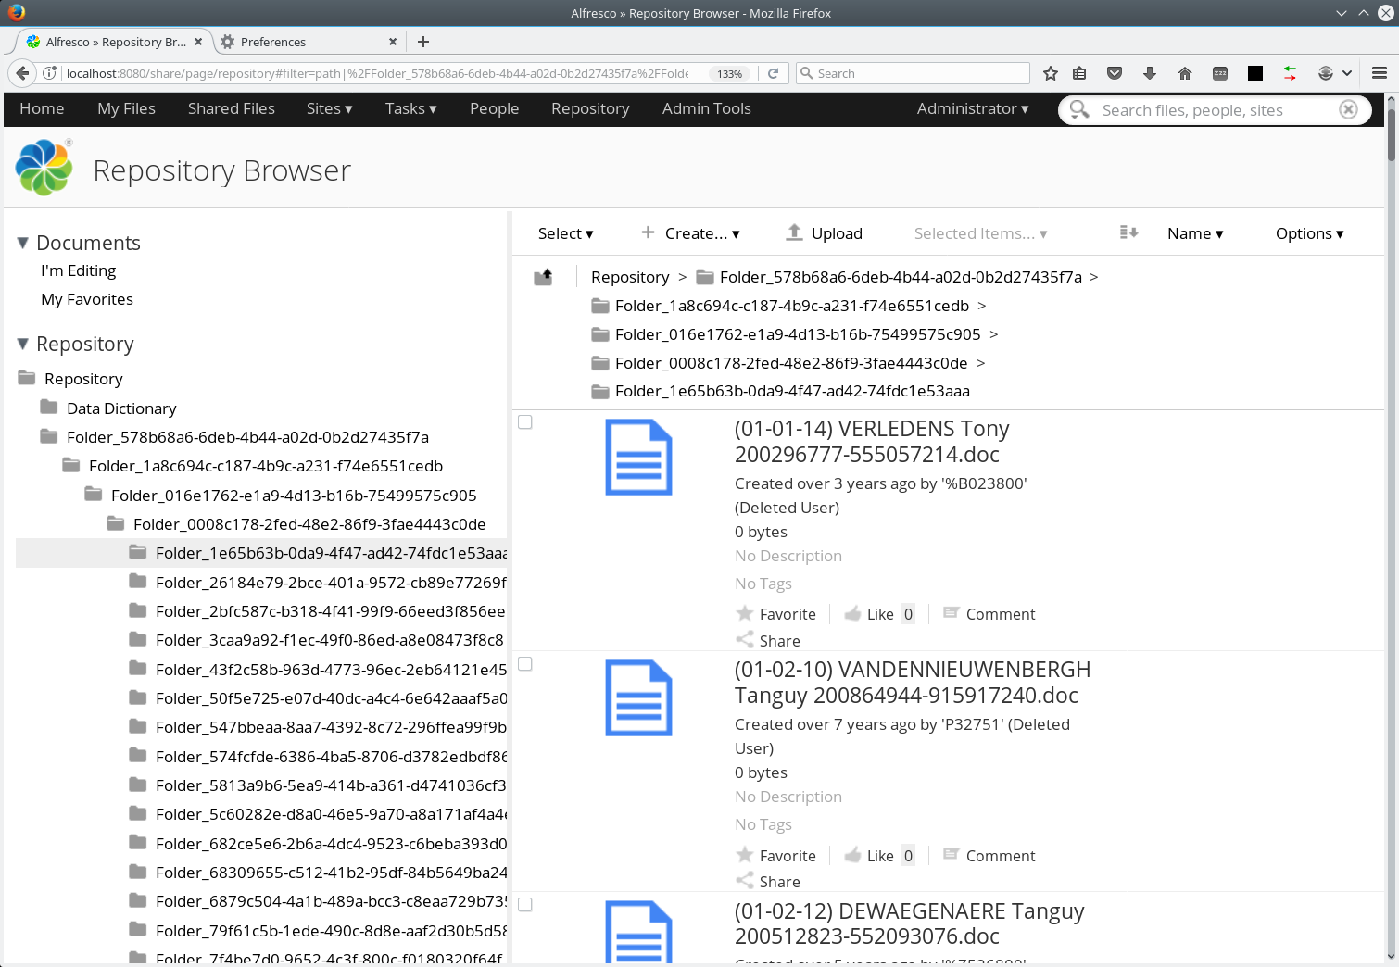
Experiments - loading documents
No content
Custom model with >10 metadata fields, values randomly generated based on constraints or data type
Folder structure with / without artificial acls
Load speed at 12 threads:
  Approx 1.3 mil docs / hour
Solr indexing real time
Notes:
In terms of loading documents, we used a custom program which pomps documents to Alfresco. Documents have no content. They are based on a custom model (which needs to have been uploaded to Alfresco), with randomly generated values. For the metadata fields with constraints, values are taken from the constraints, for the rest they are generated. There are a number of parameters to the program:
-model used
-whether to use artificial acls
-whether to disable rules and policies for better performance
-number of documents to be created
-number of threads
-items per transactions
-items per folder
The load speed is fine: approx 1mil docs in 45 min. If resources are available, loading also scales well. It takes a bit more than 3 days to load 100mil docs. Solr indexes real-time – if enough resources. We use a single ingestion server and a single Alfresco node.

Slide 15
Experiments - loading documents
No content
Custom model with >10 metadata fields, values randomly generated based on constraints or data type
Folder structure with / without artificial acls
Load speed at 12 threads:
  Approx 1.3 mil docs / hour
Solr indexing real time
Notes:
In terms of loading documents, we used a custom program which pomps documents to Alfresco. Documents have no content. They are based on a custom model (which needs to have been uploaded to Alfresco), with randomly generated values. For the metadata fields with constraints, values are taken from the constraints, for the rest they are generated. There are a number of parameters to the program:
-model used
-whether to use artificial acls
-whether to disable rules and policies for better performance
-number of documents to be created
-number of threads
-items per transactions
-items per folder
The load speed is fine: approx 1mil docs in 45 min. If resources are available, loading also scales well. It takes a bit more than 3 days to load 100mil docs. Solr indexes real-time – if enough resources. We use a single ingestion server and a single Alfresco node.

Slide 16
Experiments – problems encountered
Ran out of inodes on solr’ partition – needed to reformat the partition with small block size
Db tunning – max connections
Memory tunning on db, alfresco + solr size
Increased max header size in tomcat
Performance improvements:
Disabling acl-checks on Alfresco’s side, post-searching
Notes:
We ran into a number of problems while doing the experiments, which had as consequences rerunning, starting from scratch etc. One of the undocumented problems related to solr is running out of inodes due to the content folder – that contains a very large number of small files, equal to the total number of documents in the repo. For an ext4 filesystem, this means either a huge partition or a partition formatted with small block sizes.
Other problems were: tunning the maximum number of connections on the db side (for large number of shards), tunning memory on the db, alfresco and solr side.
Also, the header size in solr’s tomcat needed to be increased when having many results returned from the search.

Slide 17
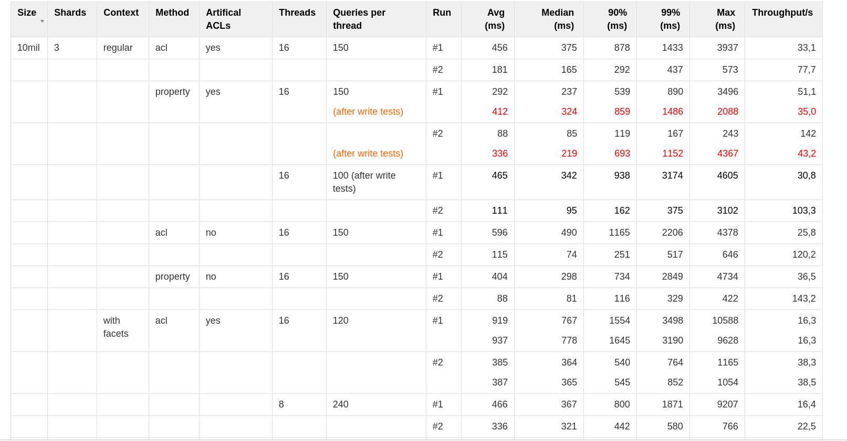
Results

Slide 18
Conclusions
Search slow?
Primary culprit: DB access / cache
  Expensive bulk load
  Cache “sabotage”: nodesSharedCache TTL
  (used OOTBee Support Tools for insights)

Slide 19
Conclusions
Search slow?
Primary culprit: DB access / cache
  Expensive bulk load
  Cache “sabotage”: nodesSharedCache TTL
  (used OOTBee Support Tools for insights)
Secondary culprit: Repository-tier ACL checking
  Misleading: PermissionEvaluationMode.NONE
  Low default size of caches for readers/readersDenied

Slide 20

Conclusions
Natural best performer: property sharding + shard-targeted queries
  ~20% (+-10%) better general performance
  Improved scaling for parallel requests

Slide 21
Further work
In progress: 100 million documents
  Extended data model
  Realistic value distribution for sharding property
Planned: customer reference setup
  Ideally: 100% live data clone, augmented via generation
  Oracle instead of PostgreSQL

Slide 22
Speaker contacts
roxana.angheluta@xenit.eu
axel.faust@acosix.de

