Slide 1
Honeycomb & Beyond
Martin Cosgrave
Daren Firminger

Slide 2

Why Honeycomb?
Objective to have an Order of the Bee Release
Demonstrating a production quality implementation of Alfresco Open Source

Slide 3
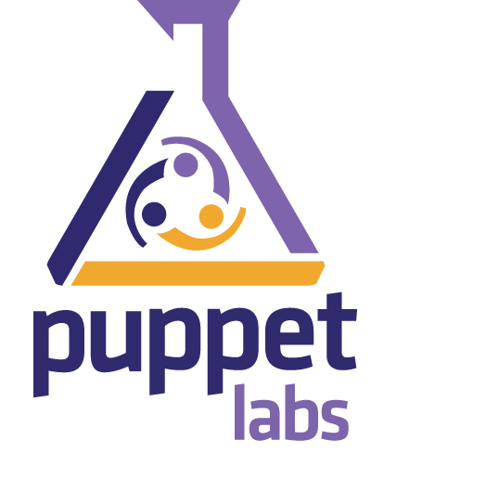
Why Puppet
Bring your machine to a known state, and keep it there using automation
Repeatable builds all the way to production.

Slide 4
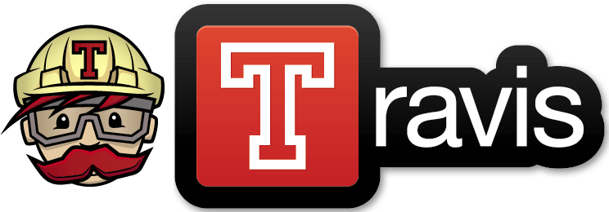
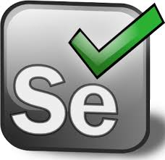
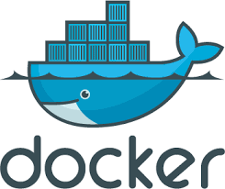
Good Times & Bad Times

Slide 5
Puppet Pros and Cons
Good: Leaves a natively installed build on the system, which can be maintained at a known state with config changes managed via a rerun of the process, config can be managed, (if stuck too). Used along with puppet master managing multiple alfresco nodes from one build system. Reliable Build.
Bad: maintainance, vulnerable to download changes
Build time, depending where in the world you are deploying, as longest time is pulling in all the assets
Lessons Learnt

Slide 6
Do we upgrade to handle 5.1+ changes or are we chasing a forever moving snake.
Other Puppet Users help to support 4.2.f, 5.0d, 5.1e…..many many versions if CI used and releases become weekly.
Future Puppet-Alfresco

Slide 7

DOG FOODING
HoneyComb build used to support
Beecon 2016

Slide 8
Docker …..
Docker as a production environment?
Needs more RAM than Puppet native grua : Why another docker tool?
Simple! grua fill grua refill grua stack grua restack grua status
Beyond Puppet

Slide 9
Growing beyond the single VM
Docker & Weave
Machine1 — master node weave launch FQDN
$eval(weave env)
Machine 2 weave launch FQDN
$eval(weave env)
Oh please bare metal !!
CORE OS
Scaling
Weave provides seamless dns across the entire cluster.
Allows alfresco components to be moved onto remote vm, requires data stores to be NFS shared to all vms

Slide 10
Alternative build systems, chef, ansible, salt, docker
SPK
Simple, Reliable, Fast, Repeatable, Resilient and Reactive
Standard build

Slide 11
Help the little guys
Keep the technology open, enabling the use of BPM to grow
Interoperability improves with open products
Keeps skill sets relevant to younger developers, unable commercial licencing
Oh yes Alfresco want to IPO, go sit on the beach in the Cayman Islands … what happens after IPO?, what if Oracle decides to buy? Or Microsoft? Or Documentum?
Why its Important

