Slide 1

Remote Office Documents transformations for Alfresco
Younes Regaieg
Software Engineer @ Xenit Solutions

Slide 2

Remote Office Documents transformations for Alfresco
Younes Regaieg
Buzzing Bee @ Order Of The Bee
@yreg (IRC)
@yregaieg (twitter)

Slide 3




Document transformations in Alfresco

Slide 4

Document transformations can be greedy in terms of resources !

Slide 5
Document transformations can be greedy in terms of resources !

Slide 6
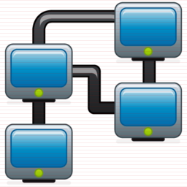

Community Edition vs Enterprise Edition
Single instance vs Multi instance

Slide 7
Community Edition vs Enterprise Edition
Single instance vs Multi instance

Slide 8

Externalizing the transformation
JOD Converter Service

Slide 9
Externalizing the transformation
JOD Converter Service

Slide 10
Externalizing the transformation
JOD Converter Service
JOD Converter Service
Load Balancer
JOD Converter Service

Slide 11

Micro service architecture
JOD Converter Service
JOD Converter Service
Load Balancer
JOD Converter Service

Slide 12
Micro service architecture
JOD Converter Service
JOD Converter Service
Load Balancer
JOD Converter Service

Slide 13
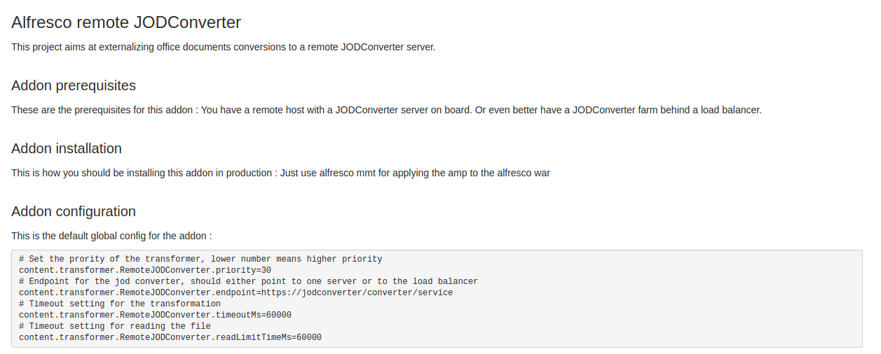
Fork it, build it, contribute back !
https://bitbucket.org/xenit/alfresco-remote-jodconverter/

Slide 14
Fork it, build it, contribute back !
https://bitbucket.org/xenit/alfresco-remote-jodconverter/

Slide 15
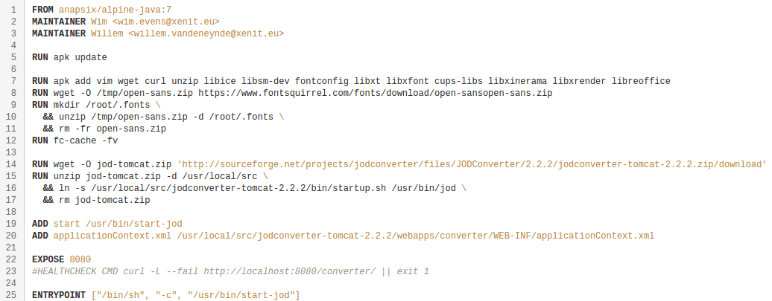
Fork it, build it, contribute back !
https://bitbucket.org/xenit/docker-jodconverter-ws

Slide 16
Fork it, build it, contribute back !
https://bitbucket.org/xenit/docker-jodconverter-ws

Slide 17
Docker-compose up -d
version: '2'
services:
alfresco-core:
image: hub.xenit.eu/alfresco-<client-name>-5.1:latest
volumes:
- alfresco:/opt/alfresco/alf_data
restart: unless-stopped
links:
- jodconverter
ports:
- 8080:8080
environment:
- …
- ALF_content.transformer.RemoteJODConverter.endpoint=http://jodconverter:8080/converter/service
jodconverter:
image: hub.xenit.eu/jodconverter-ws
restart: unless-stopped

Slide 18
Docker-compose up -d
version: '2'
services:
alfresco-core:
image: hub.xenit.eu/alfresco-<client-name>-5.1:latest
volumes:
- alfresco:/opt/alfresco/alf_data
restart: unless-stopped
links:
- jodconverter
ports:
- 8080:8080
environment:
- …
- ALF_content.transformer.RemoteJODConverter.endpoint=http://jodconverter:8080/converter/service
jodconverter:
image: hub.xenit.eu/jodconverter-ws
restart: unless-stopped

Slide 19
#Todo list
Update to a more up-to-date version of the JODConverter service
Add support for few extra extensions/mimetypes
Integrate with a monitoring back end to easily visualize failed transformations
Better handling for failed transformations (forward the transformation request to the following transformer
Scaling up (integration with consul and registrator to scale up and spin extra containers if/when needed)

Slide 20
#Todo list
Update to a more up-to-date version of the JODConverter service
Add support for few extra extensions/mimetypes
Integrate with a monitoring back end to easily visualize failed transformations
Better handling for failed transformations (forward the transformation request to the following transformer
Scaling up (integration with consul and registrator to scale up and spin extra containers if/when needed)

Slide 21
#Todo list
Update to a more up-to-date version of the JODConverter service
Add support for few extra extensions/mimetypes
Integrate with a monitoring back end to easily visualize failed transformations
Better handling for failed transformations (forward the transformation request to the following transformer
Scaling up (integration with consul and registrator to scale up and spin extra containers if/when needed)

Slide 22
Speaker contacts
Younes Regaieg <younes.regaieg@xenit.eu>

