Slide 1


Rust
For Python Developers

Slide 2


What is Rust?
A statically typed, compiled, memory safe language
No garbage collector
Low-level control
Compiler
Source code
*.rs
Checks & optimization
Machine code
(*.exe, ELF)

Slide 3
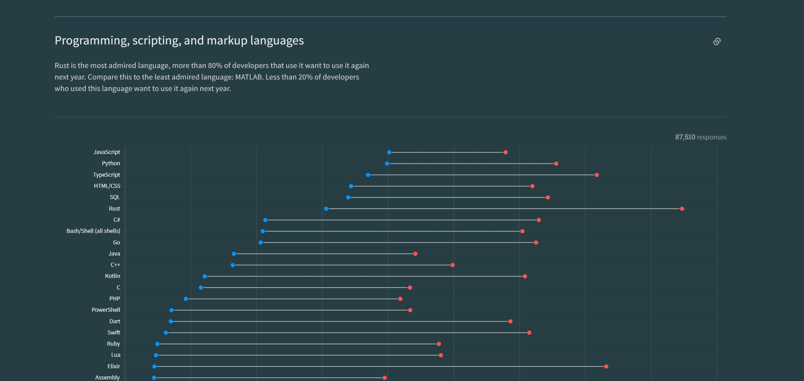
Why Rust?
Most admired language in the stack overflow survey since 2016
Fast

Slide 4

Where is it used?
Linux kernel
Python tools/packages
Ruff
Polars
Command line tools
Eza
Ripgrep
Starship
Notes:
“Rust has become the second language officially accepted for Linux kernel development, along with C.” – Dec 2022

Slide 5

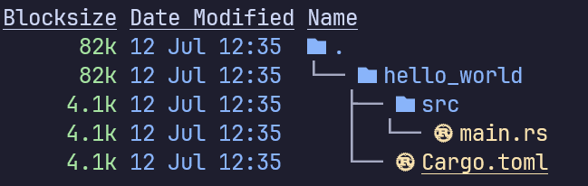
Starting a project
In a shell:
Source code
Project specifications

Slide 6
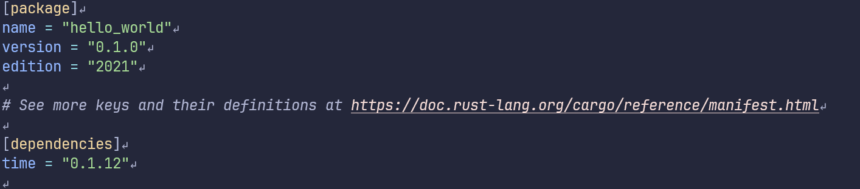
Cargo.toml
Project information
External packages

Slide 7
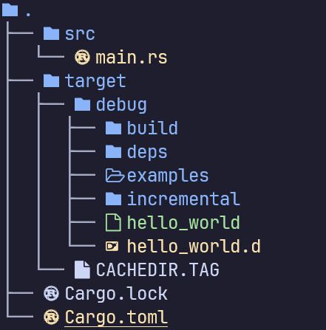
Compiling & running
Compiling
Running the program
Compiling & running
Binary

Slide 8
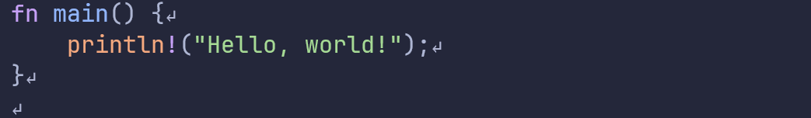
Hello world!
Every project needs a main function as entry point
Note:
Curly braces around the function body
Statements ends with a ‘;’
“println!” Is a macro
Notes:
`println!` is a macro, behaves like a function but with different rules

Slide 9
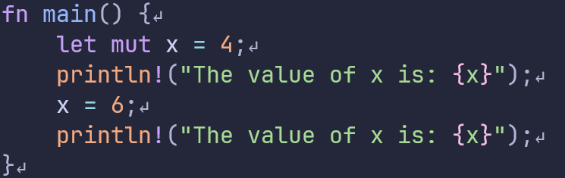
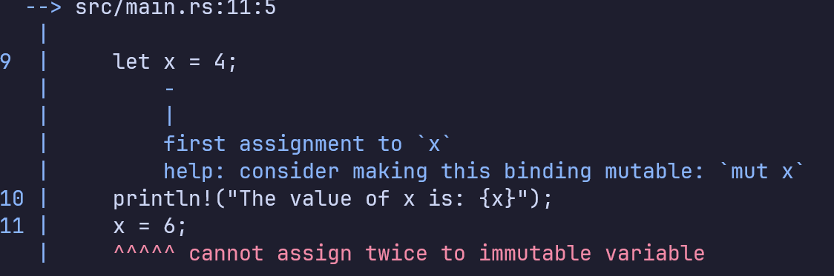
Variables
By default, immutable
Initialize with `let` keyword
Types cannot change
Shadowing is allowed

Slide 10
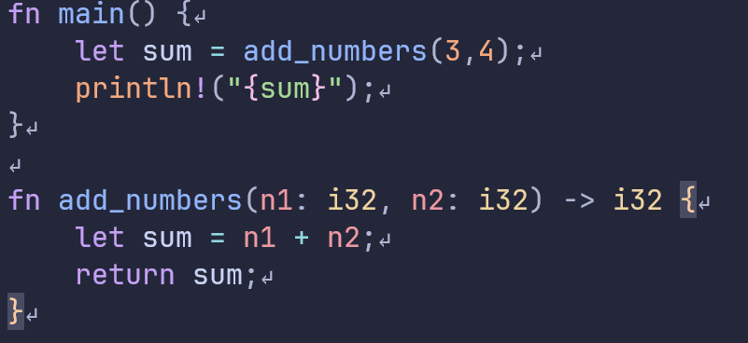
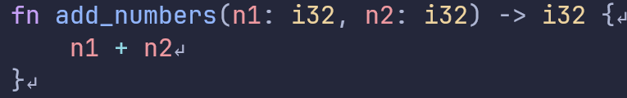
Functions
Argument and return types are mandatory
Arguments
Return type

Slide 11
Memory
Stack
Heap
Ordered and structured
Last in first out
All data stored on the stack must have a known, fixed size
Fast
Less organized
Allocating and accessing is slower
Data can change size

Slide 12
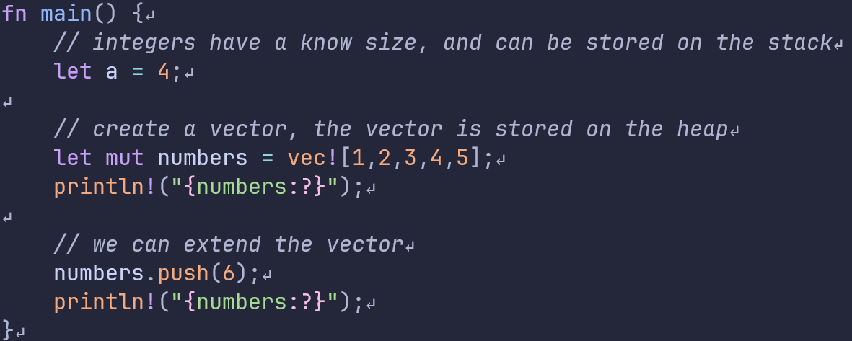
Memory
Stack
Heap
[1,2,3,4,5]
Main()
a = 4
numbers

Slide 13
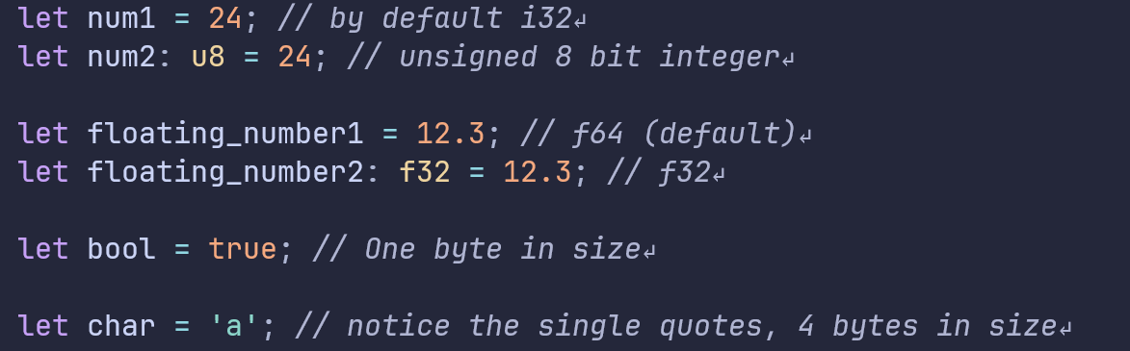
Scalar types
Stored on the stack
Compiler can usually infer the (default) type

Slide 14
Compound types
Array – List of elements of one type
Tuple – List of elements, types can be different
Stack
Vector – Ordered growable array, only one type
String – Like a vector but for characters
Struct – Named fields that can be of multiple types, think of a Python class
Enum – A type which is one of a few variants
Heap
Remember: Data on the stack cannot grow!

Slide 15
Ownership
"Ownership is a set of rules that govern how a Rust program manages memory.“
3 Rules for ownership:
- Each value in Rust has an owner
- There can only be one owner at a time
- When the owner goes out of scope, the value will be dropped.

Slide 16
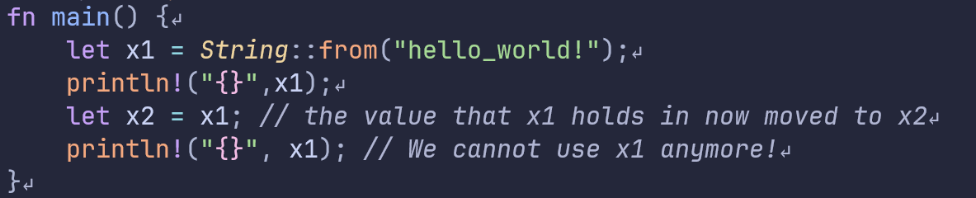
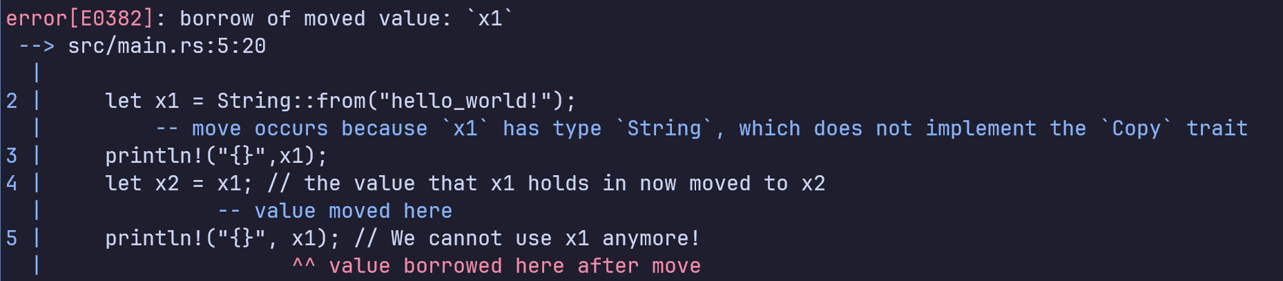

Slide 17
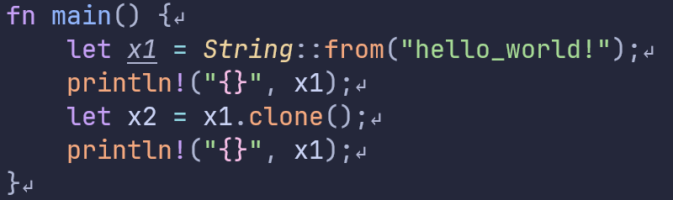
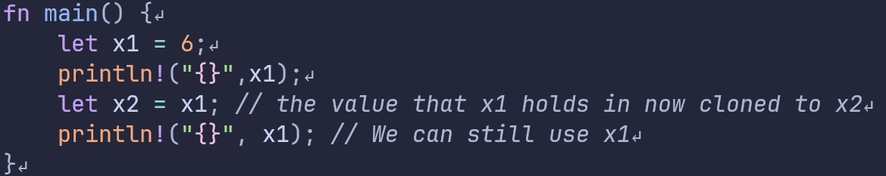
We can use clone to copy the value and not transfer ownership
Simple types implement “copy”, which means they are by default cloned instead of moved.

Slide 18
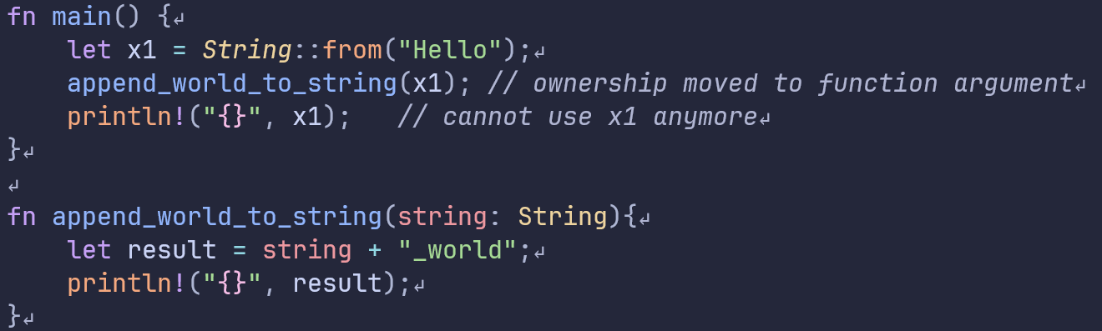
Passing a variable into a function will transfer ownership
This will not compile!

Slide 19
Pointers
A variable that holds a memory address
Cheaper to pass an address around than large objects
Can cause a lot of bugs! (not in Rust)
Dangling pointers
Pointers to uninitialized memory
Freeing a pointer twice
Multiple pointers to the same data can cause data races

Slide 20
Memory safety
“The majority of vulnerabilities fixed and with a CVE assigned are caused by developers inadvertently inserting memory corruption bugs into their C and C++ code.” – Microsoft blogpost
“The Chromium project finds that around 70% of our serious security bugs are memory safety problems. Our next major project is to prevent such bugs at source.” - Google

Slide 21
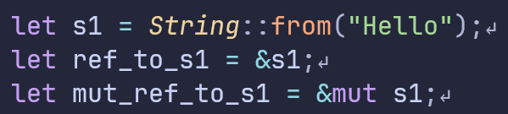
References
Special type of pointer with compile time checks
Create with `&`
If you want to change data through a reference you need a mutable reference
&{..}
S1 = address
“Hello”
*{..}

Slide 22
Rules for references
1. At any given time, you can have either one mutable reference or any number of immutable references.
2. References must always be valid

Slide 23
Reference examples

Slide 24
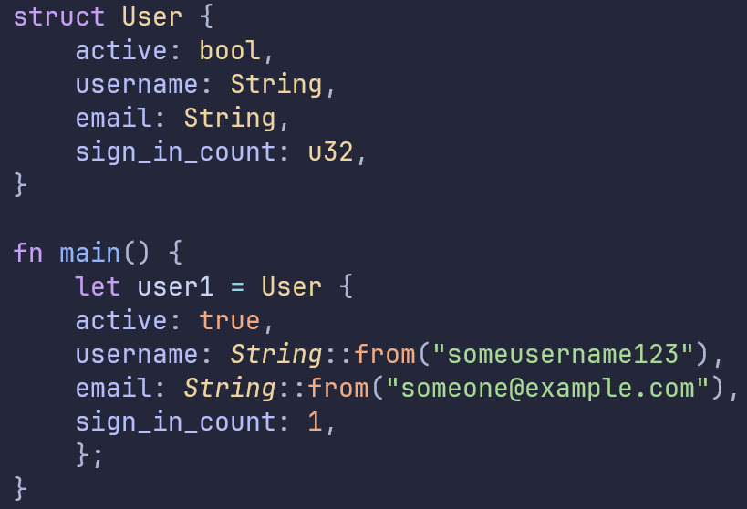
Structs
Most similar Rust type to a Python class
Named attributes
Supports methods and associated functions

Slide 25
Enums

