Slide 1


Rust
For Python Developers

Slide 2
Schedule
Presentation
Rust practice exercises
Python & Rust practice exercises
Drinks 🍻
Notes:
We will start with a presentation in which we first will explain what the language is, what makes it unique and why should you care. We will also go over some basic syntax. Ofcourse you cannot learn an entire new programming language in an afternoon. But we are going to try anyway.
Then we have prepared some exercises to practice with Rust
Next, we have a workshop/ guided exercises with Python & Rust
And we will end with drinks.

Slide 3
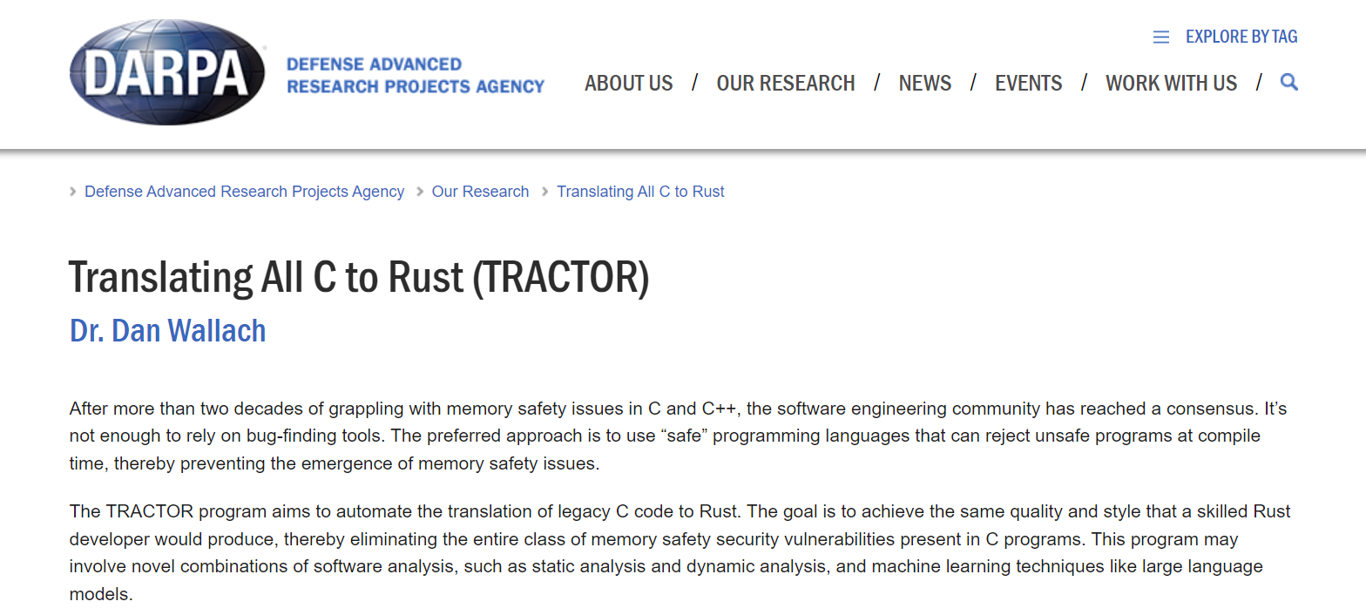

Slide 4


What is Rust?
A statically typed, compiled, memory safe language
No garbage collector
Compiler
Source code
*.rs
Checks & optimization
Machine code
(*.exe, ELF)
Notes:
In a lot of way the opposite of Python:
- Statically typed: types of variables can not change after declaration
Compiled: the source code (.rs files) are compiled into a binary first before you can execute them
Memory safe, like Python, Java, C sharp etc.
No gc makes it fast, why?
In Python you can create a new variable with some data and memory is allocated for you. You don’t have to clean it up yourself, because of the gc. The gc is an extra runtime that will check if data is still being used, and if it is not, it gets cleaned up, and the memory can be used for something else.
In c/c++ you as a developer have to ask for memory, and free the memory if when you are done. This is a lot of responsibility, for instance, if you forget to free the memory you will have a memory leak. This is a problem for long running programs. And if you free it more than once, you corrupt data.
Rust has a solution, the ownership model.

Slide 5
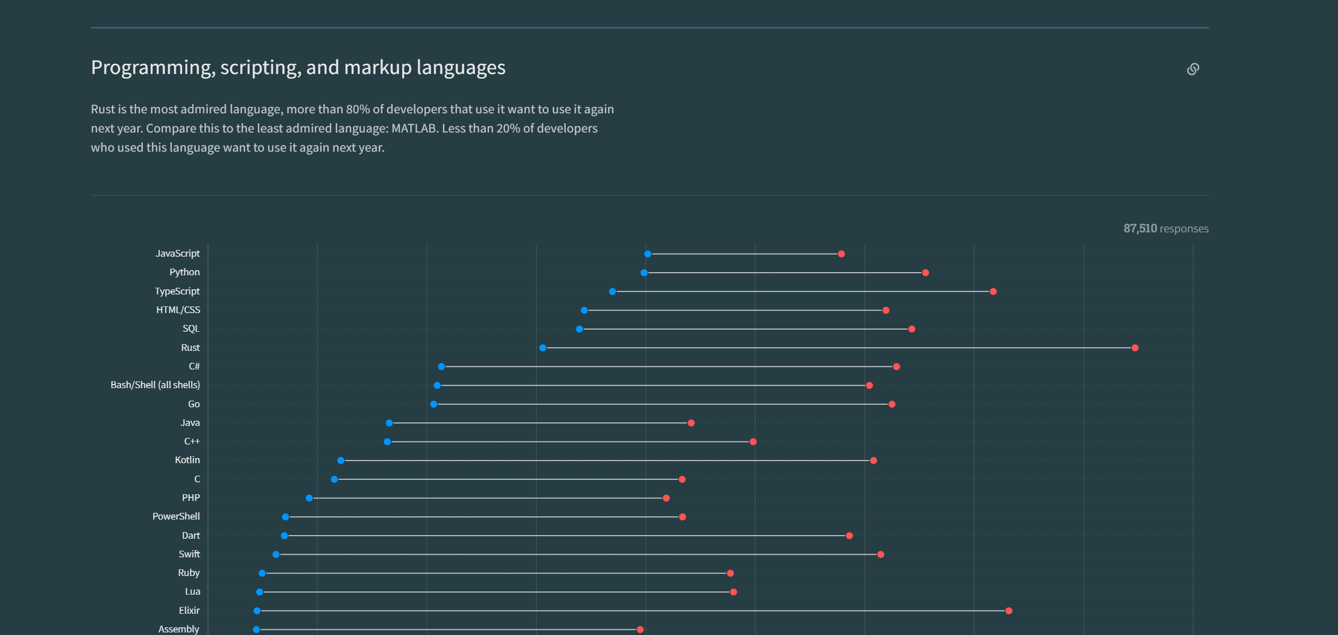
Why Rust?
Most admired language in the stack overflow survey since 2016
Fast
Low-level control

Slide 6



Where is it used?
Linux kernel
Python tools/packages
Ruff
Polars
Command line tools
Eza
Ripgrep
Starship
Notes:
“Rust has become the second language officially accepted for Linux kernel development, along with C.” – Dec 2022

Slide 7
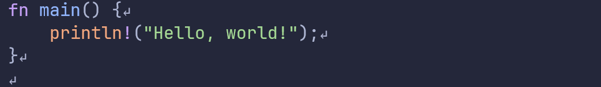
Hello world!
Every project needs a main function as entry point
Note:
Curly braces around the function body
Statements ends with a ‘;’
“println!” Is a macro
Notes:
Always start with hello world
Main function is entry
`println!` is a macro, behaves like a function but with different rules
Statements end with semi colon

Slide 8
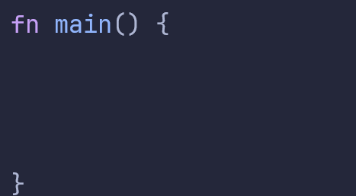


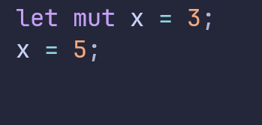


Variables
Declare with `let` keyword
Types cannot change
By default, immutable
Only available in the “scope” they are declared in
You can declare and initialize in one statement
This is not allowed

Slide 9
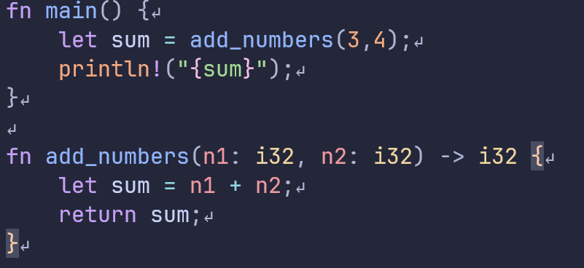
Functions
Argument and return types are mandatory
Arguments
Return type
Notes:
Familiar for people who use mypy
You have to give types of arguments and return
Function is called from main function

Slide 10
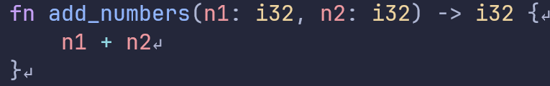
Functions
You can use expressions in functions instead of return
Statements
Expression
Notes:
Always end lines of code with semi colon, unless you want them to return something.

Slide 11
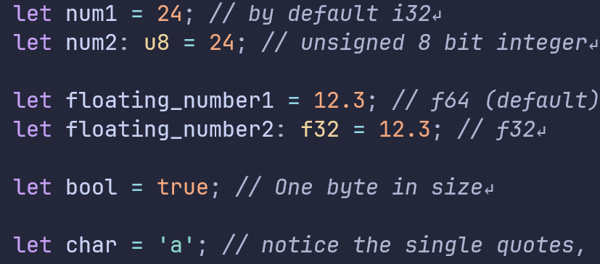
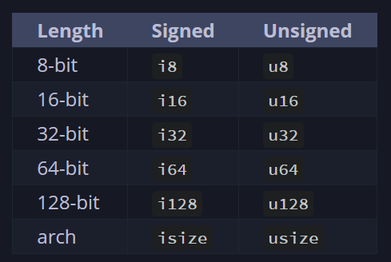
Scalar types
Stored on the stack
Compiler can usually guess the type from context
Notes:
Two types of integers: signed and unsigned
Two types of floating points, use f64
Bools, true and false are not capitalized!
Characters, note: difference between single and double quotes.

Slide 12
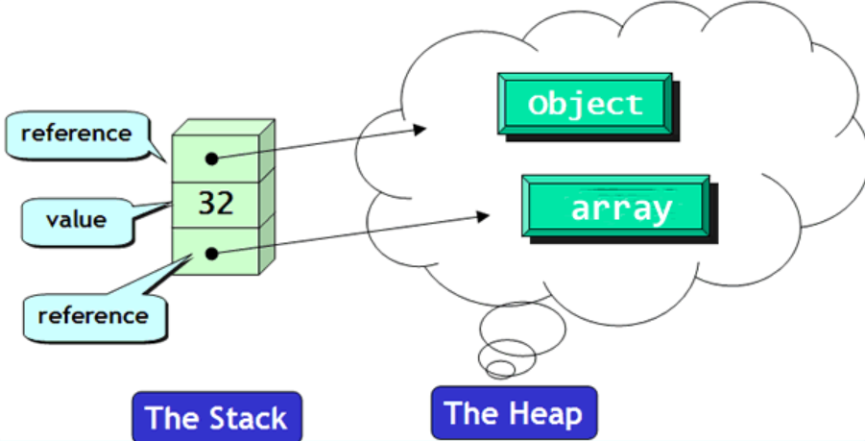
Memory
Stack
Heap
Ordered and structured
Last in first out
All data stored on the stack must have a known, fixed size
Fast
Less organized
Allocating and accessing is slower
Data can change size

Slide 13
Compound types
Array – List of elements of one type
Tuple – List of elements, types can be different
Struct – Named fields that can be of multiple types, think of a Python class
Enum – A type which is one of a few variants
Stack
Vector – Ordered growable array, only one type
String – Like a vector but for characters
Heap
Remember: Data on the stack cannot grow in memory size!

Slide 14
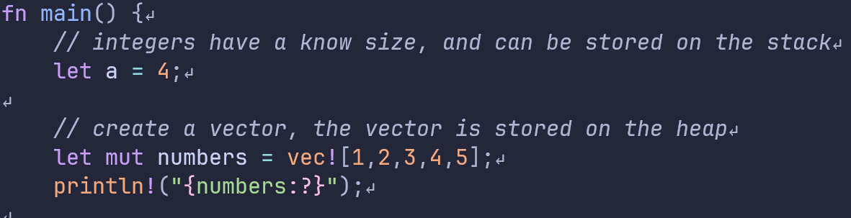
Memory
Stack
Heap
[1,2,3,4,5]
Main()
a = 4
numbers

Slide 15
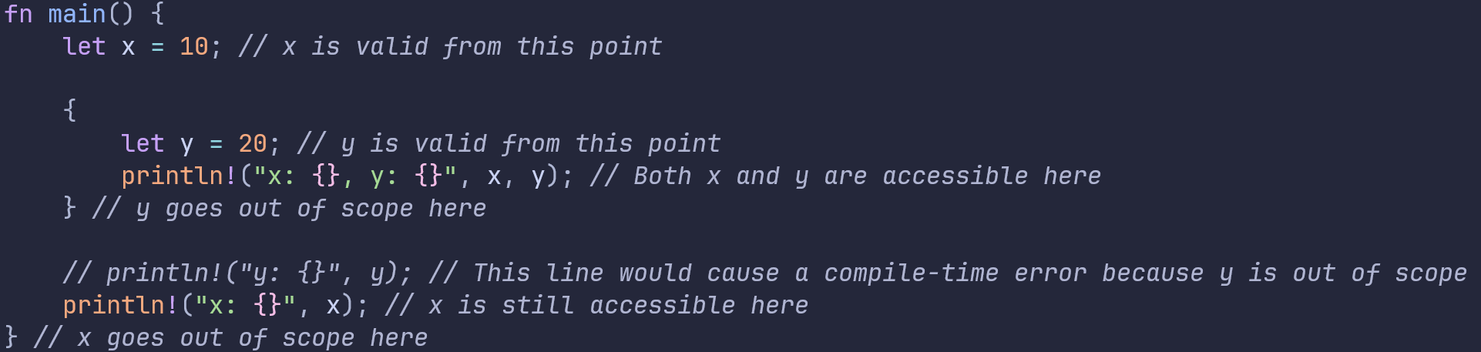
Scope
When you declare a variable in Rust, it is only accessible within the scope in which it was declared.
Notes:
Once the block is exited, the variable goes out of scope, and Rust automatically calls the drop method to clean up the variable.

Slide 16
Ownership
"Ownership is a set of rules that govern how a Rust program manages memory.“
3 Rules for ownership:
- Each value in Rust has an owner
- There can only be one owner at a time
- When the owner goes out of scope, the value will be dropped.

Slide 17
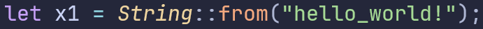



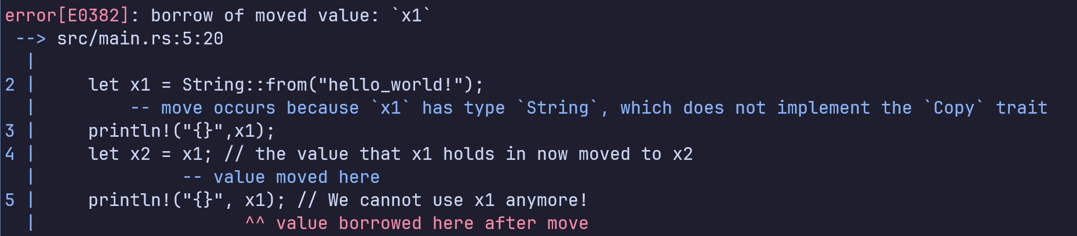
Ownership transfer
x1
“hello_world!”
x2

Slide 18

Cloning data
x1
“hello_world!”
“hello_world!”
x2
Cloning data does not transfer ownership but makes a copy

Slide 19
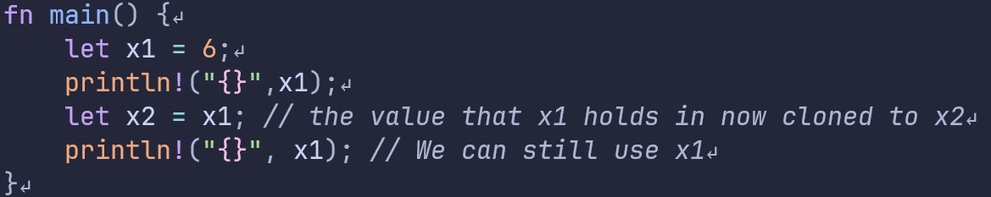
Copy trait
Simple types implement “copy”, which means they are by default cloned instead of moved.

Slide 20
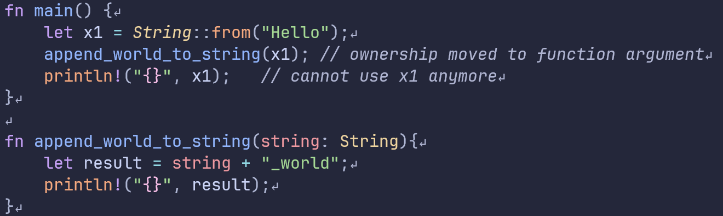
Ownership transfer
Passing a variable into a function will transfer ownership
x1
“Hello”
string
This will not compile!

Slide 21
Pointers
A variable that holds a memory address
Cheaper to pass an address around than large objects
Issues with pointers (not in Rust)
Dangling pointers
Pointers to uninitialized memory
Freeing a pointer twice
Multiple pointers to the same data can cause data races

Slide 22
Memory safety
“The majority of vulnerabilities fixed and with a CVE assigned are caused by developers inadvertently inserting memory corruption bugs into their C and C++ code.” – Microsoft blogpost
“The Chromium project finds that around 70% of our serious security bugs are memory safety problems. Our next major project is to prevent such bugs at source.” - Google

Slide 23
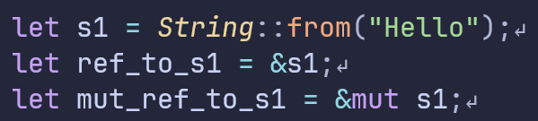
References
Special type of pointer with compile time checks
Create with `&`
If you want to change data through a reference you need a mutable reference
&{..}
S1 = address
“Hello”
*{..}

Slide 24
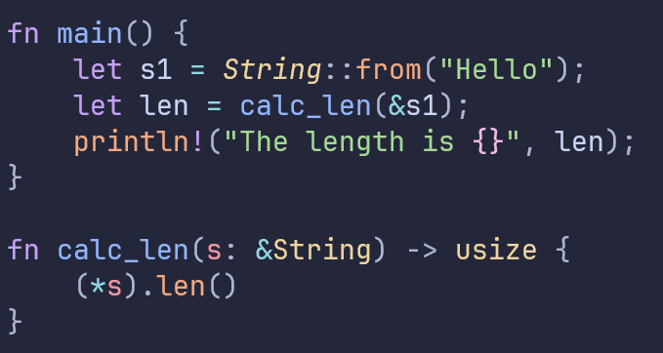
References example
s
s1
“Hello”

Slide 25
Rules for references
1. At any given time, you can have either one mutable reference or any number of immutable references.
2. References must always be valid

Slide 26
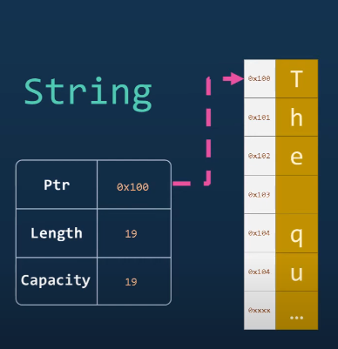
Strings
Two main types:
String type, heap allocated,
mutable, can grow
string slice, &str,
fixed

Slide 27
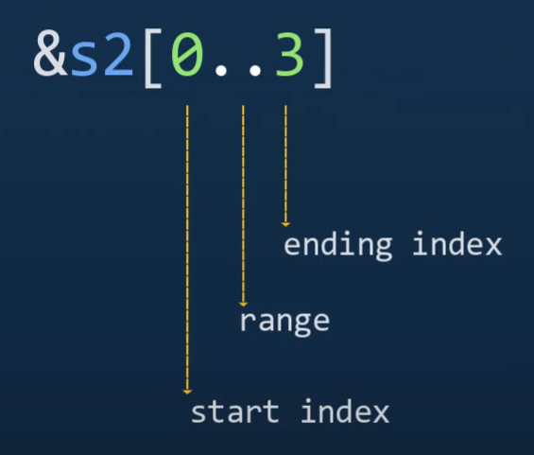
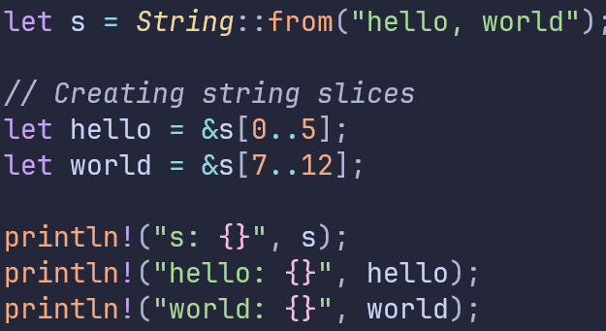
String slices
References to portions of a ‘String’

Slide 28
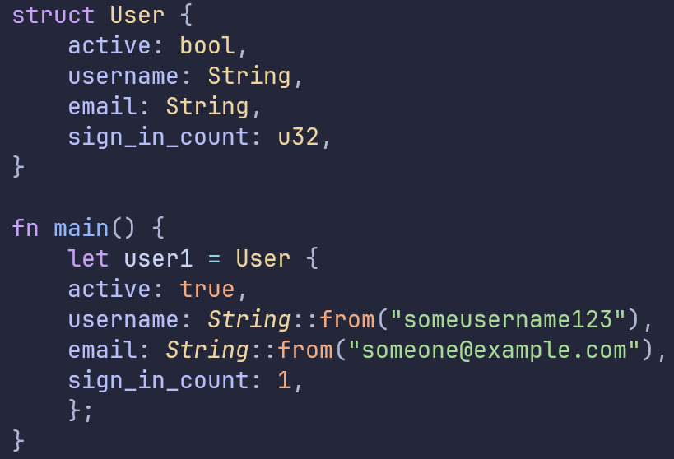
Structs
Most similar Rust type to a Python class
Named attributes
Supports methods and associated functions

Slide 29
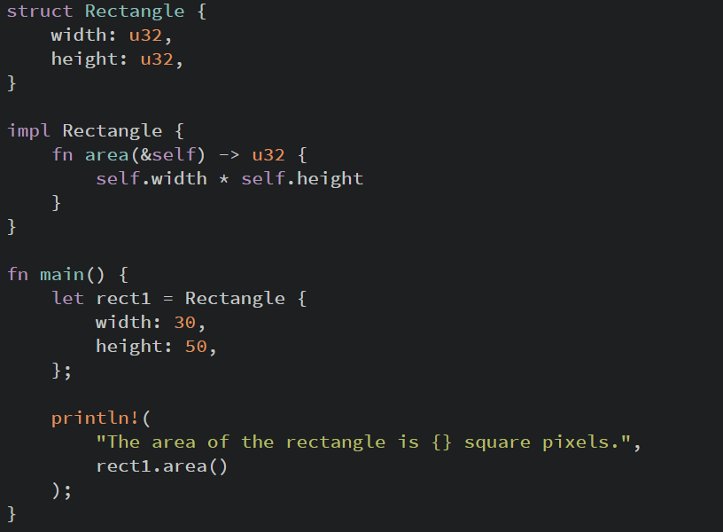
Structs
Use self to reference the object
Use Self (capitalized) to reference the type

Slide 30
Macros
Expand into other code at compile time
More flexible than functions
Some are used as “decorators”
Notes:
Unlike functions, which operate on runtime values and have a fixed signature and type constraints, macros operate on the syntax of the code itself, enabling more flexible and reusable abstractions.

Slide 31
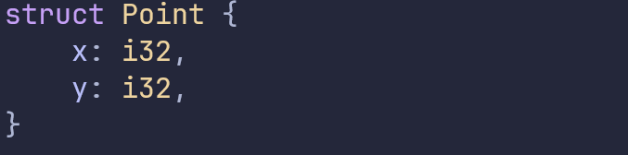
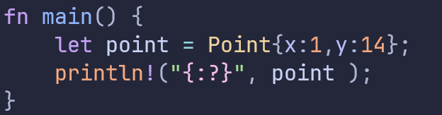

Macros
Notes:
Unlike functions, which operate on runtime values and have a fixed signature and type constraints, macros operate on the syntax of the code itself, enabling more flexible and reusable abstractions.

Slide 32
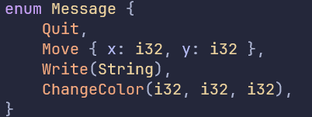
Enums
A value from a possible set of values

Slide 33
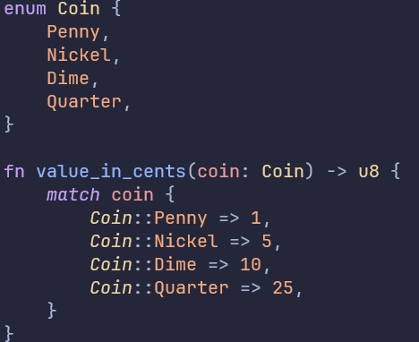
Pattern matching
You must handle all case when using match

Slide 34
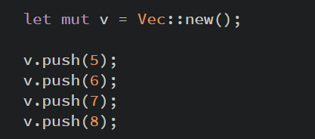

Vectors
Ordered collection of elements of the same type
Create using function:
Or macro:

Slide 35
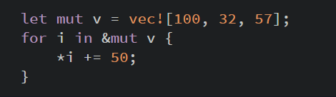
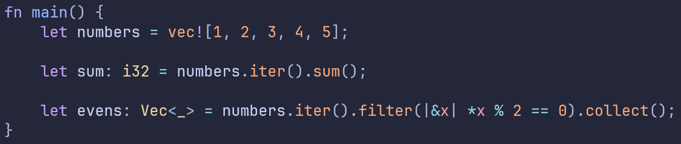
Vector iteration
Iterate with for loop
Or turn a vector into an iterator

Slide 36
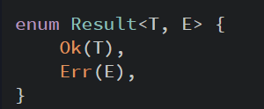
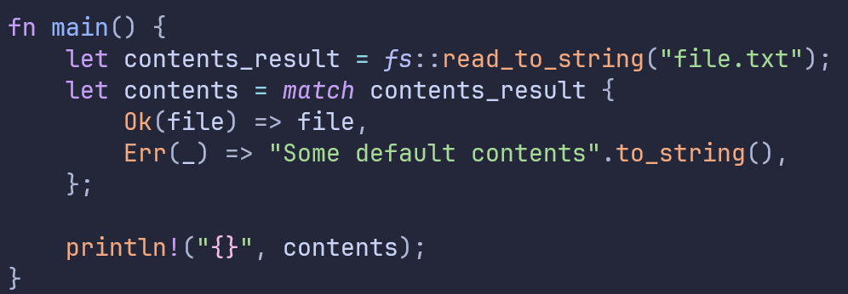
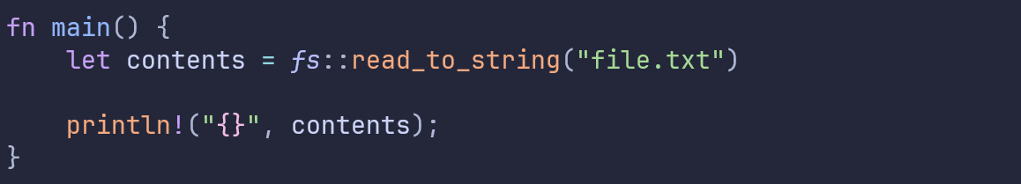

Errors
Functions that can fail will return a Result

Slide 37

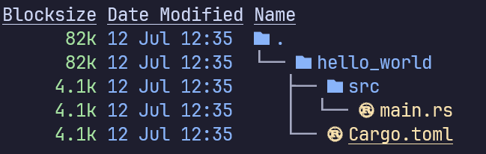
Starting a project
In a shell:
Source code
Project specifications

Slide 38
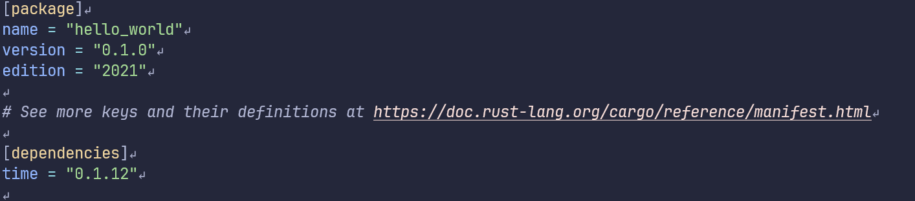
Cargo.toml
Project information
External packages

Slide 39
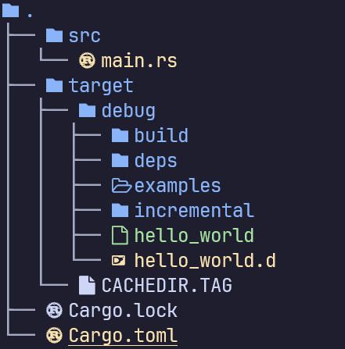
Compiling & running
Compiling
Running the program
Compiling & running
Binary

Slide 40

Questions?

