Slide 1


Rust
For Python Developers

Slide 2
Schedule
Presentation
Rust practice exercises
Python & Rust practice exercises

Slide 3


What is Rust?
A statically typed, compiled, memory safe language
No garbage collector
Low-level control
Compiler
Source code
*.rs
Checks & optimization
Machine code
(*.exe, ELF)

Slide 4
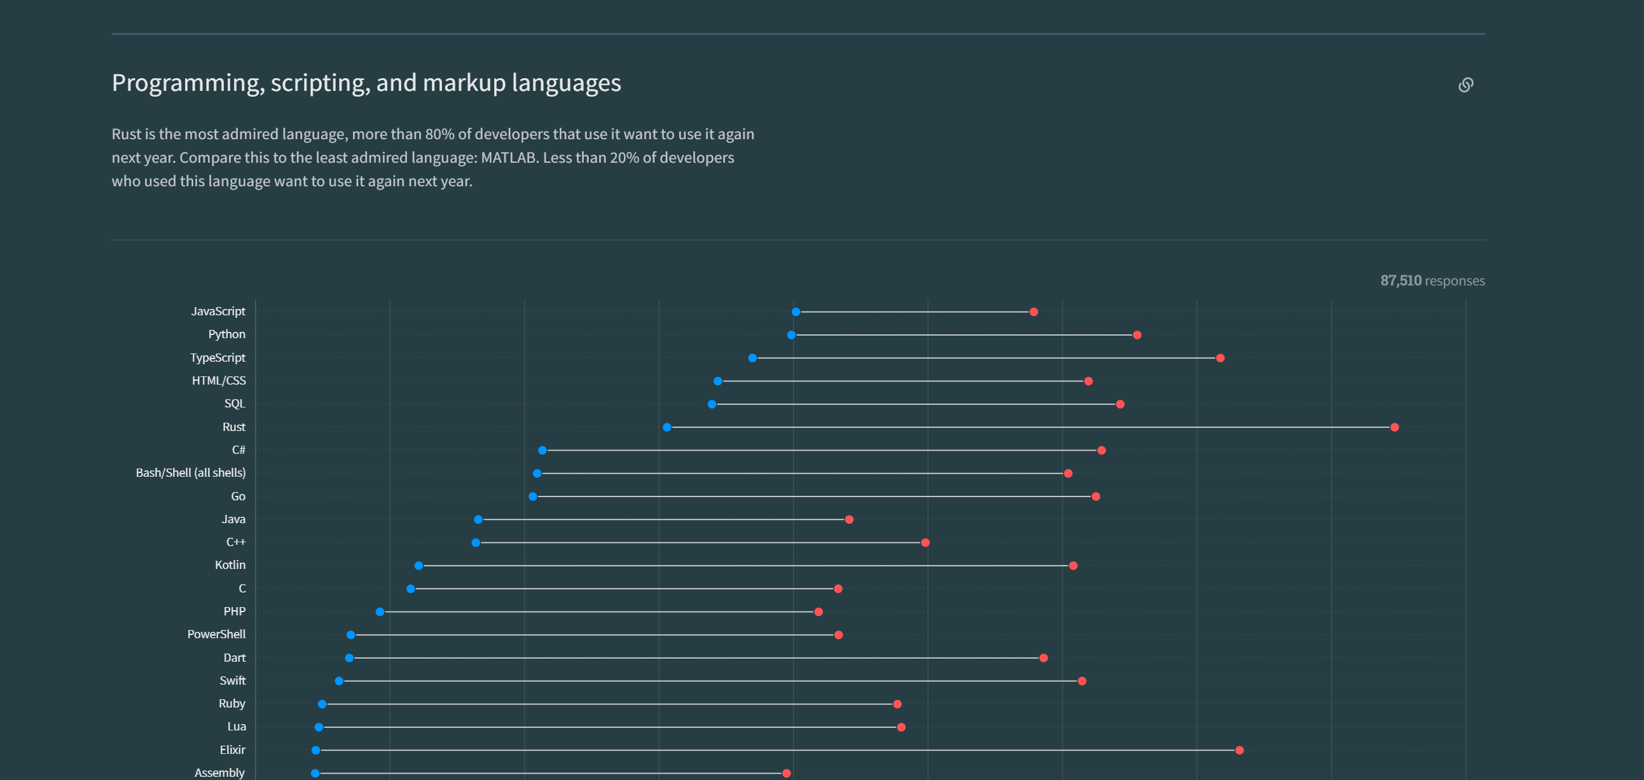
Why Rust?
Most admired language in the stack overflow survey since 2016
Fast

Slide 5



Where is it used?
Linux kernel
Python tools/packages
Ruff
Polars
Command line tools
Eza
Ripgrep
Starship
Notes:
“Rust has become the second language officially accepted for Linux kernel development, along with C.” – Dec 2022

Slide 6
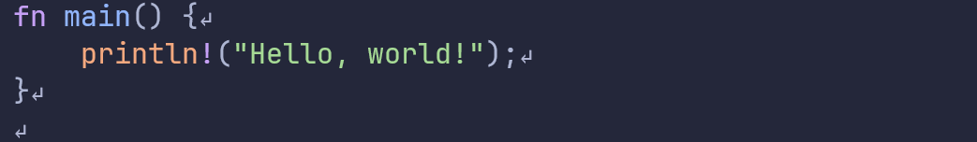
Hello world!
Every project needs a main function as entry point
Note:
Curly braces around the function body
Statements ends with a ‘;’
“println!” Is a macro
Notes:
`println!` is a macro, behaves like a function but with different rules

Slide 7
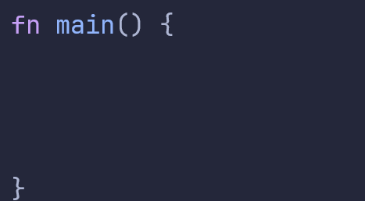


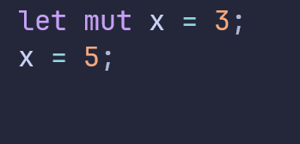


Variables
Declare with `let` keyword
Types cannot change
By default, immutable
Only available in the “scope” they are declared in
You can declare and initialize in one statement
This is not allowed

Slide 8
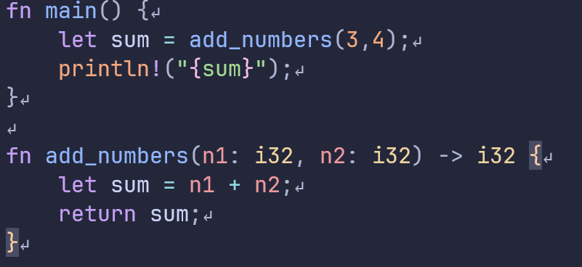
Functions
Argument and return types are mandatory
Arguments
Return type

Slide 9
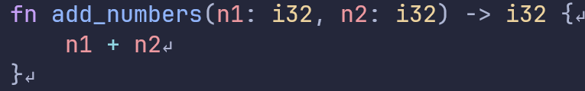
Functions
You can use expressions in functions instead of return
Statements
Expression

Slide 10
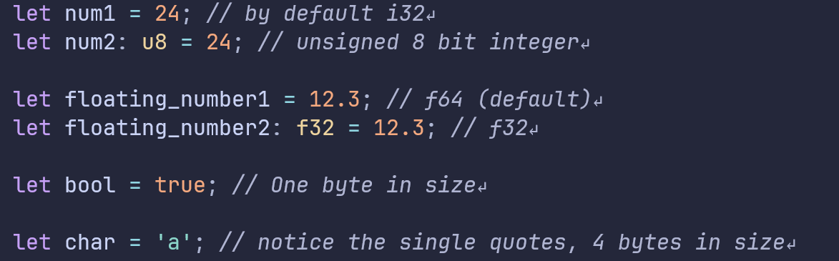
Scalar types
Stored on the stack
Compiler can usually guess the type from context

Slide 11
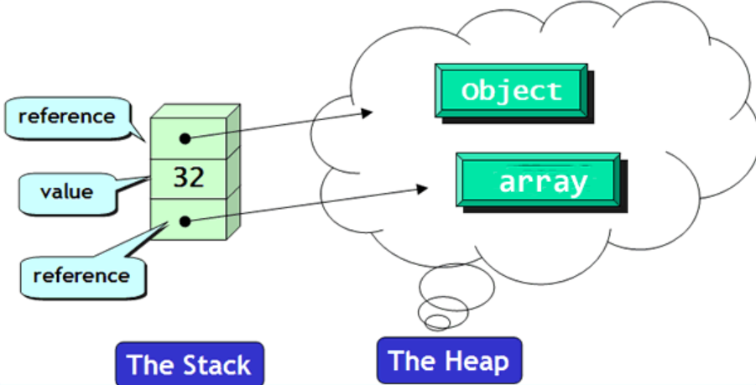
Memory
Stack
Heap
Ordered and structured
Last in first out
All data stored on the stack must have a known, fixed size
Fast
Less organized
Allocating and accessing is slower
Data can change size

Slide 12
Compound types
Array – List of elements of one type
Tuple – List of elements, types can be different
Stack
Vector – Ordered growable array, only one type
String – Like a vector but for characters
Struct – Named fields that can be of multiple types, think of a Python class
Enum – A type which is one of a few variants
Heap
Remember: Data on the stack cannot grow!

Slide 13
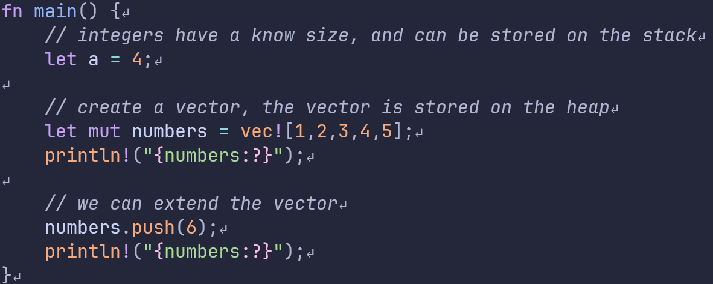
Memory
Stack
Heap
[1,2,3,4,5]
Main()
a = 4
numbers

Slide 14
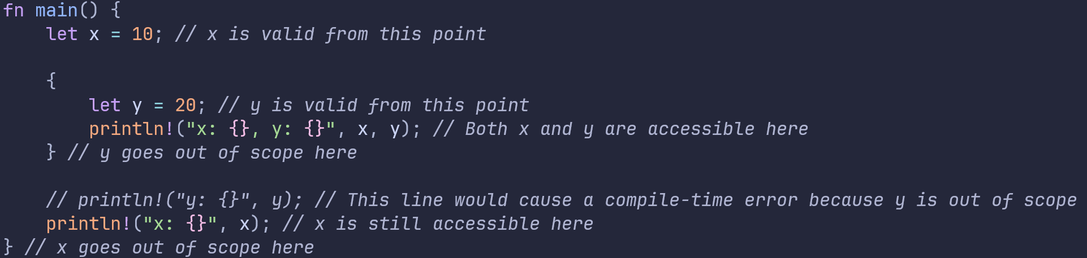
Scope
When you declare a variable in Rust, it is only accessible within the scope in which it was declared.
Notes:
Once the block is exited, the variable goes out of scope, and Rust automatically calls the drop method to clean up the variable.

Slide 15
Ownership
"Ownership is a set of rules that govern how a Rust program manages memory.“
3 Rules for ownership:
- Each value in Rust has an owner
- There can only be one owner at a time
- When the owner goes out of scope, the value will be dropped.

Slide 16
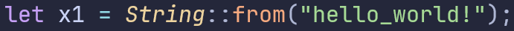



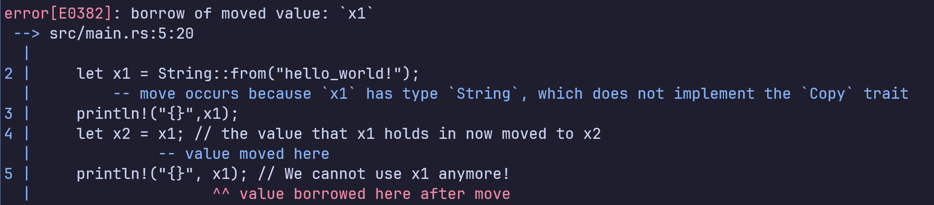
Ownership transfer
x1
“hello_world!”
x2

Slide 17

Cloning data
x1
“hello_world!”
“hello_world!”
x2
Cloning data does not transfer ownership but makes a copy

Slide 18
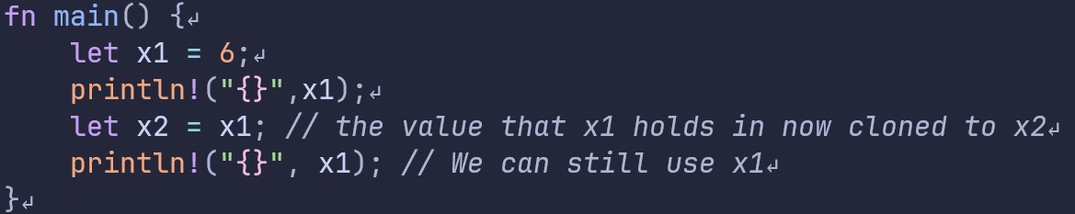
Copy trait
Simple types implement “copy”, which means they are by default cloned instead of moved.

Slide 19
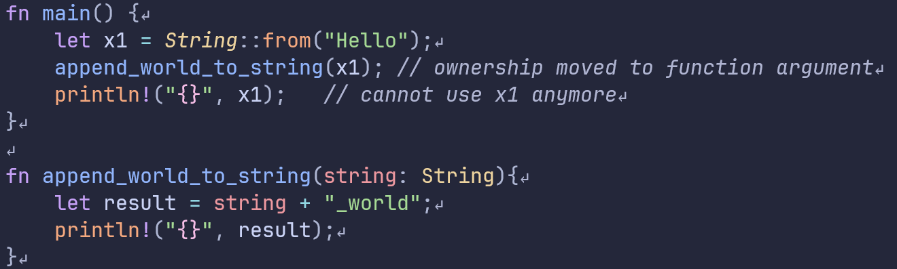
Ownership transfer
Passing a variable into a function will transfer ownership
This will not compile!

Slide 20
Pointers
A variable that holds a memory address
Cheaper to pass an address around than large objects
Issues with pointers (not in Rust)
Dangling pointers
Pointers to uninitialized memory
Freeing a pointer twice
Multiple pointers to the same data can cause data races

Slide 21
Memory safety
“The majority of vulnerabilities fixed and with a CVE assigned are caused by developers inadvertently inserting memory corruption bugs into their C and C++ code.” – Microsoft blogpost
“The Chromium project finds that around 70% of our serious security bugs are memory safety problems. Our next major project is to prevent such bugs at source.” - Google

Slide 22
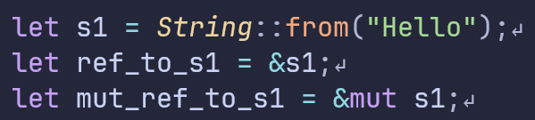
References
Special type of pointer with compile time checks
Create with `&`
If you want to change data through a reference you need a mutable reference
&{..}
S1 = address
“Hello”
*{..}

Slide 23
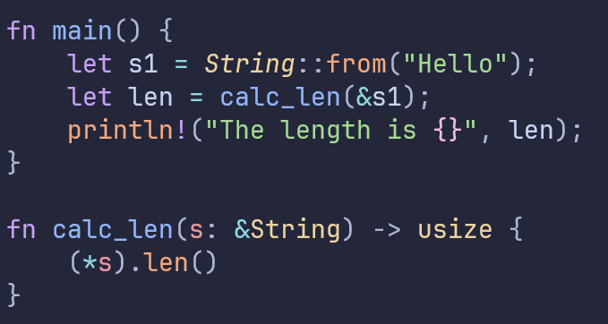
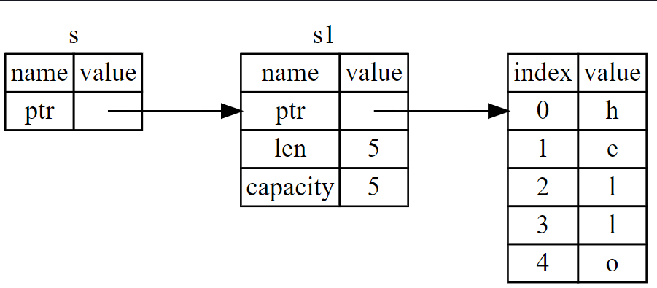
References example

Slide 24
Rules for references
1. At any given time, you can have either one mutable reference or any number of immutable references.
2. References must always be valid

Slide 25
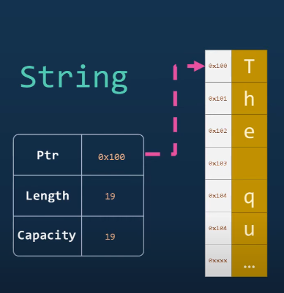
Strings
Two main types:
String type, heap allocated,
mutable, can grow
string slice, &str,
fixed

Slide 26
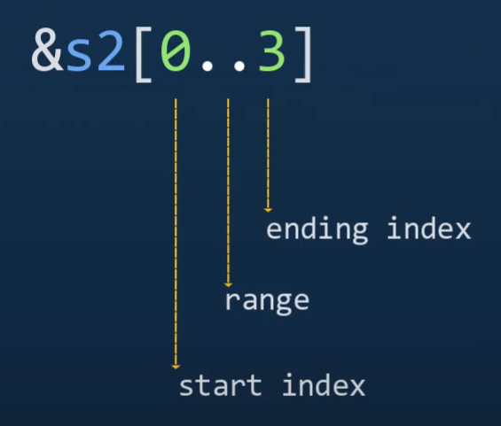
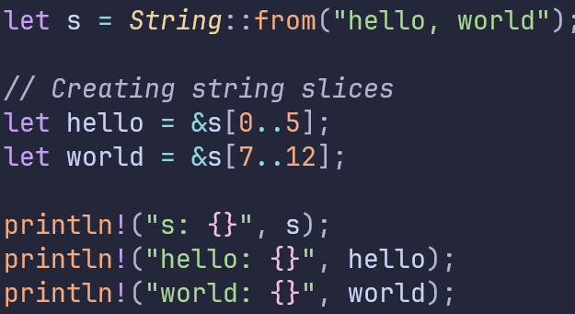
String slices
References to portions of a ‘String’

Slide 27
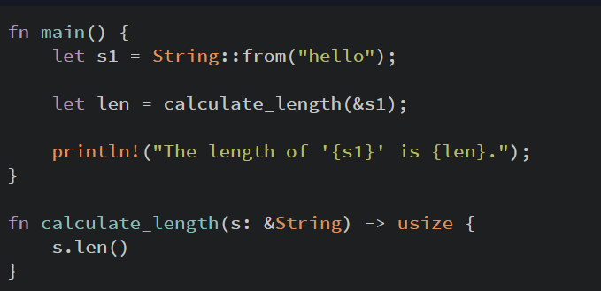
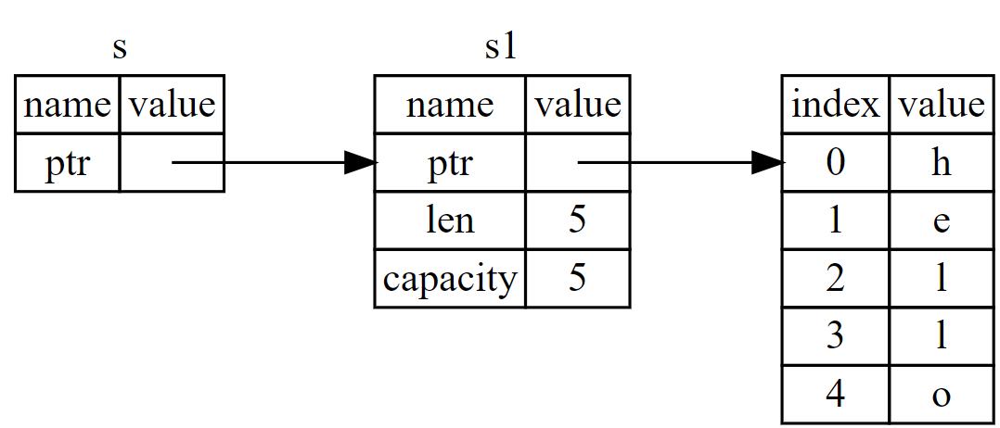
Reference example

Slide 28
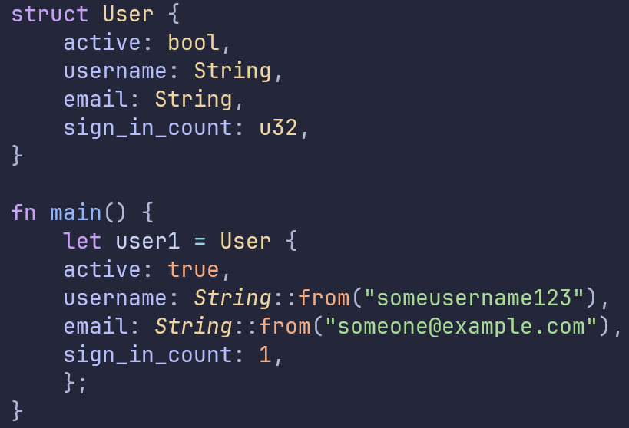
Structs
Most similar Rust type to a Python class
Named attributes
Supports methods and associated functions

Slide 29
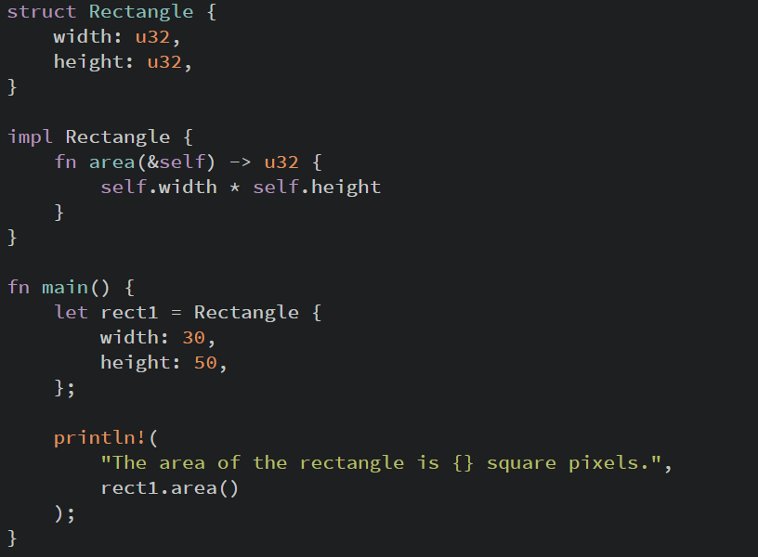
Structs
Use self to reference the object
Use Self (capitalized) to reference the type

Slide 30
Macros
Expand into other code at compile time
More flexible than functions
Some are used as “decorators”
Notes:
Unlike functions, which operate on runtime values and have a fixed signature and type constraints, macros operate on the syntax of the code itself, enabling more flexible and reusable abstractions.

Slide 31
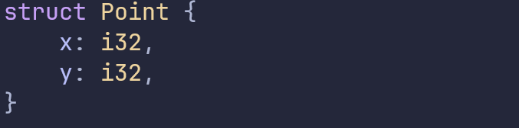
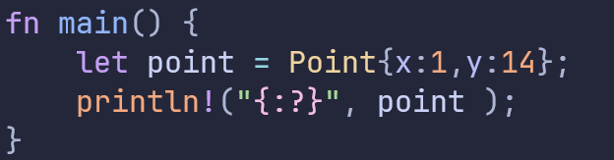

Macros
Notes:
Unlike functions, which operate on runtime values and have a fixed signature and type constraints, macros operate on the syntax of the code itself, enabling more flexible and reusable abstractions.

Slide 32
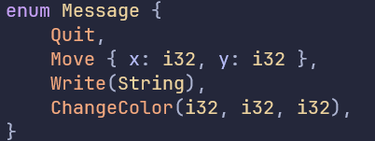
Enums
A value from a possible set of values

Slide 33
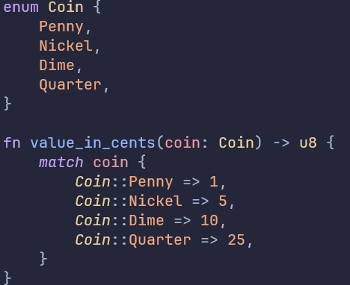
Pattern matching
You must handle all case when using match

Slide 34
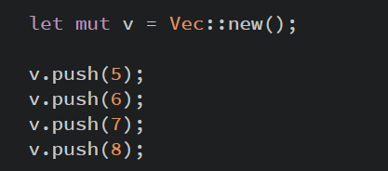

Vectors
Ordered collection of elements of the same type
Create using function:
Or macro:

Slide 35
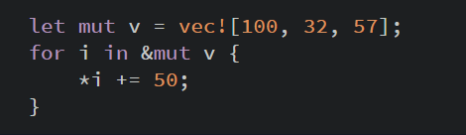
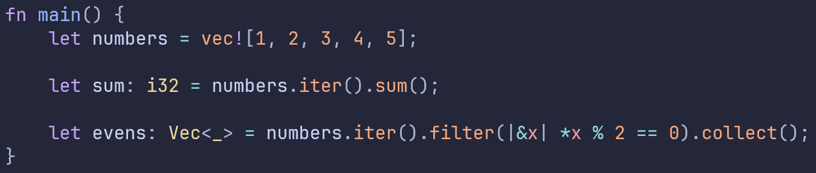
Vector iteration
Iterate with for loop
Or turn a vector into an iterator

Slide 36
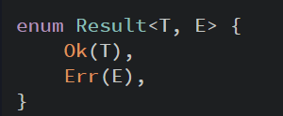
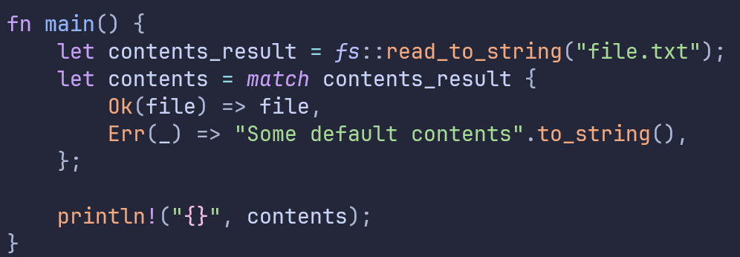
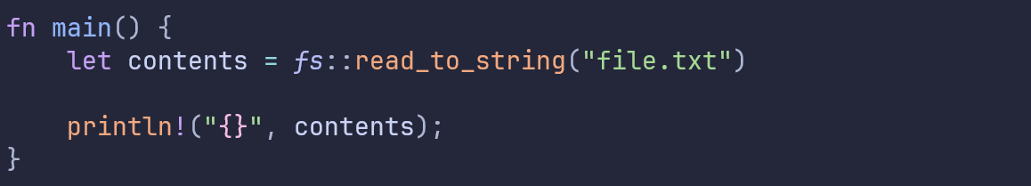

Errors
Functions that can fail will return a Result

Slide 37

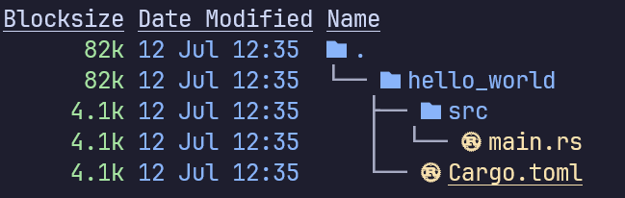
Starting a project
In a shell:
Source code
Project specifications

Slide 38
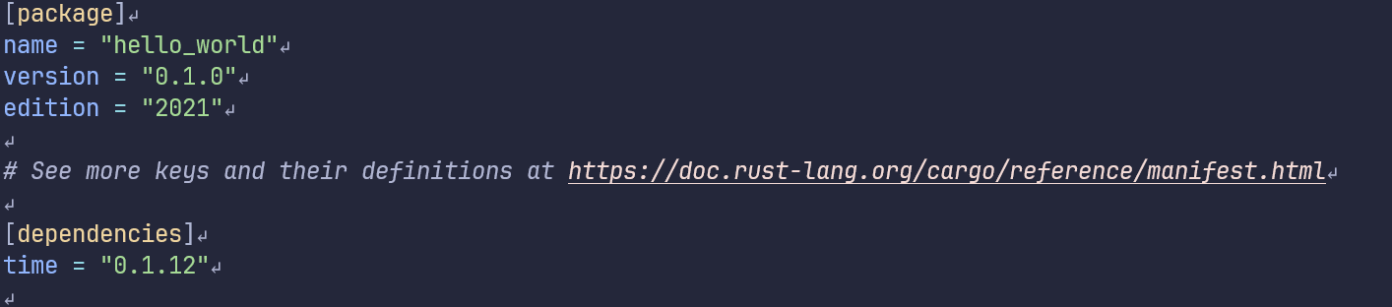
Cargo.toml
Project information
External packages

Slide 39
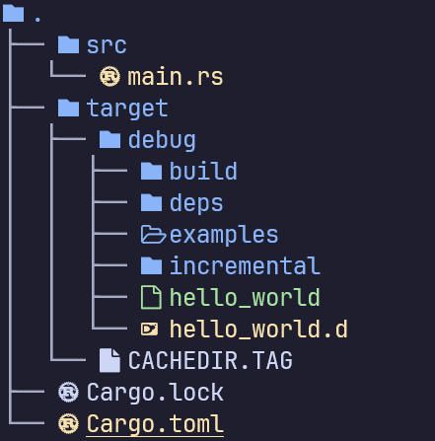
Compiling & running
Compiling
Running the program
Compiling & running
Binary

Slide 40

Questions?

