Slide 1

337
Angular 2
Notes:
https://angular2-intro.firebaseapp.com/#/29
http://angularjs.blogspot.nl/2015/08/angular-1-and-angular-2-coexistence.html
http://larseidnes.com/2014/11/05/angularjs-the-bad-parts/
Example GITHUB → https://github.com/r-park/book-angular2-firebase
http://tryangular2.github.io/#/section-9/page-37

Slide 2
Goal
To learn the basics of the Framework Angular 2:
Module
Component
Property Binding
Forms and NgModel
Bootstrap
Use a Service
A bit of TypeScript
Define a class/Type
Define a typed array

Slide 3
Angular 2
TypeScript
Component based
Performance
Geen $Scope
DI
Efficiënt ontwikkelen
Notes:
TypeScript en Angular 2 gaan hand in hand. TypeScript is een typed superset van JavaScript
Component based → Is herbruikare logica die je toevoegt aan je html-pagina.
Performance beter! → Betere/efficientere structuur: Angular 2 Apps zijn opgebouwd volgens een boomstructuur.
Geen $Scope → Geen gezamenlijk gebruik van de Scope. Componenten zijn niet meer gekoppeld aan elkaar middels $Scope.
DI – Wordt gebruik gemaakt van interfaces (niet van concrete implementaties)
IDE → refactoring + autocompletion + type error op compilatie en runtime nivo
http://www.technofattie.com/2014/03/21/five-guidelines-for-avoiding-scope-soup-in-angular.html
http://busypeoples.github.io/post/thinking-in-components-angular-js/
- Gezamenlijk gebruik van $scope door meerdere controllers → controller kunnen niet afzonderlijk getest worden.
Problemen met scope in controller:
Niet makkelijk te testen
Controller is gekoppeld aan $scope
Controller niet herbruikbaar
Controller moeilijk te onderhouden
Gezamenlijk gebruik van $scope door meerdere controllers
- Scope kan je niet migreren

Slide 4
TypeScript
Angular 2 apps worden geschreven in TypeScript
Angular 2 heeft eigen TypeScript libraries,
die geïmporteerd kunnen worden
Notes:
- TypeScript komt sterk overeen met Java/C#
- Geimporteerd kunnen worden in je applicatie/component
http://blog.rangle.io/write-angular-2-style-code-now-typescript-decorators-components-and-flux-for-angular-1-x-applications

Slide 5
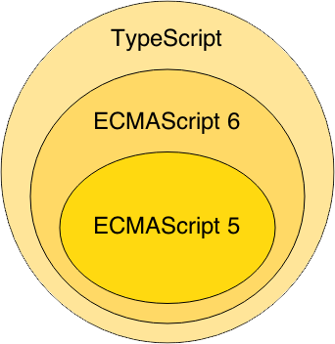
TypeScript
Notes:
Waarom TypeScript?
TypeScript is superset of ES6 en ES5.
ES = Standaard specificatie van JavaScript
ES6 = de nieuwste specificatie van Javascript, maar wordt nog niet ondersteund in browsers. → VB: Angular 2
ES5 is de huidige standaard voor javascript en wordt ondersteund in de browsers. → Vb: Angular 1 valt hieronder
TypeScript wordt vertaald naar ES5 (Middels een Transpiler).
-----------------
TypeScript is van Microsoft.
Javascript is geschreven conform ES5

Slide 6
TypeScript Class
class BookListComponent {
books: String[];
constructor() {
this.books =[‘book1’, ‘book2’]
}
}
Notes:
Example of a TypeScript class !!!

Slide 7
TypeScript
Inheritance
class BookListComponent extends SuperComponent {
private name : string;
}
Interface
class BookListComponent implements IBookCmp {
}

Slide 8
Component based
Een component is logica die je toevoegt aan je DOM elementen
Angular 2 app is een boomstructuur van componenten
Index.html
AppComponent
app.template.html
menu.template.html
MenuComponent
BookListComponent
booklist.template.html
BookCmp
BookCmp
…
Notes:
AngularJS 2 is a tree of components, because it has the same structure as your html-structure !!!
Index.html is the parent template of AppComponent ect…
AppComponent is the parent of menuComponent and BookListComponent

Slide 9
Steps to take off
Create Component
Create Template
Bootstrap
Transpilation
Notes:
Transpilation → A source-to-source compiler translates between programming languages that operate at approximately the same level of abstraction, while a traditional compiler translates from a higher level programming language to a lower level programming language

Slide 10
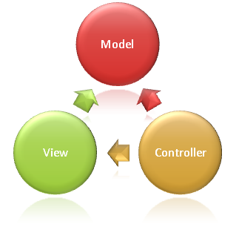
Syntax Component
import {Component} from 'angular/core';
@Component({
selector: ‘book-list'
templateUrl: ‘booklist.template.html'
})
export class BookListComponent {
books: string[];
constructor() {
this.books =[‘book1’, ‘book2’]
}
}
Notes:
Structuur
This Component-class is written in Typescript!
How to convert this class in a Component:
- You import the Typescript libraries from Angular 2 ---> a Component is imported here
- You can now convert the class in a Component with the @Component annotation
- templateUrl - the address of this component's template
How does this work in action
With the CSS selector you can tell Angular to create an instance of this component where it finds a <book-list> tag in parent HTML.
You export the Component class so that you can import and use it in the rest of your application.

Slide 11
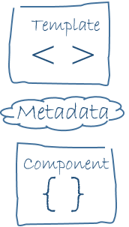
MetaData
@Component({
selector: ‘book-list'
templateUrl: ‘booklist.template.html'
})
selector - a css selector that tells Angular to create and insert an instance of this component where it finds a <book-list> tag in parent HTML: <book-list></book-list>
Angular inserts an instance of the BookListComponent view between the tags.
templateUrl - the address of this component's template

Slide 12
Syntax template booklist.template.html
<p>To do: </p>
<ul>
<li *ng-for = “let book of books">
{{book.cover}}
</li>
</ul>
Notes:
https://angular.io/docs/ts/latest/guide/template-syntax.html#!#star-template
*ng-for – Why?
The STAR Turns the li element and its contents into a template, and uses that to instantiate a view for each item in list.

Slide 13
Example Simple App
https://angular.io/resources/live-examples/quickstart/ts/plnkr.html
Index.html
AppComponent
app.template.html
Notes:
AngularJS 2 is a tree of components, because it has the same structure as your html-structure !!!
Index.html is the parent template of AppComponent ect…

Slide 14
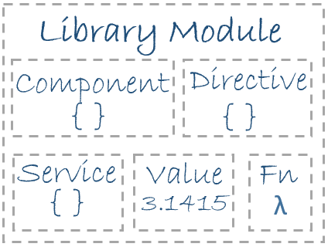
Module
Angular apps are composed of modules.
Modules exports classes, function, values — that other modules import.

Slide 15
AppModule = entry point App
import {NgModule} from ‘@angular/core';
import {BrowserModule} from ‘@angular/platform-browser';
import {AppComponent} from ‘./app.component';
import {BookListComponent} from ‘./components/book/booklist.component';
import {MenuComponent} from ‘./components/menu/menu.component';
@NgModule({
imports: [BrowserModule], // inject build-in modules
declarations: [AppComponent , BookListComponent, MenuComponent], // inject your own components
bootstrap: [AppComponent] // main component you need to bootstrap
})
export class AppModule { }
Notes:
AppModule is the main entrypoint of your application = root module
@NgModule: Use @NgModule to Manage Dependencies in your Angular 2 Apps
Since we declared the BookListComponent in our root module, we can now use this BookListComponent anywhere in our application without needing to declare or import it again. In essence, the @NgModule handles dependency injection for us, so any component we declare will have the inherent knowledge of our other dependencies. We are not limited to declaring only components here, we could additionally write a directive or service, and declare use it the exact same way.
Imports: for importing build-in modules example BrowserModule for using: *ng-for
Declarations: for injecting your components
Bootstrap: you need to bootstrap your main component

Slide 16
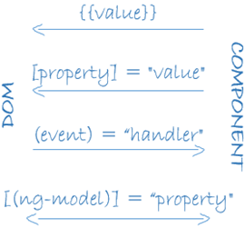
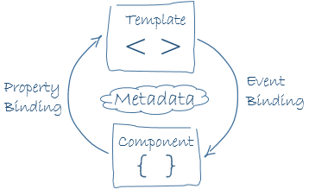
Data binding
<div>{{book.cover}}</div> <book-list [books]=“books”></book-list> <div (click)="selectBook($event)></div>
<input [(ngModel)]="userName" >
Notes:
1. Binds a property to an interpolated string
2. Binds property value to the result of expression books.
3. Calls method selectBook when a click event is triggered on this button element (or its children) and passes in the event object.

Slide 17
Show / Hide CSS Classes
USE:
<div [class.filter-is-visible]=“isVisible“>
OR
<div [ngClass]="{active: isActive, disabled: isDisabled}">
Notes:
[class.extra-sparkle]
Binds the presence of the CSS class filter-is-visible on the element to the truthiness of the expression show.
[ngClass]
Binds the presence of CSS classes on the element to the truthiness of the associated map values. The right-hand expression should return {class-name: true/false} map.

Slide 18
Getting started
You can find the repo on GitHub
Clone it: git clone https://github.com/hackages/hackjam.angular.git
Install Angular CLI: angular-cli: npm i angular-cli@latest -g
Bootstrap your application: npm start
!oops
This application doesn't work :(

Slide 19
Links
https://angular.io
https://angular.io/docs/ts/latest/guide/cheatsheet.html

Slide 20
TODO: Features to implement in your app
Fix all the bugs before trying to implement any other features
Display all categories on the menu
Learn about structural directive
Learn how to create a class and create a typed array in TypeScript
Display all books on the main area
Learn about property bindings
On click on a category, update the list of books and change the class to selected
The filter should be applied to the category of the book
The css class should be applied to the anchor: hint [class.selected] or [ngClass]
On click on the filter button, open the menu filter component
Implement the search
Learn about Forms and NgModel
The search should be applied to the title and the category
Architecture: Split your app into small components

Slide 21
FORMS

Slide 22
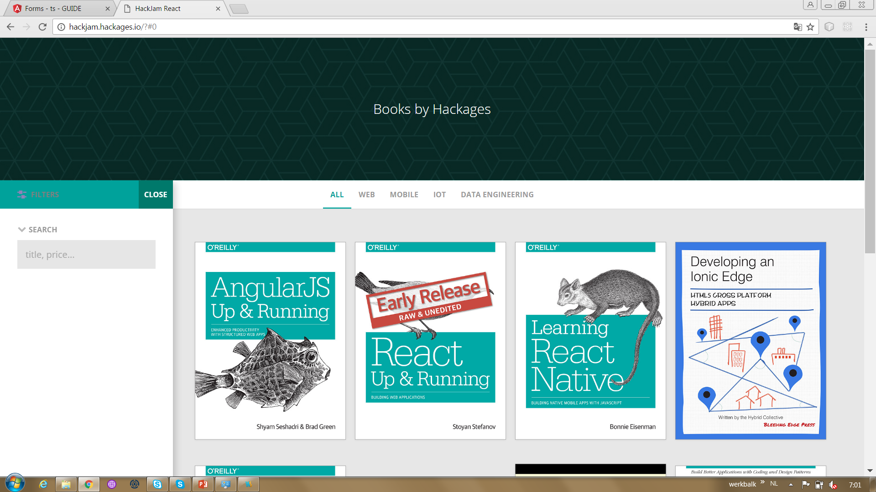
Forms
Implement the search in the side bar
Learn about Forms and NgModel
The search should be applied to the title and the category

Slide 23
Forms
import {NgModule} from ‘@angular/core';
import { FormsModule } from '@angular/forms';
import {BrowserModule} from ‘@angular/platform-browser';
import {AppComponent} from ‘./app.component';
import {BookListComponent} from ‘./components/book/booklist.component';
import {MenuComponent} from ‘./components/menu/menu.component';
@NgModule({
imports: [BrowserModulem, FormsModule], // inject build-in modules
declarations: [AppComponent ,BookListComponent, MenuComponent], // inject your own components
bootstrap: [AppComponent] // main component you need to bootstrap
})
export class AppModule { }
Notes:
Add this to the in app.module.ts
import { FormsModule } from '@angular/forms';
@NgModule → imports: [BrowserModulem, FormsModule], // inject build-in modules

Slide 24
Forms [(ngModel)]

Slide 25
Forms [(ngModel)]
Change app.template.html section: Sidebar navigation:
<form (submit)="search()">
<input class="form-control" type="text" id="search" required [(ngModel)]="searchString" name="searchString" placeholder="Title or category">
</form>
Notes:
[(ngModel)] Provides two-way data-binding, parsing, and validation for form controls.

Slide 26
Forms Search()
In app.components.ts:
search() { this.books = mockBooks.filter(b => b.category.toLowerCase().includes(this.searchString.toLowerCase()) || b.title.toLowerCase().includes(this.searchString.toLowerCase())); }

Slide 27
Service
Steps how to make a service for getting the books and categories
Create a new folder: app/services
Add a service in this folder: app.service.ts
Import this new service in app.component.ts
Import {AppService} from ‘./service/app.service’
Define the service as a provider in app.component.ts
@Component → providers: [AppService]
Inject an instance of the AppService via the constructor of the AppComponent
Use the AppService to fetch the Books and Categories → make use of the lifecycle hook: ngOnInit

Slide 28
app.service.ts
import {Injectable} from 'angular/core';
import{Book, mockBooks} from ‘../mocks/books’
import{Category, categories} from ‘../mocks/categories’
@Injectable()
export class AppService {
getBooks(): Promise<Books[]> {
return Promise.resolve(mockBooks);
}
getCategories(): Category[]> {
return Promise.resolve(categories);
}
}
Notes:
You export the AppService class so that you can import it into the application that you just created.
Use @Injectable →???

Slide 29
Dependency Injection
implements
depends on
Service
Interface
Service
Implementatie
Component
Notes:
Alternatief voor $Scope = DI !!!

Slide 30
Architecture: Split your app into small components
Steps to create a BookListComponent:
Create a new folder: app/components/book
Add new template for the booklist in this folder:
Booklist.template.html
Copy the html for showing a booklist to: Booklist.template.html
Create a new BookListComponent in this folder
booklist.component.ts
Replace the html in In app.template.html with:
<book-list [books]=“books”></book-list>
Import(!) and Declare(!) the BookListComponent in app.module.ts

Slide 31
bookList.component.ts
import {Component, Input} from 'angular/core';
@Component({
moduleId: module.id,
selector: ‘book-list'
templateUrl: ‘booklist.template.html'
})
export class BookListComponent {
@Input books;
}

