Slide 1

337
Angular 2
Notes:
https://angular2-intro.firebaseapp.com/#/29
http://angularjs.blogspot.nl/2015/08/angular-1-and-angular-2-coexistence.html
http://larseidnes.com/2014/11/05/angularjs-the-bad-parts/
Example GITHUB → https://github.com/r-park/book-angular2-firebase
http://tryangular2.github.io/#/section-9/page-37

Slide 2
Goal
To learn the basics of the Framework Angular 2:
From 6:00 PM:
A bit of TypeScript
Module
Component
Property Binding
Forms and NgModel
From 7:45 PM:
Use a Service
Architecture

Slide 3
Angular 2
TypeScript
Component based
Performance
NO $Scope
DI
Efficient development
Notes:
TypeScript en Angular 2 gaan hand in hand. TypeScript is een typed superset van JavaScript
Component based → Is herbruikbare logica die je toevoegt aan je html-pagina.
Performance beter! → Betere/efficientere structuur: Angular 2 Apps zijn opgebouwd volgens een boomstructuur.
Geen $Scope → Geen gezamenlijk gebruik van de Scope. Componenten zijn niet meer gekoppeld aan elkaar middels $Scope.
DI – Wordt gebruik gemaakt van interfaces (niet van concrete implementaties)
IDE → refactoring + autocompletion + type error op compilatie en runtime nivo
http://www.technofattie.com/2014/03/21/five-guidelines-for-avoiding-scope-soup-in-angular.html
http://busypeoples.github.io/post/thinking-in-components-angular-js/
- Gezamenlijk gebruik van $scope door meerdere controllers → controller kunnen niet afzonderlijk getest worden.
Problemen met scope in controller:
Niet makkelijk te testen
Controller is gekoppeld aan $scope
Controller niet herbruikbaar
Controller moeilijk te onderhouden
Gezamenlijk gebruik van $scope door meerdere controllers
- Scope kan je niet migreren

Slide 4
TypeScript
Angular 2 apps are written in TypeScript
TypeScript libraries for Angular 2
can be imported
TypeScript = ES6 + Types + Annotations
Notes:
- TypeScript komt sterk overeen met Java/C#
- Kan geimporteerd worden in je applicatie/component
http://blog.rangle.io/write-angular-2-style-code-now-typescript-decorators-components-and-flux-for-angular-1-x-applications

Slide 5
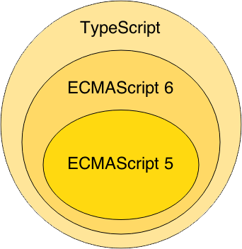
TypeScript
Notes:
Waarom TypeScript?
TypeScript is superset of ES6 en ES5.
ES = Standaard specificatie van JavaScript
ES6 = de nieuwste specificatie van Javascript, maar wordt nog niet ondersteund in alle browsers.
ES5 is de huidige standaard voor javascript en wordt ondersteund in de browsers.
TypeScript wordt vertaald naar ES5 (Middels een Transpiler).
-----------------
TypeScript is van Microsoft.
Javascript is geschreven conform ES5

Slide 6
TypeScript Class
class BookListComponent {
books: String[];
constructor() {
this.books =[‘book1’, ‘book2’]
}
}
Notes:
Example of a TypeScript class !!!
This → refers to the class.

Slide 7
TypeScript
Interface
class BookListComponent implements IBookCmp {
}

Slide 8
TypeScript
Generics
function identity<T>(arg: T): T {
return arg;
}
Lambda
var calculateInterest = (amount, interestRate,
duration) => amount * interestRate * duration / 12

Slide 9
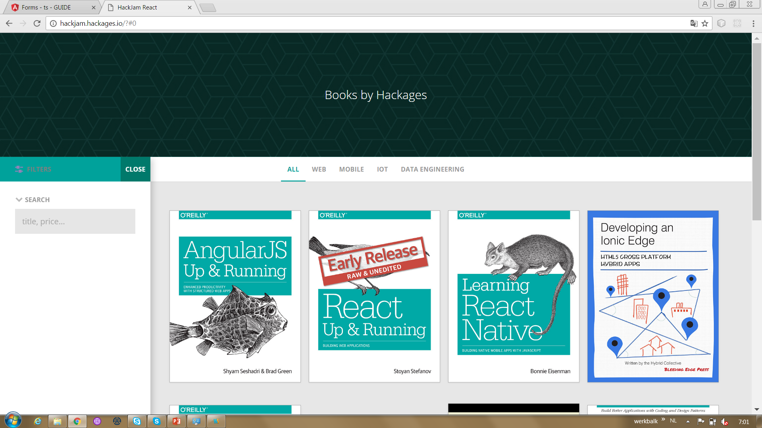
Forms
Implement the search in the side bar
Learn about Forms and NgModel
The search should be applied to the title and the category

Slide 10
Component based
AppComponent
HeaderComponent
SideBarComponent
MenuComponent
BookListComponent

Slide 11
Component based
Een component adds logic/behaviour to a DOM elementen
Angular 2 app consist of a treestructuur of components
Index.html
AppComponent
app.template.html
SideBarComponent
MenuComponent
BookListComponent
booklist.template.html
BookCmp
BookCmp
…
Notes:
AngularJS 2 is a tree of components, because it has the same structure as your html-structure !!!
Index.html is the parent template of AppComponent ect…
AppComponent is the parent of menuComponent and BookListComponent
Zone.js -> to perform change detection in our application

Slide 12
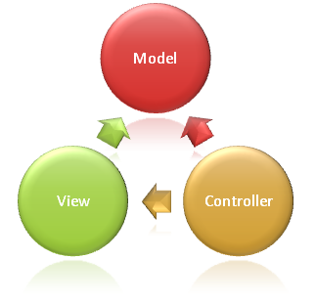
Syntax Component
import {Component} from 'angular/core';
@Component({
selector: ‘book-list'
templateUrl: ‘booklist.template.html'
})
export class BookListComponent {
books: string[];
constructor() {
this.books =[‘book1’, ‘book2’]
}
}
Notes:
Structuur
This Component-class is written in Typescript!
How to convert this class in a Component:
- You import the Typescript libraries from Angular 2 ---> a Component is imported here
- You can now convert the class in a Component with the @Component annotation
- templateUrl - the component's template
How does this work in action
You can call this component in html with the <book-list>-tag. This tag is the name of the selector!!!
You export the Component class so that you can import and use it in the rest of your application.

Slide 13
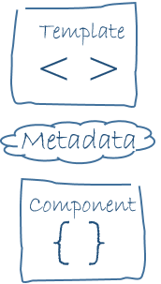
MetaData
@Component({
selector: ‘book-list'
templateUrl: ‘booklist.template.html'
})
selector - a css selector that tells Angular to create and insert an instance of this component where it finds a <book-list> tag in parent HTML: <book-list></book-list>
Angular inserts an instance of the BookListComponent view between the tags.
templateUrl - the component's template

Slide 14
Syntax template booklist.template.html
<p>Booklist: </p>
<ul>
<li *ng-for = “let book of books">
{{book.title}}
</li>
</ul>
Notes:
https://angular.io/docs/ts/latest/guide/template-syntax.html#!#star-template
*ng-for – Why?
The STAR Turns the li element and its contents into a template, and uses that template to instantiate a view for each item in list.

Slide 15
Example Simple App
https://angular.io/resources/live-examples/quickstart/ts/plnkr.html
Index.html
AppComponent
app.template.html
Notes:
AngularJS 2 is a tree of components, because it has the same structure as your html-structure !!!
Index.html is the parent template of AppComponent ect…

Slide 16
Module
SideBarComponent
AppModule
Module
AppComponent
HeaderComponent
SideBarComponent
MenuComponent
BookListComponent
Notes:
Angular apps are composed of modules.
Modules exports classes, function, values — that other modules import.

Slide 17
AppModule = entry point App
import {NgModule} from ‘@angular/core';
import {BrowserModule} from ‘@angular/platform-browser';
import {AppComponent} from ‘./app.component';
import {BookListComponent} from ‘./components/book/booklist.component';
import {MenuComponent} from ‘./components/menu/menu.component';
@NgModule({
imports: [BrowserModule], // inject build-in modules
declarations: [AppComponent , BookListComponent, MenuComponent], // inject your own components
bootstrap: [AppComponent] // main component you need to bootstrap
})
export class AppModule { }
Notes:
AppModule is the main entrypoint of your application = root module
@NgModule: Use @NgModule to Manage Dependencies in your Angular 2 Apps
Since we declared the BookListComponent in our root module, we can now use this BookListComponent anywhere in our application without needing to declare or import it again. In essence, the @NgModule handles dependency injection for us, so any component we declare will have the inherent knowledge of our other dependencies. We are not limited to declaring only components here, we could additionally write a directive or service, and declare use it the exact same way.
Imports: for importing build-in modules example BrowserModule for using: *ng-for
Declarations: for injecting your own components
Bootstrap: you need to bootstrap your main component

Slide 18
Data binding
Data binding is the mechanism used to ensure the linking between what a user see on the screen and the data value in our Class.
(View/template <-> Component)

Slide 19
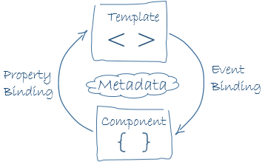
Data binding

Slide 20
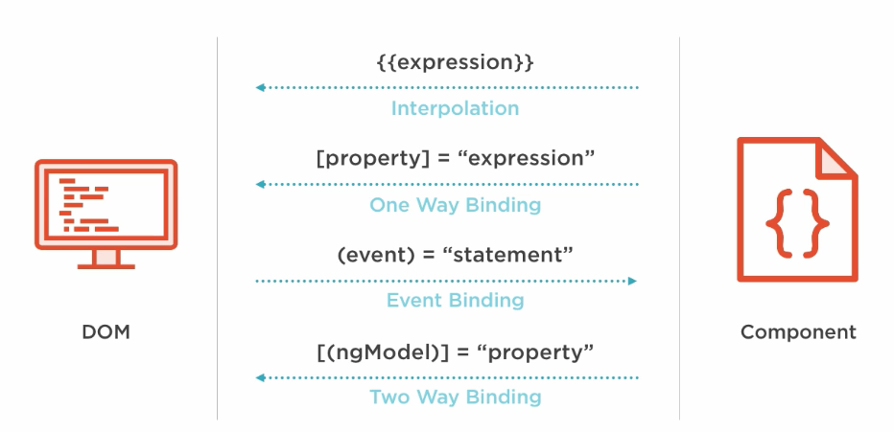
Data binding
<div>{{book.title}}</div> <input value=“text” [disabled]=“isDisabled”></input> <div (click)="selectBook($event)></div>
<input [(ngModel)]=“searchTermBook" >
Notes:
1. To render a value in the view
2. To resolve and bind a variable to a component-property
3. Calls method selectBook when a click event is triggered on this button element (or its children) and passes in the event object.
4. Two way data binding is used in forms.

Slide 21
Example two way databinding
https://embed.plnkr.co/HpQHJ6ljGFrHy8abCPuh/

Slide 22
Show / Hide CSS Classes
USE:
<div [class.filter-is-visible]=“isVisible“>
OR
<div [ngClass]="{active: isActive, disabled: isDisabled}">
<div [ngClass]="selCat==category.name ? 'selected' : '‘ ">
<div [ngClass]="!navClosed ? 'filter filter-is-visible': 'filter‘ ">
Notes:
[class.extra-sparkle]
Binds the presence of the CSS class filter-is-visible on the element to the truthiness of the expression isVisible.
[ngClass]
Binds the presence of CSS classes on the element to the truthiness of the associated map values. The right-hand expression should return {class-name: true/false} map.

Slide 23
FORMS

Slide 24
Forms
Implement the search in the side bar
Learn about Forms and NgModel
The search should be applied to the title and the category

Slide 25
Forms
import {NgModule} from ‘@angular/core';
import { FormsModule } from '@angular/forms';
import {BrowserModule} from ‘@angular/platform-browser';
import {AppComponent} from ‘./app.component';
import {BookListComponent} from ‘./components/book/booklist.component';
import {MenuComponent} from ‘./components/menu/menu.component';
@NgModule({
imports: [BrowserModulem, FormsModule], // inject build-in modules
declarations: [AppComponent ,BookListComponent, MenuComponent], // inject your own components
bootstrap: [AppComponent] // main component you need to bootstrap
})
export class AppModule { }
Notes:
Add this to the in app.module.ts
import { FormsModule } from '@angular/forms';
@NgModule → imports: [BrowserModule, FormsModule], // inject build-in modules

Slide 26
Forms [(ngModel)]

Slide 27
Forms [(ngModel)]
Change app.template.html section: Sidebar navigation:
<form (submit)="search()">
<input class="form-control" type="text" id="search" required [(ngModel)]="searchString" name="searchString" placeholder="Title or category">
</form>
Notes:
[(ngModel)] Provides two-way data-binding, parsing, and validation for form controls.

Slide 28
Getting started
You can find the repo on GitHub
Clone it: git clone https://github.com/petereijgermans11/hackjam-angular
Install Angular CLI: angular-cli: npm i angular-cli@latest -g
Bootstrap your application: npm start
!oops
This application doesn't work :(

Slide 29
Links
https://angular.io
https://angular.io/docs/ts/latest/guide/cheatsheet.html
Guide_hackjam.docx

Slide 30
TODO: Features to implement in your app
Fix all the bugs before trying to implement any other features
Display all categories on the menu
Learn about structural directive
Learn how to create a class and create a typed array in TypeScript
Display all books on the main area
Learn about property bindings
On click on a category, update the list of books and change the class to selected
The filter should be applied to the category of the book
The css class should be applied to the anchor: hint [class.selected] or [ngClass]
On click on the filter button, open the menu filter component
Implement the search in the sidebar (form with ngModel)

Slide 31
Services and Architecture
For suggestions clone this:
https://github.com/petereijgermans11/hackjam-angular-part1

Slide 32
Service
Steps how to make a service for getting the books and categories
Create a new folder: app/services
Add a service in this folder: app.service.ts
Import this new service in app.component.ts
Import {AppService} from ‘./service/app.service’
Define the service as a provider in app.component.ts
@Component → providers: [AppService]
Inject an instance of the AppService via the constructor of the AppComponent
Use the AppService to fetch the Books and Categories → make use of the lifecycle hook: ngOnInit
Notes:
To make this service injectable, we need to create a provider for it first.

Slide 33
AppService
import{Book, mockBooks} from ‘../mocks/books’
// To do:
// import categories….
export class AppService {
getBooks(): Promise<Books[]> {
return Promise.resolve(mockBooks);
}
// Todo:
getCategories(): …
}
}
Notes:
You export the AppService class so that you can import it into the application that you just created.
Use Promise → for async calls

Slide 34
Use the AppService in your AppComponent
Import { AppService } from './services/app.service';
@Component({
selector: 'bookstore',
templateUrl: '../app/app.template.html',
providers: [ AppService ]
})
Notes:
To make this service injectable, we need to create a provider for it first.

Slide 35
Inject service via the constructor of the AppComponent
constructor(private appService: AppService) { }
public ngOnInit(){
this.appService.getBooks().then((books) => {
this.books = books;
});
// Todo:
// get the categories…
}
Notes:
Use LifeCyclehook: ngOnInit() !!!

Slide 36
Exercise
Implement this AppService in your AppComponent

Slide 37
Architecture
Index.html
AppComponent
(event)
(event)
[title]
[categories]
[books]
HeaderComponent
MenuComponent
@Input categories
@Output categoriesChanged
BookListComponent
@Input books
SideBarComponent
@Output sideBarToggled
@Output onSearchChanged
@Input title
Notes:
See: https://angular.io/docs/ts/latest/cookbook/component-communication.html#!#child-to-parent
@Input
To define an input for a component, we use the @Input decorator.
See: http://learnangular2.com/inputs/
@Output
To create a custom event, we can use the new @Output decorator/annotation.
The child component exposes an EventEmitter property with which it emits events when something happens. The parent binds to that event property and reacts to those events.
See: http://learnangular2.com/outputs/
Zone.js -> to perform change detection in our application

Slide 38
Architecture: Split your app into small components
Steps to create a BookListComponent:
Create a new folder: app/components/book
Add new template for the booklist in this folder:
Booklist.template.html
Copy the html for showing a booklist to: Booklist.template.html
Create a new BookListComponent in this folder
booklist.component.ts
Replace the html in app.template.html with:
<book-list [books]=“books”></book-list>
Import(!) and Declare(!) the BookListComponent in app.module.ts

Slide 39
BookListComponent

Slide 40
booklist.template.html
<!--List of books-->
<section class="gallery" [class.filter-is-visible]="!navClosed">
<ul>
<li *ngFor="let book of books">
<img src="{{book.cover}}" (click)="clicked"/>
</li>
</ul>

Slide 41
bookList.component.ts
import {Component, Input} from 'angular/core';
@Component({
moduleId: module.id,
selector: ‘book-list'
templateUrl: ‘booklist.template.html'
})
export class BookListComponent {
@Input books;
}
Notes:
module.id = absolute path component
The moduleId: module.id property sets the base for module-relative loading of the templateUrl.
See: https://angular.io/docs/ts/latest/cookbook/component-relative-paths.html

Slide 42
app.template.html
…..
<book-list [books]=“books”></book-list>
….

Slide 43
Add BookListComponent in app.module.js
import {NgModule} from ‘@angular/core';
import {FormsModule} from ‘@angular/forms';
import {BrowserModule} from ‘@angular/platform-browser';
import {AppComponent} from ‘./app.component';
import {BookListComponent} from ‘./components/book/booklist.component';
import {MenuComponent} from ‘./components/menu/menu.component';
@NgModule({
imports: [BrowserModulem, FormsModule], // inject build-in modules
declarations: [AppComponent , BookListComponent, MenuComponent], // inject your own components
bootstrap: [AppComponent] // main component you need to bootstrap
})
export class AppModule { }
Notes:
Add this to the in app.module.ts
import {BookListComponent} from '@angular/forms';

Slide 44
MenuComponent

Slide 45
menu.template.html
<li *ngFor = “let category of categories” (click) = “changeCategory(category)”>
<a>{{category.name}}</a>
</li>

Slide 46
menu.component.ts
import {Component, Input, Output, EventEmitter} from 'angular/core';
@Component({
moduleId: module.id,
selector: ‘menu'
templateUrl: ‘menu.template.html'
})
export class MenuComponent {
@Input categories;
@Output categoryChanged = new EventEmitter();
changeCategory(category) : void {
this.categoryChanged.emit(category);
}
}
Notes:
Import Output and EventEmitter = Used by components to emit custom Events. The parent binds to that event and reacts to those events.

Slide 47
app.template.html
<menu (categoryChanged)=“changeCategoryParent($event)”</menu>
Notes:
Now when we used this component elsewhere in our app, we can bind the event that menuComponent emits.

Slide 48
app.component.ts
changeCategoryParent(selectedCategory: Category): void { this.categories = this.categories.map(category => { if(category === selectedCategory) category.selected = true; else category.selected = false; return category; }); this.filterBooks(selectedCategory); }

Slide 49
Add MenuComponent in app.module.js
import {NgModule} from ‘@angular/core';
import {FormsModule} from ‘@angular/forms';
import {BrowserModule} from ‘@angular/platform-browser';
import {AppComponent} from ‘./app.component';
import {BookListComponent} from ‘./components/book/booklist.component';
import {MenuComponent} from ‘./components/menu/menu.component';
@NgModule({
imports: [BrowserModulem, FormsModule], // inject build-in modules
declarations: [AppComponent ,BookListComponent, MenuComponent], // inject your own components
bootstrap: [AppComponent] // main component you need to bootstrap
})
export class AppModule { }
Notes:
Add this to the in app.module.ts
import { MenuComponent } from '@angular/forms';

Slide 50
Architecture: Split your app into small components
Steps todo:
Implement the BookListComponent
Implement the MenuComponent
Implement the HeaderComponent (the same as the BookListComponent)
Implement the SideBarComponent (conform the MenuComponent)
For suggestions clone this:
https://github.com/petereijgermans11/hackjam-angular-part1

