Slide 1
Rivulet Weekly Meeting
2019.7.26

Slide 2
Key Frame
Raw
Image
CNN
Res-101
Key
Feat.
MVFF
Version1
Non-key
Frame
Motion
Vector
Non-Key
Feat.
Key Frame
Raw
Image
CNN
Res-101
Key
Feat.
MVFF
Version2
Non-key
Frame
Motion
Vector
1x1 Conv
Non-Key
Feat.

Slide 3
Experiment: MVFF Version2, Test Results
 | 2 GPU | 4 GPU
R-FCN |  | 74.1
DFF | 69.6 | 73
MVFF Version2 | 62.5

Slide 4
Experiment: MVFF Version3
NNFeat
NNTask
A
A’
A”
M
Resize
T
600x1000
Conv+Pooling
36x60
NNFeat
NNTask
B
B’
B”

Slide 5
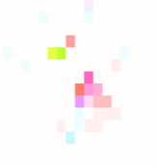
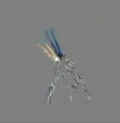
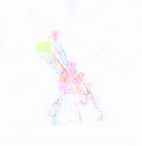
Experiment: MVFF Version4
MV
Res
Augmented MV
[1] DMC-Net: Generating Discriminative Motion Cues for
Fast Compressed Video Action Recognition (CVPR 2019)

Slide 6
Experiment: Output Level Propagation
NNFeat
NNTask
A
A’
A”
M
T
M’
NNFeat
NNTask
B
B’
B”
M’ = op(M), op in {avg, median, mode}

Slide 7
Next Week Plan
Experiment: Identify an architecture that achieves state-of-the-art mAP
Writing: Identify a list of desired experiment results

