Slide 1
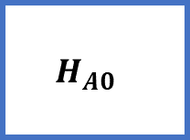
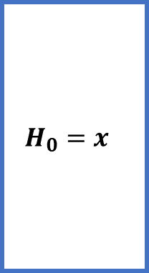
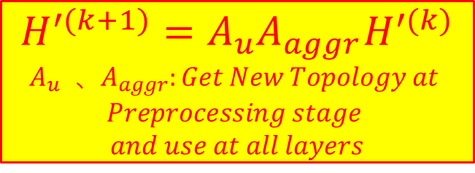
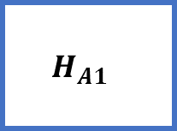
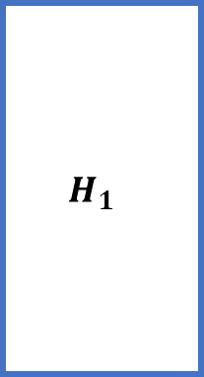
$$H^{′(k+1)}=A_{u}A_{aggr}H^{′(k)}$$
$$A_{u} 、A_{aggr}:Get New Topology at$$
$$Preprocessing stage$$
$$and use at all layers$$
$A_{aggr}$: First Phase:
compute embedding of aggregate node by Algorithm 2
$A_{u}$: Second Phase:
compute embedding of original node in GNN model method
$$H_{0}=x$$
$$H_{1}$$
𝑜𝑢𝑡𝑝𝑢𝑡
𝐸𝑚𝑏𝑒𝑑𝑑𝑖𝑛𝑔
update
update
aggregate
aggregate
$$H_{A0}$$
$$H_{A1}$$

Slide 2
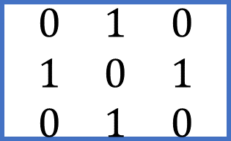
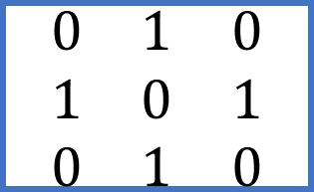
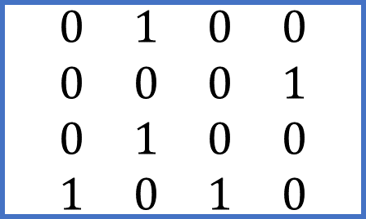
KEY POINT: computation graph (directed graph) is different from topology graph (directed or undirected graph) and our object is to eliminate redundancy in computation graph
Topology Graph
Computation Graph
HAG
0
Common neighbor
0
Common target
0
aggregated node
1
1
3
1
2
2
2
source
source
$$\begin{matrix}0 & 1 & 0 & 0 \\ 0 & 0 & 0 & 1 \\ 0 & 1 & 0 & 0 \\ 1 & 0 & 1 & 0\end{matrix}$$
$$\begin{matrix}0 & 1 & 0 \\ 1 & 0 & 1 \\ 0 & 1 & 0\end{matrix}$$
$$\begin{matrix}0 & 1 & 0 \\ 1 & 0 & 1 \\ 0 & 1 & 0\end{matrix}$$
target
target

