Slide 1
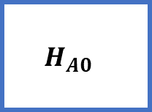
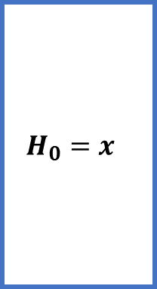
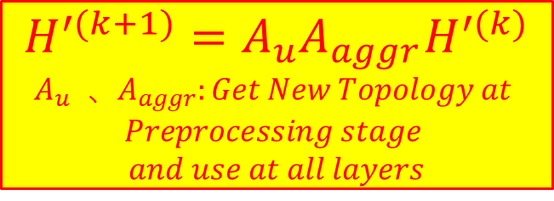
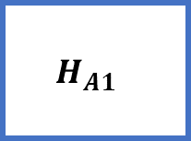
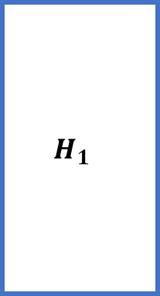
$$H^{′(k+1)}=A_{u}A_{aggr}H^{′(k)}$$
$$A_{u} 、A_{aggr}:Get New Topology at$$
$$Preprocessing stage$$
$$and use at all layers$$
$A_{aggr}$: First Phase:
compute embedding of aggregate node by Algorithm 2
$A_{u}$: Second Phase:
compute embedding of original node in GNN model method
$$H_{0}=x$$
$$H_{1}$$
𝑜𝑢𝑡𝑝𝑢𝑡
𝐸𝑚𝑏𝑒𝑑𝑑𝑖𝑛𝑔
update
update
aggregate
aggregate
$$H_{A0}$$
$$H_{A1}$$

