Slide 1

① ② ③④⑤⑥
④
③
①
⑥
⑤
②

Slide 2
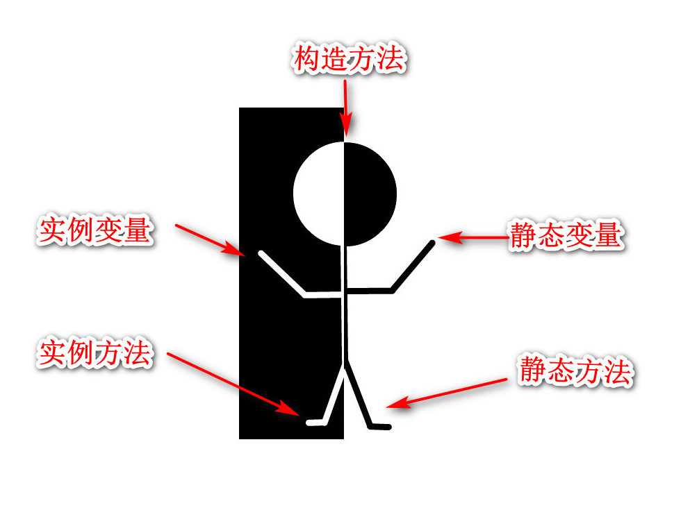

Slide 3

Add
A
Get
Delete
Update(颜色)

Slide 4
main()
call()
lambda + value
main()
call()
lambda + value

