Slide 1

① ② ③④⑤⑥
④
③
①
⑥
⑤
②

Slide 2
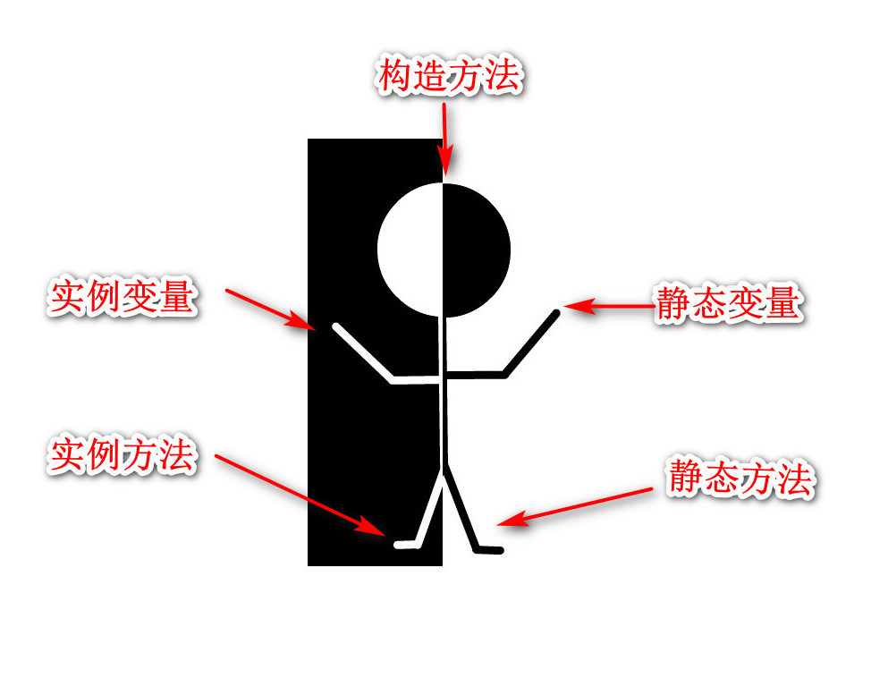

Slide 3

Add
A
Get
Delete
Update(颜色)

Slide 4
main()
call(Runnable )
闭包通过入参传递
lambda + value
main()
create()
return 闭包
lambda + value

