Slide 1























Compile
Test
Package
Compile
Test
Package
Compile
Test
Package

Slide 2


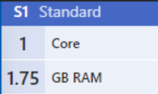



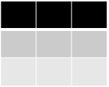



System
Environment
Application
Storage Account
Infrastructure
// stg1ad4g7
Table
Queue
Blob
File

