Slide 1
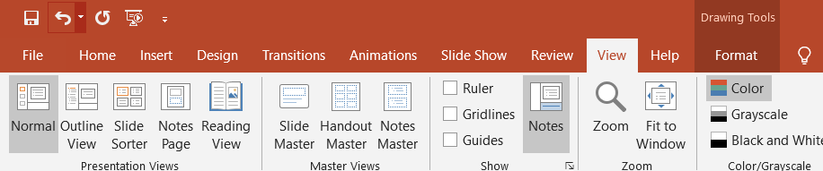
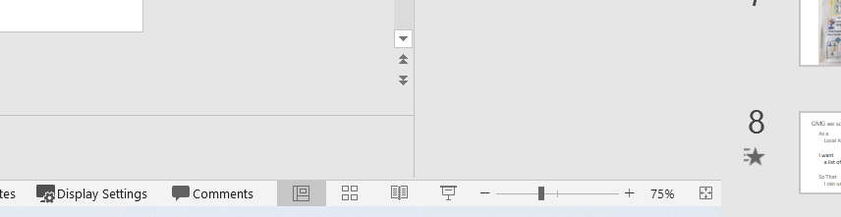
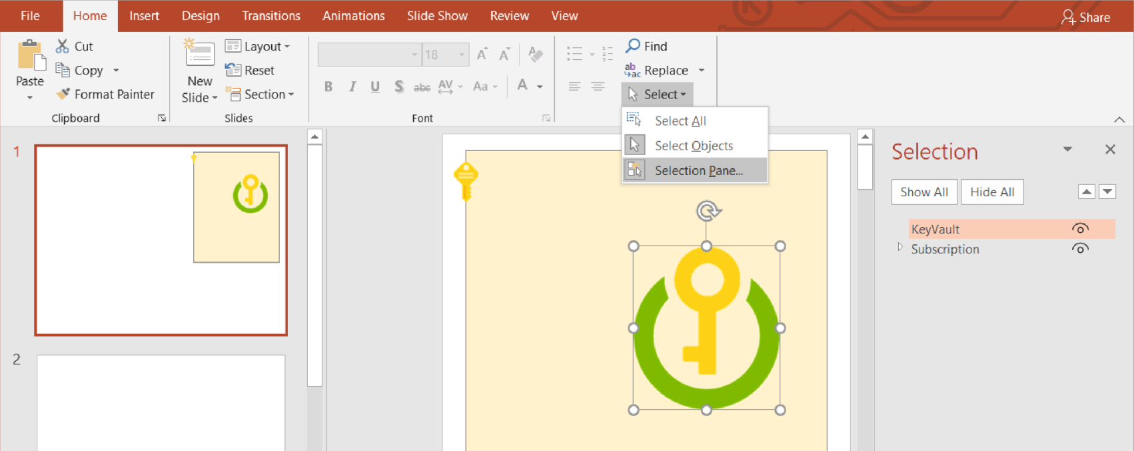

Recommendations for how to use this file
This isn’t a presentation – it’s a file for you to edit
Create your own copy of this file
Set the View to Normal if it isn’t already
Images in the gutter. You will be creating a “Cloud” out of the images in the gutter (the grey area around the slides): You can click and drag them on to the slide.
Zoom rather than resize. The images on the following slides have been scaled to fit with each other. Rather than changing the size of any of them, we suggest you zoom in when they are too small. For Windows users, you can hold down the Control Key and scroll your mouse wheel to zoom. Both Windows and Mac users may find pinching on their trackpad works too. PowerPoint’s manual zoom control is in the bottom right of the window:
Avoid Copy+Paste. Azure for Normal People leans heavily on a metaphor of how painful it is to manually do the same thing over and over again. To get the intended experience: avoid Copy+Paste. You shouldn’t need it - there are enough copies of the images in the gutter to complete the workshop without creating more with Ctrl-C, Ctrl-V.
You may find the Object Selection Pane useful to have open. Use the little triangles to collapse groups of objects
Selecting an object and pressing the arrow keys will nudge it around
You can Group Objects to make them easier to move around as a set. Select the objects and press Ctrl+G. To ungroup, select the group and press Ctrl+Shift+G
If you keep accidentally scrolling to this slide, delete it
This text is in the gutter

Slide 2




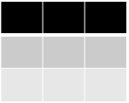






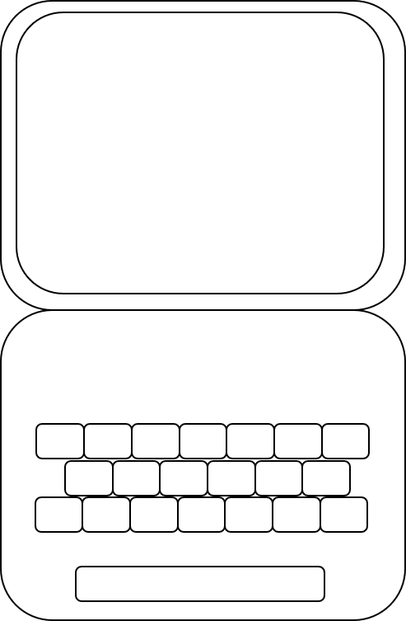







name
rbts
alx1
rby1
name
Table
Table
Queue
Queue
// stg26ea39
Contributor
Key Vault
// stg3bb28c7
Key Vault
Alex
eggs
Application
Application
Contributor
WebApp Instances: | 1
WebApp Size: | b3
Storage Account: | 1
Key Vault: | 1
Function: | 1
WebApp Instances: | 1
WebApp Size: | b3
Storage Account: | 1
Key Vault: | 1
Function: | 1
Roby
eggs
ci01
prod
Table
Table
Queue
Queue
bhas
// stg1ad4g7
// stg49a5e3f
prod
Key Vault
Key Vault
Building Height Attribute Service
?
?
?
?
Alex
Roby
BHA Application
Height Team Project
Application
Infrastructure
BHA
WebApp Instances: | 1
WebApp Size: | b3
Storage Account: | 1
Key Vault: | 1
Function: | 1
Compile
Test
Package
Compile
Test
Package
prod
env
env
env name
rby1
Azure DevOps
Azure DevOps

