Slide 1
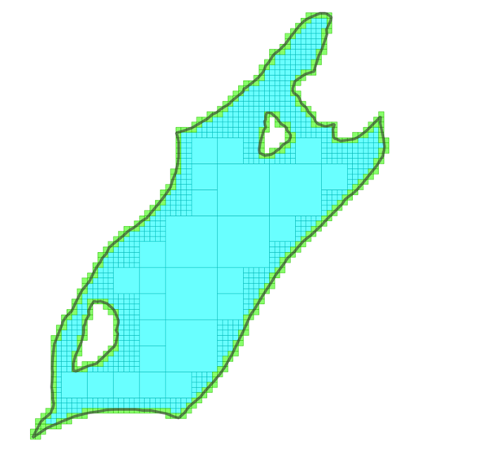
Synchronised Traversal for RADIG Reference Matching
Sheng Zhou
Senior Data Scientist
Data Science & Analytics
Chief Geospatial Office
Ordnance Survey

Slide 2
BNG grid reference as a spatial indexing method
Easy to interpret (by human) and efficient in matching (string comparison)
Issues:
Fixed resolution for all features in a dataset, regardless of their sizes
Huge challenge in selecting an appropriate resolution for dataset with vast feature size variation
Two datasets to be joined have to be indexed at the same fixed resolution

Slide 3
Resolution-Adaptive Digit Interleaving Grid (RADIG)
Using Digit Interleaving encoding to represent resolution hierarchy in reference string
A well-known techniques rooted from quadtree
References at different resolutions in the same dataset
Mixed resolution references for the same feature
Joining two datasets with references at mixed resolutions (provided they are indexed under the same RADIG)

Slide 4
Digit Interleaving: BNG vs RADIG by example
A sample BNG coordinate: 562356, 231722
BNG Grid references at different resolution (interleaving + concatenation) : TL->TL63->TL6231->TL623317-> TL62353172->TL6235671322
RADIG aligned to BNG and using digit interleaving encoding: TL->TL63->TL6321->TL632137->TL63213752->TL6321375262
Digit Interleaving: 5 6 2 3 5 6, 2 3 1 7 2 2 Digit Concat: 5 6 2 3 5 6, 2 3 1 7 2 2
RADIG Ref: T L 6 3 2 1 3 7 5 2 6 2 BNG Ref: T L 6 2 3 5 6 3 1 7 2 2

Slide 5
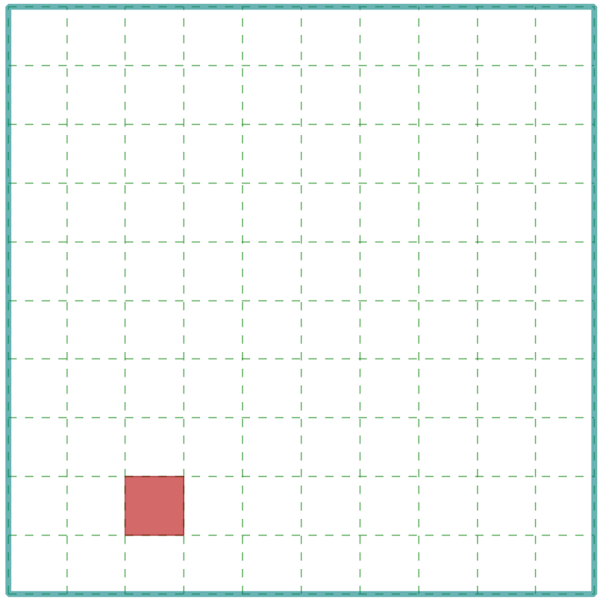
Digit Interleaved RADIG Reference for Multi-Resolution Process
Grid cell hierarchy represented by the order of digits in digit interleaving references:
Ref Series for (562356, 231722): TL->TL63->TL6321->TL632137->TL63213752->TL6321375262
Grid_Cell(TL).contains(Grid_Cell(TL63)) <=> “TL63”.startsWith(“TL”) == True
Grid_Cell(TL63).contains(Grid_Cell(TL6321) <=> “TL6321”.startsWith(“TL63”) == True
And so on…
Original BNG: TL63 vs TL6231 (not sub-stringing)
TL63
TL6321

Slide 6
Grid Cell Containment/Intersection by Substring Operations
Containment
containDF = dfFeat.join(dfQry, dfFeat.RadigRef.startsWith(dfQry.RadigRef))
Intersection
interDF = df1.join(df2, df1.RadigRef.startsWith(df2.RadigRef) | df2.RadigRef.startsWith(df1.RadigRef))

Slide 7
Dynamic Generation of Grid References Adaptive to Feature Extent
Polygon feature as an example
Start at a large initial resolution (equal or larger than the extent of the feature)
May use the lower bound instead (the next resolution smaller than the extent)
Test “effective area” value (proportion of cell intersecting the feature)
If ratio higher than predefined threshold, return the reference of this grid cell
Otherwise, sub-divide the cell, goes to next finer resolution to repeat the test
May also be controlled by a cut-off minimum resolution, and a maximum levels of sub-division

Slide 8
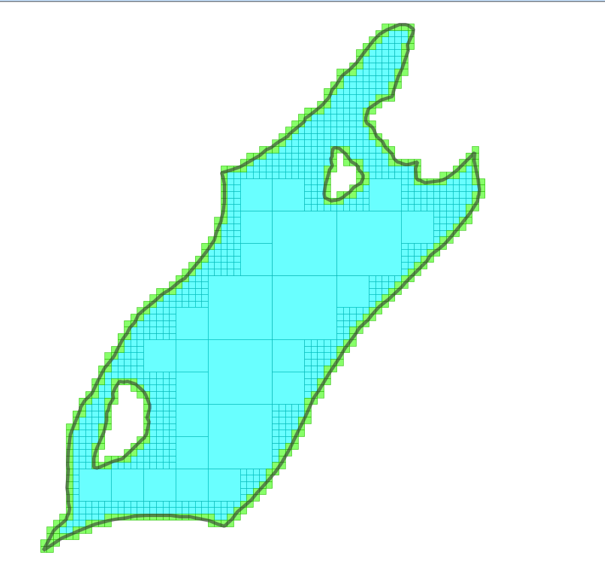
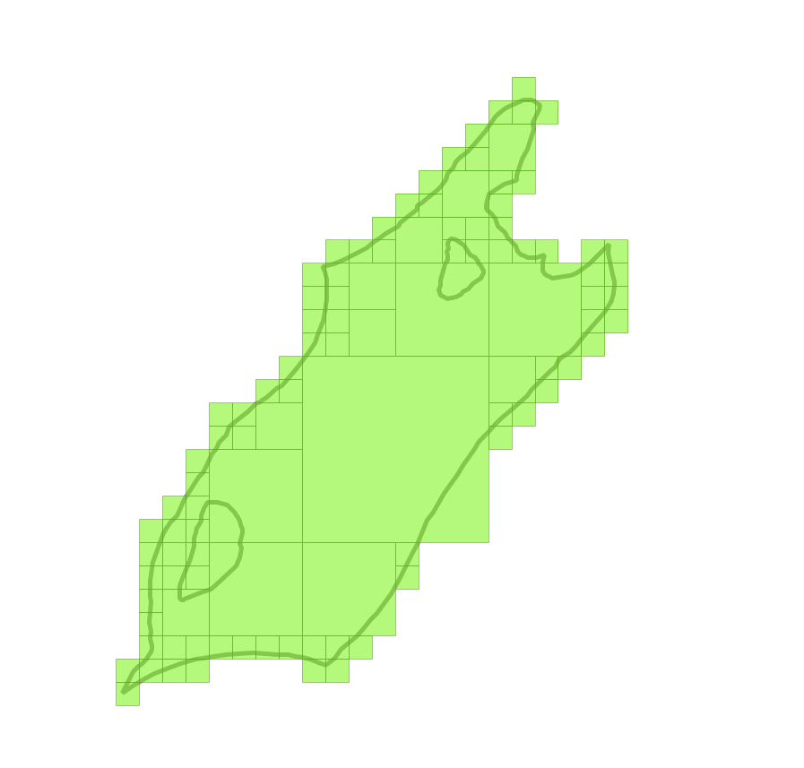
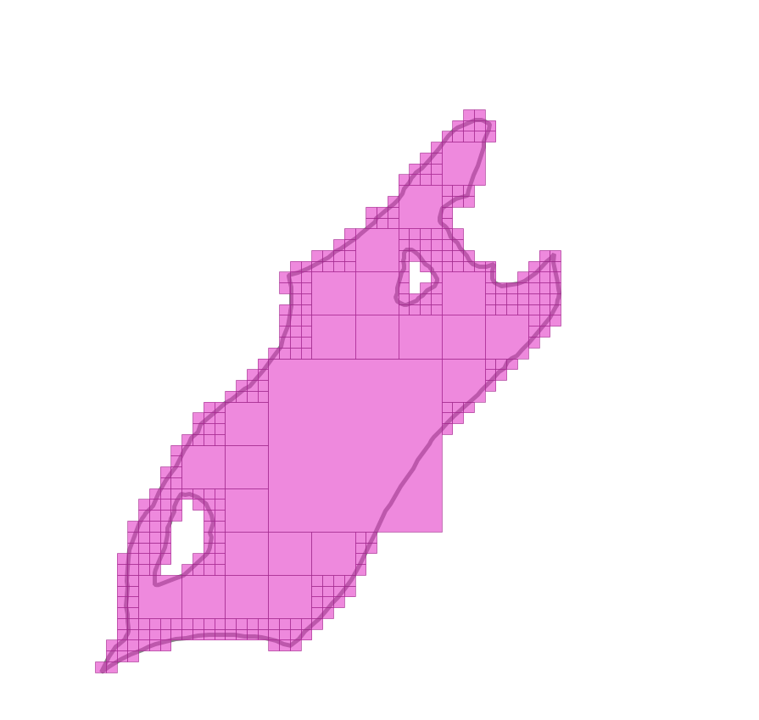
Sample RADIG Outputs (I)
Base-10, max level 5, 2x5 divisor
Base-2, max level 6
Base-16, max level 4, 4x4 divisors

Slide 9
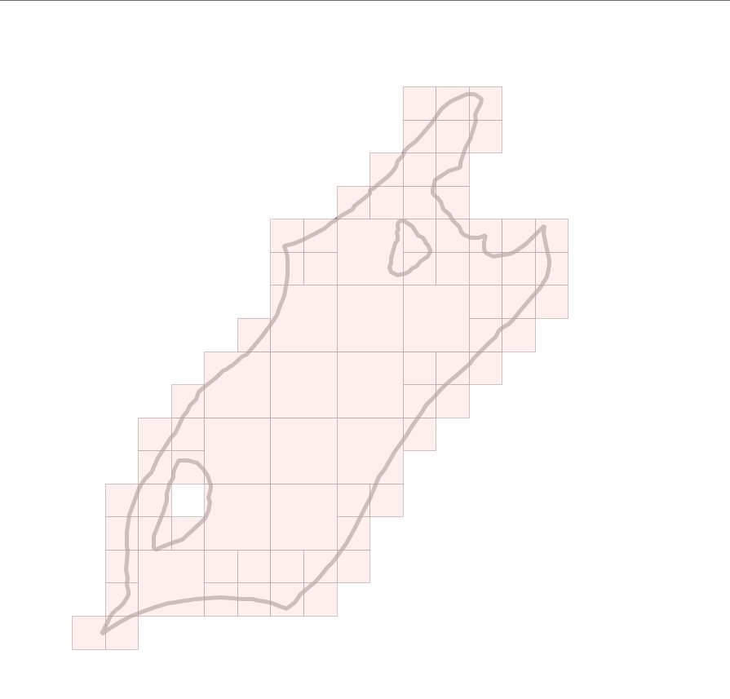
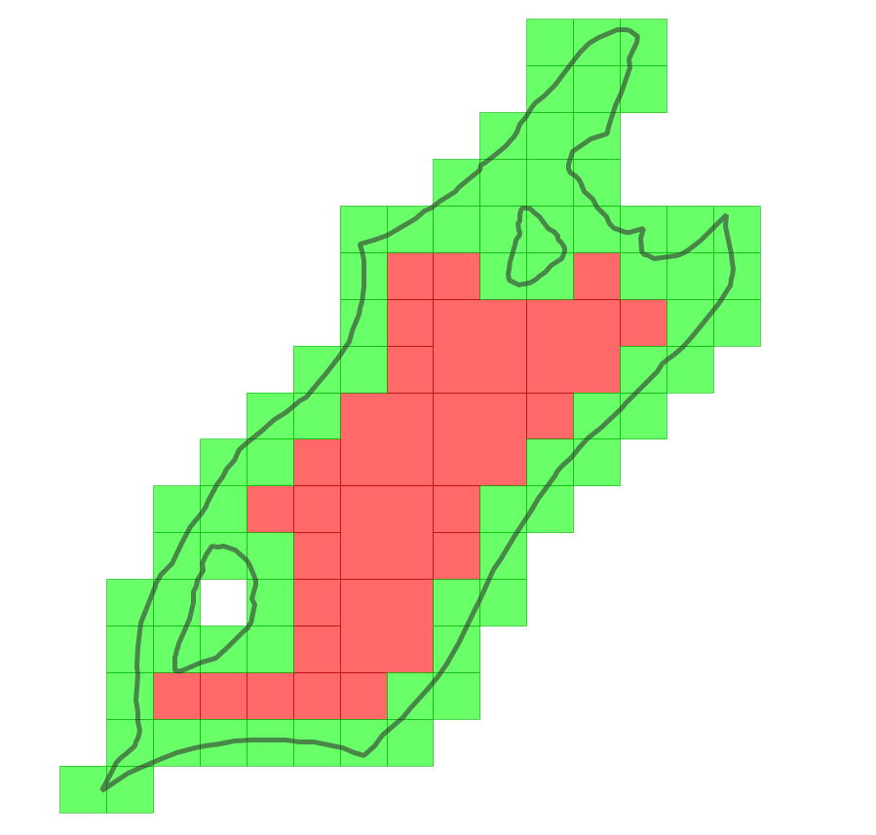
Sample RADIG Outputs (1I)
Base-10, 2 divisors (2X5), max level 4, area ratio 0.8
Base-10, divisor 2x5, max level 4, area ratio 0.8, containing cells are separated

Slide 10

Sub-stringing: Performance Issue in Reference Matching
The trouble with StartsWith() function:
Some DBMS don’t have it
Some have it, but not optimised
In Spark SQL, the call is translated to a cross-join (M x N)
We have to deal with it ourselves (for now…)

Slide 11
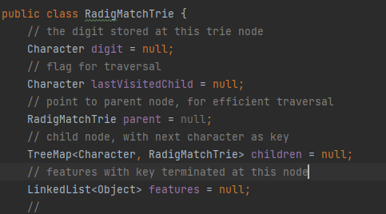
Multi-Way Trie for RADIG Reference Matching
…
S
T
U
…
…
G
L
M
…
Trie (a.k.a. Prefix tree):
Data structure for sequence matching, common sequence, etc.
RADIG Reference Matching
Example: TL6321375262
…
5
6
7
…
…
2
3
4
…
…
1
2
3
…
…
0
1
2
…
…
2
3
4
…
…
6
7
8
…
…
4
5
6
…
…
1
2
3
…
…
5
6
7
…
…
1
2
3
…

Slide 12
Querying a RADIG Match Trie
…
S
T
U
…
…
G
L
M
…
Given query reference TL6321
Drill down from top of the Trie per digit
First matching node (red cycle) and all its children (inside the dashed box) are the result
…
5
6
7
…
…
2
3
4
…
…
1
2
3
…
…
0
1
2
…
…
2
3
4
…
…
6
7
8
…
…
4
5
6
…
…
1
2
3
…
…
5
6
7
…
…
1
2
3
…

Slide 13
Synchronised Traversal for Joining Two RADIG Tries
curL = rootL,
curR = rootR
Y
Retrieve matched ref from curR
Depth-first traverse on the left Trie, visit the corresponding node on the right trie simultaneously
Time complexity: O(a*m*N) (a: the ave. key length; m: the alphabet size; N : the max Trie size)
curL is terminal?
curL = childL
curR = childR
N
N
Y
childL = curL.getNextChild
childR is null?
N
childR = curR.parent.getNextChild(childL)
childL is null?
curL == rootL?
Y
End
Y
curL = curL.parent
curR = curR.parent
N

Slide 14
curL = rootL,
curR = rootR
Y
Retrieve matched ref from curR
curL is terminal?
curL = childL
curR = childR
N
N
Y
childL = curL.getNextChild
childR is null?
N
childR = curR.parent.getNextChild(childL)
childL is null?
curL == rootL?
Y
End
Y
curL = curL.parent
curR = curR.parent
N

Slide 15
Scalable RADIG Match Trie - The Method
Two tries to be compared must cover the same key space
Partition is required for large dataset
Partition and Conquer: two approaches
Object-based Partition (Think B-tree/R-tree/BSP)
Build trie on one dataset and generate even partitions of key space (complicated)
More adaptive to unbalanced data distribution but online partition computation may be required for one dataset
Key space Partition (Think Grid/Quadtee) – the choice of our current implementation
Use regular grid cells as partition
Simple, easy to pre-compute partitions on both datasets

Slide 16
Scalable RADIG Match Trie - The Process
Select a partition scheme (e.g. 10k grid with unique ID for each cell)
Assign partition IDs to features in both dataset (features may have multiple IDs)
In both dataset, group features by partition ID
Join two datasets by partition ID
For each row in joined dataset, build RADIG match tires and match features
De-duplicate and output result

Slide 17
Mosaic vs RADIG: Running Time
Dataset: 40298590 address points vs 14767492 building polygons (Z-Order optimised when applicable)
Mosaic: ave. 1.81min
RADIG Match Trie: ave. 4.51min

Slide 18
Discussion
RADIG is slower than Mosaic (understandable with all the data structure overheads) but still at the same magnitude
With RADIG Match Trie, we can now claim RADIG is ready for practical use, especially for dataset of features with huge size variation

