Slide 1
DATA SCIENCE
Project
By Adi Hershko & Orel Yehudai

Slide 2
Before we start…
Let’s answer this question –
Who wants to be a millionaire?

Slide 3
If the answer is no…

Slide 4

You’re probably on this list

Slide 5
But how can we verify it?

Slide 6
Our research question:
Is it possible, based on raw text, to classify whether a person would appear on the upper part of the Forbes magazine, or on the lower part of it.
The main question is – how can we do that?

Slide 7
OUR PROCESS:
Step 3
Step 1
Step 2
Step 4
Data cleaning
How can we clean our data, and process text into data we can work with.
Machine Learning
How can we work with the ML models, with text?
Data acquisition
EDA
Visualize our data
How are we going to acquire our needed data?

Slide 8
Data Acquisition
01
Gathering our data from the Forbes website

Slide 9
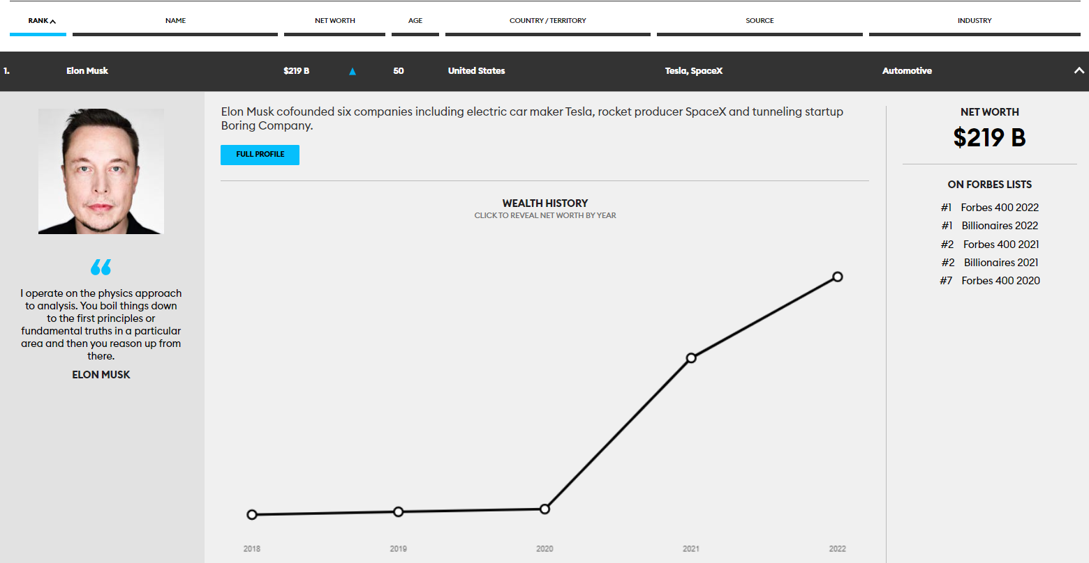
Let’s see what data we want to acquire:
Each row on the website, represents a different billionaire.
For every person, we will acquire:
Full name
Net worth
Age
Country
Source of wealth
Industry
Then, we would move on the full profile link to acquire some more information.

Slide 10
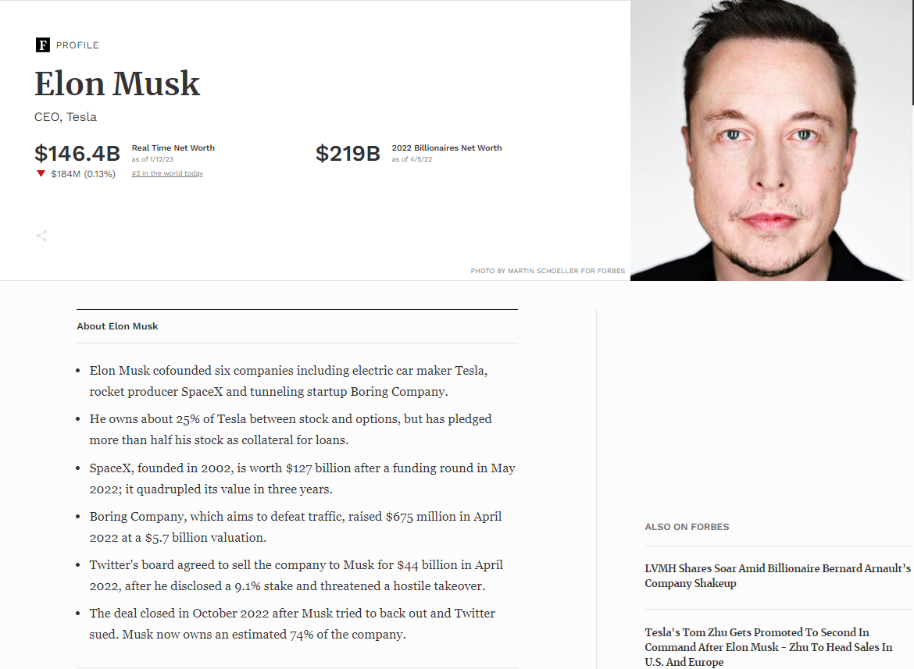
In each person “Full Profile” page, we will acquire:
Current job & workplace.
Real time net worth.
Our most important data – the text. Few lines of text that describe our billionaire.

Slide 11
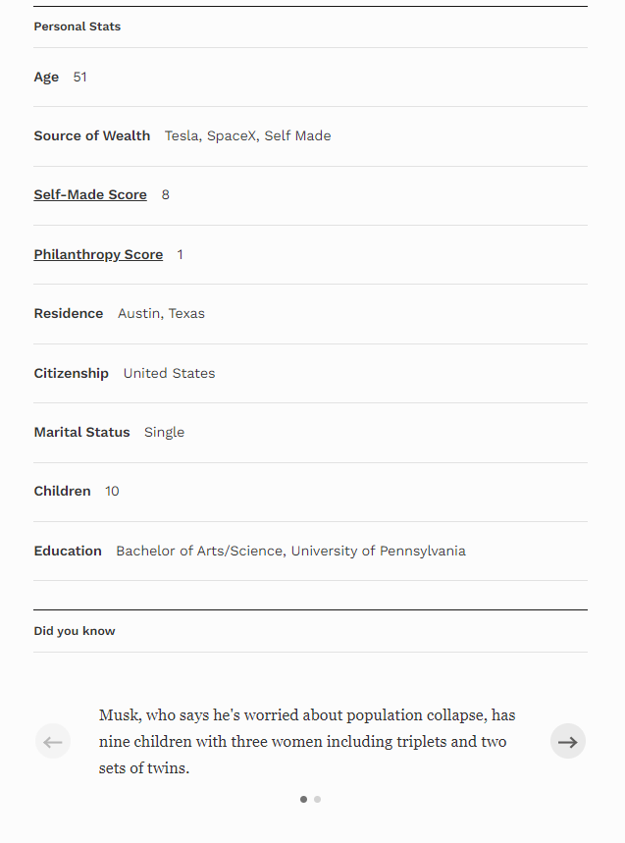
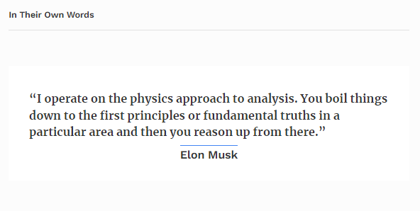
Furthermore, we will get some basic information on our person:
1. Self-Made Score (a score that represents if our billionaire made his fortune on his own, or not, like inheritance).
2. Philanthropy Score (a score that represents how much a person donates his wealth).
3. Residence.
4. Citizenship.
5. Martial Status.
6. Number of children.
7. Education.
8. An interesting fact about our billionaire.
9. A quote of our billionaire.

Slide 12
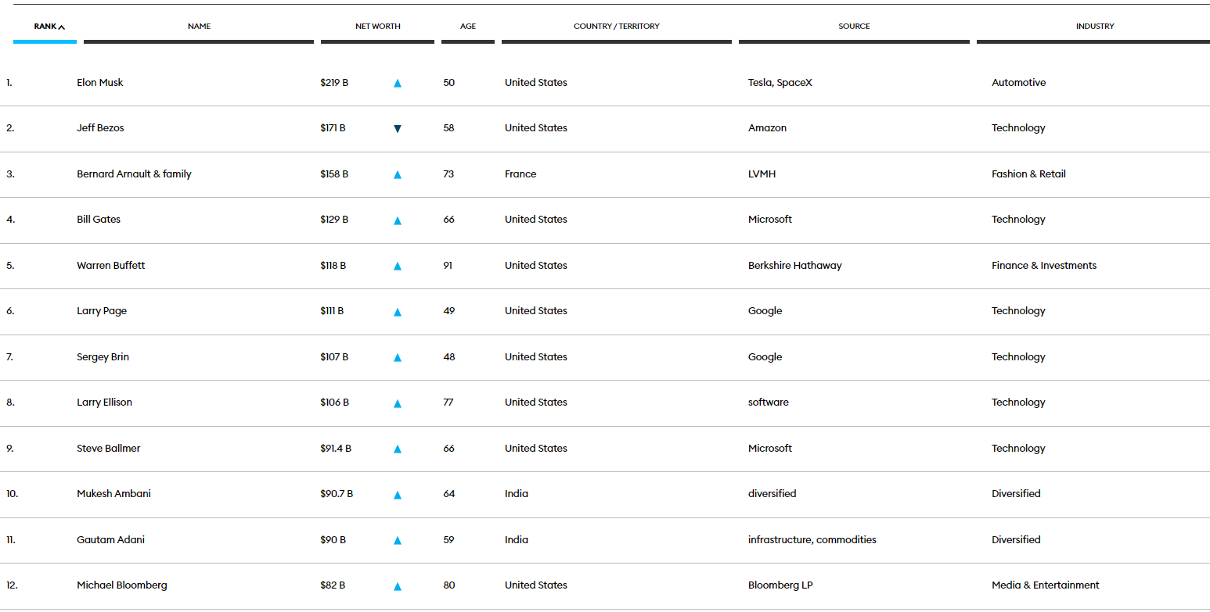
The problem we face:
In order to get the “Full Profile” data from each person, we need to ‘click’ each row, to unveil the “Full Profile” button.
Then, we need to open the “Full Profile” page itself, and acquire it’s needed data.
We also need to find a way to get the next batch of the list, which is not located on a different URL.

Slide 13
The solution:
We used the “selenium” module, which is perfect for those human-like interactions such as clicks, scroll, etc.
With the help of “selenium”, we were able to scrape the entire data we needed and save it into a csv file.
After we saved it, we advanced into the data cleaning stage.

Slide 14
Data Cleaning
02
Clean our data and process our text

Slide 15
What is the problem with our data?
Well, in a lot of cases, we have some missing information such as real time net worth, a quote, some scores, etc.
We need to decide how to clean our data accordingly to our desire and needs.
For example, a missing value in “Self-Made Score” doesn’t bug us too much – because later it will be irrelevant to us.
On the other hand, we can’t let ourselves have missing values for the text we want to analyze.

Slide 16
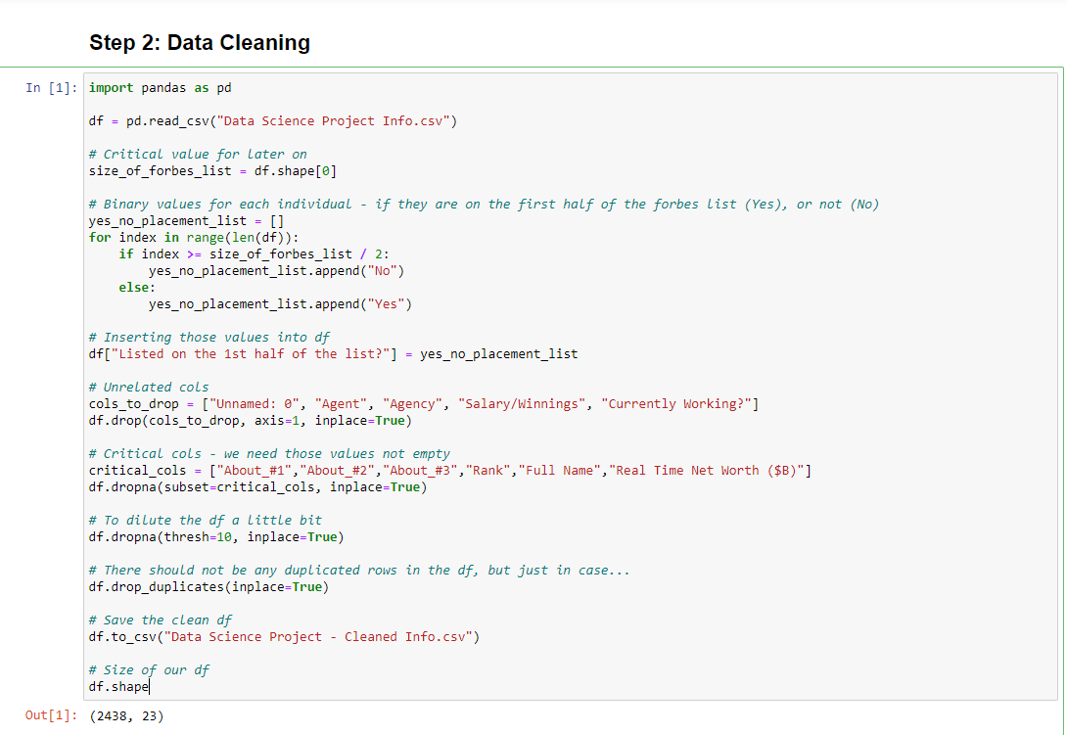
How do we fix it?
It is very simple – we ignore whatever is irrelevant to us but require the completeness of the data we need to work on.
We also added a new column in advance to help us with the ML part.
As you can see, after cleaning the data, we still have 2438 records, which is more than 90% of the original amount.

Slide 17
EDA
03
Visualize our data

Slide 18
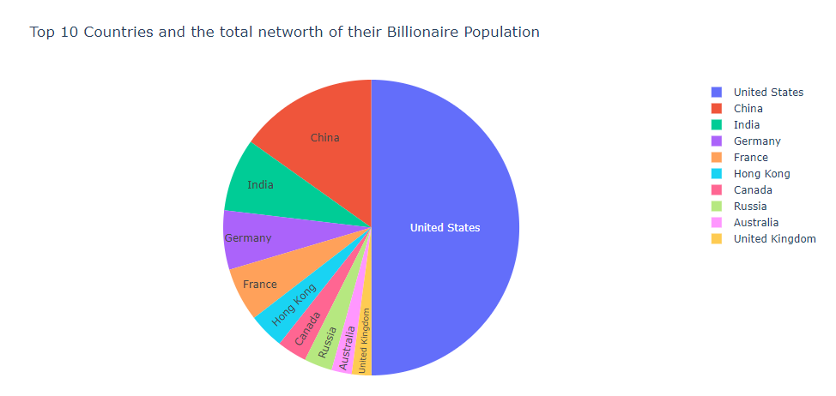
We wanted to check some interesting trends, such as:

Slide 19
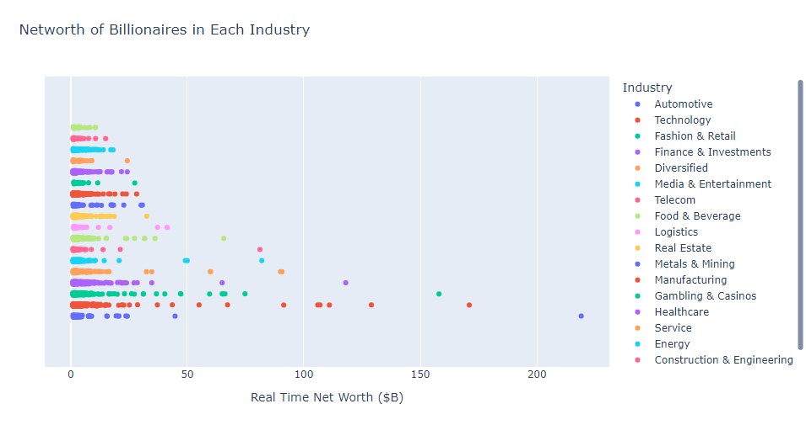

Slide 20
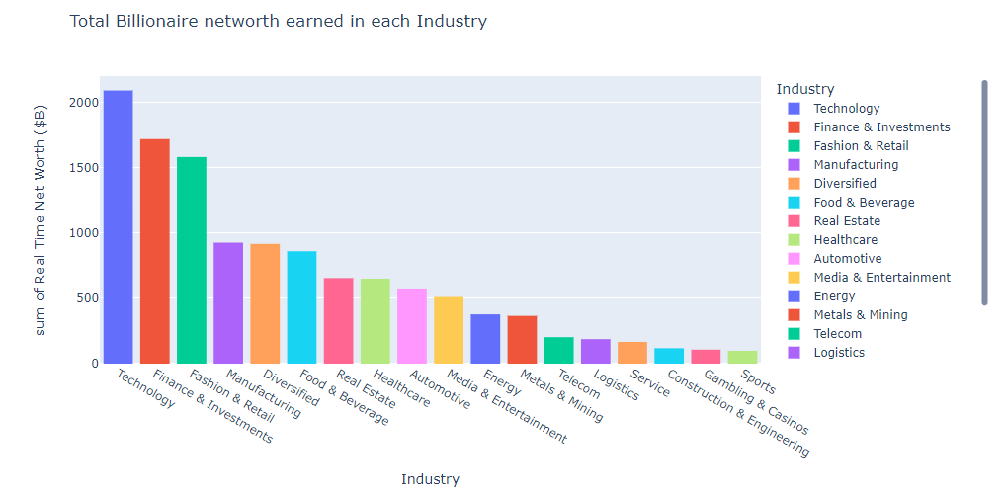

Slide 21
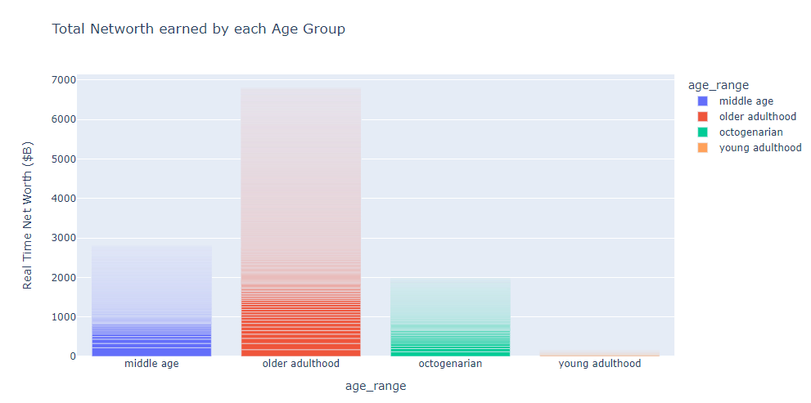

Slide 22
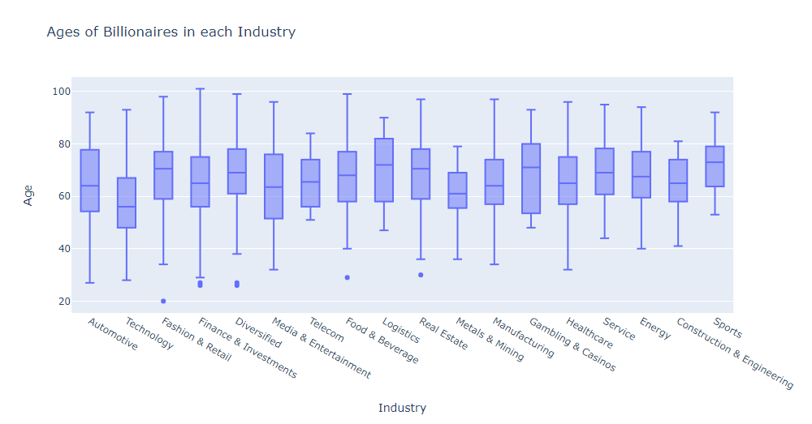

Slide 23
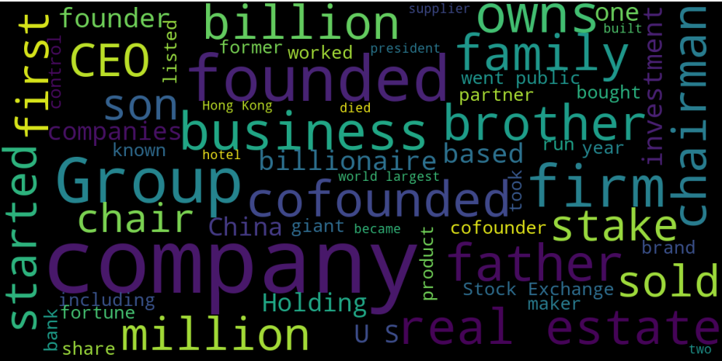
We also wanted to visualize common words across the text we gathered, *after* clearing out stop-words such as “the”, “as”, “a”, etc.

Slide 24
Machine Learning

Slide 25
Machine Learning
04
Analyze our data, train our models, and evaluate it.

Slide 26
How can we use Machine Learning algorithms with raw text?
First, we need to figure out how to process our text into data we can work with.
In our project, we created a huge vocabulary of words that appeared in the overall text and created a sparse matrix out of it.
Each column in the matrix represents a word in our vocabulary, and its value is the number of occurrences it appeared overall in the text.
We can achieve this easily with CountVectorizer, which does all the work for us.

Slide 27
After we got our sparse matrix, what do we do?
We need to decide what higher occurrences of words mean – is it helping us to decide on which part of the Forbes list a person should appear, or not.
After some tests, we decided to give more frequent words less weight than words that appear rarely.
In order to achieve this, we used TfidfTransformer which do it for us.

Slide 28
What comes next?
Before we go into the ML algorithms, we’re going to ask ourselves – is there a better way to process our text?
What we mean is that for every text we provide, we need to vectorize it into a vocabulary, and then create a sparse matrix out of it. It will be very exhausting repeating all this process multiple times, for every ML algorithm we are going to use.

Slide 29
The solution:
There is a perfect solution just for this problem – the Pipeline class, from scikit-learn.
The Pipeline class does all the work for us, we just provide the CountVectorizer for it, the method we want to normalize our data with, and the classifier we want to work with.

Slide 30
The first step towards the goal
First, we are going to split our data into train & test groups. We wanted that the test group will be 20% of overall data.
Then, we decided which ML algorithms we are going to use.

Slide 31
The ML algorithms we are going to use
Naïve Bayes
SVM / Linear SVC
KNN
Logistic Regression
Bernoulli Naïve Bayes

Slide 32
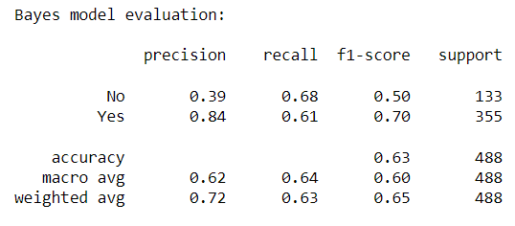
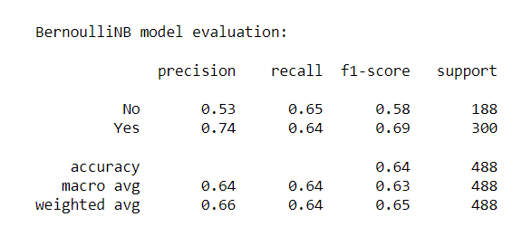
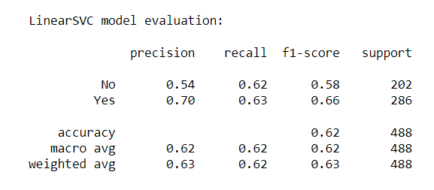
Results:

Slide 33
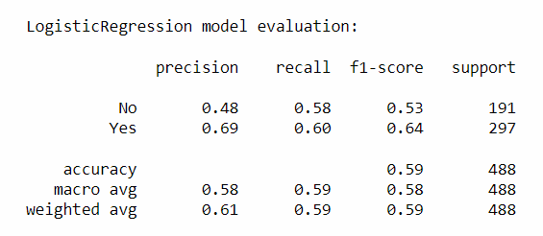
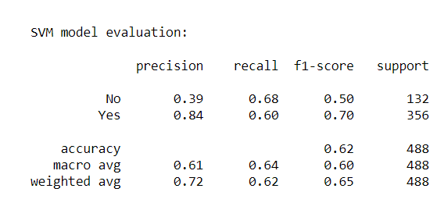
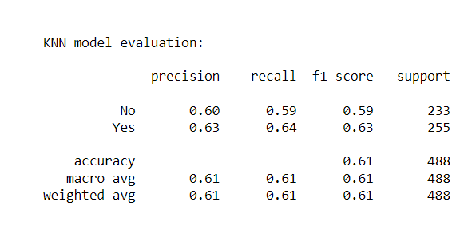
Results:

Slide 34
Are we happy with the results?
The highest f1 score is 0.64, by the BernoulliNB model. We tried to make it better by changing the way we normalized our data, but it didn’t work.
We also searched within our text for regular expressions and based on some numbers – change the text we send into the ML model. Unfortunately, it didn’t work as we excepted.

Slide 35
Thank you for your attention

