Slide 1
Noteplus
Alton Dupre, Kenyon Tiner, Tristan Harper,Ethan Purser

Slide 2
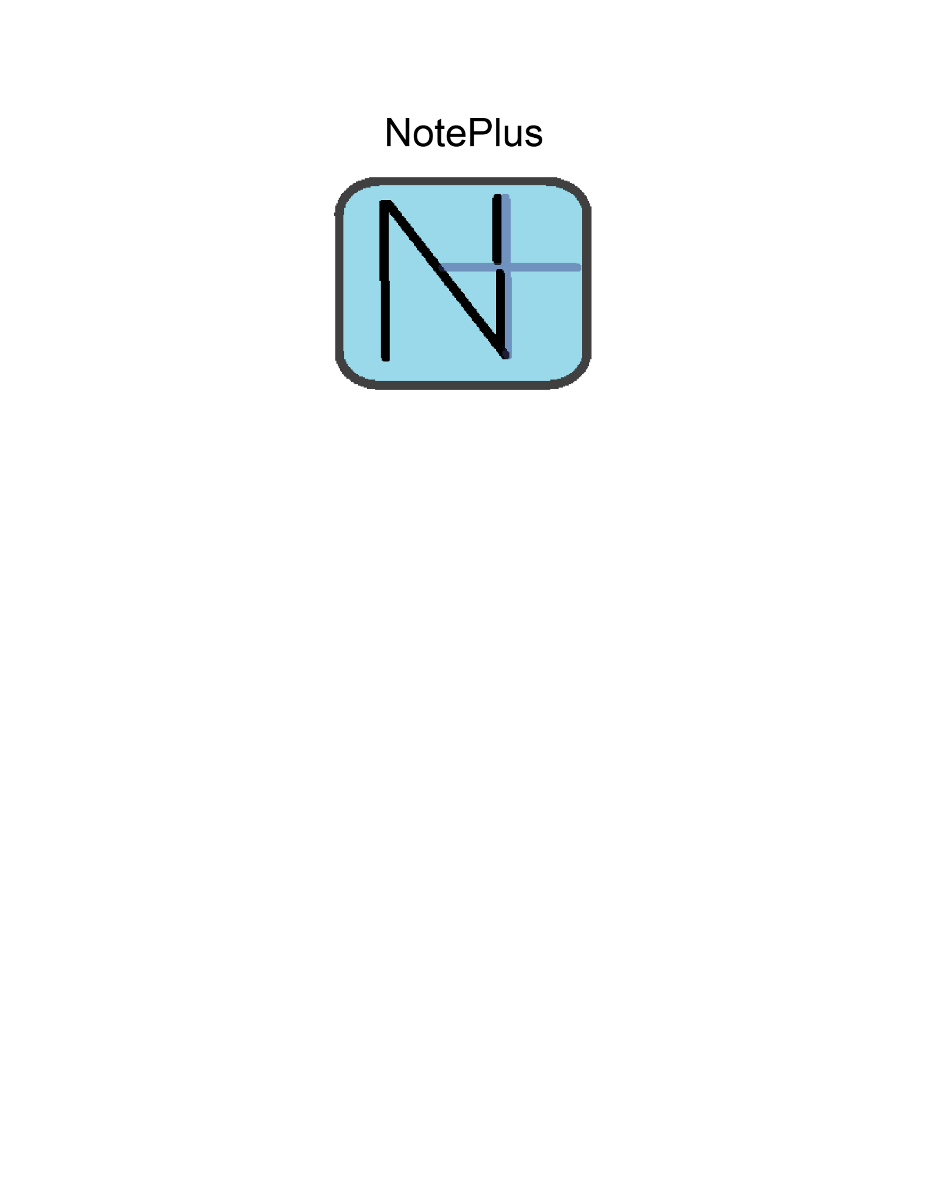
What is Noteplus
Noteplus is a note app written in C with a unique feature, it’s notesets exist on a Per Application basis. This allows for notes to be taken in the case of applications where notes may be useful, such as in a game

Slide 3

Why C
C is a lightweight, low level programming language, and while it may seem like overkill for a program as simple as Noteplus it actually allows noteplus to run as fast as it possibly can, which is particularly useful if you need to take notes in the moment and you can’t wait for an application in a higher level language to possibly load

Slide 4

Libraries used
Noteplus only relies on one library, SDL, however SDL is a rather important library for the project, as it allows for Noteplus to even exist by handling a bulk of the rendering logic and allowing for Noteplus to exist as a multiplatform application as opposed to if the Win32 and Direct2D APIs were used directly

Slide 5
Presentation

