Slide 1
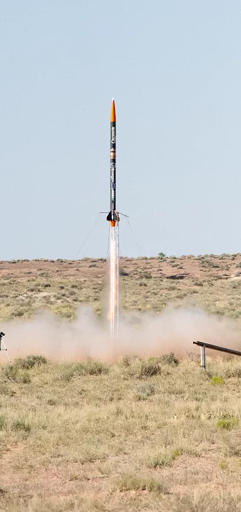
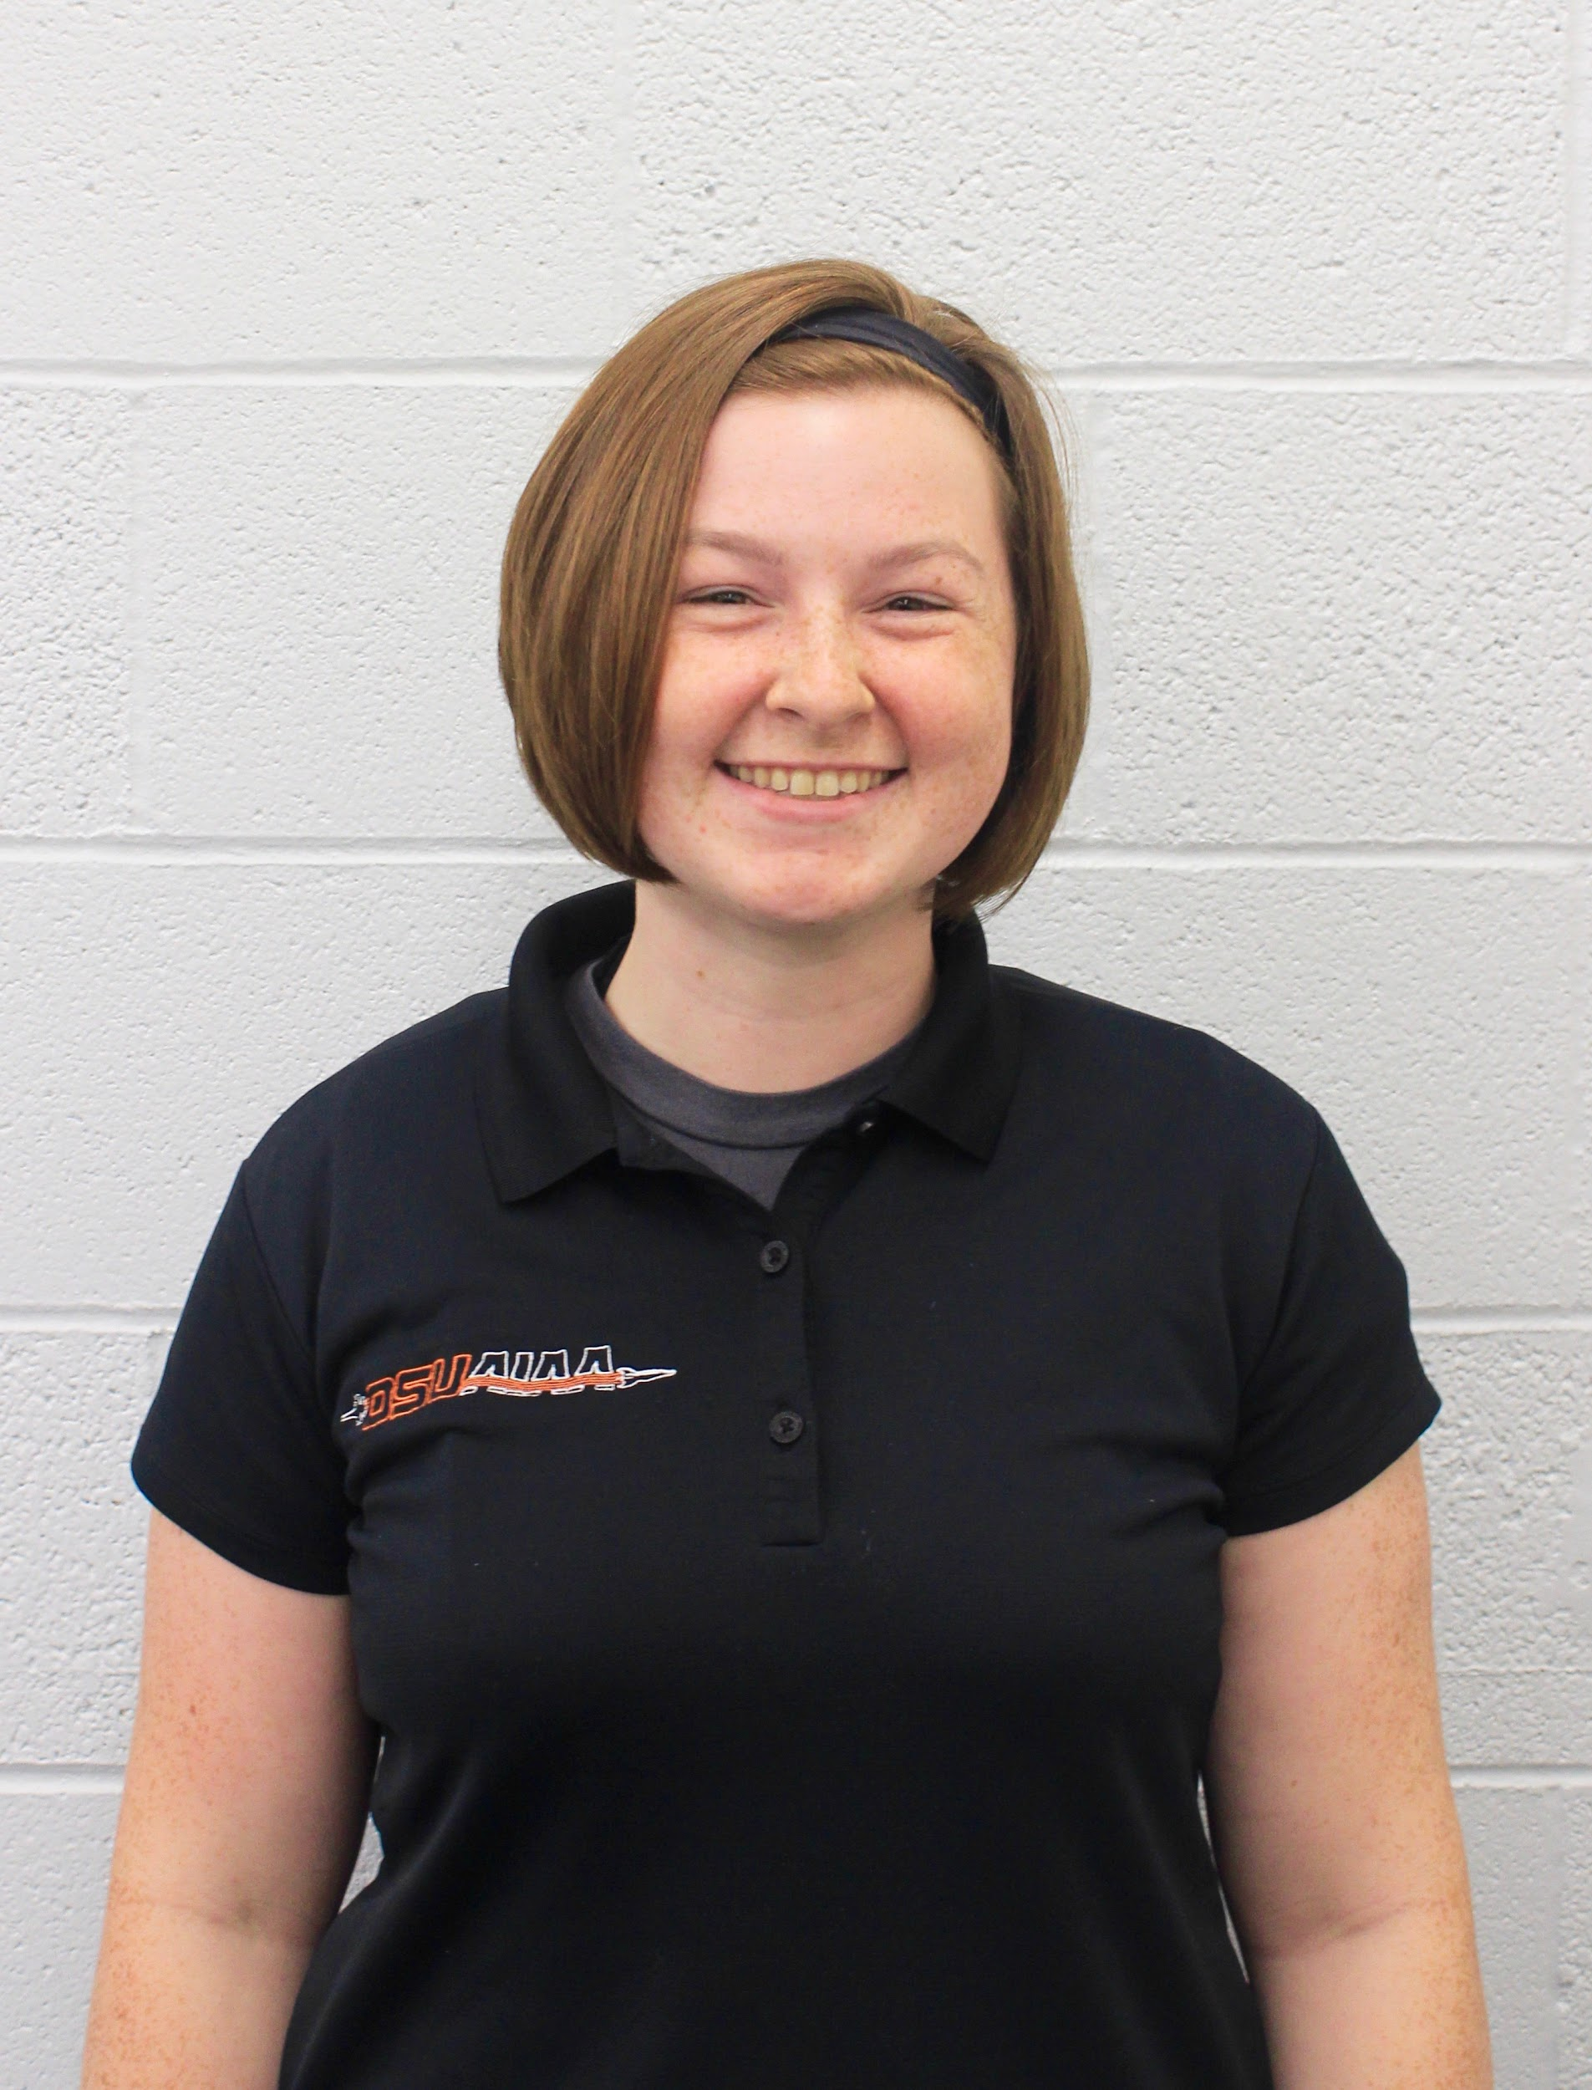

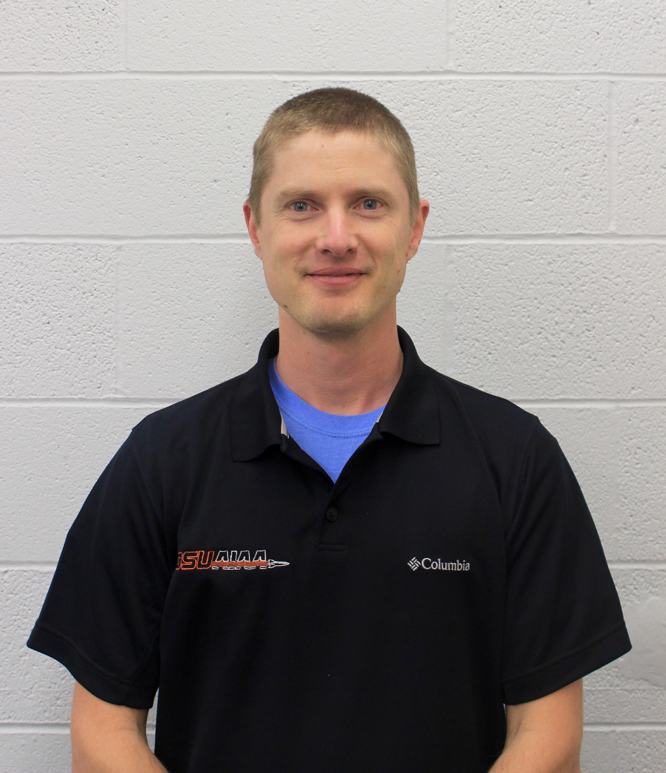
Team 41 Progress Report
30k Spaceport America Cup 2017-18

Slide 2
Overview
Project Goals
Development Roadmap
Progress and Problems
Ground Station Database Data Parsing Payload Avionics Client Side Display | Avionics Testing Rocket Avionics Networking & Hosting Display Testing

Slide 3
Project Goals
Support the team and competition goals.
Write avionics software for the rocket.
Write software to display flight data.

Slide 4
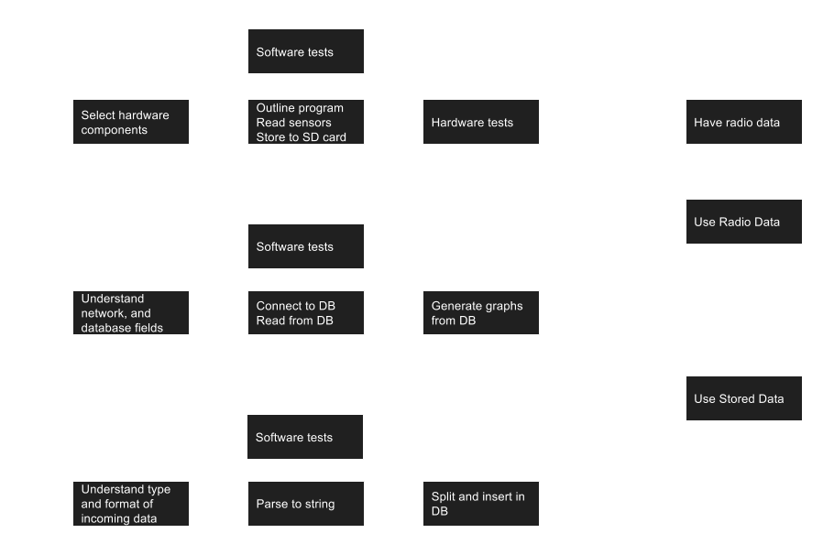
Development Roadmap

Slide 5
Development Roadmap
end of fall progress

Slide 6
Ground Station
Design Goals:
Work without external power or networking.
Portable, can function in a desert environment.
Tasks:
Receive four radio signals containing live telemetry.
Import flight data from onboard instruments using SD card.
Store flight data in a database.
Serve a WiFi network and web page to display flight data.

Slide 7
Ground Station
Problems:
Which microcomputers should we use? Decided on Raspberry Pi Zero’s for parsers, and a Raspberry Pi 3 for the database/web host.
Which battery can support our computers, and for how long? Decided to use a 22,000 mAh USB power bank.
How can we protect the electronics? Decided to use a hardshell project case.
Notes:
Battery - We selected a well-reviewed USB power bank that we estimate should run our computers for 4-6 hours, and ordered a second battery in case we need more time.
Protect - We ordered a hard, bright yellow project case to protect the electronics. We will have to see if it gets too hot and possibly add a fan or leave it open during use.

Slide 8
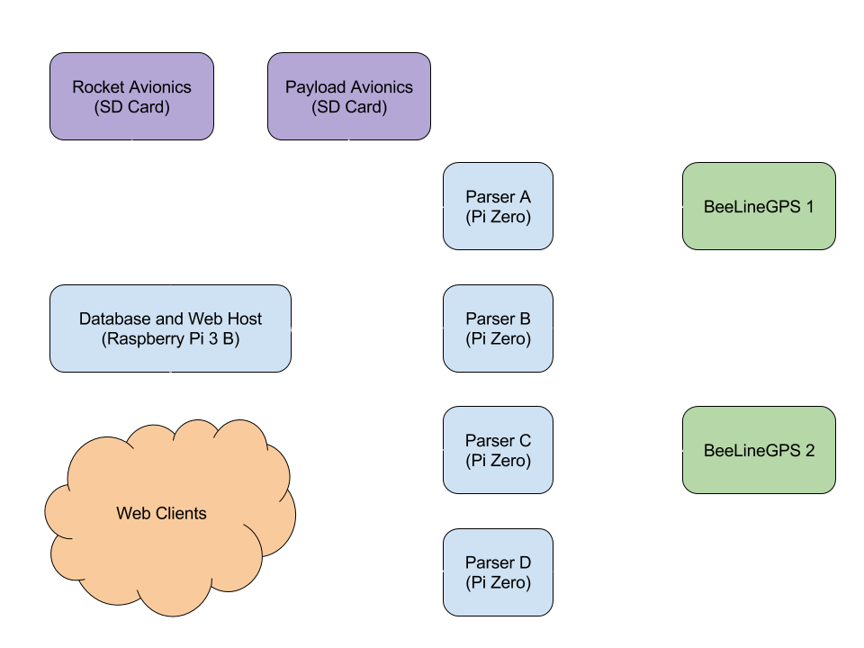
Flow of Information

Slide 9
Database
Design Goals:
Store flight data from multiple sources.
Allow queries from multiple clients.
Tasks:
Create a reasonable set of tables to store data.
Think about what information will be useful.
Find a way to relate data between sources.

Slide 10
Database
Problems:
Data from different sources will contain different fields. Database will contain one table per source.
How will we know which records are related? New flights are created by parsers. Assign a unique Flight_ID to each flight.
Data from different sources needs to be related. Use Flight_ID as a foreign key in related tables.

Slide 11
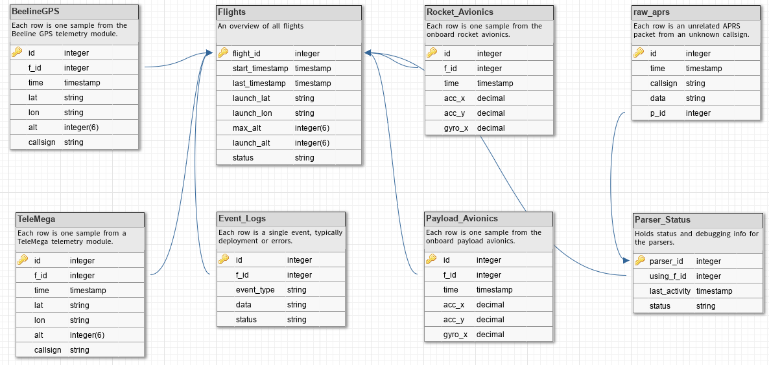
Database

Slide 12
Data Parsing
Design Goals:
Receive multiple radio signals for live telemetry.
Receive flight data stored on SD cards.
Make flight data available for display.
Tasks:
Each parser computer receives one radio signal as audio source.
Parse audio for text strings using Direwolf software.
Import files from SD cards and parse them for text strings.
Validate text string and insert into database on network.

Slide 13
Data Parsing
Problems:
Incoming radio packets may be from other senders. Use a callsign field to verify source.
Data sources may be corrupt or contain invalid data. Use checksums and validate fields before inserting into DB.
Data from one flight may be received several hours or days apart. When importing from files, prompt for flight ID.

Slide 14
Payload Avionics
Design Goals:
Record flight data using several electronic sensors.
Control a propeller to reduce net acceleration.
Tasks:
Record from several sensors including acceleration, roll/pitch/yaw, temperature, humidity, air pressure, etc.
Detect and log moment of ejection.
Control propeller to create zero gravity environment.

Slide 15
Payload Avionics
Problems:
We don’t have direct control over the sensor choices. Do our best to work with the ECE team who does.
We may not have early access to flight electronics. We may have to build our own copy of their PCB.
How fast should we spin the propeller? We’ll use a closed PID loop to read acceleration, predict a new prop speed, and adjust over time.

Slide 16
Display - Client Side
Design Goals:
Allow users to view both stored and live flight data.
Create a web browser GUI to organize and display flight data.
Supported by browsers on cell phones, tablets, and laptops.
Tasks:
Query database for flight data.
Display flight data in interesting and useful ways.
Build dynamic graphs when live telemetry is available.

Slide 17
Display - Client Side
Problems:
How do we generate dynamic graphs from a database? Using a javascript library called CanvasJS.
How will the graphs look good on cell phones AND laptops? We’re still working on this question.

Slide 18
Avionics - Reading Sensors
Design Goals:
Read from available flight sensors.
Reuse sensor code between Rocket and Payload Avionics.
Tasks:
Check sensor status / handle errors.
Write functions to read from each type of sensor.
Convert measurement unit if necessary.

Slide 19
Avionics - Reading Sensors
Problems:
Which sensors are available? The ECE team has final say over sensor models.
What sensors are available for testing? We can borrow sensors from the ECE team or purchase.
How do we read from the sensors? All sensors will return digital values. Most sensors will be I2C, but some may be SPI.

Slide 20
Avionics Testing
Design Goals:
Create a test suite for avionics software.
Ensure flight events trigger on time.
Tasks:
Write unit tests for all functions.
Simulate launches using test data from previous flights.

Slide 21
Avionics Testing
Problems:
How can we introduce instrument failures?
Use robustness testing.
How can we simulate a flight from beginning to end? Use flight data from last year’s team, or our test launch.
How can we test hardware?
We will need to test ECE hardware, and can build our own

Slide 22
Rocket Avionics
Design Goals:
Record flight data using several electronic sensors.
Use sensor data to detect and record flight events.
Tasks:
Record from several sensors including acceleration, roll/pitch/yaw, temperature, humidity, air pressure, etc.
Detect and log moment of apogee.
Detect and log separation and parachute deployments.

Slide 23
Rocket Avionics
Problems:
We don’t have direct control over the sensor choices. Do our best to work with the ECE team who does.
We may not have early access to flight electronics. We may have to build our own copy of their PCB.

Slide 24
Networking & Hosting
Design Goals:
Connect parser computers to database.
Allow users to connect via WiFi and view Display page.
Tasks:
Create network between Pi Zeros and Pi 3 using USB OTG.
Create WiFi network from Pi 3.
Create web host on Pi 3 that serves Display page.

Slide 25
Networking & Hosting
Problems:
How do we create a network over USB? The Pi Zero’s are capable and there are tutorials available.
How do we serve WiFi from the Pi 3? Possibly using the built-in WiFi card or external router.
How do we serve a webpage from the Pi 3? Using either Apache or NGINX.

Slide 26
Display Testing
Design Goals:
Ensure the graphs and information is accurate.
Ensure the page is viewable on multiple platforms.
Tasks:
Write unit tests for all reasonable functions.
Simulate inputs using test and flight data.

Slide 27
Display Testing
Problems:
How do you test websites? We’re not sure yet. Learn about industry testing procedures.
How can we ensure the page is viewable on target platforms? Use a variety of devices to view the pages.

Slide 29
Week 2
Problem Statement Started
Met with Nancy
Requirements

Slide 30
Week 3
Met with TA
Met with ECE Team
Meeting with 100k Mentors

Slide 31
Week 4
Looking for Code from Previous Year

Slide 32
Week 5
Requirements Document
CanvasJS
ECE Telemetry Unit Choice

Slide 33
Weeks 6-7
Tech Review Started and Broken Up

Slide 34
Week 8
CanvasJS Licensing Issue
Finishing Tech Review

Slide 35
Week 9
ECE Team will Write their Own Code
Design Document Responsibilities
Problem with Triggering Flight Events

Slide 36
Week 10
Design Document and Progress Report
Nancy Approved of Using Altus Metrum

