Slide 1

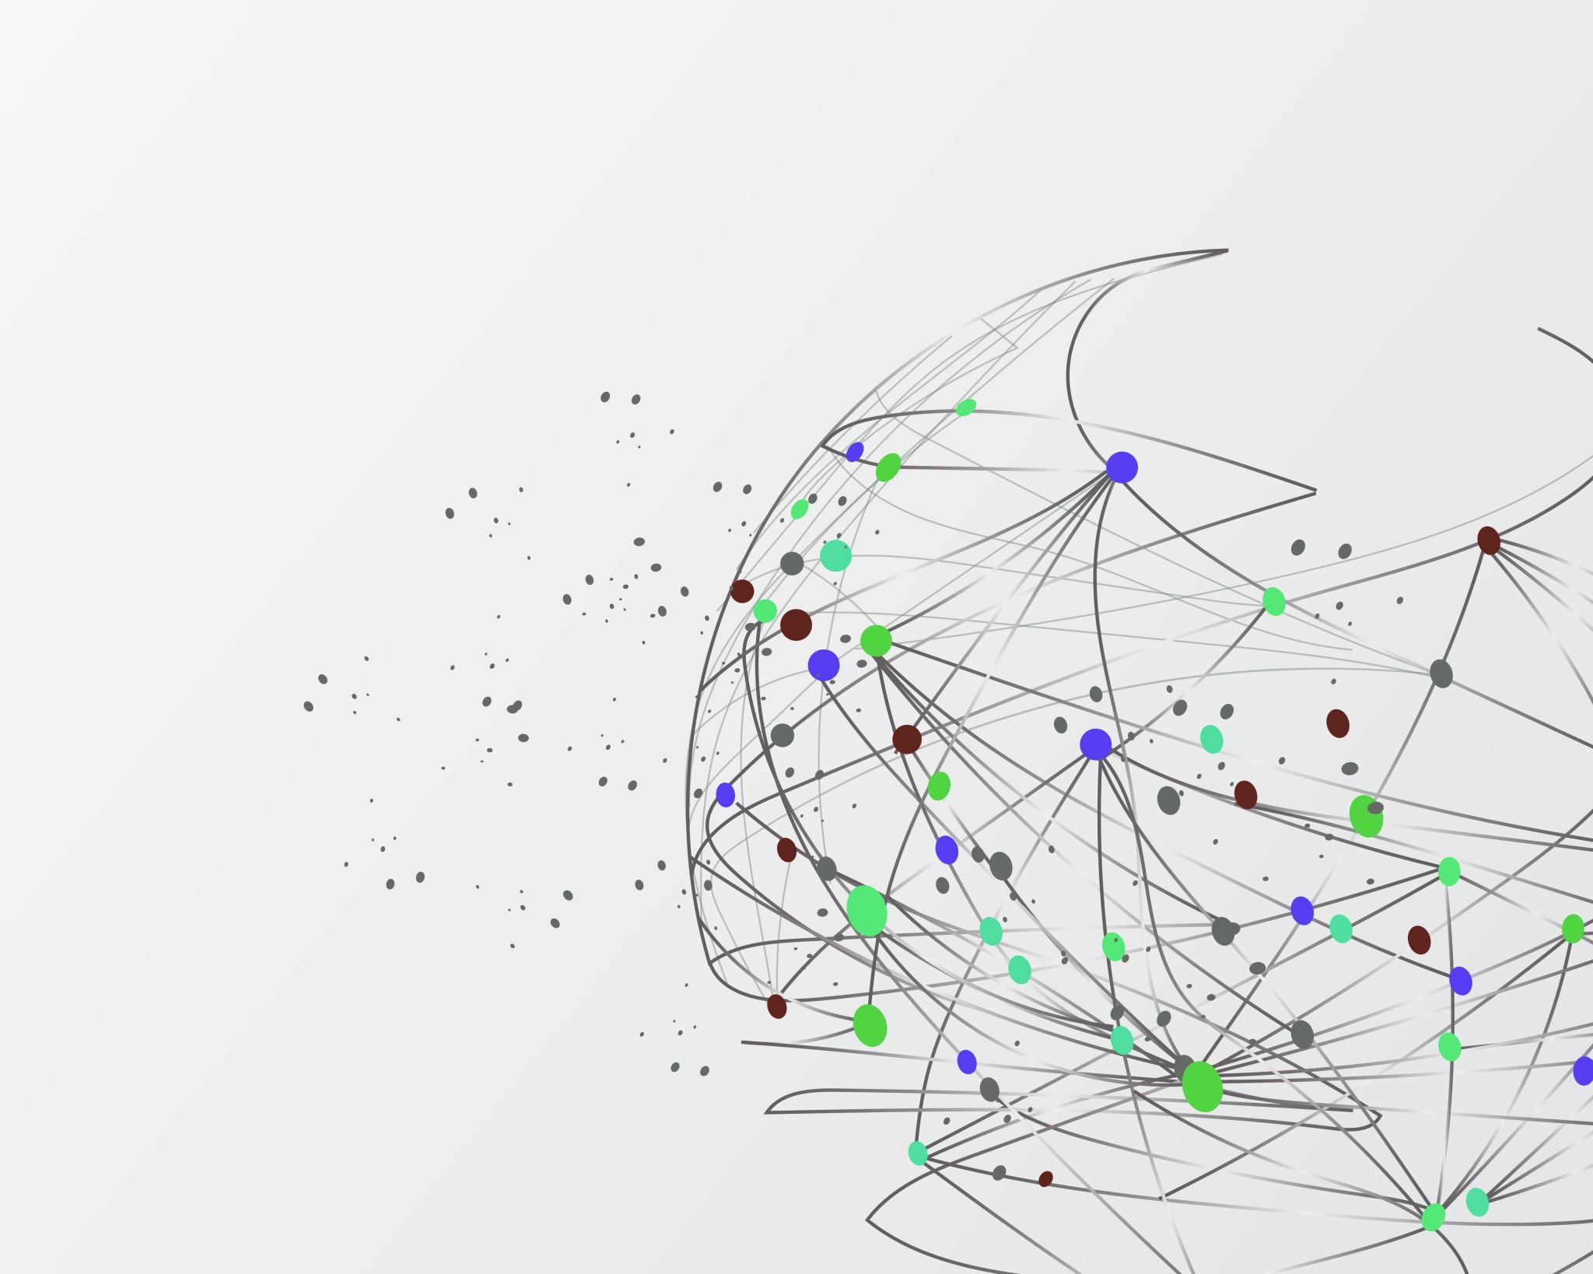
Graph Embedding by Deep Generative Graph Adversarial Networks
Submitted by :
Orel Damti 315838375
Supervisors:
Prof. Zeev Volkovich
Dr. Dvora Toledano Kitai

Slide 2

The Project Goal
The project addresses the problem of predicting missing links in a directed graph using a GAN-based approach. The DGGAN (Directed Graph Generative Adversarial Network) model aims to achieve high-precision link prediction in citation networks by learning node relationships through adversarial training.

Slide 3
Tools & Libraries
TensorFlow
NumPy
Scikit-learn (metrics)
Matplotlib

Slide 4
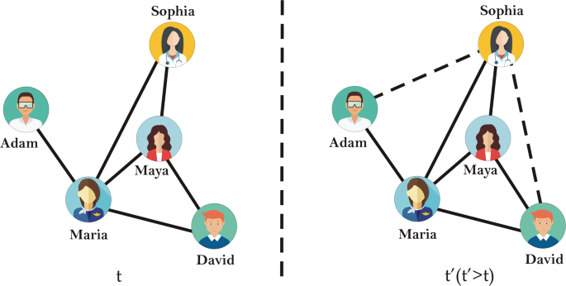
Link Prediction
Link prediction is the process of identifying potential connections or relationships between nodes in a network or graph.
It is especially challenging in sparse or dynamic networks where traditional similarity-based methods often fail.

Slide 5
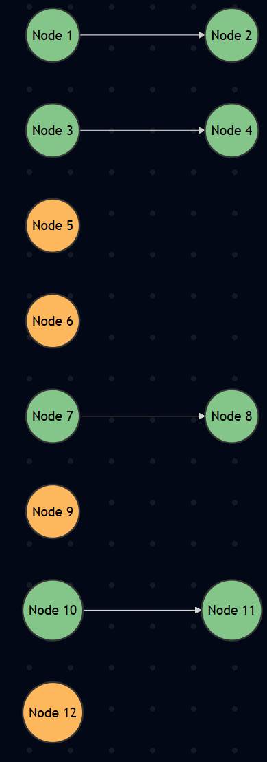
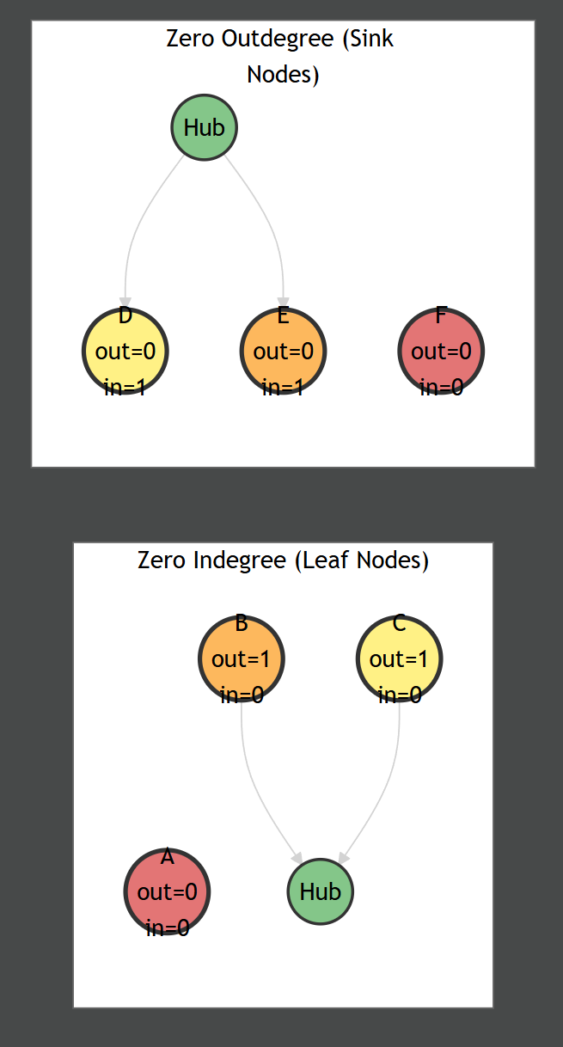
Challenges
Challenge A: Data Sparsity: 12 nodes, only 4 edges, Sparse connectivity: 2.8% density
Challenge B: Low In/Outdegree Nodes

Slide 6
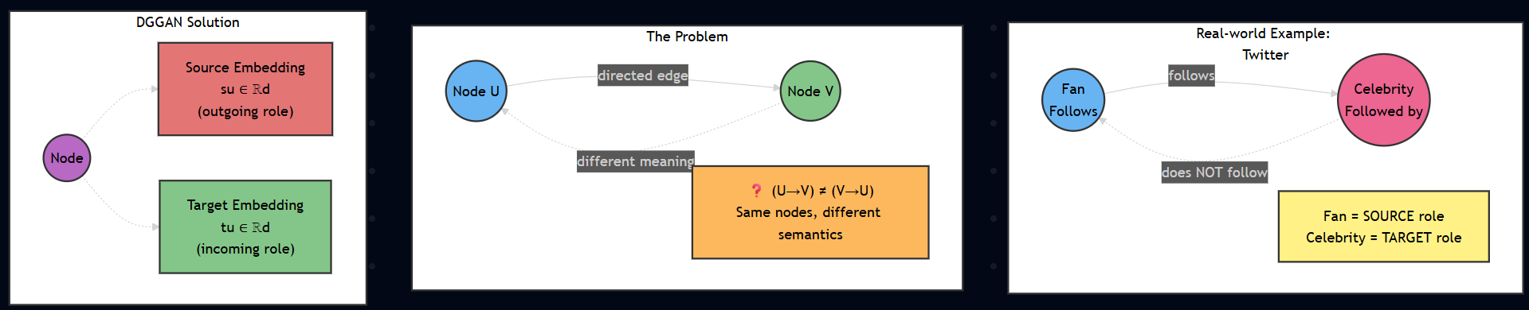
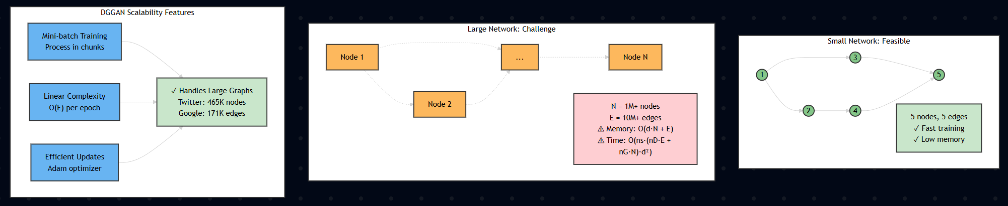
Challenges - 2
Challenge C: Directionality, Asymmetric relationships require separate source & target roles
Challenge D: Scalability, Processing large-scale networks efficiently

Slide 7
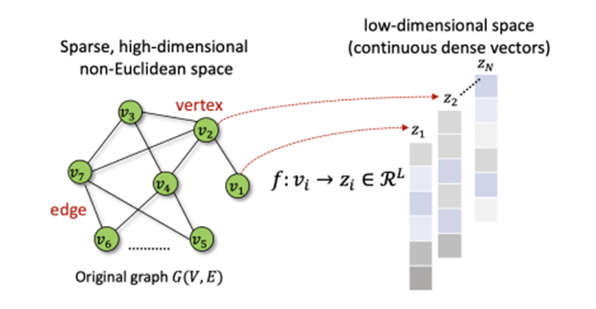
Graph Embedding
Graph embedding is the process of mapping graph nodes into a low-dimensional vector space, allowing for an analysis of the graph structure in an efficient manner.

Slide 8
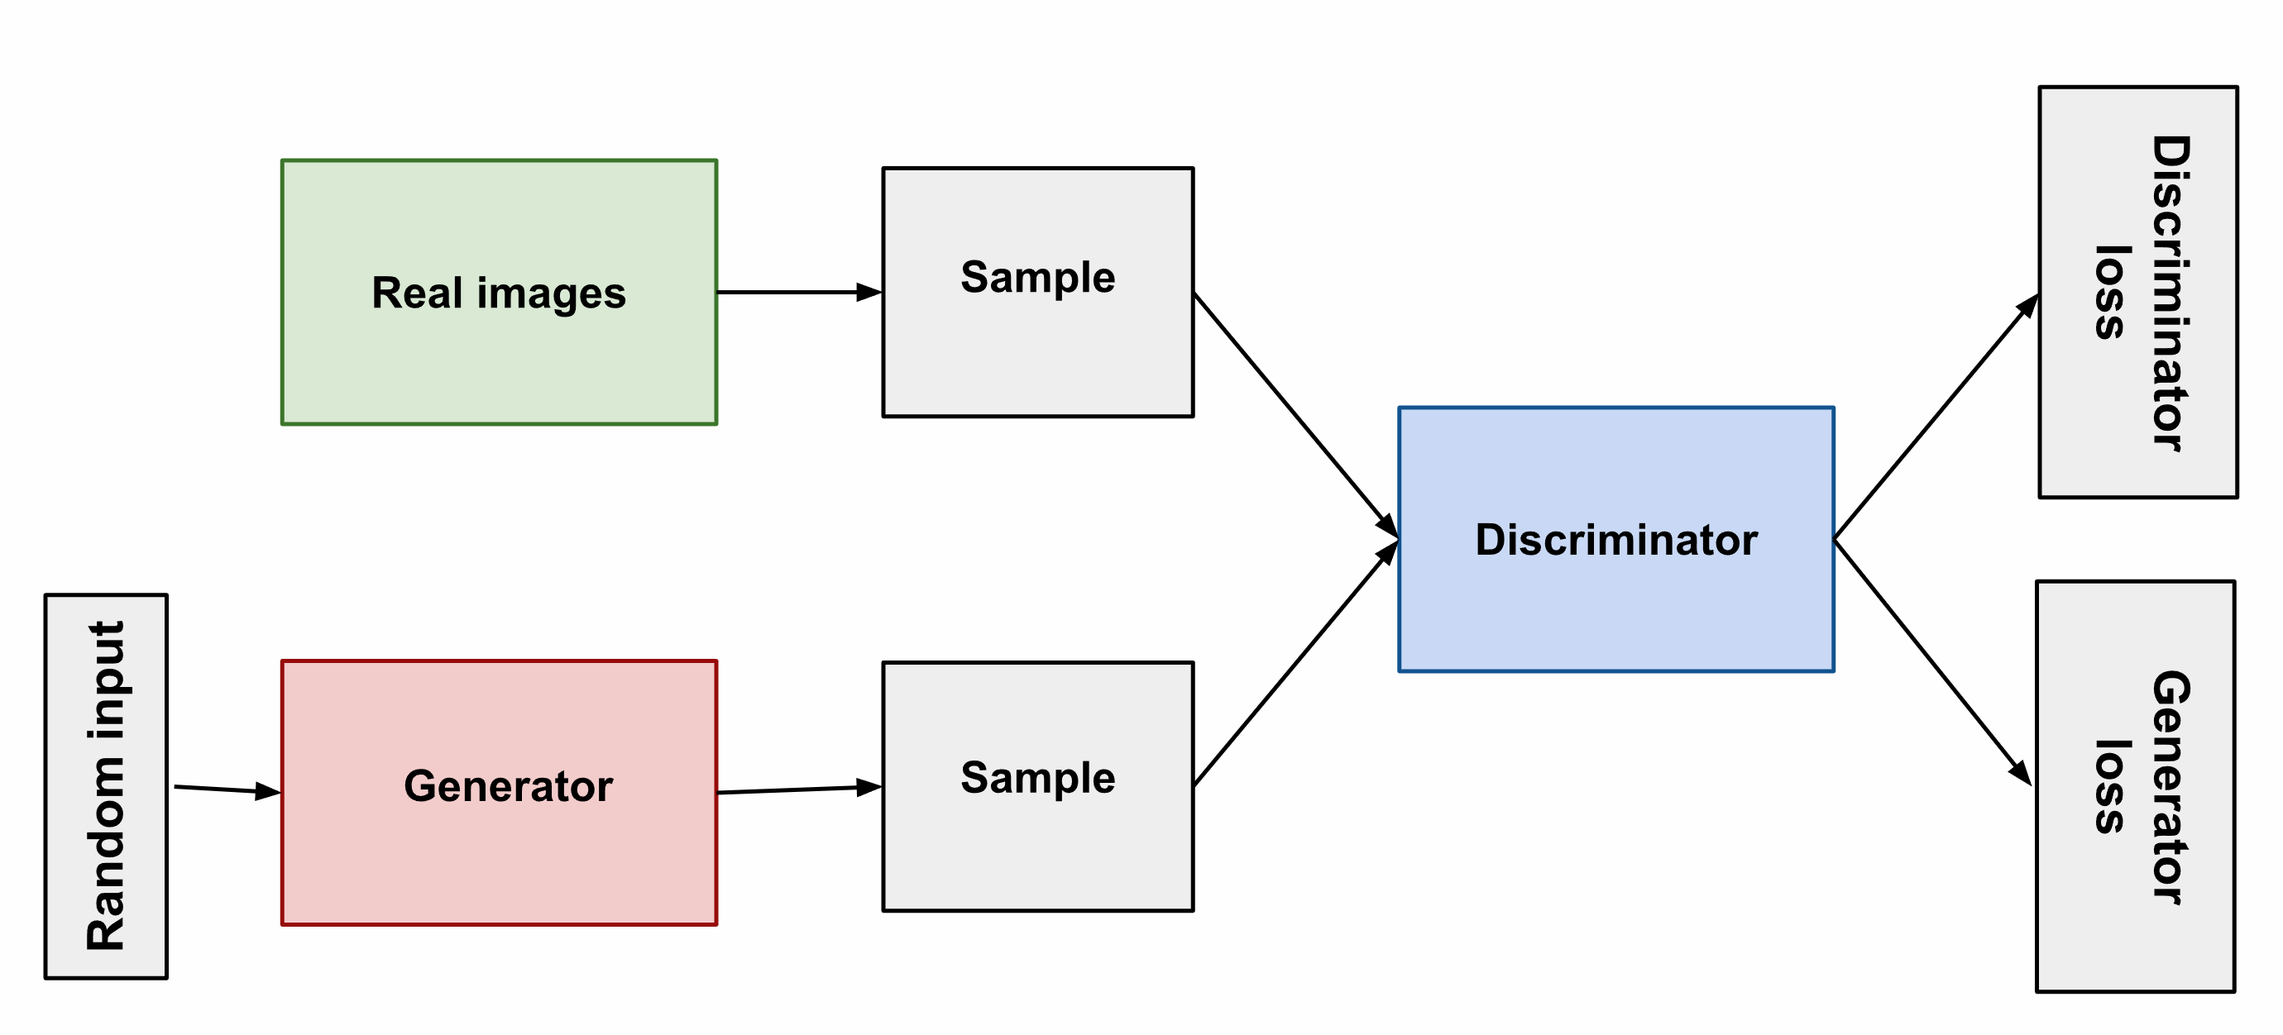
Generative Adversarial Network (GAN)
A GAN is a machine learning model that uses two neural networks to create synthetic data similar to actual data.
GANs can be used to generate realistic images, audio, and text.
A GAN consists of a generator and a discriminator competing in a game: the generator creates synthetic data (e.g., potential links), and the discriminator tries to distinguish between real and synthetic data. In this project, GAN is adapted for graph data to generate realistic citation links.

Slide 9
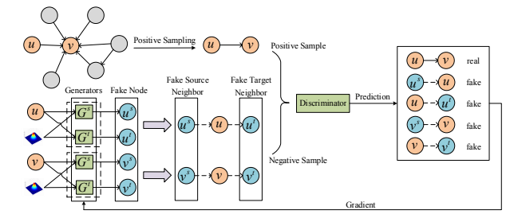
DGGAN Architecture

Slide 10
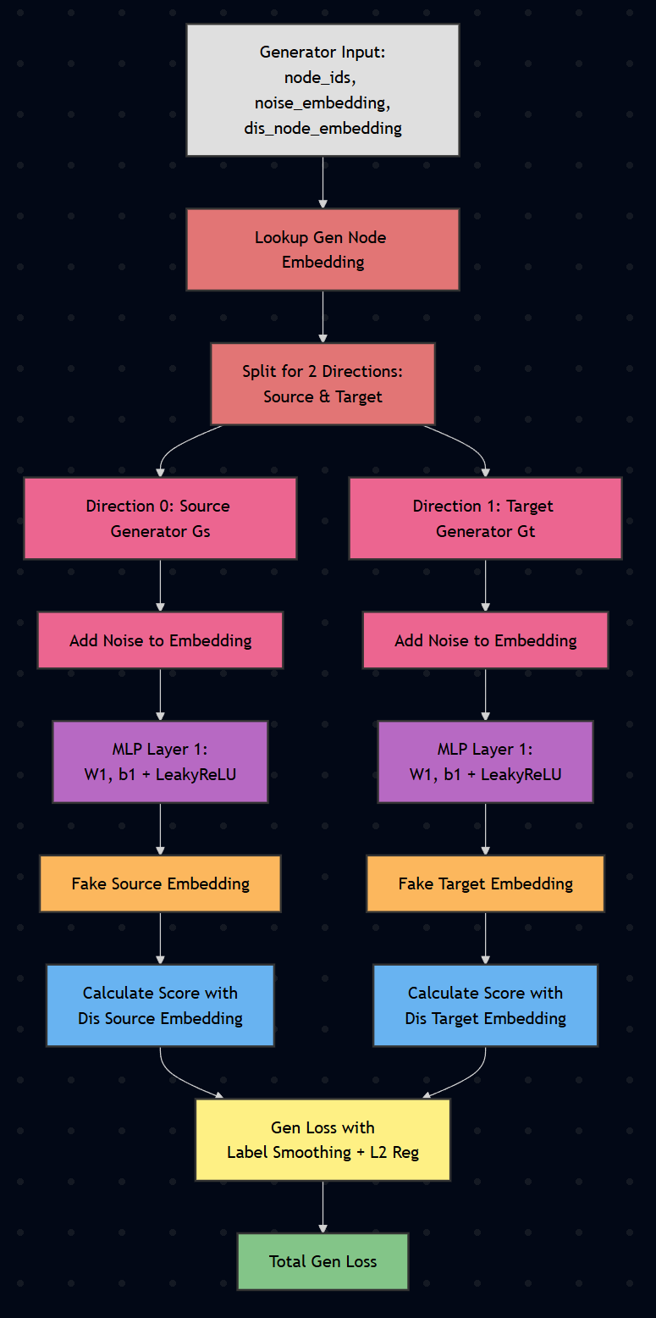
Generator Architecture

Slide 11
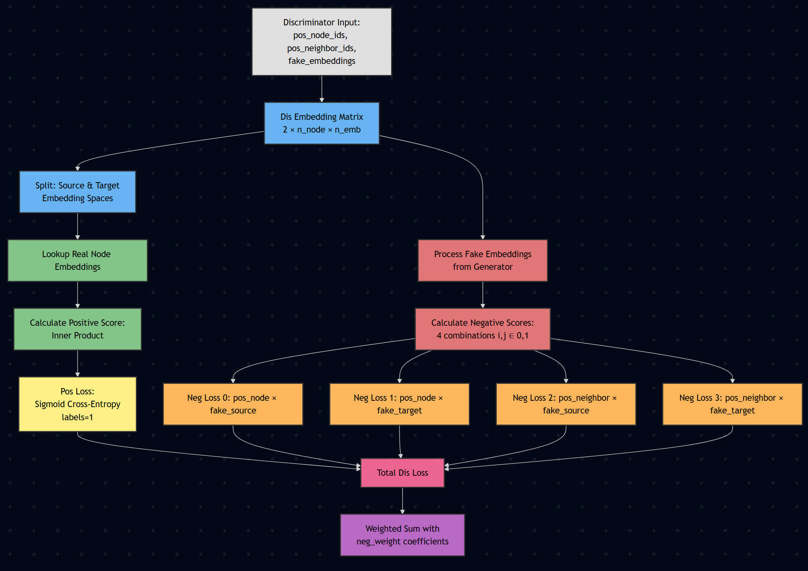
Discriminator Architecture

Slide 12
Dataset
The CORA-Full dataset is used for the node classification task.
It is an extended version of the original Cora Dataset, where:
Nodes represent academic papers
Edges represent citation relationships between papers.
Reference: https://github.com/shchur/gnn-benchmark#dataset
Dataset Statistics:
Number of nodes: 19,793
Number of edges: 126,842*
* The original dataset contains 65,311 edges. However, when using DGL (Deep Graph Library), reverse edges are automatically added and duplicate edges are removed, resulting in a different total edge count.

Slide 13
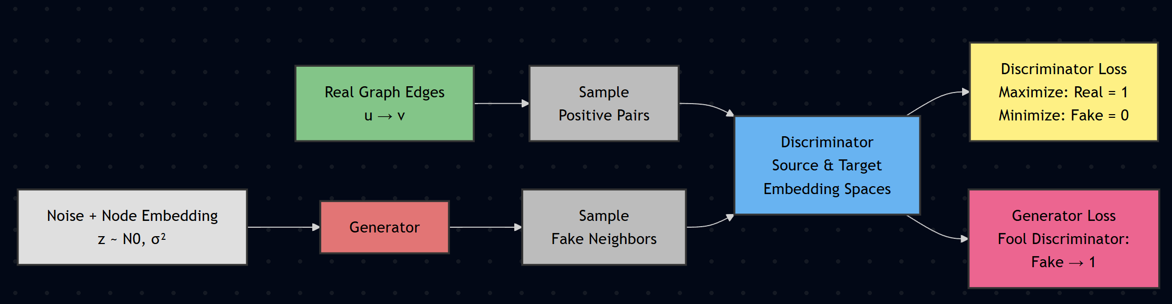
Edge Training Procedure

Slide 14
Hyperparameters
Batch Sizes:
g_batch_size = 128 - Generator batch size
n_node = 23,166 - Number of nodes
d_batch_size = 128 - Discriminator batch size
n_emb = 128 – Embedding vector size
Learning Rates:
lr_gen = 1e-4 - Generator learning rate
lr_dis = 1e-4 - Discriminator learning rate
Training Epochs:
n_epoch = 100 ( Total training epochs)
g_epoch = 5 (Generator training steps per epoch)
d_epoch = 15 (Discriminator training steps per epoch)

Slide 15
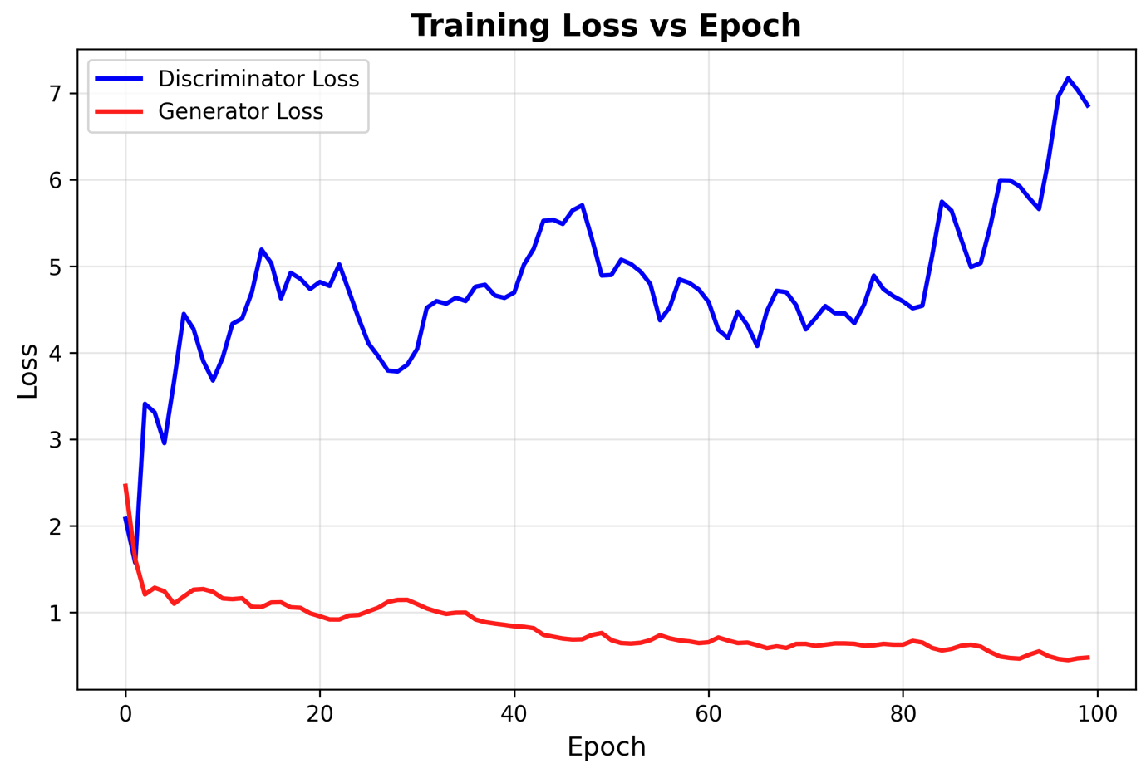
Learning Curve

Slide 16
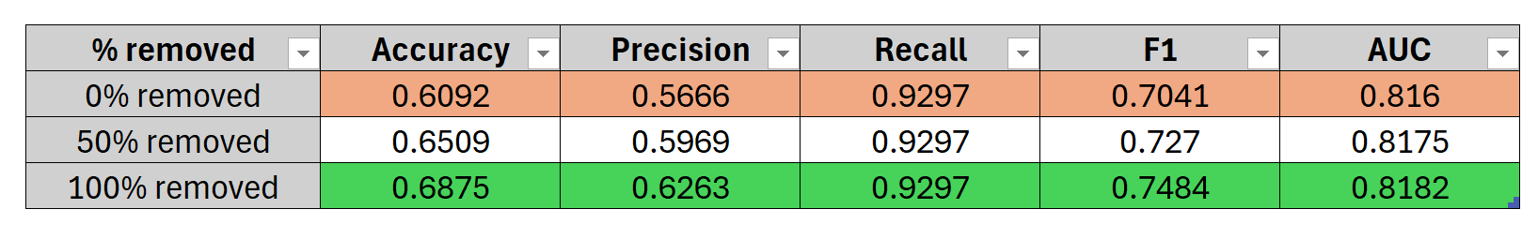
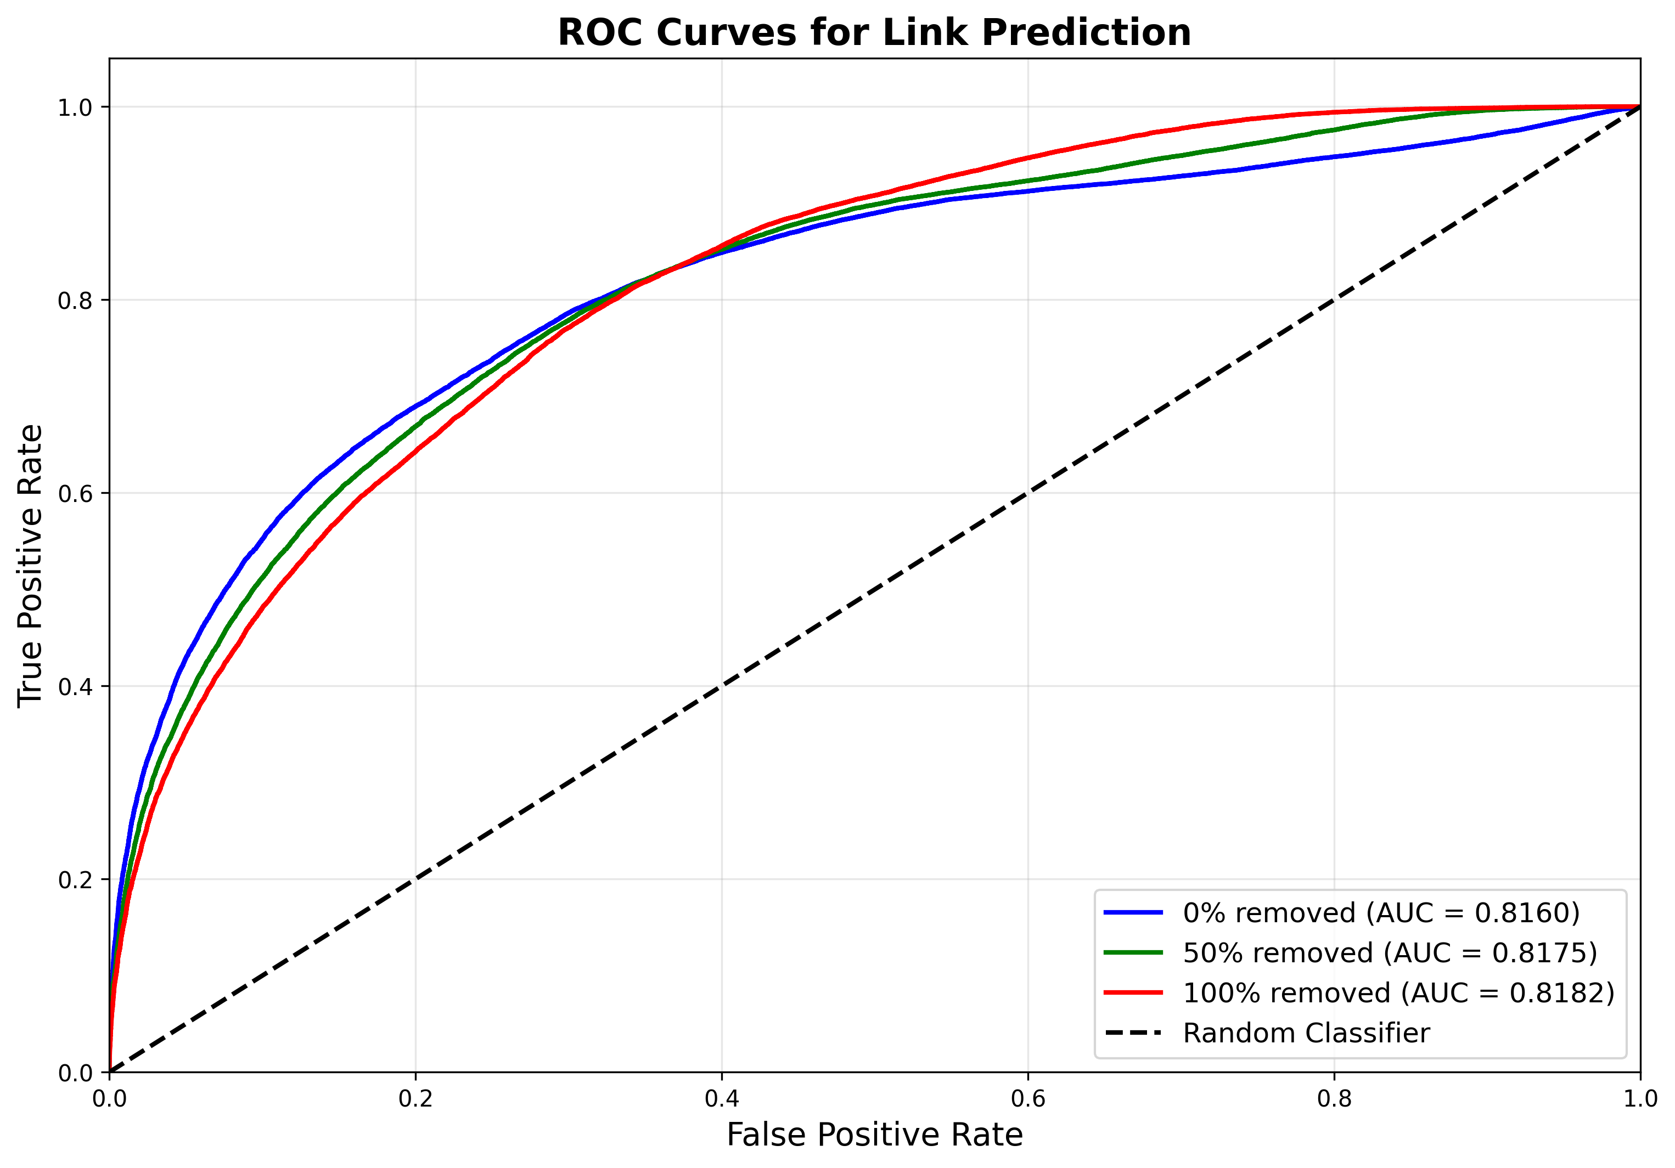
Results
0% removed: Can you tell if an edge exists vs. a completely random pair of nodes?
Hardest test - requires learning which nodes are actually connected in the graph
50% removed: Can you tell if an edge exists when half the negatives are reversed edges and half are random pairs?
Medium difficulty - tests both directionality and general connectivity
100% removed: Can you tell if an edge goes in the correct direction?
Easiest test - only requires learning edge directionality (source→target vs target→source)

Slide 17
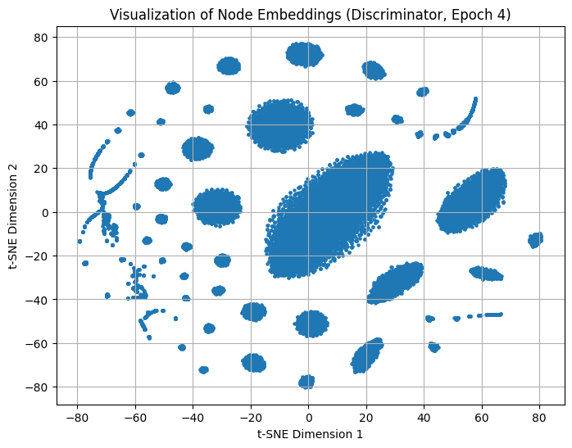
Dimensionality Reduction (t-SNE Visualization)

Slide 18
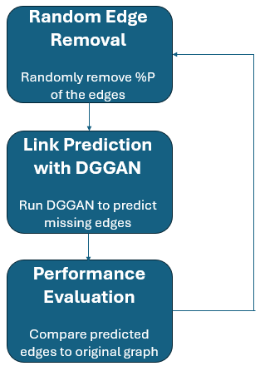
Evaluation Flow
This flowchart illustrates the full evaluation process used for validating DGGAN link predictions. The process includes randomly removing a percentage of real citation links to simulate missing edges, predicting these missing links using DGGAN, and comparing the predicted links to the original graph. This procedure is repeated k times to ensure a reliable and statistically robust performance evaluation.
Repeated k
times
k is the iteration number
P is the fraction of the omitted edges

Slide 19
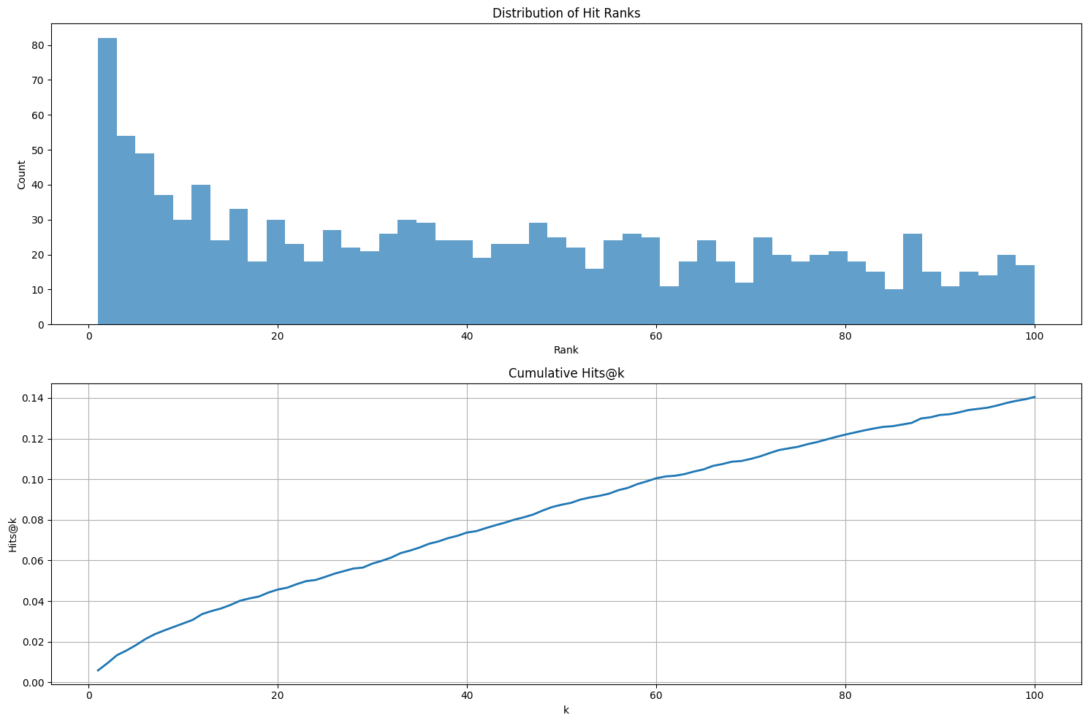
Evaluation Results - Link Reconstruction Performance
Distribution of hit ranks and cumulative hit ranks at which the model successfully predicted true citation links.

Slide 20
Repetitive Link Reconstruction Performance Hits@1
First Rank Accuracy vs Iteration
Hits@1
Result: 0.58%

Slide 21
Repetitive Link Reconstruction Performance Hits@100
Hits@100
Result: 14.32% (mean across 5 iterations)

Slide 22
Conclusion
Key Achievements:
Excellent Performance: AUC 0.816-0.818, Recall 92.97% - strong link prediction on sparse CORA-Full network
Dual Architecture Success: Minimal gap (0.002 AUC) between connectivity vs. directionality tasks proves balanced learning
Stable Convergence: 100 epochs without mode collapse; GAN dynamics work as designed
Rapid Initial Learning: 67% AUC jump in first 5 epochs demonstrates efficient pattern learning

Slide 23
Future Work
Train a DGGAN model on diverse directed graph datasets.
Improve Discriminator/Generator stability (add more epochs to the discriminator, add more layers to its architecture, etc.)
Try different model architectures for both Discriminator and Generator.
Implement Early Stopping

Slide 24


