Slide 1
The impact of physical exercise treatment on mental health
EDA Project
by Oren Ben-Ami, Gilad Danin, Yadin Sapir
July 4th, 2023

Slide 2
Scope
Introduction
Analysis
Conclusions and dilemmas

Slide 3
Introduction

Slide 4
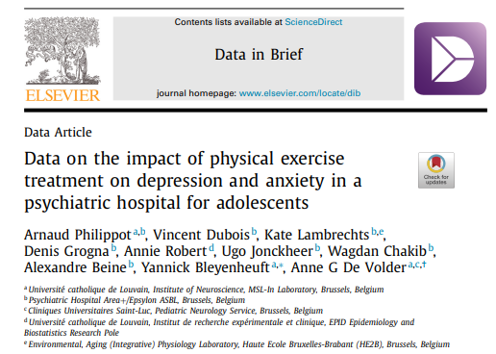
Background and Data Origin
This study by Philippot et. al 2022 tested the effect of physical exercise as intervene treatment on clinical symptoms of depression, anxiety, and physical condition among adolescent patients who have been admitted to a psychiatric hospital.
The data gathered through a randomized controlled trial (RCT) design represents the most effective methodology for drawing meaningful inferences.

Slide 5
Data overview
The data contains the results of randomized clinical trial done on youngsters hospitalized due to anxiety and depression backgrounds
The trial examined the effect of physical exercise (‘sport’) on anxiety/depression scores (compared to the placebo effect of non-sport activity)

Slide 6
Data overview
The data contains:
Physiological data: weight, BMI, maximal oxygen uptake (VO2Max)
Scores of various mental health tests before and after the activity
40 adolescents were randomly assigned to either a physical exercise or a control program done 3-4 times per week over 6 weeks
These questionnaires and tests were filled at baseline and after intervention

Slide 7
Variables Overview:
Mental examinations:
The primary outcome was the Hospital Anxiety Depression Scale for evaluation of depression (HADS-D) and anxiety (HADS-A) symptoms.
SDS: Secondary outcomes were psychological self-assessments (The Zung Self-Assessment Depression Scale
BDI-13: Beck’s abbreviated Depression Inventory
CDI: The Child Depression Inventory
STAI: The State-Trait Anxiety Inventory
HAM-D: Depression Diagnostic interview score
Physical examinations:
VO2 max: physical effort Test (Indication to cardiorespiratory fitness - the higher the better)
BMI (Body Mass Index - the lower the better)
Weight (The lower the better)

Slide 8
Goals
Use python tools to:
Explore the dataset
Present data effectively using visualization tools
Run statistical significance testing to validate observed differences
Examine possible impact of physical exercise on participants’ anxiety & depression scores

Slide 9
Analysis

Slide 10
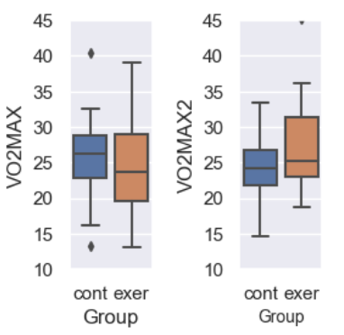
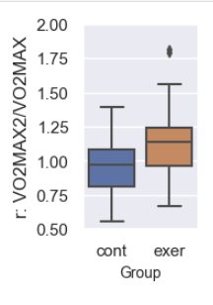
Two analytic approaches tested:
Absolute values:
Relative Assay Score per patient:
[Score After/Score before]
Before activity:
After
activity:
Control
Exercise

Slide 11
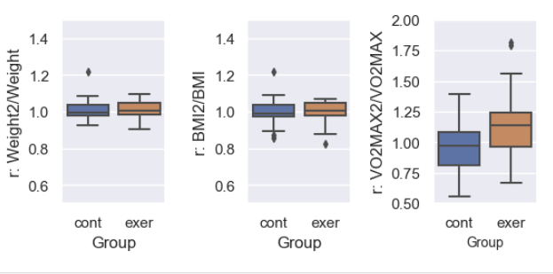
Treatment Impact on Physiological features
Wilcoxon:
p=0.9563
p=0.9273
p=0.0073

Slide 12
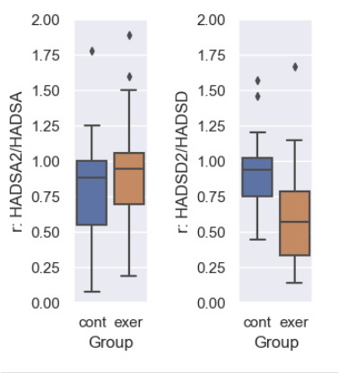
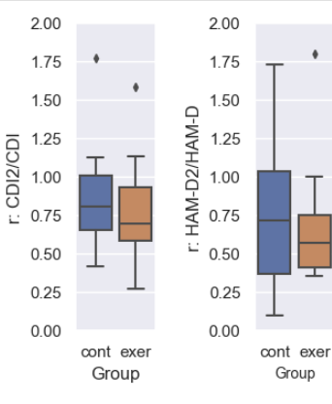
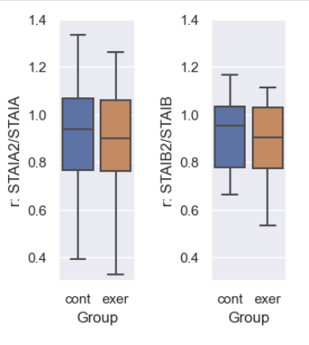
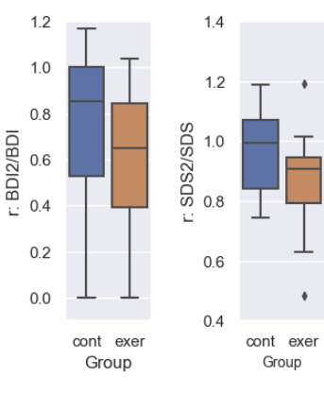
Treatment Impact on mental features
Anxiety
Depression
Wilcoxon:
p=0.2598
p=0.0153
Depression
Anxiety
Depression

Slide 13
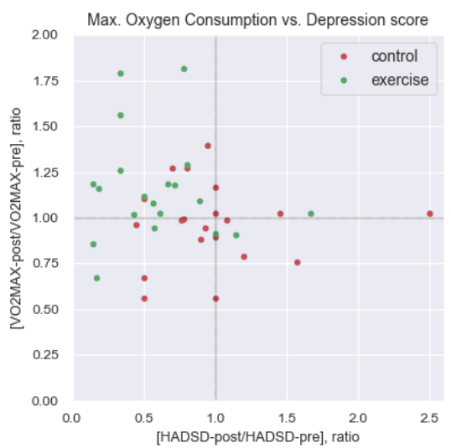
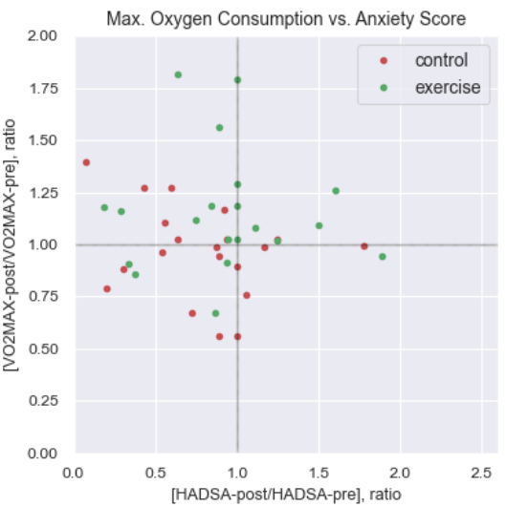
Patient-level association between exercise-induced improvements in VO2MAX and Depression Score
Exercise: p (upper-left) = 14/20 = 0.7
Exercise: p (upper-left) = 7/20 = 0.35
Control: p (upper-left) = 4/20 = 0.2
Control: p (upper-left) = 7/20 = 0.35

Slide 14
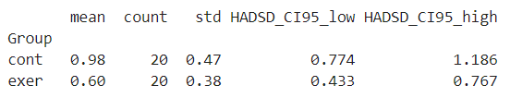
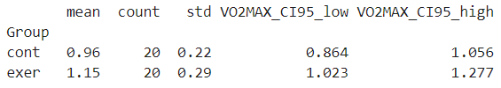
Mean Confidence interval (CI) of Exercise-affected
Depression and Max. Oxygen Consumption features
No overlap between control- & exercise-groups Mean CI Depression score
Mild overlap between control- & exercise-groups Mean CI VO2MAX score

Slide 15
Conclusions

Slide 16
Conclusions
Based on this randomized clinical trial and its limitations:
Exercise activity improves oxygen consumption as well as depression test score
Exercise activity does NOT seem to affect any of the other 7 anxiety/depression scores
Weight and BMI are insensitive indicators of exercise
Dilemmas we ran into
Usage of Relative vs. Absolute assay scores:
Relative:
Pros: does NOT require expert knowledge of the subject, clear & bias-free analysis, inter-patient variability is eliminated
Cons: possible loss of valuable information due to feature engineering

