Slide 1


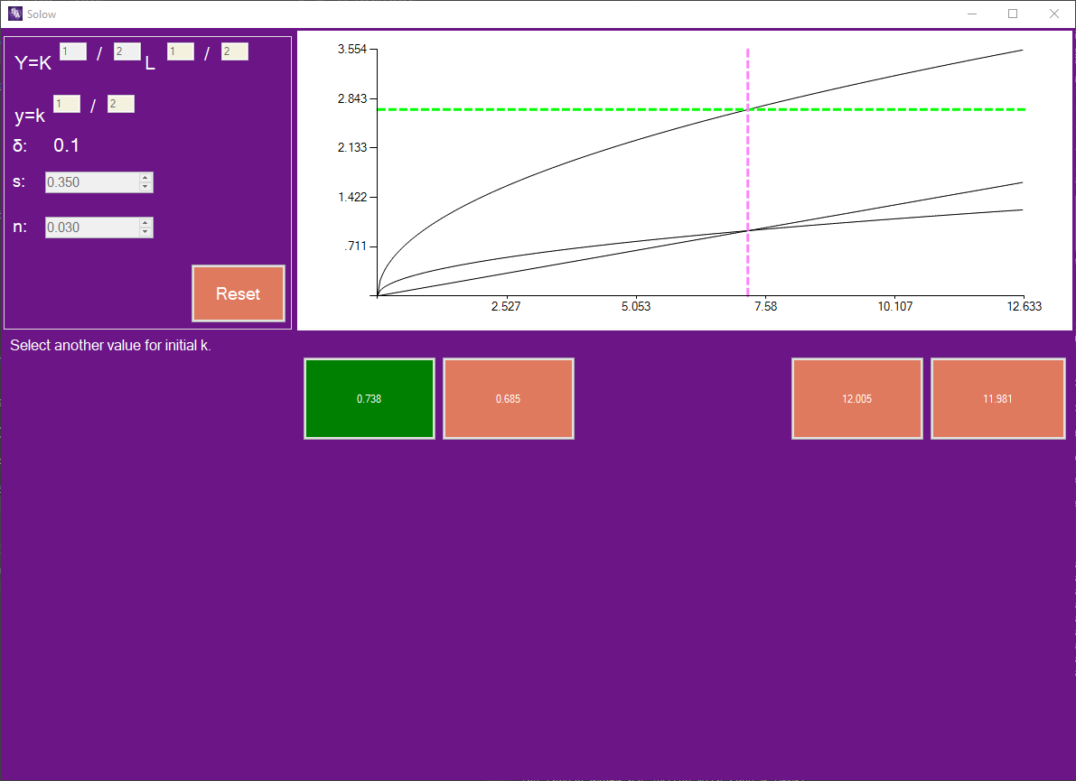
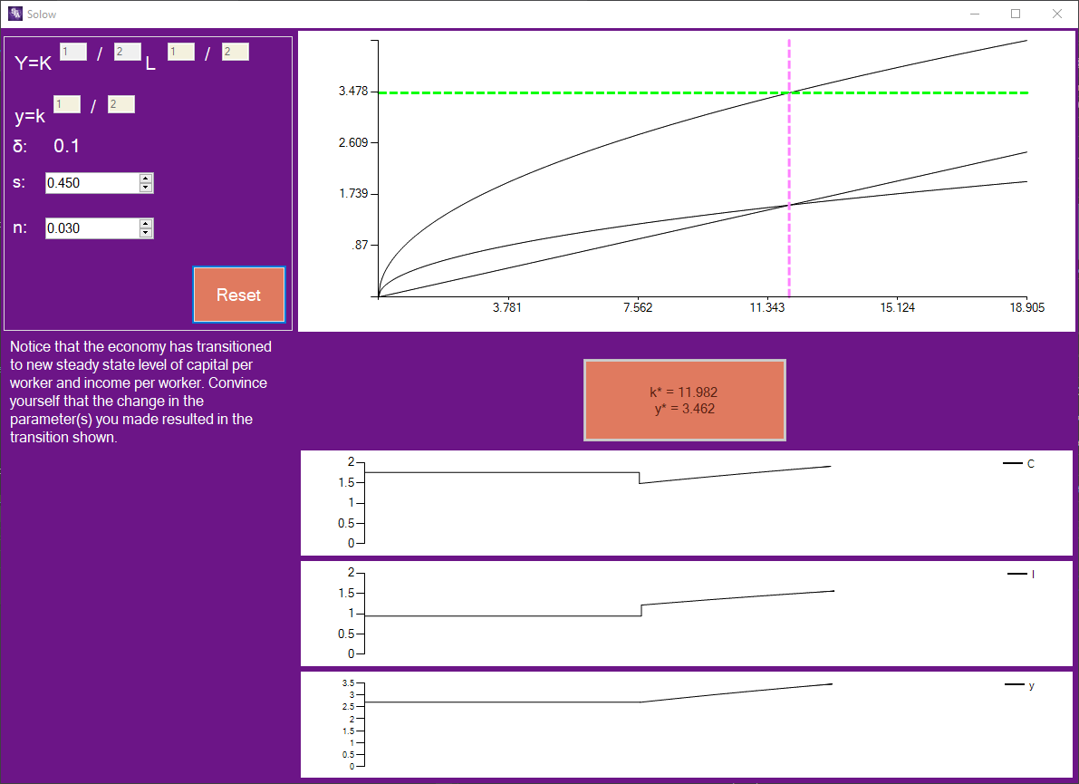
Template Provided By SFA CoSM
Replace This Text With Your Title
John Smith, MD¹; Jane Doe, PhD²; Frederick Jones, MD, PhD^{1,2}
¹University of Affiliation, ²Medical Center of Affiliation
Introduction
Production
The Solow growth model is an economics growth model that shows the growth of an economy over a long period of time. It is a difficult model for some students to understand with only static images. The goal of this projects was to produce a working software for use in teaching this model.
The focus of the producing the software revolved around utilizing the built-in chart. The chart tool is capable of displaying multiple different chart types. Though for our purposes the line chart is what was needed. The line chart would automatically draw a line from one point to another. So if a line needs to be curved multiple points are needed to give it the appearance of being curved. Also for the sections when the graph is being animated that is done by continuously adding points to the graph based on a timer at such small distances that it appears to be animating.
Architecture
Results
Before work began it was decided to produced this software with C# and Winforms. Winforms being a UI designing tool that allows developers to drag and drop UI elements into a window. C# was chosen as it was a familiar language and object oriented. The software is also multithreaded as the project went along it became apparent the need for multiple threads due to the UI and background process that must be happening at the same time.
The main element that this project uses is the grid which is a built-in form to Winforms the downside to using this though is that the platform is limited to Windows machines as it is only available in the .Net framework.
Click here to insert your Results text. Type it in or copy and paste from your Word document or other source.
This text box will automatically re-size to your text. To turn off that feature, right click inside this box and go to Format Shape, Text Box, Autofit, and select the “Do Not Autofit” radio button.
To change the font style of this text box: Click on the border once to highlight the entire text box, then select a different font or font size that suits you. This text is Calibri 32pt and is easily read up to 5 feet away on a 36x48 poster.
Zoom out to 100% to preview what this will look like on your printed poster.
Speaking of Results, yours will look better if you remember to run a spell-check on your poster! After you’ve added your content click on Review, Spelling, or press F7.
Design
The general flow of the software is designed to assist the student in learning the concepts as such there are some features are redundant but hopefully reinforce certain ideas.
Student inputs initial data
Draw Graph
Picks a value for k
Animate the graph moving towards steady state
Repeat this previous step for at least every listed k value
The program now transitions to a mode where values can be changed, and the student can watch transitions to steady state
This mode shows 3 new subgraphs to be animated along with the main subgraph
Conclusions
Click here to insert your Conclusions text. Type it in or copy and paste from your Word document or other source.
This text box will automatically re-size to your text. To turn off that feature, right click inside this box and go to Format Shape, Text Box, Autofit, and select the “Do Not Autofit” radio button.
To change the font style of this text box: Click on the border once to highlight the entire text box, then select a different font or font size that suits you. This text is Calibri 32pt and is easily read up to 5 feet away on a 36x48 poster.
Zoom out to 100% to preview what this will look like on your printed poster.
Contact
References
[name]
[organization]
[address]
[email]
[phone]

