Slide 1
Sign Language To Text
Oren Raz and Lam Kai Yi Karen

Slide 2
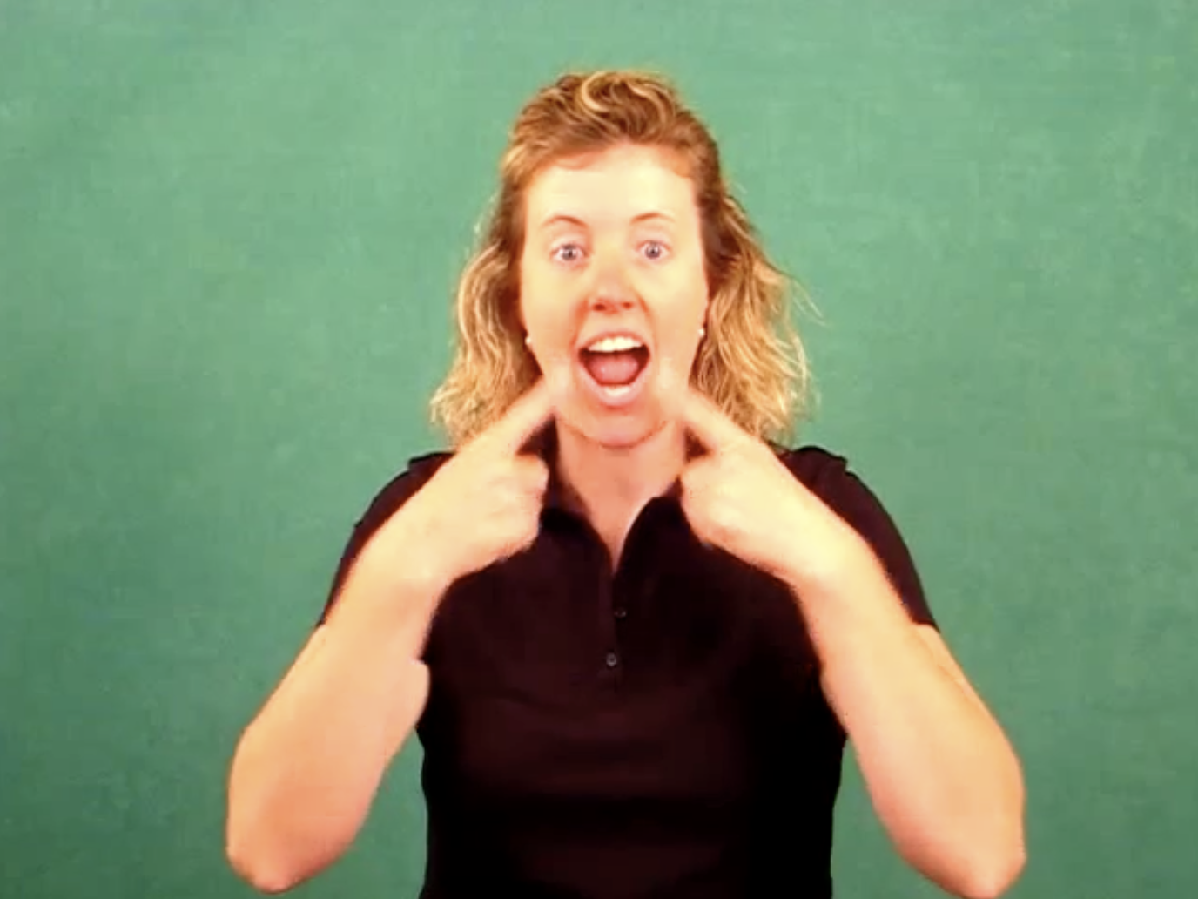
Recap: Sign Language to Text
PURPOSE
Bridge the communication gap between deaf person and non-signing person
GOAL
Translate signed speech to text
Translate short phrases and word of signed speech to text
Manageable Scope
Accomplish

Slide 3
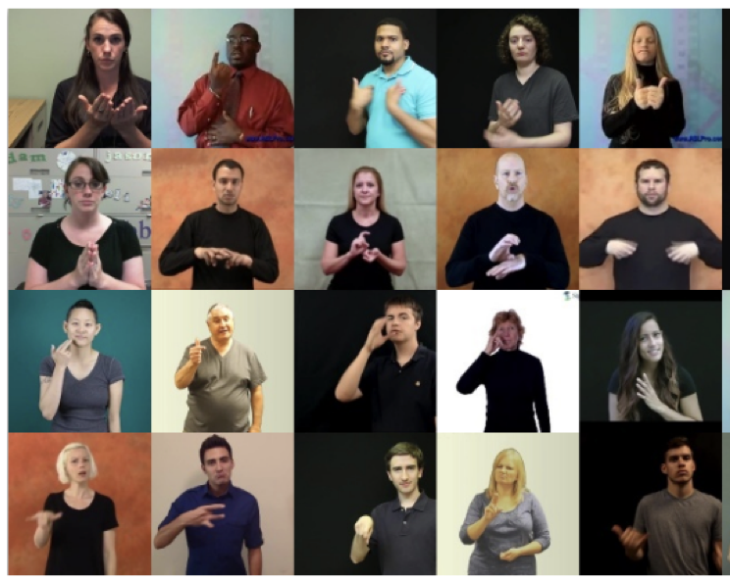
The Dataset: Word-Level American Sign Language Dataset (WLASL) Dataset
ABOUT DATASET
Created by Dongxu Li and Hongdong Li for the purpose of facilitating research in sign language understanding
OVERVIEW OF DATASET
# of Unique Words | 2000
# of Unique Sources | 19
# of Unique Signers | 119
Total Instances | 21083
Data Split | Train (14289) Test (2878) Validation sets (3916)
Data Format | Videos Folder – Consisting of videos in mp4, mpeg format Json File – Labels for videos (word, bbox, fps, source, split, url)

Slide 4
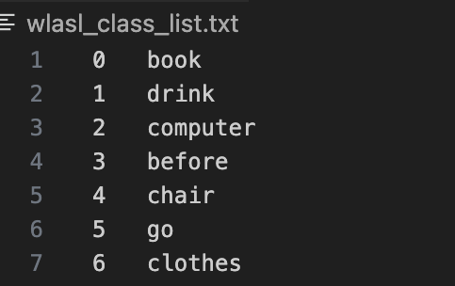

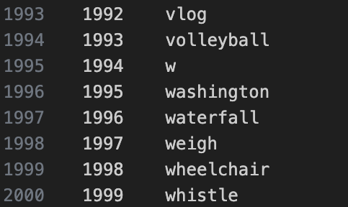
Type of ML Task: Classification
PROPOSED VIDEO ANALYSIS MODEL
(current project)
Video of signed word
1 word from a list of 2000 words

Slide 5
Data Exploration: Word-Level American Sign Language Dataset (WLASL) Dataset
MISSING DATA?
Sufficiently large dataset --> Exclude missing data from dataset
 | COMPLETE DATASET | AFTER REMOVAL OF MISSING DATA
# of Unique Words | 2000 | 2000
# of Unique Sources | 19 | 9
# of Unique Signers | 119 | 78
# of Instances | 21083 | 11980
Average Instances Per Word | 10.5415 | 5.99
Minimum Instances Per Word | 6 | 2
Maximum Instances Per Word | 40 | 16

Slide 6
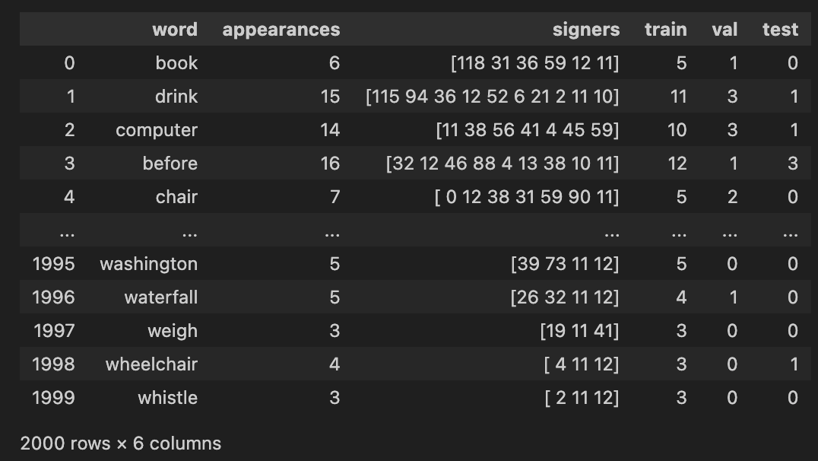
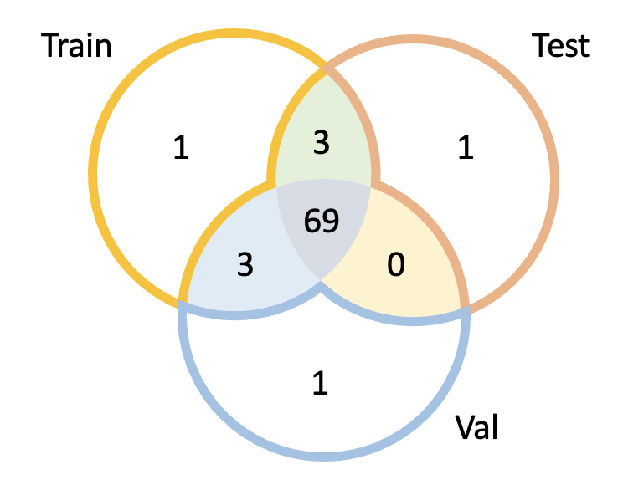
Data Exploration: Word-Level American Sign Language Dataset (WLASL) Dataset
NEED FOR REGROUPING OF TRAIN, TEST, VALIDATION SETS
Venn Diagram of Signer ID in different data splits
Missing Data in Validation and Test Set when missing data is excluded
Overlaps in Signer IDs between Train, Test and Validation Set

Slide 7
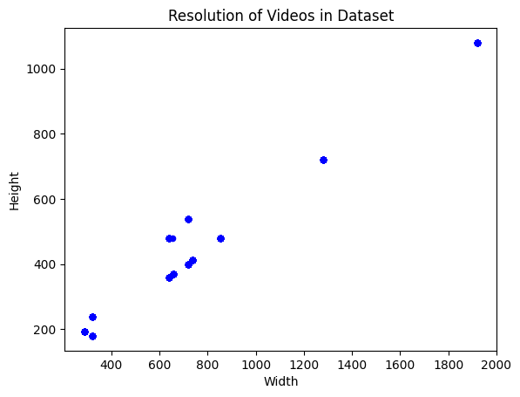
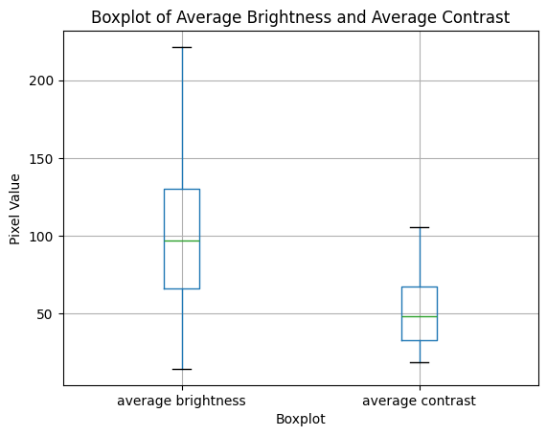
Data Exploration: Word-Level American Sign Language Dataset (WLASL) Dataset
ANALYSIS OF VIDEO QUALITY
LENGTH
Average Length: 2.43s
Minimum Length: 0.63s
Maximum Length: 8.125s
RESOLUTION
BRIGHTNESS AND CONTRAST
*BUT between frames of individual videos, there is little variation in brightness and contrast

Slide 8
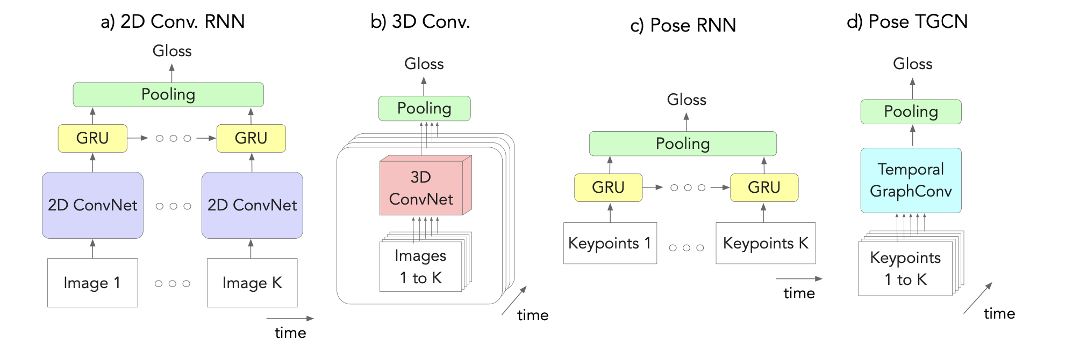
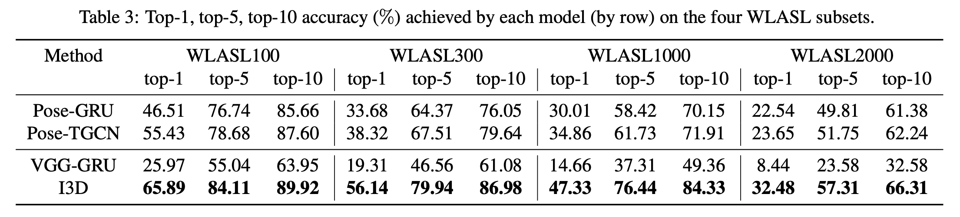
Data Exploration: Word-Level American Sign Language Dataset (WLASL) Dataset
PREVIOUS WORK MENTIONED IN PAPER
https://arxiv.org/pdf/1910.11006.pdf

Slide 9
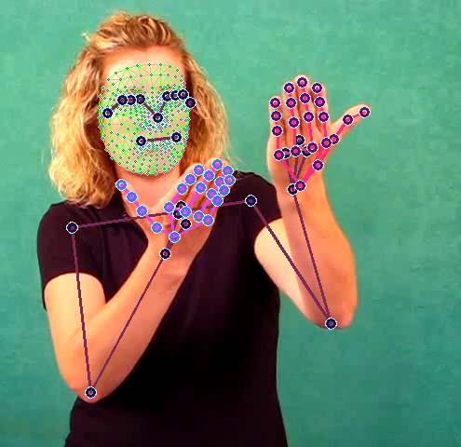
Potential for Further Annotation / Edits
DIMENSIONALITY REDUCTION
Highlight key features in a frame --> Array of points
Mediapipe, OpenCV
FUTURE DEVELOPMENT - USE OF NLP
For future expansion of model to translate longer sentences
Signed Word in Sentence
PROPOSED VIDEO ANALYSIS MODEL
(current project)
Possible Words + Confidence Level
Translated Sentence
NLP MODEL
(future project)
Predicted word with higher accuracy

Slide 10
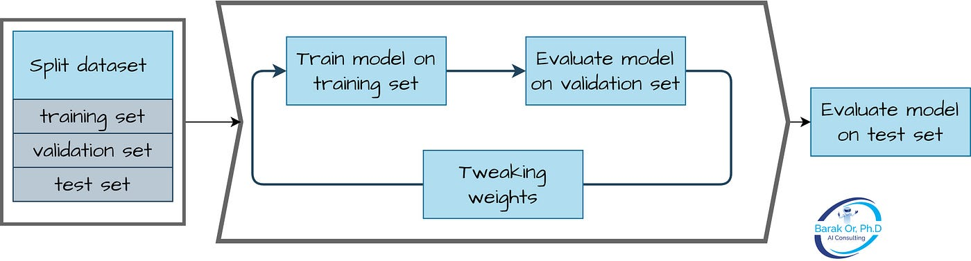
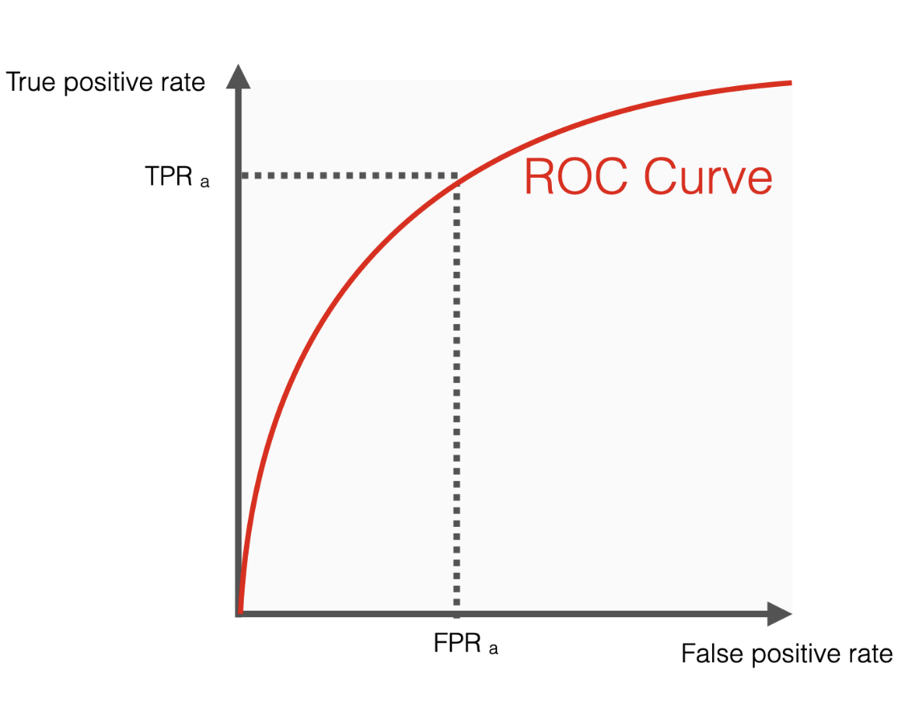
Measuring Performance
Model Comparison
Accuracy = Correct Prediction / All Prediction
Average Precision = Σ (TP / (TP + FP)) / # of classes
Average Recall = Σ (TP / (TP + FN)) / # of classes
F1 Score
Receiver Operating Characteristic (ROC) Curve
https://pub.towardsai.net/breaking-the-mold-challenging-the-common-split-for-training-validation-and-test-sets-in-machine-271fd405493d

