Slide 1
Sign Language To Text
Oren Raz and Lam Kai Yi Karen
🤗

Slide 2
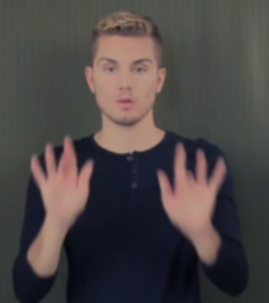
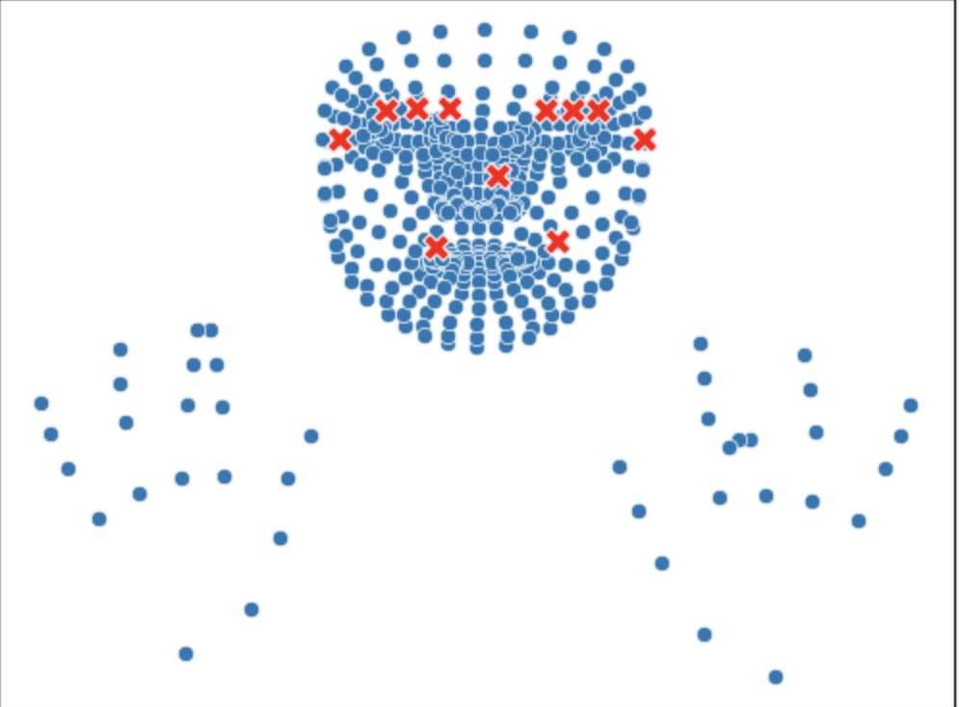
Recall From Last Week – Reflections + Suggestions
THE CHALLENGE: TOO MUCH DATA
SLOW DATA PRE-PROCESSING AND MODELTRAINING
Supervised Learning
THE SOLUTION:
SUBSET OF DATA FOR TRAINING PURPOSES
Able to train different models and get results fast
11,980 videos
Each video has multiple frames
Each frame has 543 numbered landmarks

Slide 3
Subset of Data For Training Purposes
HOW DID WE CHOOSE THE WORDS?
Prompt
Here is a list of words, can you build 5 sentences from them, output both the sentence itself and the raw words as they appear in the list:
Subset of 32 Words --> 274 Instances
'tall', 'man', 'red', 'shirt', 'play', 'basketball', 'cold', 'pizza', 'top', 'cheese', 'taste', 'delicious', 'lazy', 'afternoon', 'dark', 'room', 'small', 'lamp', 'empty', 'big', 'dog', 'walk', 'beautiful', 'every', 'morning', 'short', 'woman', 'wear', 'dress', 'have', 'beautiful', 'daughter'
Truncated Output
Sentence: "The tall man can play basketball."
Raw Words: tall man play basketball
Prompt
Can you make them slightly longer? Same rules apply.
Truncated Output
Sentence: "The tall man, wearing a red shirt, can play basketball very well in the neighborhood."
Raw Words: tall man red shirt play basketball well neighborhood

Slide 4
The Baseline: Regression Models
In ONE Video
n number of frames
The Results
Model | Accuracy | Precision | Recall | F1-Score
Logistic Regression (iter = 100) | 0.38 | 0.37 | 0.38 | 0.35
Logistic Regression (iter = 200) | 0.42 | 0.49 | 0.42 | 0.41
SVM (kernel = "linear") | 0.44 | 0.59 | 0.44 | 0.47
Random Forest | 0.54 | 0.65 | 0.54 | 0.55
543 Landmark Points (x, y, z coordinates)
Exclude Face Points --> 76 Left
Average between Frames
Flatten
*Precision, Recall and F1 Score are weighted averages
Video_id | 0 | 1 | ... | 223 | 224
62175 | 0.425838 | 0.218913 | ... | 0.348759 | -0.016910

Slide 5
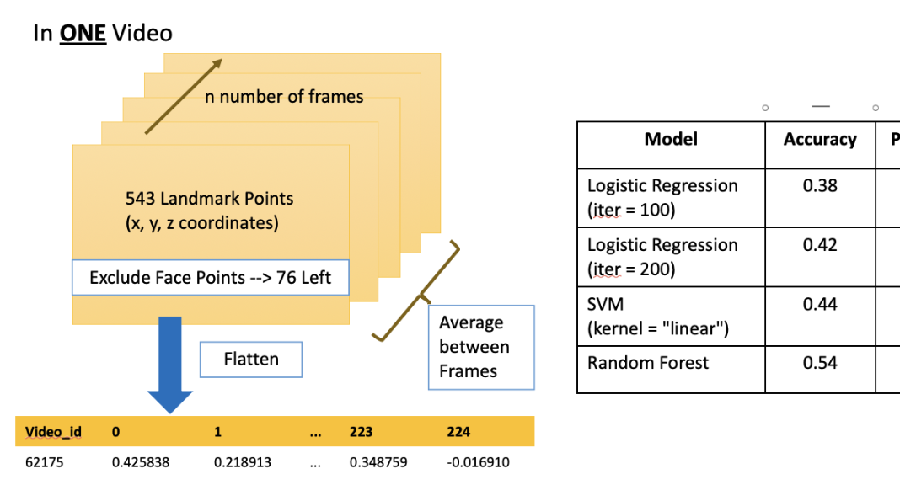
The Baseline: Area for Improvements
Possible Improvements
Average of Frames does not really capture the temporal variation of movement
Experiment with Non-linear classifiers
Hyperparameter Tuning

Slide 6
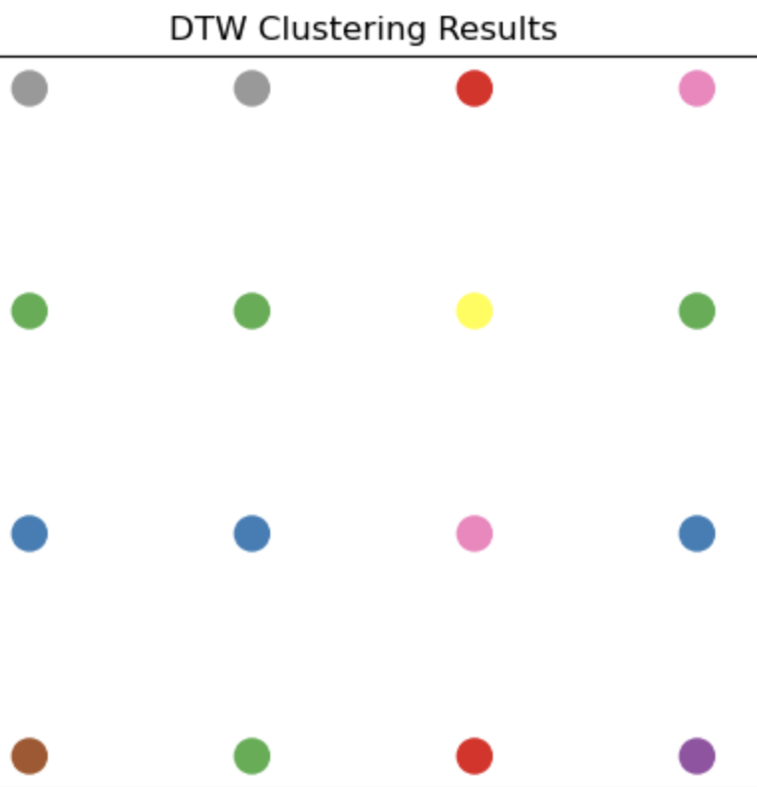
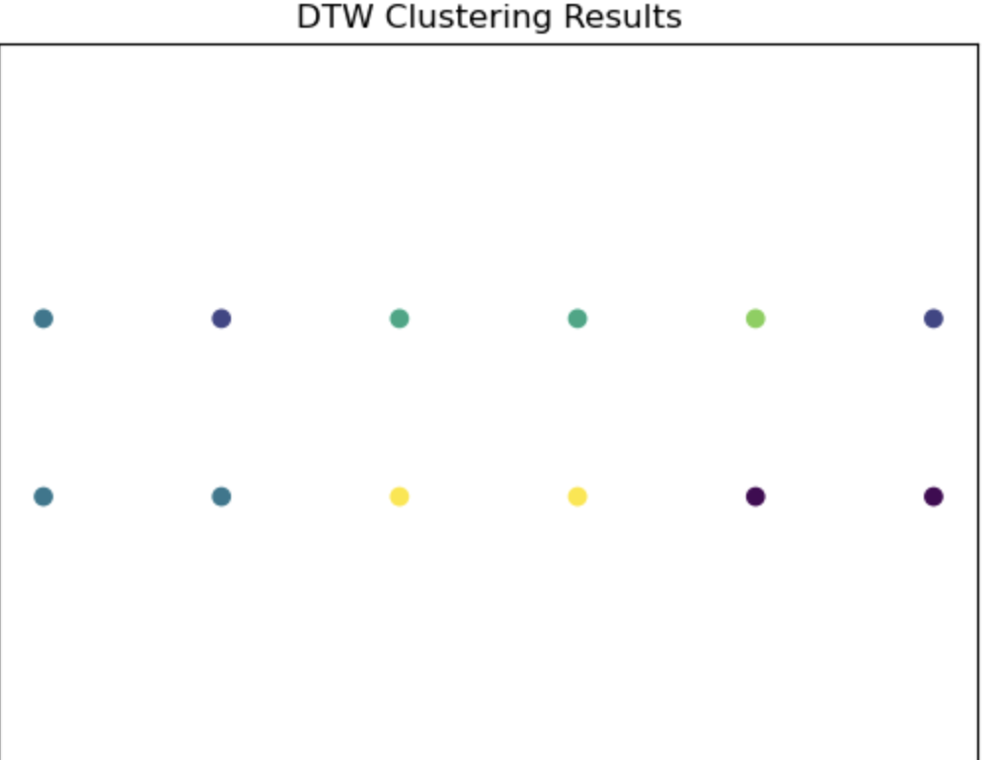
Unsupervised: Dynamic Time Wrapping + K Means
DTW is designed to detect similar movements
morning
afternoon
small
big
tall
dress
beautiful
play
basketball
morning
woman
man
short
tall

Slide 7
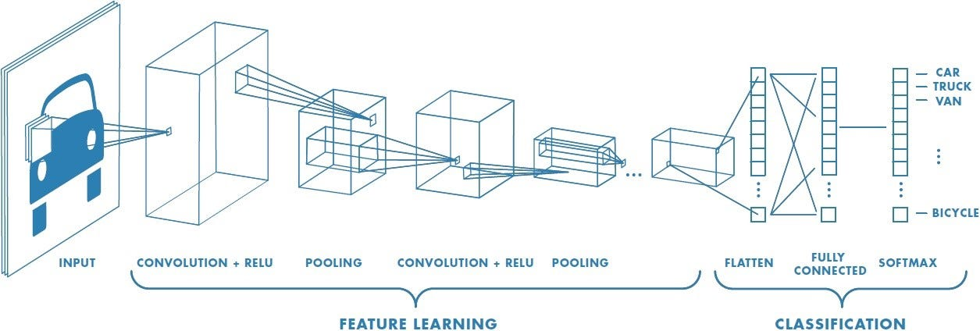
Reflections – Next Steps
EXPLORE OTHER MODELS
Convolutional Neural Networks and Deep Learning
Able to learn more complex patterns and features from images
EXPLORE METHODS TO BETTER CAPTURE TEMPORAL VARIATIONS
Use Dynamic Time Wrapping (DTW) as preprocessing to combine with other models
DTW Drawback: Time-consuming
Explore other options to capture differences between frames
OTHER POSSIBILITIES
Include more data in testing subset for more comprehensive testing
Feature Engineering
Hyperparameter Tuning
Ensemble Learning

