Slide 1
When AI Makes Things Up: Understanding and Tackling Hallucinations
PyData Global 2025

Slide 2

About the Speaker
Aarti Jha
Principal Data Scientist
Red Hat
Bengaluru, India

Slide 3

AI in Our Everyday Lives
PyData Global 2025

Slide 4
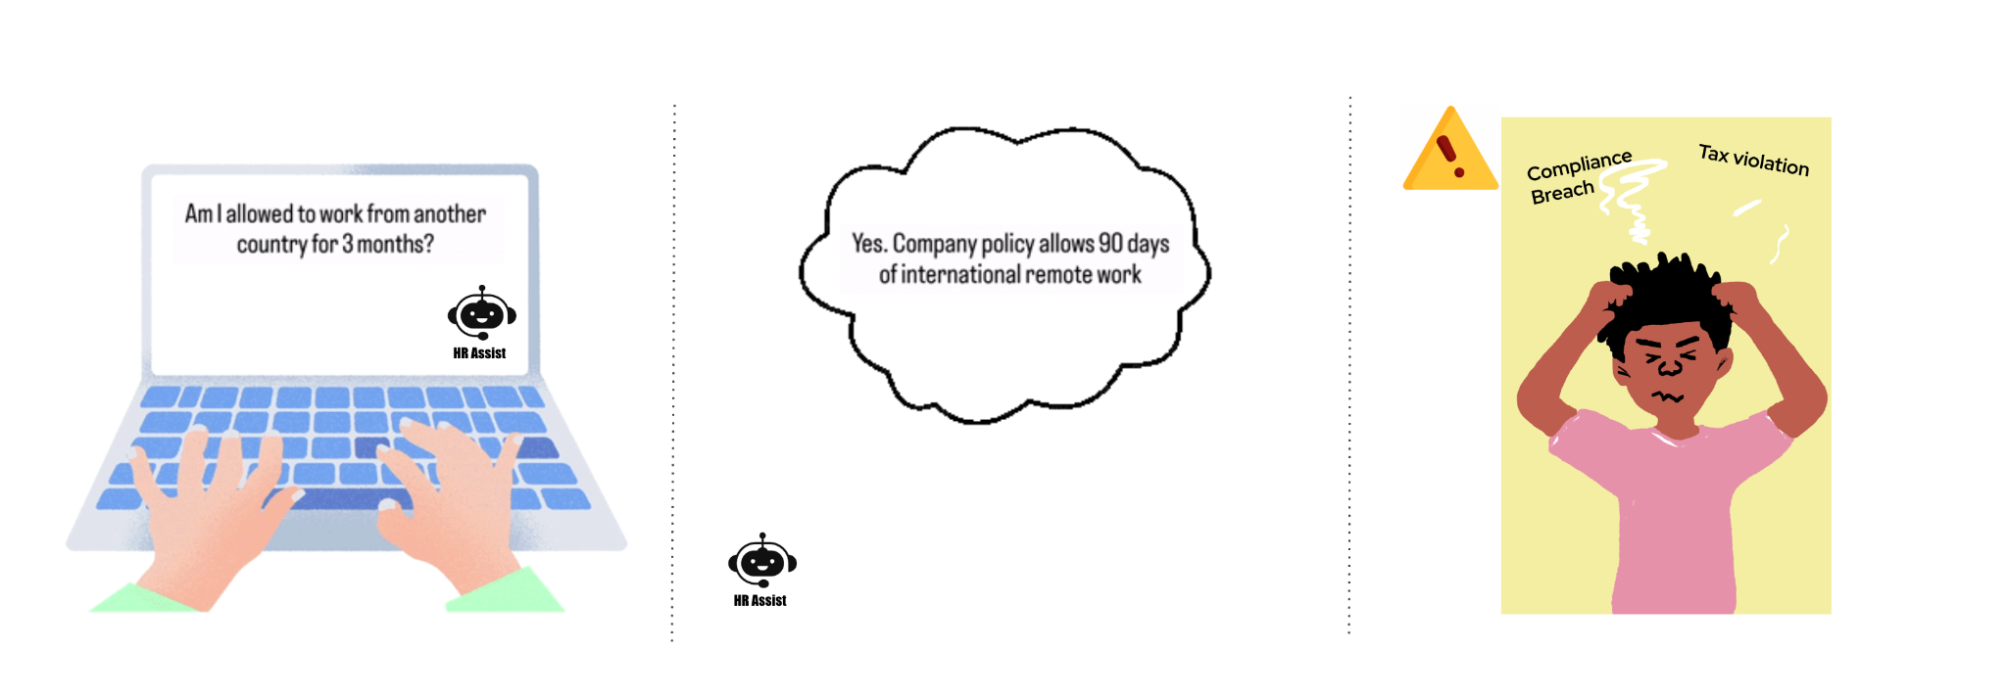
When AI Sounds Right
- But Isn’t
PyData Global 2025

Slide 5
What are Hallucinations?
Hallucination occurs when an AI system generates information that is factually incorrect, unsupported, or entirely fabricated - while sounding confident and fluent.
PyData Global 2025

Slide 6




This Isn’t Just a Chatbot Problem
Enterprise Assistants
Search & Knowledge Systems
Summarization & Reporting
Coding & Debugging
May confidently invent internal process steps, system behaviors, or operational constraints that don’t actually exist.
May fabricate facts or mix multiple sources into a single but incorrect answer.
May introduce events, conclusions, or numbers that were never present in the source.
May generate plausible-looking but non-existent APIs, functions, or incorrect fixes.
PyData Global 2025

Slide 7
Why Do Hallucinations Happen?
Model Behavior
Input & Prompt Issues
Incomplete or ambiguous prompts
Missing key constraints
Missing context
Over-generalization
Next-token prediction nature
Long-context degradation
System Design Choices
Knowledge & Data Gaps
Limited or biased training data
Outdated information
Out-of-distribution questions
Lack of grounding / verification
Optimization for fluency over accuracy
PyData Global 2025

Slide 8
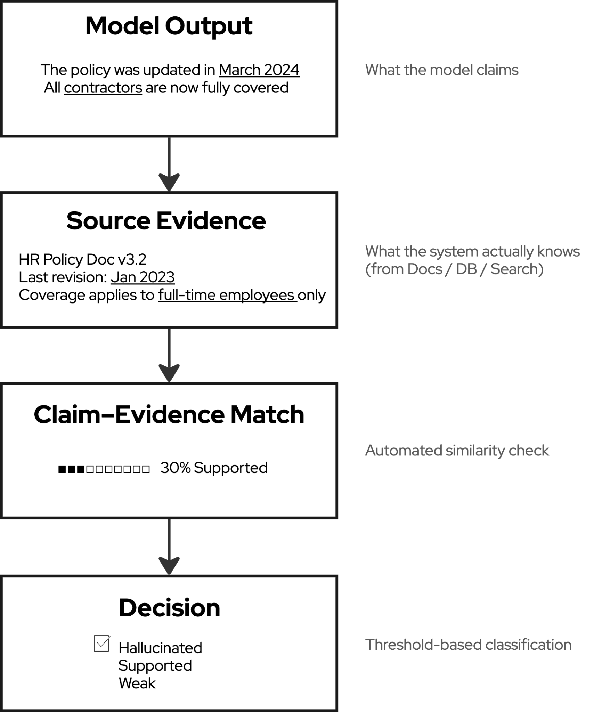
Evidence-Based
Hallucination Detection
PyData Global 2025

Slide 9
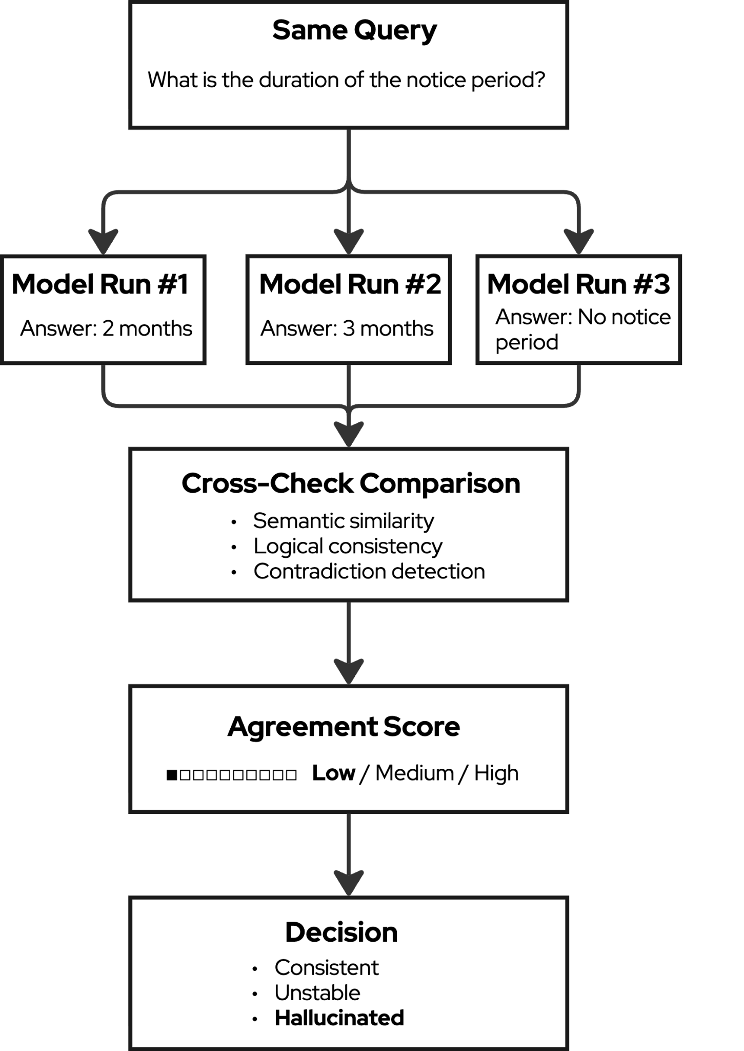
Consistency-Based
Hallucination Detection
PyData Global 2025

Slide 10
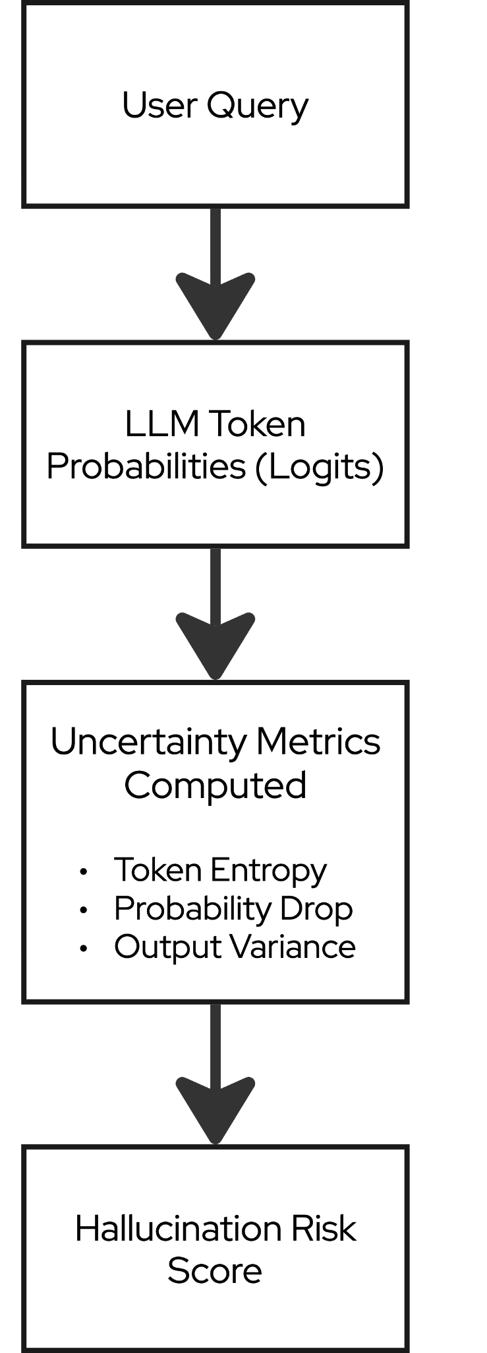
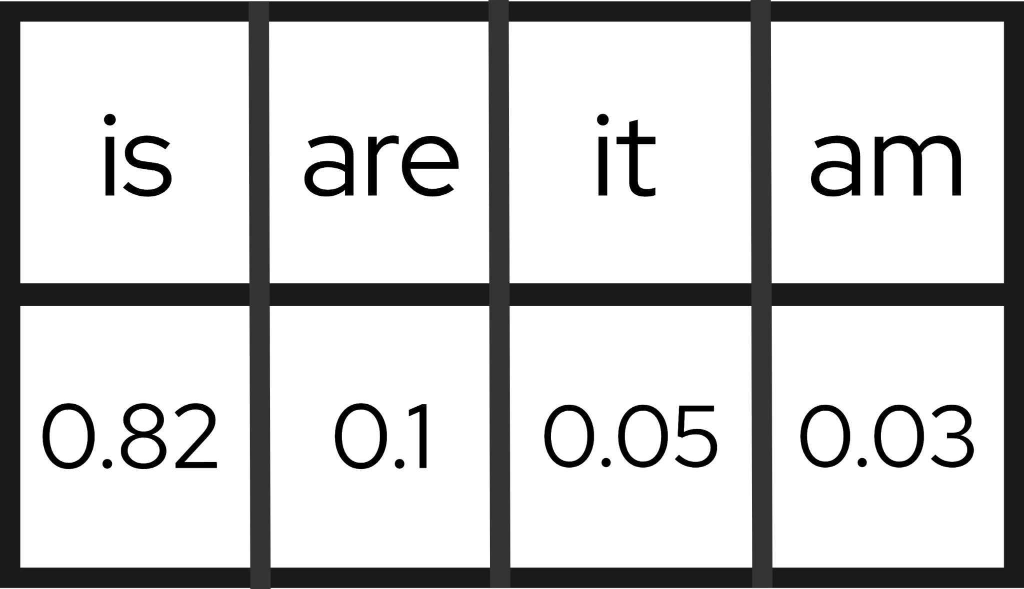
Model Confidence-Based
Hallucination Detection
Metrics:
Token Entropy: Measures how spread out token probabilities are during generation
Probability Drop: Detects sudden drops in confidence between consecutive tokens
Token 1: max prob = 0.91
Token 2: max prob = 0.38
Output Variance: Measures how much outputs change across multiple generations
Run 1 → “Notice period is 30 days”
Run 2 → “Notice period is 60 days”
Run 3 → “Notice period is 45 days”
Low Uncertainty → Stable & Confident Output
High Uncertainty → Potential Hallucination Risk
PyData Global 2025

Slide 11
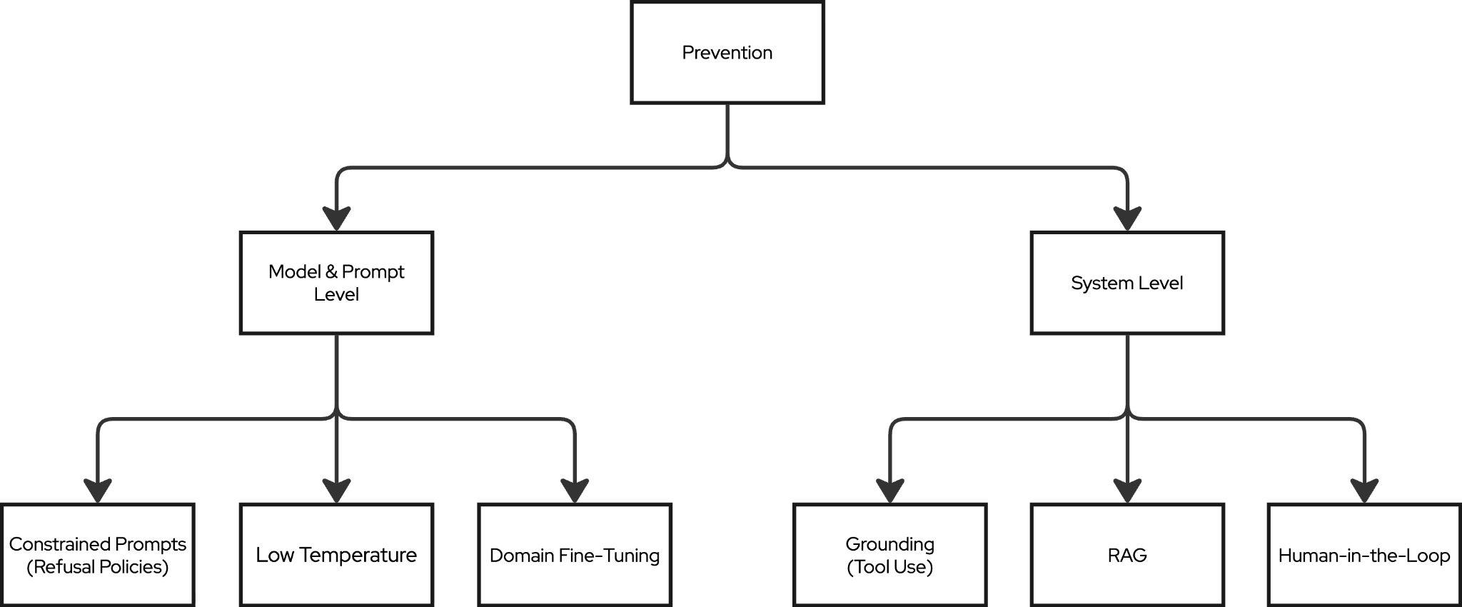
From Detection to Prevention
PyData Global 2025

Slide 12
Prevention at the Model & Prompt Level
Constrained Prompts
Refusal Policies
Limit how the model can reason and respond.
Example: “Answer only using the provided context. Do not use general knowledge.”
Block answers without verifiable sources.
Example: “No source → No answer.”
Low Temperature
Domain Fine-Tuning
Reduce randomness in generation.
Effect: More stable, deterministic outputs.
Train on domain-specific data.
Effect: Better grounded domain behavior.
PyData Global 2025

Slide 13
Prevention at the System Level
Tool Use
Grounding (Single Source of Truth)
Force answers to come only from verified system data.
Example: Answer only from an internal database or approved API.
Delegate precise tasks to deterministic tools instead of the model.
Example: Use a calculator for totals, not the LLM.
RAG (Context Injection)
Human-in-the-Loop
Retrieve and inject external domain knowledge at query time.
Example: Fetch policy docs before generating an answer.
Route high-risk outputs for manual verification.
Example: Compliance, finance, legal approvals.
PyData Global 2025

Slide 14
What Production Exposed That Demos Didn’t
Before Release (What Looked Fine)
Passed offline accuracy tests
Tools worked in isolation
Clean, curated queries
After Release (What Actually Happened)
Real users asked vague, messy questions
Model chained wrong tools
Partial retrieval + fluent answers
The New Failure Mode (NEW INSIGHT)
Small errors compounded across layers
Each step looked “mostly correct”
End result: confidently wrong output
Production doesn’t create new hallucinations - it amplifies small ones into real failures.
PyData Global 2025

Slide 15
Trustworthy AI Lifecycle
DATA
MODEL
SYSTEM
OPERATIONS
Clean, high-quality sources
Provenance & traceability
Data versioning
Right model for the task
Prompt Optimisation
Evaluation benchmarks
Guardrails & safety rules
Fail-safe UX (don’t overtrust outputs)
Logging & traceability
Continuous monitoring
User & system feedback loops
Ongoing evaluation & re-training
PyData Global 2025

Slide 16

Thank you!
PyData Global 2025
Connect with me on LinkedIn!

