Slide 1
Chromium网页渲染技术
罗升阳

Slide 2
About Me
《Android系统源代码情景分析》一书作者
《老罗的Android之旅》专栏作者
个人站点：http://0xcc0xcd.com

Slide 3
Agenda
Chromium多进程架构
Chromium多线程模型
Chromium网页分层技术
Chromium网页分块技术
Chromium网页合成技术

Slide 4
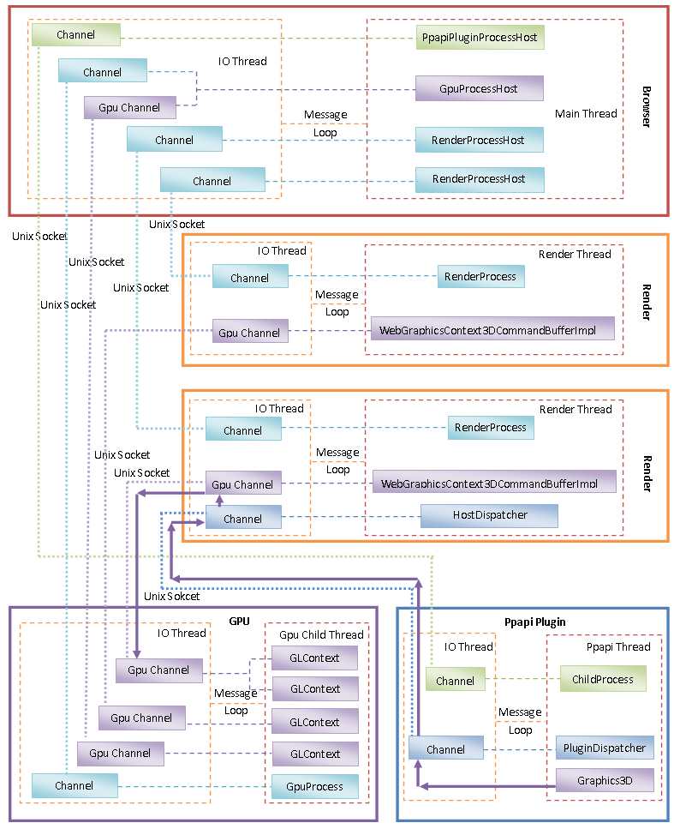
Chromium多进程架构

Slide 5
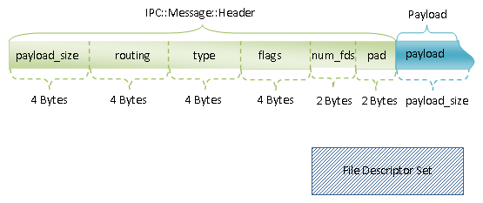
IPC Message

Slide 6
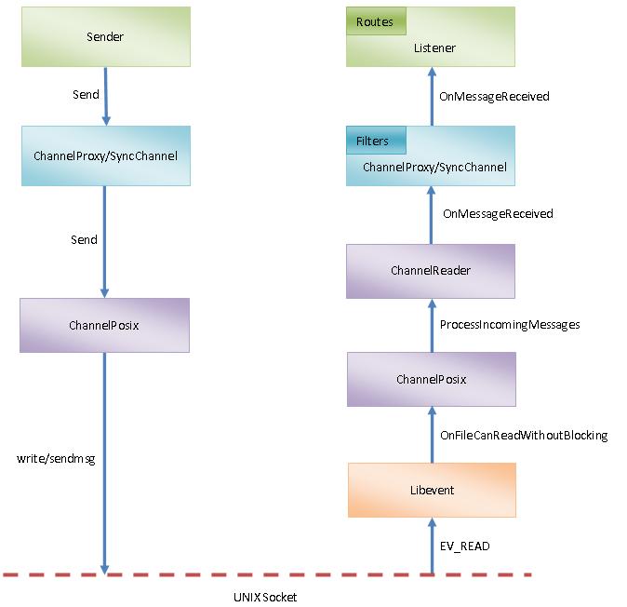
Send and Receive IPC Msg

Slide 7
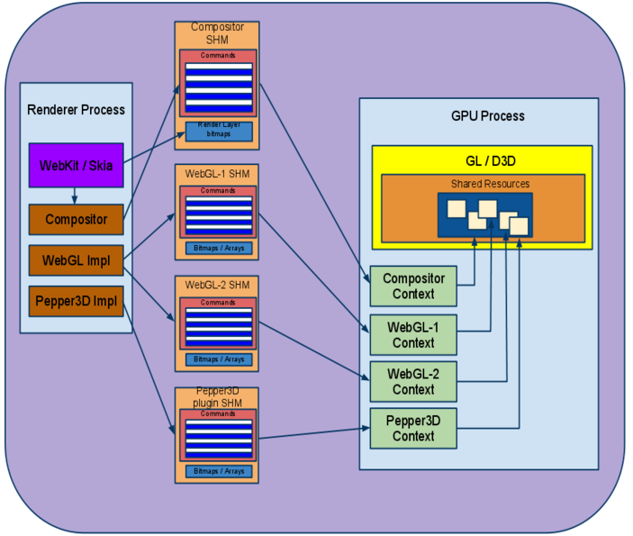
GPU进程

Slide 8
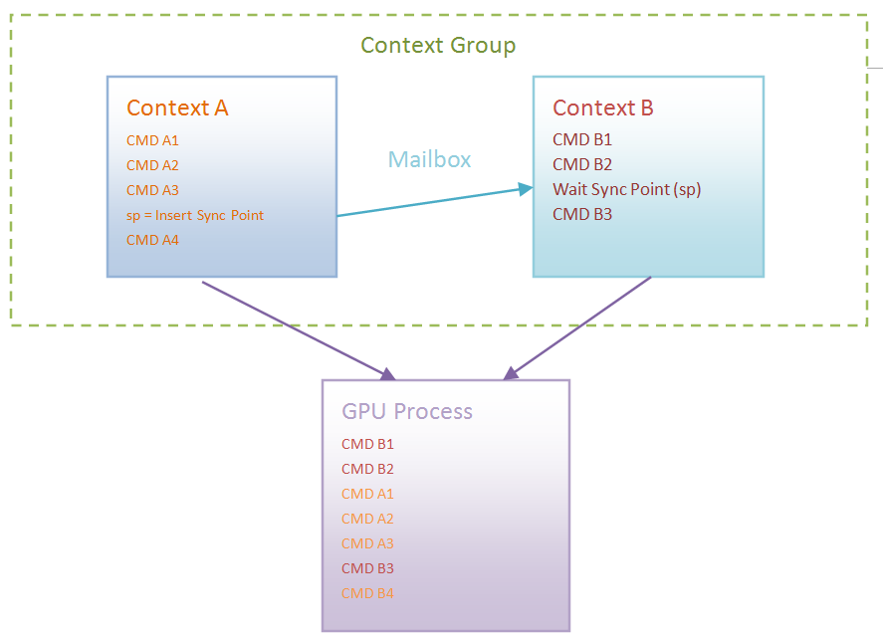
资源同步
Mailbox
Name
Texture ID
Sync Point

Slide 9
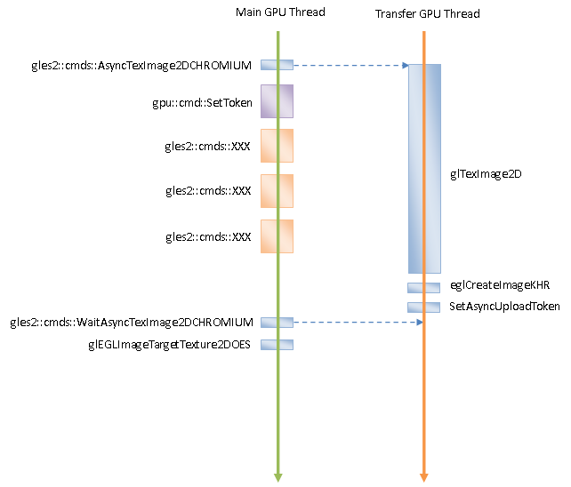
异步纹理上传

Slide 10
GPU Process Architecture Benefits
Security: The bulk of the rendering logic remains in the sandboxed Renderer process, and access to platform 3D APIs is limited to only the GPU process.
Robustness: A GPU process crash (e.g. due to faulty drivers) doesn't bring down the browser.
Uniformity: Standardizing on OpenGL ES 2.0 as the rendering API for the browser regardless of the platform allows for a single, easier to maintain codebase across all OS ports of Chrome.
Parallelism: The Renderer can quickly issue commands into the command buffer and go back to CPU-intensive rendering activities, leaving the GPU process to process them. We can make good use of both processes on multi-core machines as well as the GPU and CPU simultaneously thanks to this pipeline.

Slide 11
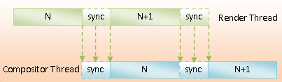
GPU多线程模型
Pass msgs between threads for communication
Discourage locking and thread-safe objects
Objects live on only one thread

Slide 12
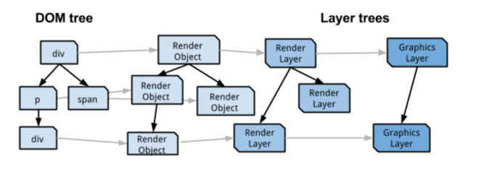
网页分层技术

Slide 13
From DOM Tree to Render Object Tree
display != ”none”

Slide 14
From Render Object Tree to Render Layer Tree
It's the root object for the page
It has explicit CSS position properties (relative, absolute or a transform)
It is transparent
Has overflow, an alpha mask or reflection
Has a CSS filter
Corresponds to <canvas> element that has a 3D (WebGL) context or an accelerated 2D context
Corresponds to a <video> element

Slide 15
From Render Layer Tree to Graphics Layer Tree
Layer has 3D or perspective transform CSS properties
Layer is used by <video> element using accelerated video decoding
Layer is used by a <canvas> element with a 3D context or accelerated 2D context
Layer is used for a composited plugin
Layer uses a CSS animation for its opacity or uses an animated webkit transform
Layer uses accelerated CSS filters
Layer has a descendant that is a compositing layer
Layer has a sibling with a lower z-index which has a compositing layer (in other words the layer overlaps a composited layer and should be rendered on top of it)

Slide 16
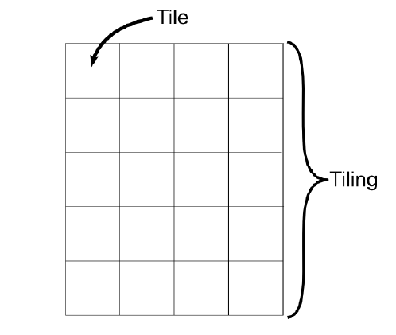
网页分块技术

Slide 17
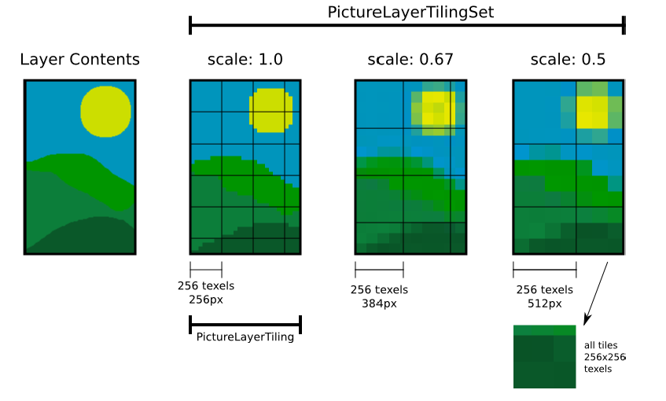
Tiling Set

Slide 18
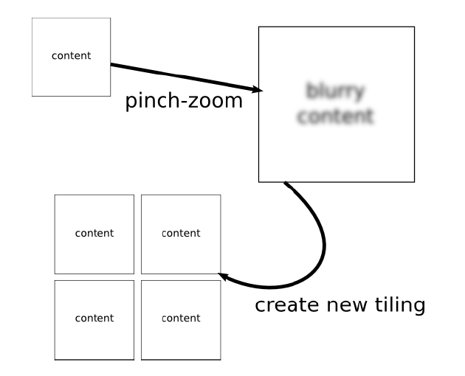
Pinch Zoom

Slide 19
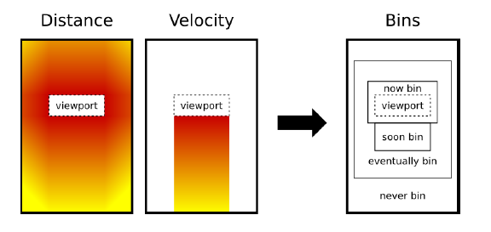
Tile Priority

Slide 20
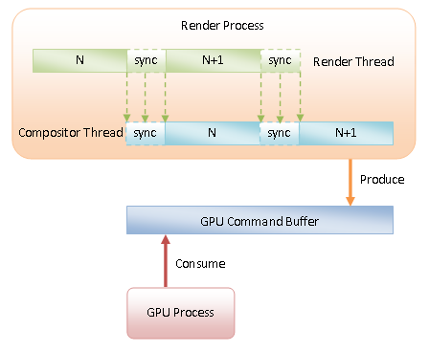
Chromium网页合成技术
Paint
Draw

Slide 21
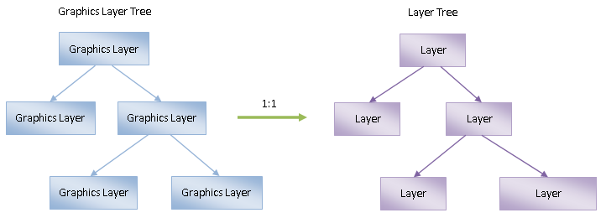
From Graphics Layer Tree to CC Layer Tree

Slide 22
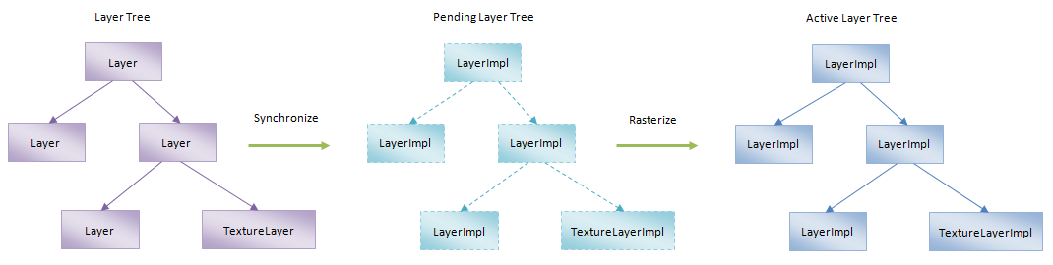
Synchronize and Rasterize

Slide 23
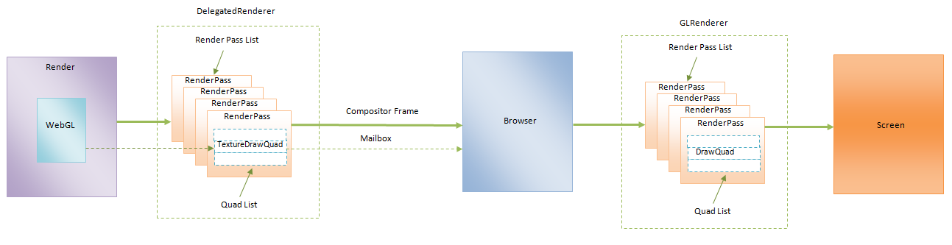
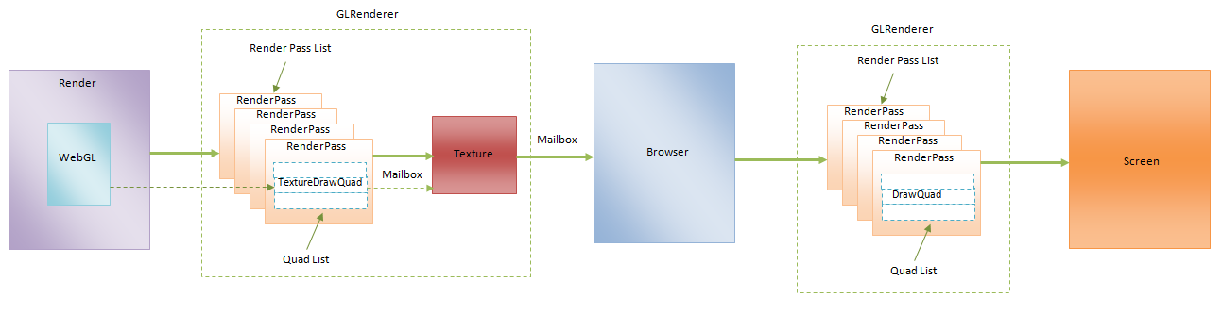
Draw Active Layer Tree

Slide 24
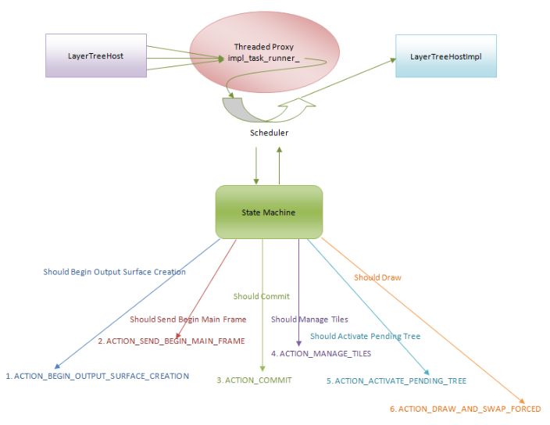
Scheduler

Slide 25
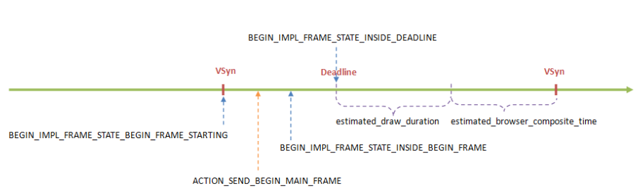
VSync

Slide 26
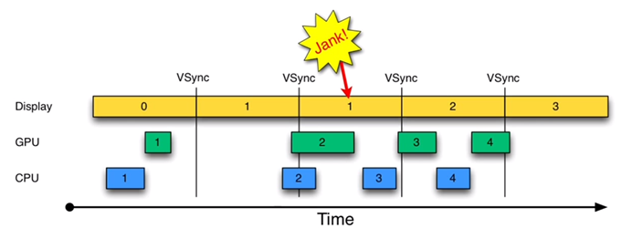
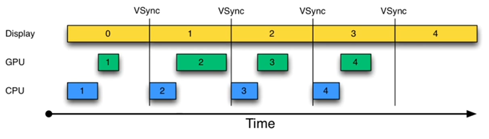
Why VSync?

Slide 27
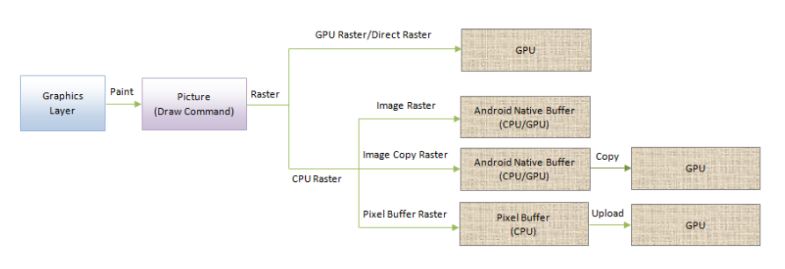
Rasterizing

Slide 28
Q&A

Slide 29
Thanks

