Slide 1
Test design techniques
Made by Horak Orest

Slide 2
Equivalence partitioning and Boundary value analysis
To have ability to buy products on web store user should register his login name on web registration page. The field for entering login name should:
contain letters only
to be no shorter than 4 characters
to be no longer than 10 characters.
Login names which do not meet requirements will not be allowed.
Build equivalence classes (partitions) based on given information
Stand Out boundary values

Slide 3
# | Condition | Expected result
1 | Put 3 characters | Display message ‘Not be shorter than 4 characters’
2 | Put 4 characters | Successfully complete
3 | Put 7 characters | Boundary value
4 | Put 10 characters | Successfully complete
5 | Put 11 characters | Display message ‘Not be longer than 10 characters’
Boundary value
 | Invalid | Successfully complete | Invalid
Class | <4 | 4 -10 | >10
EP | 2 | 5 | 11
BVA | 0-3 | 4-10 | >10

Slide 4
Decision tables
If you are a new customer opening a credit card account, you will get a 15% discount on all your purchases today. If you are an existing customer and you hold a loyalty card, you get a 10% discount. If you have a coupon, you can get 20% off today (but it can't be used with the 'new customer' discount).
Build decision table based on given information
Cover requirements above by tests (write test cases’ names and objectives) based on decision table analysis

Slide 5
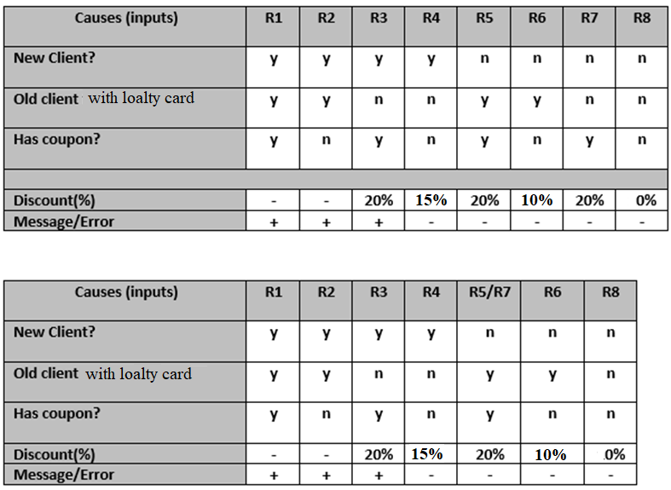

Slide 6
State transition
User tops his friend’s mobile account using sending money option. He enters amount of money he likes to send, types mobile number and click ‘Send’. If entered amount of money is allowed and phone number format is correct, then money will be sent and user will get appropriate message. If sum of replenishment is too low or too high, then user should re-enter it. If phone number format is incorrect, then user should enter correct phone number.
Build state transition diagram based on given information

