Slide 1
Diet Manager
Orest Kisi, Orest Brukhal
SWEN.383.700 - SW Des Principles and Patterns

Slide 2
Table of Contents
Introduction
Objectives
MVC Pattern
Composite Pattern
Factory Method, Observer, Singleton and Facade Patterns
Class Diagram
Sequence Diagram
Testing Strategy
Conclusion

Slide 3
Introduction
The Diet Manager is a desktop program designed to help users monitor their dietary intake, track exercise activities, and manage their weight goals.
It provides features to log food consumption, record exercise sessions, set calorie targets, and visualize nutritional data.

Slide 4
Objectives
1. Food and Exercise Logging: Enable users to easily log their daily food intake and exercise activities, including details such as servings consumed, exercise duration, and intensity.
2. Database Management: Provide a database of basic foods, recipes, and exercises, allowing users to create custom meals and workouts tailored to their preferences and dietary requirements.
3. Customization and Flexibility: Allow users to customize exercise entries and calorie expenditure calculations based on factors such as weight, intensity, and duration.
4. User-Friendly Interface: Design an intuitive and visually appealing user interface that facilitates seamless navigation, data entry, and information retrieval.
5. Data Persistence and Integrity: Implement robust mechanisms for storing user data, ensuring data integrity, and enabling seamless synchronization across devices.

Slide 5
Architecture Review - MVC Pattern
Model: Classes such as LogManager, RecipeFinder, and RecipeManager encapsulate the application's business logic and data management functionality.
View: The SwingGUI class and its associated factory classes (ComponentFactory, TextFieldComponent, TextAreaComponent, etc.) create and manage the graphical user interface components.
Controller: Event listeners (ActionListener and ItemListener) in the SwingGUI class respond to user interactions and delegate control flow to methods in the model layer.

Slide 6
Architecture Review - Composite Pattern
Component (Interface/Abstract Class): This base class defines a common interface for all individual components and composites.
ComponentFactory (Creator): Central to the Composite Pattern in our implementation,
Leaf (Concrete Classes like ButtonComponent, LabelComponent, etc.): These classes represent the leaf nodes in the composition hierarchy, meaning they do not have any children.
It abstracts the instantiation details of both leaf and composite components.
It provides a unified interface to create any GUI component required by the application, ensuring that all components are instantiated in a consistent manner.
This factory handles the specifics of creating each component type, whether it's a simple button or a complex panel with nested components.
They implement the operations defined in the Component class which typically involve rendering the GUI element and handling user interactions.
Each component like ButtonComponent wraps a specific Swing component (e.g., JButton) and standardizes its initialization and behavior.

Slide 7
Architecture Review - Factory Method, Observer, Singleton & Facade Patterns
ComponentFactory: Responsible for creating various Swing components (JLabel, JTextField, JButton, etc.) based on specific requirements, encapsulating the instantiation logic, and promoting loose coupling.
The addActionListener() and addItemListener() methods register action and item listeners, respectively, to handle user interactions with GUI components.
The CSVWriter class ensures that only one instance of the CSVWriter class is created throughout the application's lifecycle. It achieves this by providing a static method, getInstance(), which returns the same instance of the CSVWriter class every time it's called.
ApplicationFacade class abstracts the complexity of interactions with multiple manager classes (ExerciseManager, CheckProgress, LogFinder, RecipeManager). It acts as a centralized point for the GUI to interact with the application logic, conforming to the Facade Pattern.

Slide 8
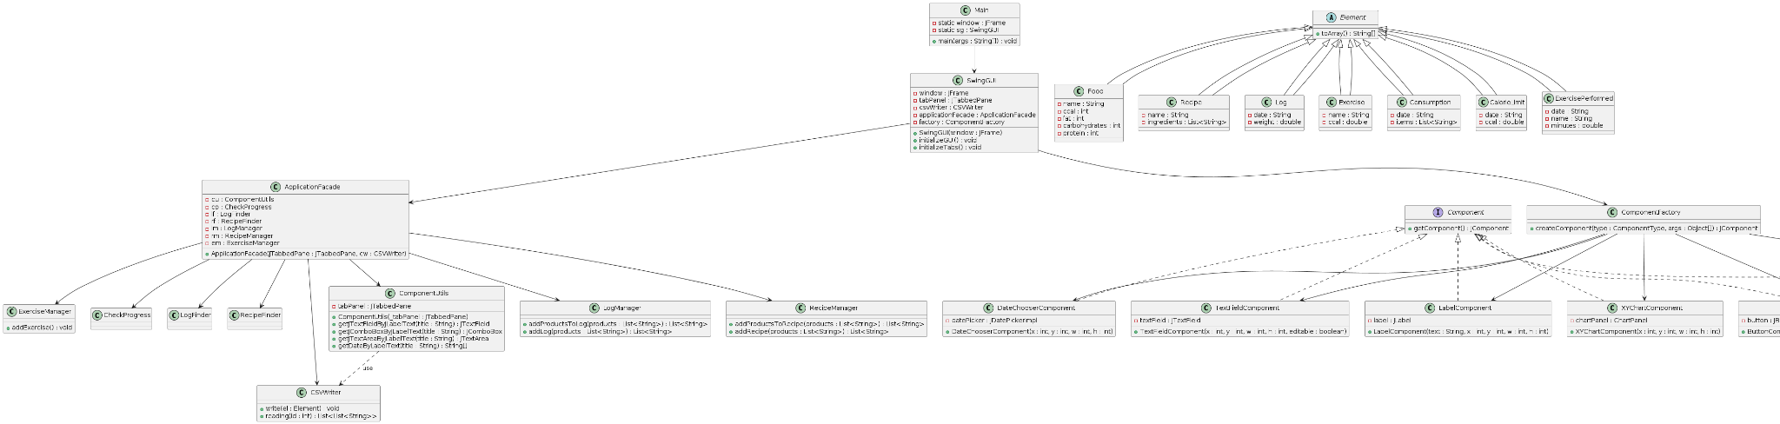
Class Diagram

Slide 9
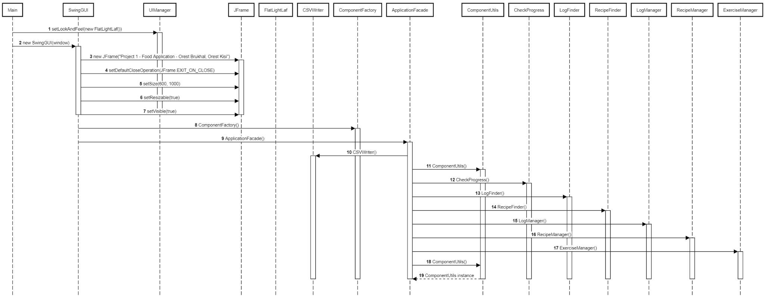
Sequence Diagram

Slide 10
Thanks for Attention!

