Slide 1
Prediction length of stay at hospital

Slide 2

Agenda
Model training:
Choosing of dataset
Preparation of the data
Splitting the data to test and train and reshaping data
Model preparation and its training
Evaluation of model
Correlation
Feature Importance
Example of prediction
Plot of prediction and actual values
Prediction using the most important features
Development of Back-end
Development of Front-end

Slide 3
Choosing of dataset
Dataset Hospital Length of Stay Dataset Microsoft:
https://www.kaggle.com/datasets/aayushchou/hospital-length-of-stay-dataset-microsoft?resource=download
This dataset has 100k data points on patients admitted into hospital, indicators of their health condition and how long they were admitted in the hospital
Sample data:
eid | vdate | rcount | gender | dialysisrenalendstage | asthma | irondef | pneum | substancedependence | psychologicaldisordermajor | depress | psychother | fibrosisandother | malnutrition | hemo | hematocrit | neutrophils | sodium | glucose | bloodureanitro | creatinine | bmi | pulse | respiration | secondarydiagnosisnonicd9 | discharged | facid | lengthofstay
1 | 8/29/2012 | 0 | F | 0 | 0 | 0 | 0 | 0 | 0 | 0 | 0 | 0 | 0 | 0 | 11.5 | 14.2 | 140.3611318 | 192.4769177 | 12 | 1.390722238 | 30.43241778 | 96 | 6.5 | 4 | 9/1/2012 | B | 3
2 | 5/26/2012 | 5 | F | 0 | 0 | 0 | 0 | 0 | 0 | 0 | 0 | 0 | 0 | 0 | 9 | 4.1 | 136.7316918 | 94.07850731 | 8 | 0.943164319 | 28.46051612 | 61 | 6.5 | 1 | 6/2/2012 | A | 7
3 | 9/22/2012 | 1 | F | 0 | 0 | 0 | 0 | 0 | 0 | 0 | 0 | 0 | 0 | 0 | 8.4 | 8.9 | 133.0585135 | 130.5305238 | 12 | 1.065750282 | 28.84381191 | 64 | 6.5 | 2 | 9/25/2012 | B | 3

Slide 4
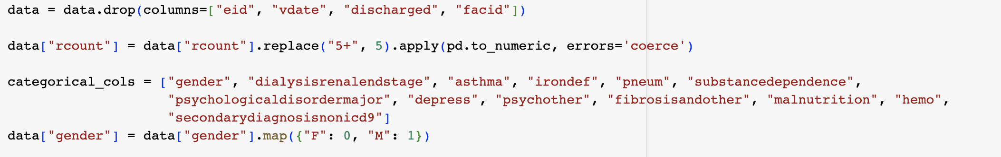
Preparation of the data
Deleting of date columns
Change string with numeric value
Map F and M strings to categorical values

Slide 5
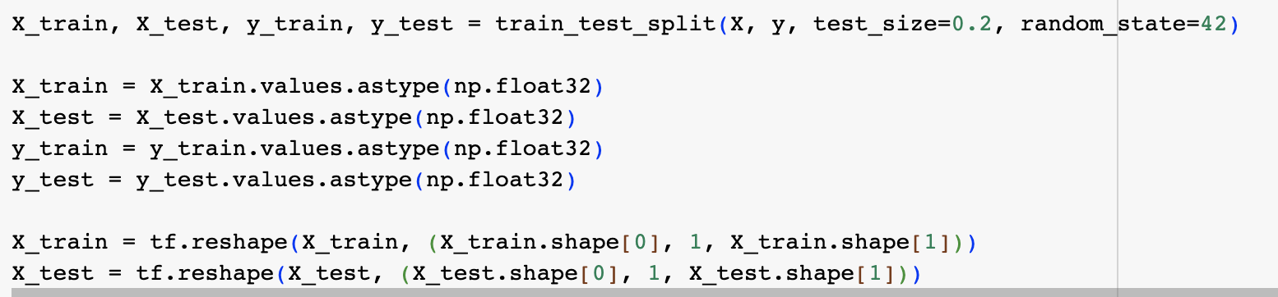
Splitting the data to test and train and reshaping data
Split data to train and test data
Converting to numpy array
Reshaping array to tersenflow ternsors

Slide 6
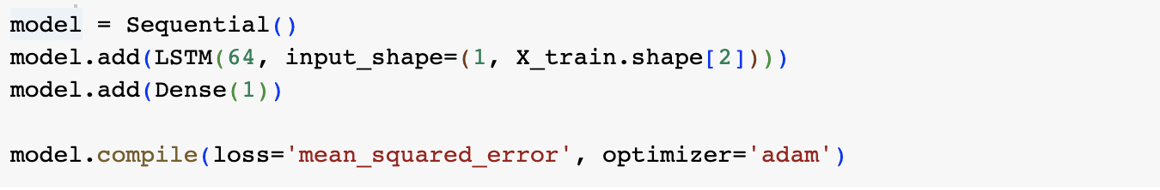
Model preparation and its training
Created LSTM model with 64 neurons
Compiled the model with adam optimizer
Added early stopping to avoid overfitting
Training the model

Slide 7
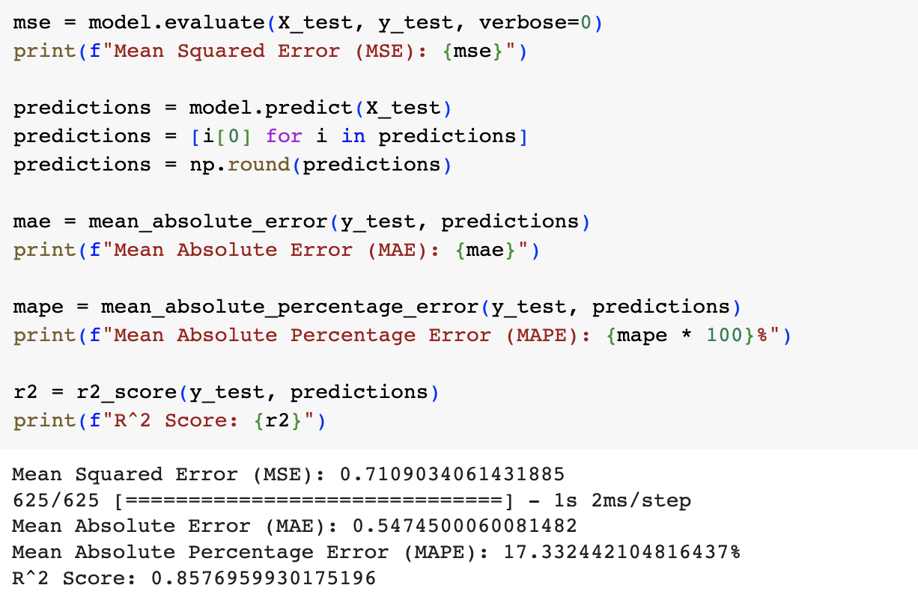
Evaluation of model
Calculation of predictions
Evaluation of model using MSE, MAE, MAPE, R^2
Accurancy is approximately 83%.

Slide 8
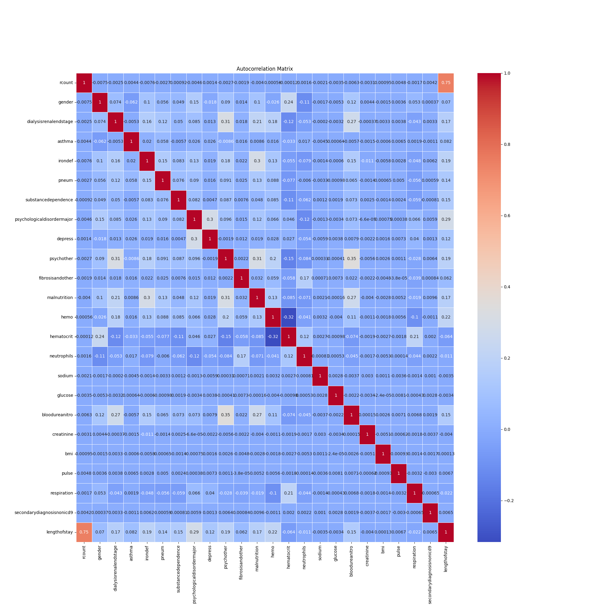
Correlation

Slide 9
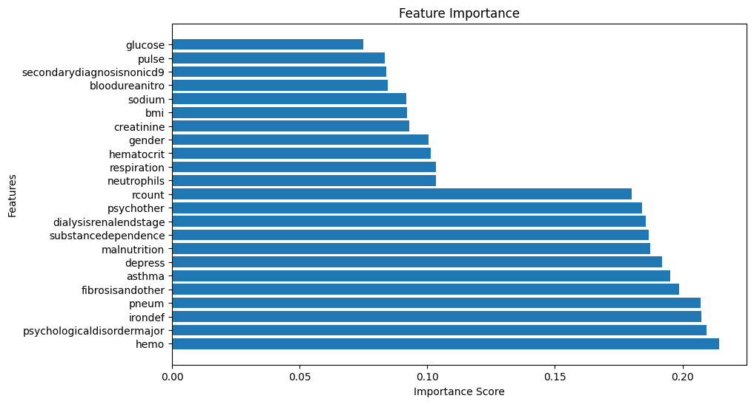
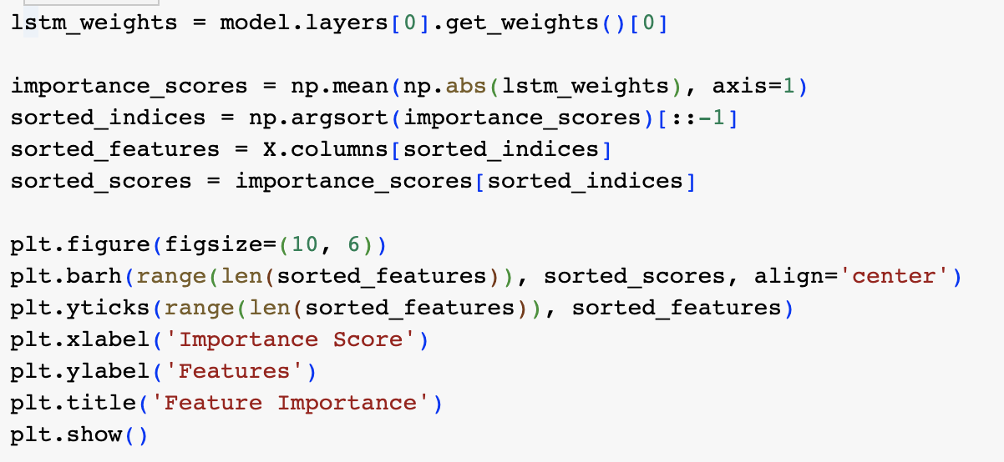
Feature Importance
Code for calculation and showing feature importance
Feature importance plot

Slide 10
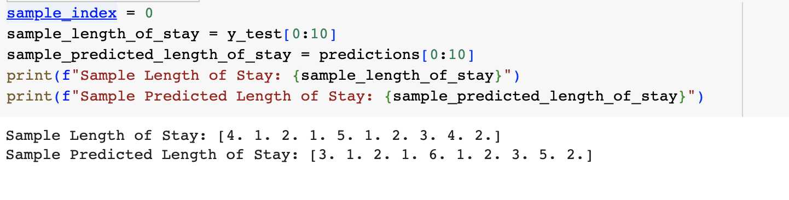
Example of prediction
As you can see avarage error is not bigger than one day

Slide 11
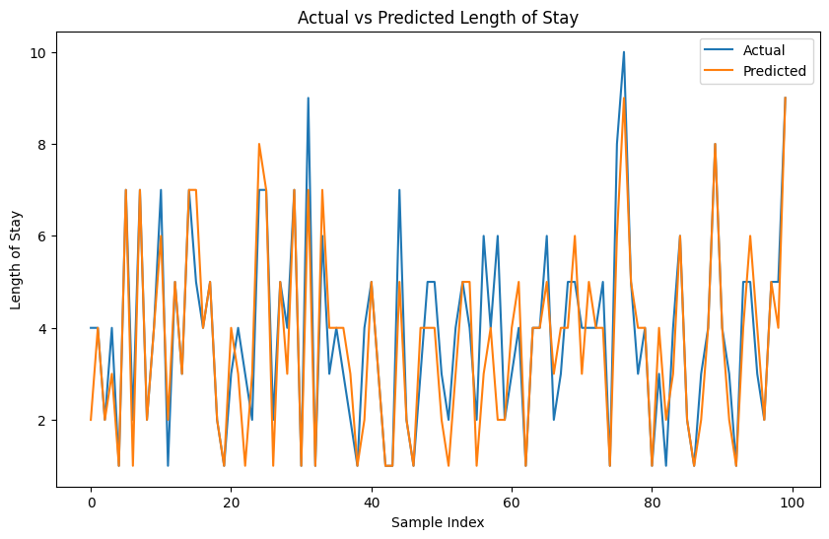
Plot of prediction and actual values

Slide 12
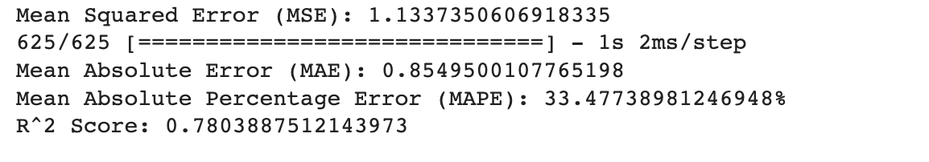
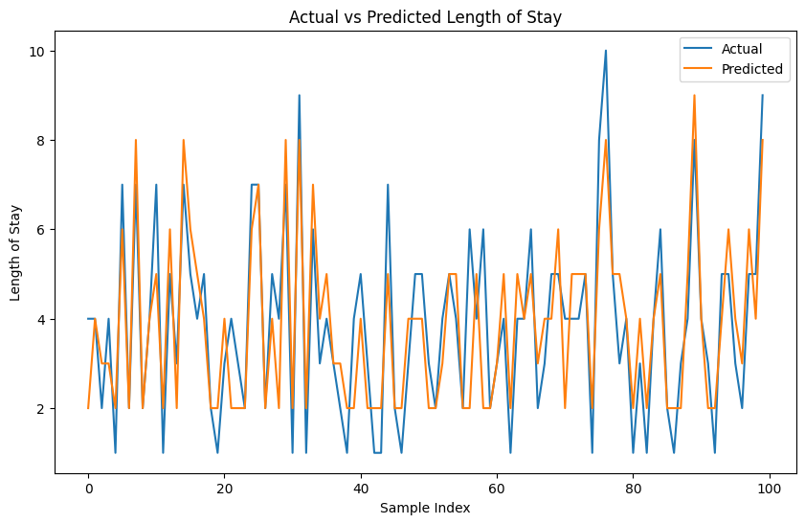
Prediction using the most important features

Slide 13
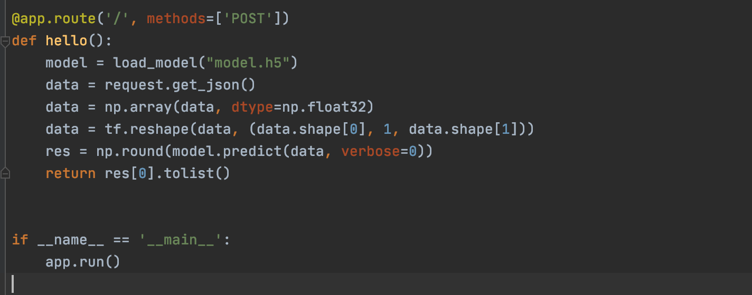
Development of Back-end
Simple flask application that loads model and predict value

Slide 14
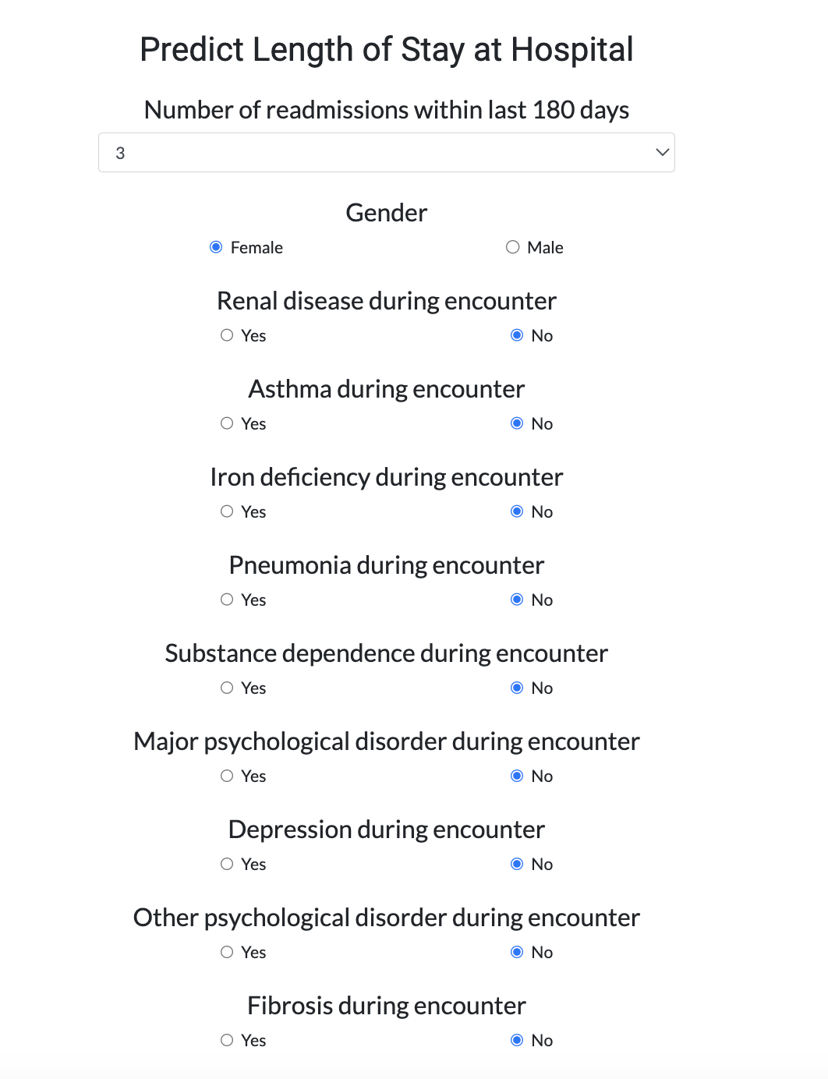
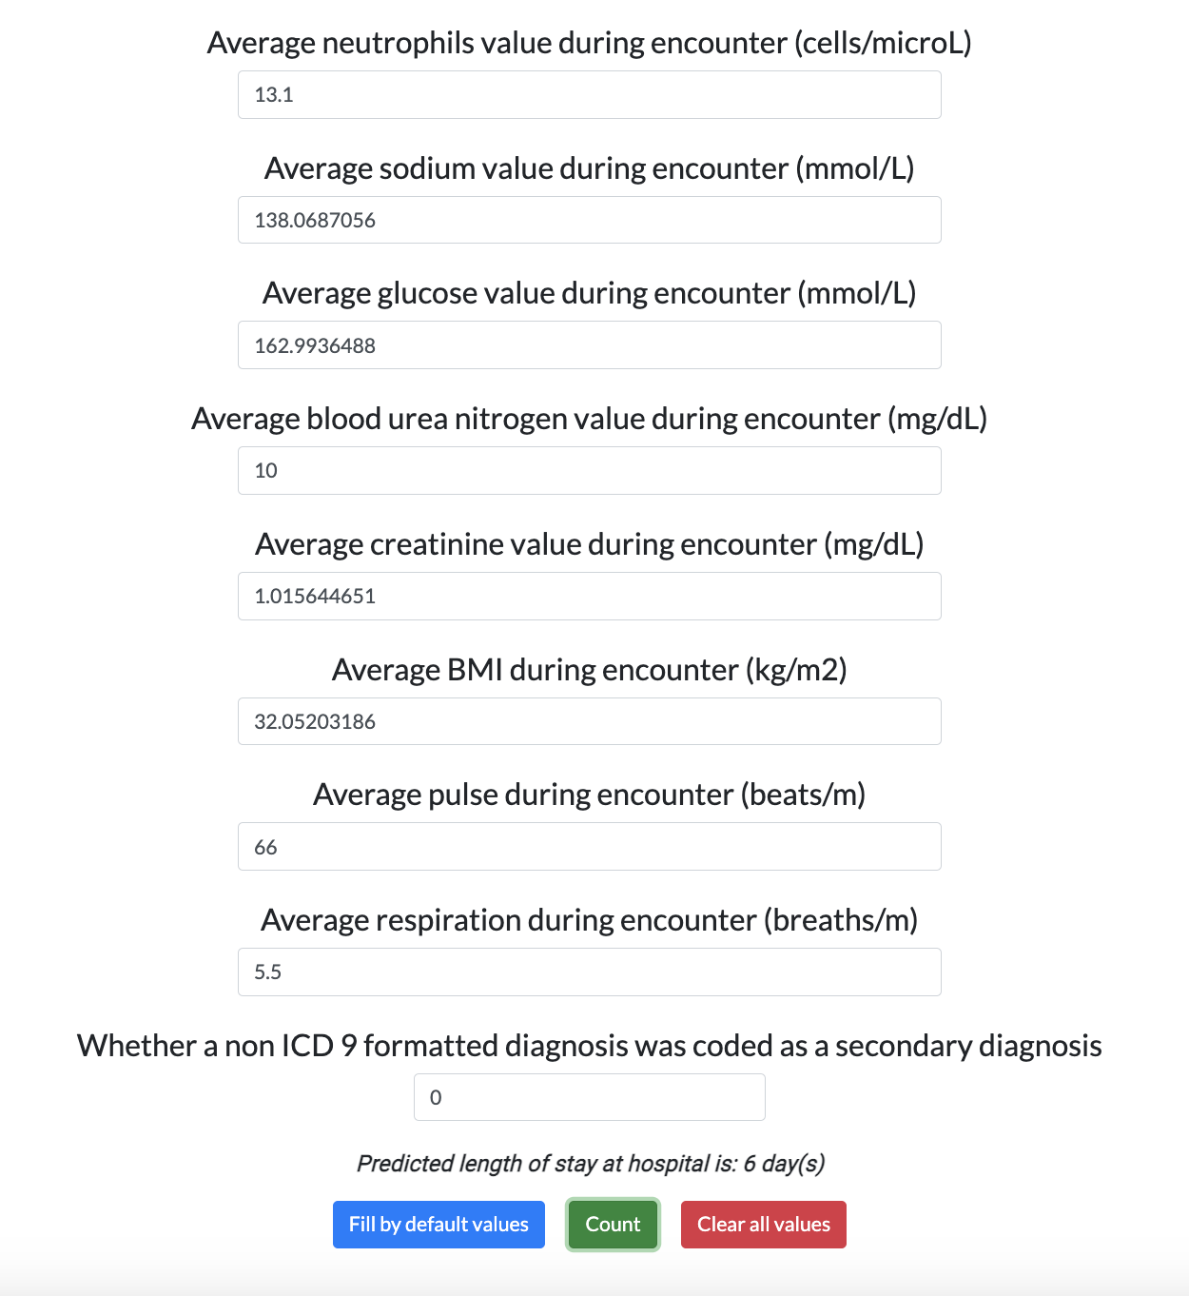
Development of Front-end
User can provide analysis indicators and the model will predict the length of stay at hospital

Slide 15
thank you for attention!

