Slide 1

What is the Lightning Network?
Orfeas Stefanos
Thyfronitis Litos
University of Edinburgh

Slide 2
Problem
All txs validated by all wallets

Slide 3
Problem
All txs validated by all wallets
Solution
- Move most txs off-chain
- Resolve disputes on-chain

Slide 4


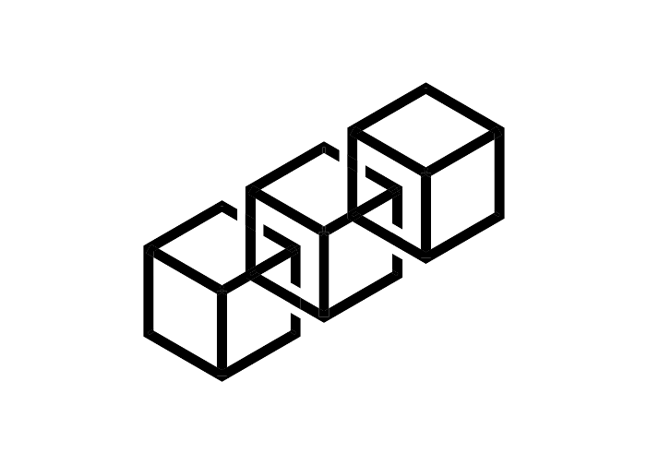
Enter payment channels
Open
F
Alice: 1
Bob: 2
Version: 1

Slide 5
Pay
Alice: 1.1
Bob: 1.9
Version: 2

Slide 6
Pay
Alice: 1.1
Bob: 1.9
Version: 2
Alice: 1.3
Bob: 1.7
Version: 3
Alice: 0.4
Bob: 2.6
Version: 8

Slide 7
Close
F

Slide 8
Close
F
Alice: 0.4
Bob: 2.6
Version: 8
Alice: 0.4
Bob: 2.6

Slide 9
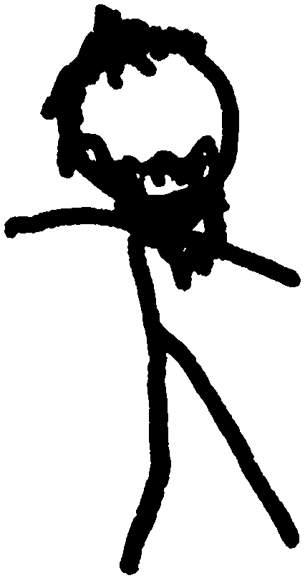
Multi-hop payments
Alice
Charlie
Charlie
Bob

Slide 10
Multi-hop payments
Alice
Charlie
Charlie
Bob
Give 1
to Bob
Take 1
from Alice

Slide 11
Why Intermediary can’t cheat?
HTLC
Alice
Charlie
Charlie
Bob
Give 1
to Bob
Take 1
from Alice

