Slide 1



A Composable Security Treatment of the Lightning Network
Aggelos Kiayias
Orfeas Stefanos Thyfronitis Litos
CSF 2020
17/3/2022

Slide 2


20,000 tx/s
7 tx/s

Slide 3
instant*
1 hour

Slide 4
Problem
All txs validated by all wallets
Solution
- Move most txs off-chain
- Resolve disputes on-chain

Slide 5



Alice
4
Bob
1

Slide 6
Alice
Alice
4
3
Bob
Bob
1
2
Notes:
Later date
Cloud = cheap
n = #times Alice & Bob change their minds on outputs = #channel payments
cheap = o(1)

Slide 7

Lightning Channels
Open
Alice: 1
Bob: 2
Alice: 1
Bob: 2
F
Alice & Bob: 3

Slide 8

Lightning Channels
Open
Pay
Alice: 1
Bob: 2
Alice: 1
Bob: 2
Alice: 1.3
Bob: 1.7
Alice: 1.3
Bob: 1.7
F
Alice & Bob: 3

Slide 9
Lightning Channels
Open
Pay
Alice: 1
Bob: 2
Alice: 1
Bob: 2
Alice: 1.3
Bob: 1.7
Alice: 1.3
Bob: 1.7
F
Alice & Bob: 3
Unlimited times
No touching blockchain

Slide 10
Lightning Channels
Open
Pay
Close
Alice: 1
Bob: 2
Alice: 1
Bob: 2
Alice: 1.3
Bob: 1.7
Alice: 1.3
Bob: 1.7
Alice: 1.3
Bob: 1.7
Alice: 1.3
Bob: 1.7
F
C
Alice & Bob: 3
Unlimited times
No touching blockchain
Alice: 1.3
Bob: 1.7

Slide 11
Lightning Channels
Open
Pay
Close
Unilateral!
Alice: 1
Bob: 2
Alice: 1
Bob: 2
Alice: 1.3
Bob: 1.7
Alice: 1.3
Bob: 1.7
Alice: 1.3
Bob: 1.7
Alice: 1.3
Bob: 1.7
F
C
Alice & Bob: 3
Unlimited times
No touching blockchain
Alice: 1.3
Bob: 1.7

Slide 12

Multi-hop payments
From channels to network!
Alice
Charlie
Charlie
Bob
Give 1
to Bob
Take 1
from Alice

Slide 13
Main result
Prove Lightning Network secure in the Universal Composability framework
Notes:
Every box 1 Turing machine
Environment can’t tell real from ideal world
Simulator weirdest part
Mu₁ – mu_n parties of LN protocol

Slide 14
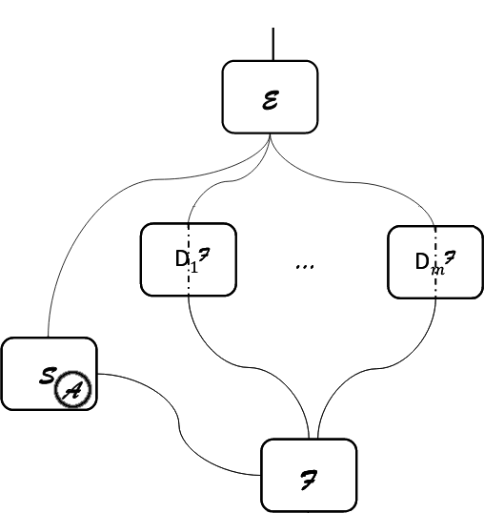
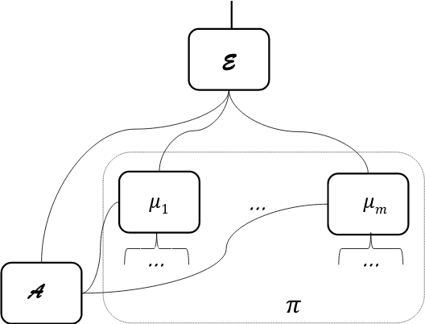
Simulation-based Security
Figure: “Universally Composable Security”, Ran Canetti https://eprint.iacr.org/2000/067

Slide 15
This work
a) Define functionality

Slide 16
This work
b) Implement specification
a) Define functionality

Slide 17
This work
b) Implement specification
c) Prove indistinguishability
a) Define functionality
Notes:
Proof of ind = def. simulator + follow every message seq from E and show that responses same in ideal & real
As secure as Bitcoin
Also
- prove revocation keys secure
- exact negligent behavior
TODOs:
- add fees
- prove actual commit secret generation secure

Slide 18
This work
b) Implement specification
c) Prove indistinguishability
a) Define functionality
Notes:
G_Ledger (Zikas et al) as hybrid
Very complex
Justification: G_Ledger (e.g. FairSwap) unrealizable

Slide 19
Blockchain Functionality
[BMTZ’17, BGKRZ’18]
We prove that
a naive, instant-finality ledger is unrealizable
Notes:
Every box 1 Turing machine
Environment can’t tell real from ideal world
Simulator weirdest part
Mu₁ – mu_n parties of LN protocol

Slide 20
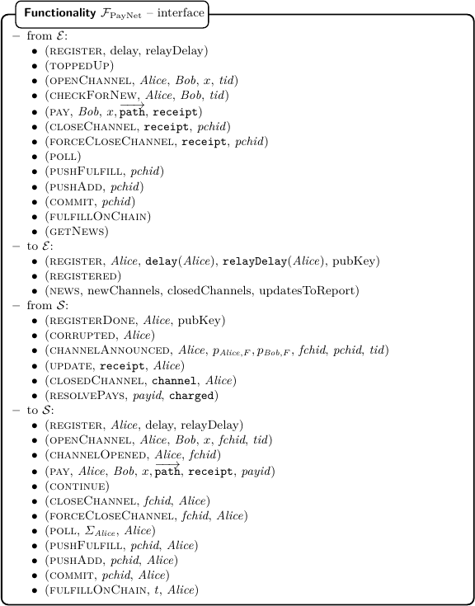
Functionality
Notes:
Complicated interface – match protocol messages with E
But abstracts protocol messages, no cryptographic primitives → much simpler
Think of Env as human user + polling daemon
Let’s look at subset

Slide 21
Our contributions
Use a realistic ledger functionality
  Prove naive ledger unrealizable
Prove Lightning Network security in UC framework
Derive exact time bounds for how often parties need to check the chain
Notes:
Every box 1 Turing machine
Environment can’t tell real from ideal world
Simulator weirdest part
Mu₁ – mu_n parties of LN protocol

Slide 22
Further work
Virtual channels
  Channels on top of channels
  No on-chain txs for open/close
  “Elmo: Recursive Virtual Payment Channels for Bitcoin”
  https://raw.githubusercontent.com/OrfeasLitos/virtual-payment-channels/master/virtual-channels.pdf
Notes:
Every box 1 Turing machine
Environment can’t tell real from ideal world
Simulator weirdest part
Mu₁ – mu_n parties of LN protocol

Slide 23
Further work
Virtual channels
  Channels on top of channels
  No on-chain txs for open/close
  “Elmo: Recursive Virtual Payment Channels for Bitcoin”
  https://raw.githubusercontent.com/OrfeasLitos/virtual-payment-channels/master/virtual-channels.pdf
Thank you! Questions?
https://eprint.iacr.org/2019/778
Notes:
Every box 1 Turing machine
Environment can’t tell real from ideal world
Simulator weirdest part
Mu₁ – mu_n parties of LN protocol

Slide 24
Bonus slides:
Protocol example
Notes:
Every box 1 Turing machine
Environment can’t tell real from ideal world
Simulator weirdest part
Mu₁ – mu_n parties of LN protocol

Slide 25
Alice
5

Slide 26
5
Com
0
5
0
Alice
5

Slide 27
Alice
& Bob
5
Com
0
5
0
Alice
5

Slide 28
Alice
& Bob
5
Com
0
5
Bob
0
Alice
5

Slide 29
Alice w/ Δt OR Bob_rev
Alice
& Bob
5
Com
0
5
Bob
0
Alice
5

Slide 30
Alice w/ Δt OR Bob_rev
Alice
Alice
& Bob
Alice
& Bob
5
5
Com
0
Com
0
5
5
Bob w/ Δt OR Alice_rev
Bob
0
0
Alice
5

Slide 31
Alice w/ Δt OR Bob_rev
Alice
Alice
& Bob
Alice
& Bob
5
5
Com
0
Com
0
5
5
Bob w/ Δt OR Alice_rev
Bob
0
0
Alice
& Bob
Alice
F
5
5

Slide 32
Alice w/ Δt OR Bob_rev
Alice
Alice
& Bob
Alice
& Bob
4
4
Com
1
1
Com
1
5
5
Bob w/ Δt OR Alice_rev
Bob
1
1
Alice
& Bob
Alice
F
5
5

Slide 33
Alice w/ Δt OR Bob_rev
Alice
Alice
& Bob
Alice
& Bob
4
4
Com
1
1
Com
1
5
5
Bob w/ Δt OR Alice_rev
Bob
1
1
Alice
& Bob
Alice
F
5
5

Slide 34
Alice w/ Δt OR Bob_rev
Alice
Alice
& Bob
Alice
& Bob
4.5
4.5
Com
2
0.5
Com
2
5
5
Bob w/ Δt OR Alice_rev
Bob
0.5
0.5
Alice
& Bob
Alice
F
5
5

Slide 35


Alice w/ Δt OR Bob_rev
Alice
& Bob
Alice
Alice
& Bob
4.5
F
Com
2
5
5
5
Bob
0.5
Alice
& Bob
F
Com
5
Dispute period t

Slide 36
Alice w/ Δt OR Bob_rev
Alice
& Bob
Alice
Alice
& Bob
5
F
Com
0
5
5
5
Bob
0
Alice
& Bob
F
Com
5
Dispute period t

Slide 37
Alice w/ Δt OR Bob_rev
Alice
& Bob
Bob
Alice
& Bob
Rev
Alice
5
5
F
Com
0
5
5
5
Bob
0
Alice
& Bob
F
Com
Rev
5
Dispute period t

