Slide 1
A Composable Security Treatment of the Lightning Network
Aggelos Kiayias
Orfeas Stefanos Thyfronitis Litos
University of Edinburgh
19/10/2019

Slide 2
Security
All about things NOT allowed
Encryption DOESN’T leak plaintext
Hash function DOESN’T leak preimage
Signature CAN’T be made by random folks
…
Lightning DOESN’T lose parties’ funds
Notes:
LN not about new functionality
(fast payments through promises & goodwill)
But about ONLY desired functionality
(promises & goodwill can be broken)
(and insurers make a fortune)

Slide 3
Property-based Security
Approach
Define desirable properties
Write protocol
Prove protocol has properties
Unclear if properties capture everything
Notes:
Property: IND-CPA – A can encrypt
Protocol: RSA
Proof: look it up
IND-CCA defined then – A can decrypt

Slide 4
Simulation-based Security
Approach
Define ideal functionality
Write protocol
Prove protocol looks like functionality
Functionality captures everything
Notes:
Functionality: uncorruptible, models what trusted party would do with all player inputs
E.g. encryption: give Alice’s message to Bob w/o showing it to Adversary

Slide 5
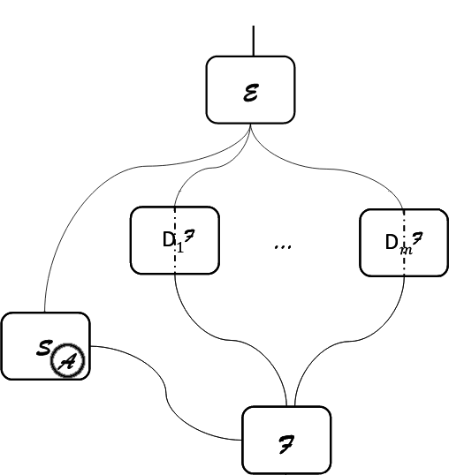
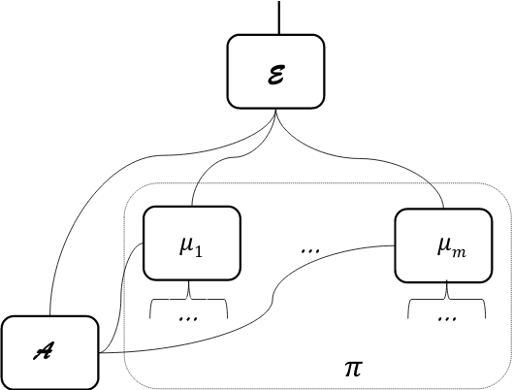
Simulation-based Security
Credits: “Universally Composable Security”, Ran Canetti https://eprint.iacr.org/2000/067
Notes:
Every box 1 Turing machine
Environment can’t tell real from ideal world
Simulator weirdest part
Mu₁ – mu_n parties of LN protocol

Slide 6
Our paper
Define functionality
Prove indistinguishability
Notes:
Also
- prove revocation keys secure
- exact negligent behavior

Slide 7
How often online?
W/o HTLCs (from paper)
W/ HTLCs

Slide 8
Functionality
Openchannel, pay, closechannel, forceclosechannel
Poll
Resolvepays, checkclosed
Getnews

